Slide 1
Cryptocurrency price prediction workshop
Welcome and thanks for joining us today

Slide 2
Schedule
Proposed topics/agenda :
10:00 am: Meet and networking at Bloomberg 1st Floor
10:30 am: Welcome, Suzana Ilic, MLT
10:35 am: Intro - Ashley Smart, Bloomberg
11:00 am: Discussion and team building
12:00 am: Start working on projects
12:30 am: Lunch
3:00 pm: Open discussion, Q&A
4:30 pm: Project Presentations
5:00 pm: Closing, building exit, after event networking and beer @Stand T

Slide 3
Welcome
Hosts
Ashley Smart
Suzana Illic
Please feel free to approach us with any questions, comments or feedback
Slack
machinelearningtokyo.slack.com
Resources for today
https://github.com/ashleysmart/mlgym/blob/master/stock_price/
WIFI
Guests - Your temporary guest login and password will be on the badge please check it and trial it now
Bloomberg staff - You can enable access to the wifi via {WIFI} and will likely require your buint etc

Slide 4
Access to the office
Guests, We have limited access today.
Be aware there are security cameras everywhere and the badge lets security know the range of your access
We are restricted to the 21st floor so please don’t use the stair cases, please stay close to the MPR and TR-01 rooms
We do not have access to the pantry this round so please limit eating and drinking the food from that area, There is a table of items behind us and pizza will be provided for lunch. If you have any requests let we know
Toilets
Male Toilets are through the heavy grey firedoor and on at the tokyo station end of the office pantry, then proceed to the north side of the building
Female toilets are through the heavy grey firedoor on the palace side of the building and then proceed to the north side of the building
Bloomberg staff
Please avoid leading the guests out of the allowed areas
Please offer any assistance if you see they need some or wandering into the out of bounds areas

Slide 5
Photography
Photos are limited to the event
Please avoid photographing random parts of the office
Especially don’t photograph anything that looks like Bloomberg internal information
If anyone enters or exits the building please don’t take pictures of them, they may not wish their presence at this company to be public knowledge
Taking pictures of the event attendees and event work is ok in the assigned areas we have for today
I will likely take some pictures during the event
Please sign a release form if you don’t mind your picture taken and used for Bloomberg publications (likely internal and for meetup only)
If you wish to avoid being photographed or don’t want to sign the consent let me know and I will avoid taking your picture

Slide 6
Emergency notes
The security staff are all trained first aiders, if anything medical problem occurs report it to them immediately
I am also first aid trained so alert me if im closer and then proceed to get the security staff
In the case of earth quake or fire
Emergency exits are in the halls that lead to the toilets
Please follow the prompts of the security staff, they will likely do a head count at some staging point
The elevators and fire doors can lock down automatically, if you find yourself locked into an area move to the emergency exits or locate the intercom to call the security to your location

Slide 7
The plug
https://www.bloomberg.com/careers/

Slide 8
Disclaimer
Bloomberg, the organizers or other attendees of this event are not responsible for any trading losses you incur if you take the models built here today or information discussed and apply it in a real market

Slide 9
THE Fun Stuff
Lets change to a discussion format

Slide 10
TODAYS Objective
Design and build models for the prediction of Crypto currency prices
This is a workshop so we want to focus on practical application of existing ML techniques
We don’t have any perfect answers for you, we will offer some suggestions and talking points (to get started)
We would like to see collaboration for this event. Please share and discuss ideas openly
Feel free to work in teams, I would suggest we use a scrum method to get the work done
Its best to focus on a task that is only slightly out of your skill level, this way you challenge yourself but don’t become unable to proceed. Please proceed as far as possible under your own steam and avoid disrupting other attendees with constant questions or requests for help. They are also here to expand their skills not to tutor. If you need help please approach me directly.

Slide 11
SOME basics of applied Machine learning
If you do not have a machine setup for machine learning please use colab via the browser.
I would suggest you start with keras on tensorflow as its one of the most widely used systems, and is quite simple to learn and use
I would suggest you create a simple single layer model to read in say 20 prior traded values and output a prediction for the next value (see the example below)
I would suggest you prefer synthetic data to train this model as it can be adjusted to explore bugs and design flaws in a model where as real data cant be.
The stock example for today is here
https://github.com/ashleysmart/mlgym/blob/master/stock_price/Direct_SyntheticData.ipynb

Slide 12
A overview of a Direct price prediction model
Predict given
Data
Data
Y

Slide 13
A overview of an LSTM price prediction model
p0
LSTM
d0

Slide 14
A overview of an autoencoder price prediction model
Identify Past Trend
Predict given
embedding
Data
Y1,y2…
Trend embedding

Slide 15
A overview of a Trend/Event price prediction model
Predict given
Trend
X
Y
Identify Past Trend
Data
Trend embedding

Slide 16
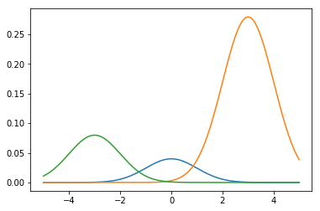
A overview of a GMM for price prediction
Y
GMM
Params
X
scale mean stddev
P(Y|X,data)
P
Identify Past Trend
Data
Trend embedding

Slide 17
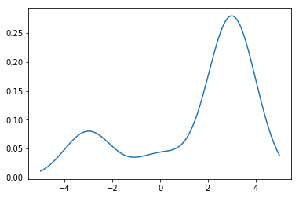
Gaussian mixture models – 1D slice

Slide 18
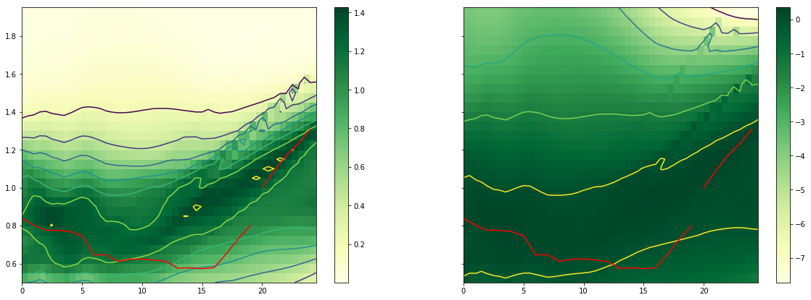

Slide 19
Datasets
Synthetic data:
https://github.com/ashleysmart/mlgym/blob/master/stock_price/SyneticTradeData.ipynb
https://github.com/ashleysmart/mlgym/blob/master/stock_price/VirtualExchange.ipynb
Kaggle Crypto data set:
https://www.kaggle.com/mczielinski/bitcoin-historical-data
NYSE FA data set:
https://www.kaggle.com/dgawlik/nyse
Binance
https://www.binance.com/?ref=10099792
https://medium.com/@samuelson78x/binance-get-historical-data-api-1bc8c758fa85

Slide 20
Blogs and other references
https://blockgeeks.com/guides/what-is-cryptocurrency/
http://www.wildml.com/2018/02/introduction-to-learning-to-trade-with-reinforcement-learning/

Slide 21
Now lets move to a Open discussion format

Slide 24
Zeroth discussion point
Done outside the building while we wait for people to gather
Introductions
First off who has tried to build a model to predict prices?
What kind of models did they try and what worked out

Slide 25
First Discussion Point – Direct pricing model
The real estate pricing model idea.
https://www.youtube.com/watch?v=ISBGFY-gBug
What data do we need
How should be normalizing the data? And why?
How can we enhance the data?
Given some fundamentals about the item can we improve things (can this work for cryptos?)
A discussion of the nature of the market
Market depth and books
https://hackernoon.com/depth-chart-and-its-significance-in-trading-bdbfbbd23d33

Slide 26
First discussion point – supplement notes
Models and blogs
https://medium.com/mlreview/a-simple-deep-learning-model-for-stock-price-prediction-using-tensorflow-30505541d877
https://www.kaggle.com/pablocastilla/predict-stock-prices-with-lstm
https://medium.com/@huangkh19951228/predicting-cryptocurrency-price-with-tensorflow-and-keras-e1674b0dc58a

Slide 27
Second discussion point – mixture models
What where the problems with approach of directly predicting the price?
What happens when data is perturbed with random noise?
Does anyone think it was a good idea? Why?
P(y|x) – predict instead the change that the price moves to a new value
What is likely to happen once the simple model is build and trained?
Why does everyone think that would be the case?
Note the proof about the general result that MSE leads to
https://youtu.be/rqJ8SrnmWu0 20:30
The Gaussian mixture model better/worst? How? Why?
https://github.com/ashleysmart/mlgym/blob/master/stock_price/GuassianMixture-SynthTrade.ipynb

Slide 28
Third Discussion point – wrap up
What did everyone learn?
What was the better parts of the workshop
What needs improvement
What models do we conclude produce the best results?
What data methods seemed to work out the best for people?

Slide 29
Additional points of interest
Various topic ideas in case we have an advance group
Market entry algorithms
The Problem of book depth
how to divide and buy/sell large orders without market side effects
Trading bot wars
Assume we get enough agents written, what happens if we place them in a fictional competive trading system
what is the Predator prey cycle in this system?
Is online learning sufficient to bet the predator bots in this environment?
Would this be a trap where the biggest GPUs can learn the longest max/min move (RRT* of course) how can we find out.. Can we do it anyway? should we do it anyway?
Moral questions of human free trading
Gah.. This would expand itself

Slide 30
General training materials
David Rosenbergs the mathematical discussion on ML
https://bloomberg.github.io/foml/#lectures
Andrew NGs learning curve method
https://www.youtube.com/watch?v=ISBGFY-gBug

