Slide 1
Accounting Desktop Application
Authored by
Robert Gaisey
October 16th, 2023

Slide 2
JP Morgan Checking
Balance:
Pending Transactions:
Available:
Available:
Available:
Netflix subscription
15.49
10/15/2023
Pending:
Joint transfer
300.00
10/02/2023
CC Payment
45.00
10/02/2023
Recent Transactions:
Marathon
89.14
10/02/2023
Kroger
65.42
10/01/2023
Home Depot
85.14
10/01/2023
Total:
Date:
Acct:
Post Transaction
Cancel

Slide 3
Chase Prime VISA
Limit: $15000
APR: 25%
CASH APR: 25%
Balance:
Pending Transactions:
Available:
Available:
Available:
Interest(Charges)
56.00
10/02/2023
Pending:
Interest( Cash)
5.00
10/02/2023
Annual Fee
59.00
10/02/2023
Recent Transactions:
Marathon
89.14
10/02/2023
Kroger
65.42
10/01/2023
Home Depot
85.14
10/01/2023
Total:
Date:
Acct:
Post Transaction
Cancel

Slide 4
CapitalOne Auto Loan
Original Balance: $15000
Current Balance: $15000
Loan Term: 48 months
Payoff Date: 05/15/2050
Monthly Payment:
Post Transaction
Date:
Recent Payments:
September monthly
305.21
09/15/23
August Monthly
305.21
08/15/23
July Monthly
305.21
07/15/23

Slide 5
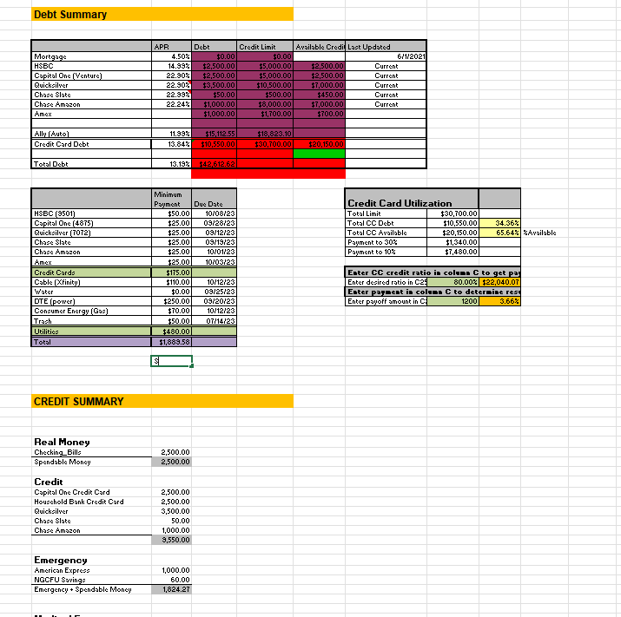
Summary
Balance:
Pending Transactions:
Available:
Available:
Available:
Netflix subscription
15.49
10/15/2023
Pending:
Joint transfer
300.00
10/02/2023
CC Payment
45.00
10/02/2023
Recent Transactions:
Marathon
89.14
10/02/2023
Kroger
65.42
10/01/2023
Home Depot
85.14
10/01/2023
Total:
Date:
Acct:
Post Transaction
Cancel

