Slide 1
Quote of The Day Android App Design
Authored by
Robert Gaisey
January 4th, 2024

Slide 2
Today’s Quote
March 5, 2021
I no longer have a manager. I can’t be managed.
- Kanye West
The first 5% and last 10% of the work will take 50% of the effort. Plan accordingly
- Me
Update
Upload
Edit

Slide 3
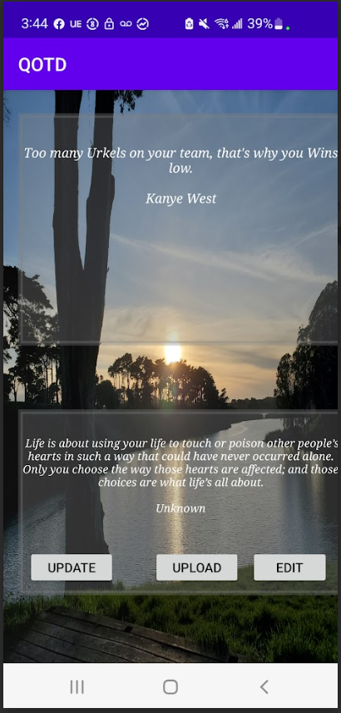

Slide 4
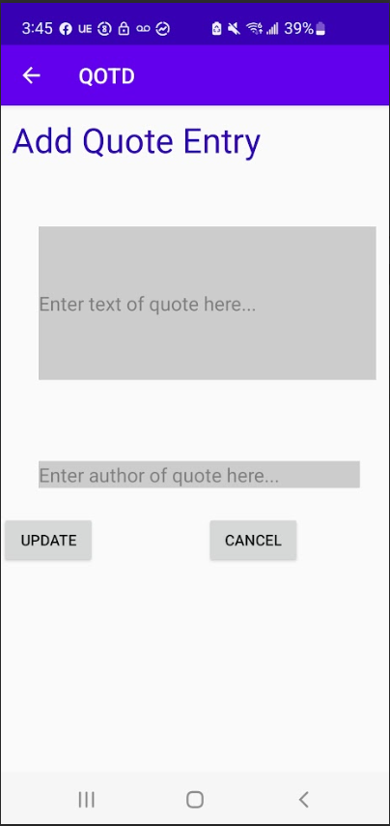

Slide 5
Edit Quotes Below
Check to Edit Labels
Forget inspiration. Habit is more dependable. Habit will sustain you; whether you are inspired or
Octavia Butler
Good, Better, Best. Never let it rest. Until your good is better, and your better is best.
Rueben Harris
If you stick a knife in my back 9 inches and pull it out 6 inches; there’s no progress. If you pull it
Malcolm X
Sometimes; not saying anything is the answer. You see; silence can never be misquoted
Kareem Biggs Burke
I no longer have a manager. I can’t be managed.
Kanye West
Save Changes
Cancel

Slide 6
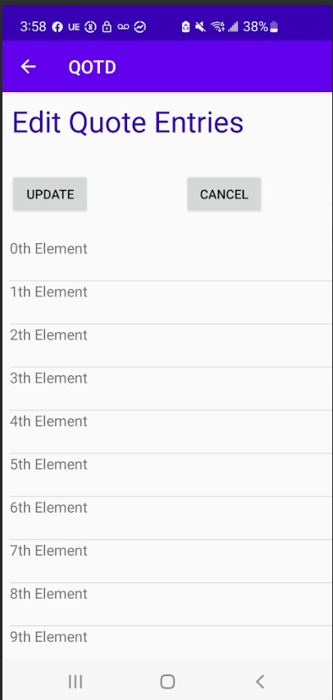

Slide 7
Model
Quote
mTitle
mId
mDate
mSolved
QuoteList
ArrayList
Controller
ViewQuoteFragment (Main)
AddQuoteFragment
EditQuoteFragment
labelPickerFragment
getActivity()
getActivity()
MainActivity
SingleFragmentActivity
View
FrameLayout
FrameLayout
RecyclerView

Slide 8
Model
Controller
View

