Slide 1
Room Bookings Display: Slot Machine
Strawberry Shortcake

Slide 2
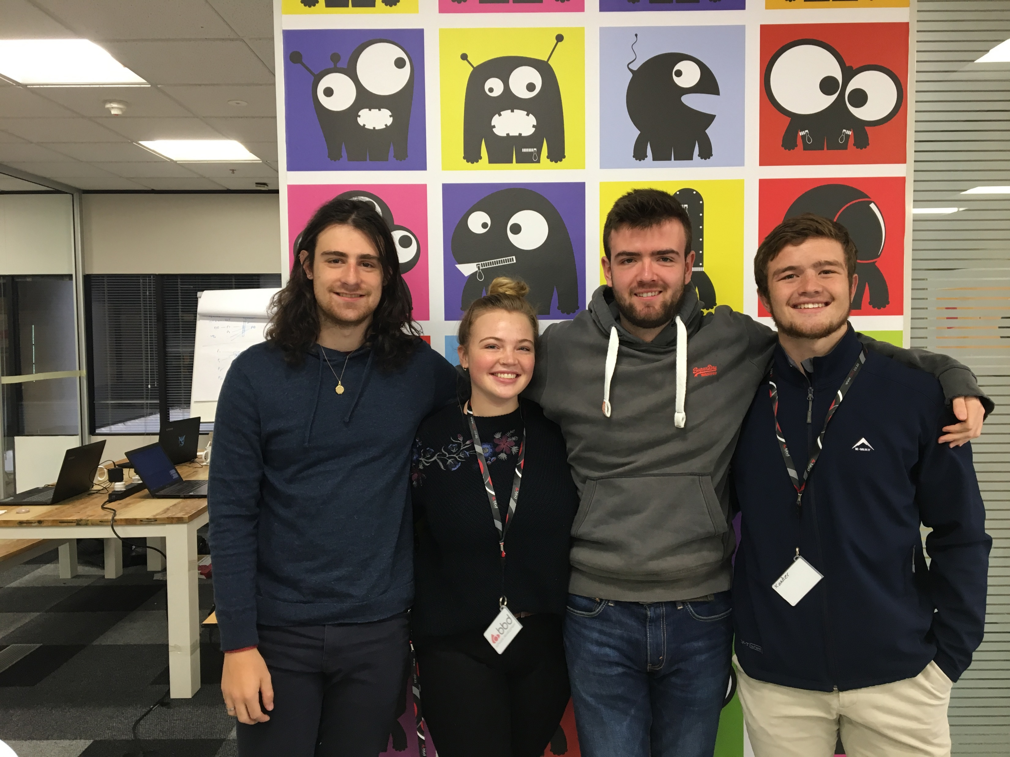

Slide 3
Task
BBD has many meeting rooms
Employees use Microsoft Outlook to book a time to use a specific room
A printout is then displayed outside the meeting room
The problem is that printouts posted will not contain updated information
Our task is to create a program that will enable a mounted device to display this updated information
Resources given:
Raspberri Pi with touch screen
Azure Active Directory credentials
Notes:
Rob

Slide 4
How
Web based application:
JavaScript
HTML+CSS
Link to Azure Active Directory
Host on an external server:
XAMPP (Apache)
Notes:
Rob

Slide 5
JavaScript
Tokens
Authentication
Pull data
Populate table
Refresh
First bootup
Notes:
Duncan

Slide 6
Design Choices
Portrait
Table format
Red for booked slots
BBD colours
Blue header
Icons for rooms
Notes:
Duncan

Slide 7
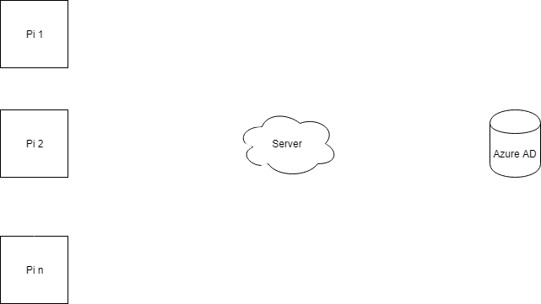
Server
Notes:
Xander

Slide 8
Challenges
Everything
Token Authorisation
Using an external server before remembering apache
Show web browser on boot-up
Change pi’s orientation, issues with touchscreen
Case didn’t fit
Notes:
Xander

Slide 9
Future expansions
Add more time slots
View future dates
Put it on a proper server
Making it more dynamic
Security-MSAL
Database system for admins
More visually appealing interface
Removal of past meetings
Different colours for adjacent meetings
Notes:
Emma

Slide 10
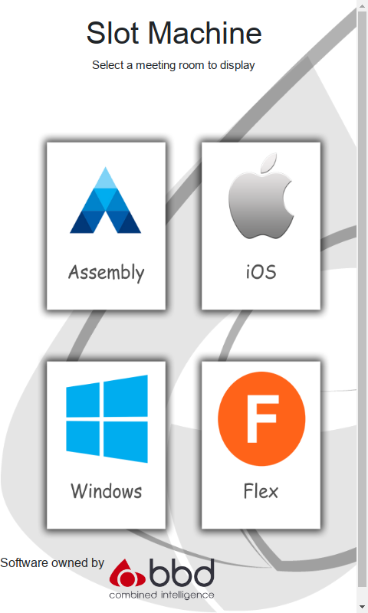
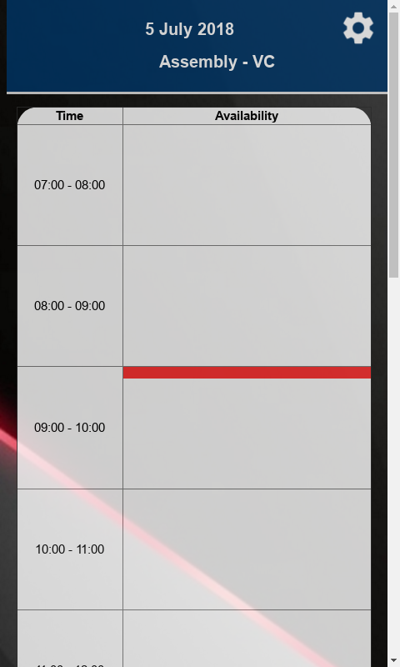
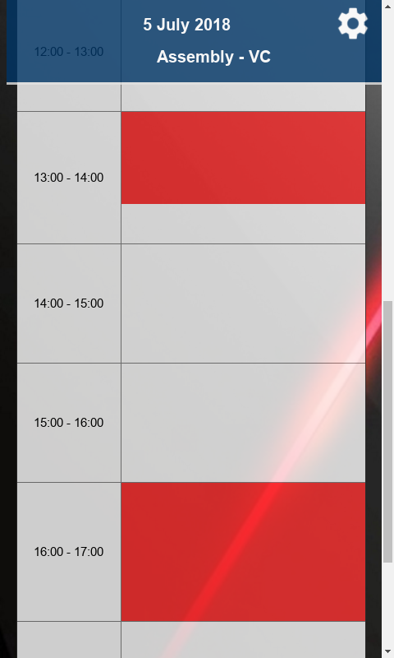
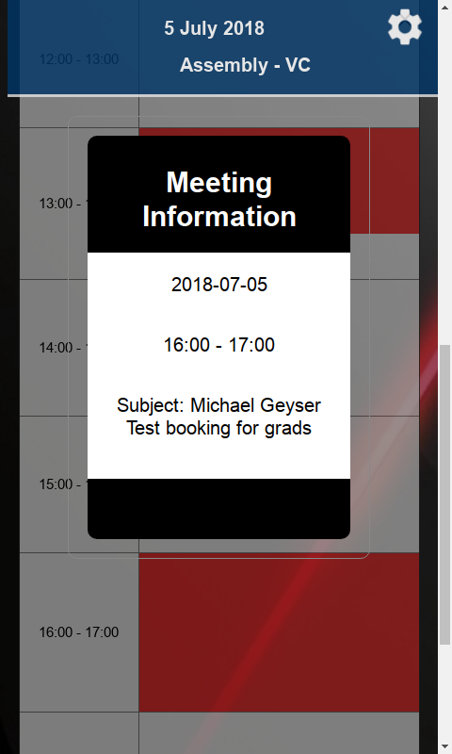
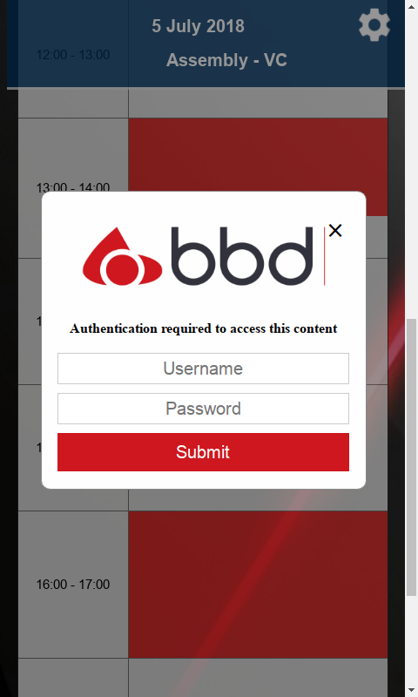
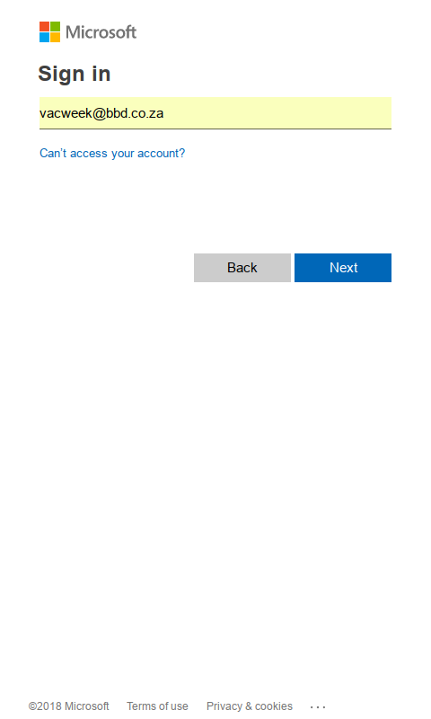
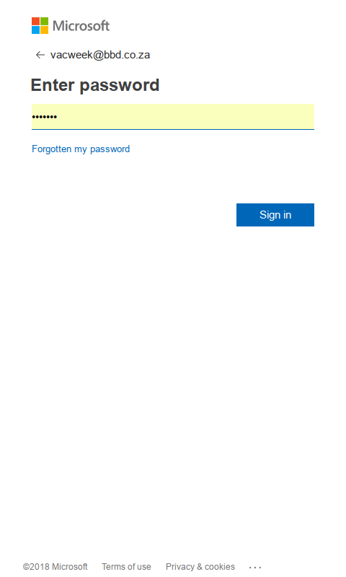
DEmo
Notes:
Emma + Robert

Slide 11
What we learnt
Don’t underestimate
Cross collaboration
Lots of brain power can fix a problem
Learn more under pressure
Focus on what’s important
Try create an MVP first
Notes:
Every

Slide 12
Questions?

