Slide 1
Approximation Algorithms
Analysis of Algorithms

Slide 2
Motivation: Getting around NP-completeness
Exponential time may be acceptable for small inputs [Brute Force]
Isolate special cases that can run in polynomial time [DC, GRDY, DP]
Near-optimal solutions may be acceptable [Approximation Algorithms]

Slide 3
Performance Ratios
C* is the cost of the optimal solution
C is the cost of the solution produced by an approximation algorithm
An algorithm has an approximation ratio of ρ(n) if for an input of size n, C is within a factor of C*

Slide 4
Performance Ratios [cont.]
Maximization problem
0 < C <= C*
C* / C factor by which the cost of the optimal solution is larger than the cost of the approximate solution
Minimization problem
0 < C* <= C
C / C* factor by which the cost of the approximate solution is larger than the cost of the optimal solution

Slide 5
Definitions
Approximation Algorithm
produces “near-optimal” solution
Algorithm has approximation ratio ρ(n) if:
Approximation Scheme
(1+ε)-approximation algorithm for fixed ε
ε > 0 is an input
Polynomial-Time Approximation Scheme
time is polynomial in n
C = cost of algorithm’s solution
C* = cost of optimal solution
n = number of inputs = size of instance

Slide 6
How do approximations algorithms work?
Exploit the nature of the problem
Use greedy techniques
Use linear programming
Use dynamic programming
Use random assignments

Slide 7
Overview
VERTEX-COVER
Polynomial-time 2-approximation algorithm
TSP
TSP with triangle inequality
Polynomial-time 2-approximation algorithm
TSP without triangle inequality
Negative result on polynomial-time ρ(n)-approximation algorithm

Slide 8
The vertex-cover problem
Let G=(V,E) be an undirected graph
A vertex cover
subset V’ of V
such that if (u,v) is an edge of G, then either u belongs in V’ or v belongs in V’ (or both)
The size of a vertex cover is the number of vertices in it

Slide 9
The vertex-cover problem [cont.]
The vertex-cover problem is to find a vertex cover of minimum size
Such a vertex-cover is called an optimal vertex cover
This problem is NP-complete

Slide 10
Consider the graph:
b
c
d
a
e
f
g
By inspection, optimal vertex cover is {b,d,e}
C* = size of optimal solution = 3

Slide 11
Approx-Vertex-Cover (G)
C ← NULL //C contains results of vertex cover
E’ ← E[G] //Initially all edges are stored here
while E’ != NULL //all edges that are not considered yet
do let (u,v) be an edge of E’ //select an edge from E’
C ← C U {u,v} //add vertices to C of the selected edge
remove from E’ all edges incident on u or v
//delete all edges related to the vertices “u” and “v”
return C

Slide 12
Back to our graph:
b
c
d
a
e
f
g
C :
a b
c d
e f
Approximate vertex cover. C=6
E’ :
(a,b)
(b,c)
(c,d)
(c,e)
(d,e)
(d,f)
(d,g)
(e,f)

Slide 13
Improved version:
b
c
d
a
e
f
g
C :
d e b c
Approximate vertex cover. C=4
E’ :
(d,e)
(c,d)
(c,e)
(d,f)
(d,g)
(e,f)
(b,c)
(a,b)

Slide 14
Is it possible to approximate the optimal solution?
b
c
d
a
e
f
g
In this case, and with our algorithm, NO!

Slide 15
Analysis of Algorithm
Running time:
O(V+E): if we use adjacency list.
2-Approximation Algorithm
Minimization problem C* = 3; C = 6
Factor = C/C* = 2
Notes:
Problem: Why O(V+E)

Slide 16
Theorem: APPROX-VERTEX-COVER is a polynomial-time 2-approximation algorithm
Proof:
Polynomial time algorithm because : Complexity = O(V+E)
Let, A = set of edges picked by approximation algorithm
No 2 edges in A share an endpoint.
Thus no 2 edges in A are covered by the same vertex in C*
So, Lower bound: |C*| >= |A|
We pick an edge for which neither of its endpoints are already in C
So, Upper bound: |C| = 2|A|
Therefore: |C| = 2|A| <= 2|C*|
Notes:
Problem: Can’t understand

Slide 17
Traveling Salesman
TSP with triangle inequality
Polynomial-time 2-approximation algorithm
TSP without triangle inequality
Negative result on polynomial-time ρ(n)-approximation algorithm

Slide 18
The traveling-salesperson problem.
Given a complete undirected graph G=(V,E)
Each edge has a nonnegative integer cost c(u,v)
Find a Hamiltonian cycle of G with minimum cost.
This is a NP complete problem

Slide 19
Triangle Inequality
The cost function satisfies the triangle inequality for all vertices u, v, w in V
c(u,w) <= c(u,v) + c(v,w)

Slide 20
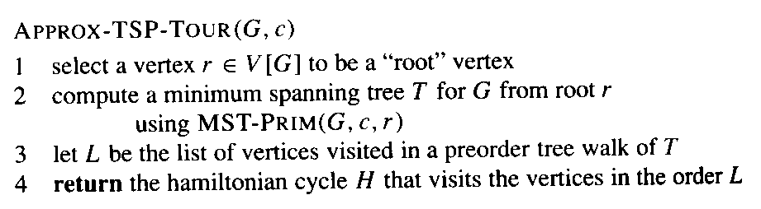
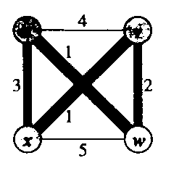
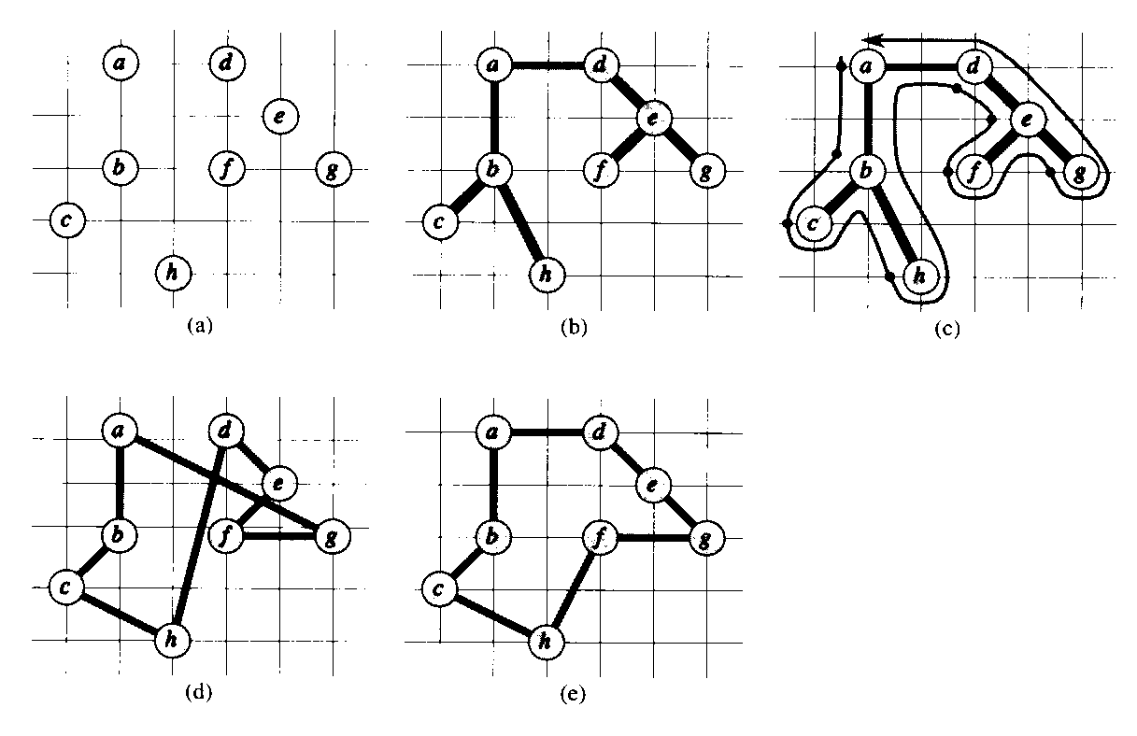
TSP with Triangle Inequality
u
v
5
3
3
5
x
w
4
Cost Function Satisfies
“full walk” = abcbhbadefegeda
Triangle Inequality
final approximate tour
optimal tour
source: 91.503 textbook Cormen et al.

Slide 21
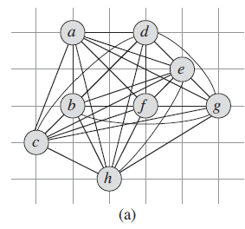
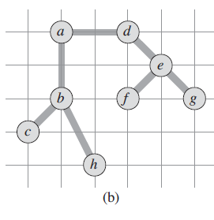
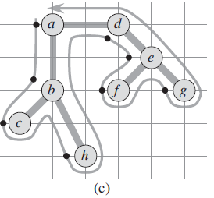
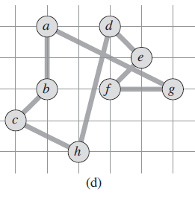

Slide 22
TSP with Triangle Inequality
Time Complexity:
MST-Prim()’s running time: O(V²)
So, APPROX-TSP-TOUR’s running time: O(V²)

Slide 23
TSP with Triangle Inequality
Theorem: APPROX-TSP-TOUR is a polynomial-time 2-approximation algorithm for TSP with triangle inequality.
Proof:
Algorithm runs in time polynomial in n.
(since deleting 1 edge from a tour creates a spanning tree)
(lists vertices when they are first visited and when returned to after visiting subtree)
(since full walk traverses each edge of T twice)
Now make W into a tour H using triangle inequality.
(New inequality holds since H is formed by deleting duplicate vertices from W.)

Slide 24
TSP without Triangle Inequality
If P ≠ NP, then for any constant ρ≥1, there is no polynomial time approximation algorithm with approximation ratio ρ for the general traveling-salesman problem
Prove: try yourself

