Slide 1
Backtracking
Md. Rezaul Karim
CSEDU

Slide 2
Features of Backtracking
Backtracking is more intelligent variation of brute force approach
The principal idea is to construct solutions one component at a time and evaluate such partially constructed candidates as follows.
If a partially constructed solution can be developed further without violating the problem’s constraints, it is done by taking the first remaining legitimate option for the next component
If there is no legitimate option for the next component, no alternatives for any remaining component need to be considered.
In this case, the algorithm backtracks to replace the last component of the partially constructed solution with its next option.

Slide 3
State-SpaceTree
It is convenient to implement this kind of processing by constructing a tree of choices being made, called the state-space tree.
Its root represents an initial state before the search for a solution begins.
The nodes of the first level in the tree represent the choices made for the first component of a solution, the nodes of the second level represent the choices for the second component, and so on.
A node in a state-space tree is said to be promising if it corresponds to a partially constructed solution that may still lead to a complete solution; otherwise, it is called nonpromising
Leaves represent either nonpromising dead ends or complete solutions found by the algorithm

Slide 4
State-SpaceTree
A state-space tree for a backtracking algorithm is constructed in the manner of depth first search.
If the current node is promising, its child is generated by adding the first remaining legitimate option for the next component of a solution, and the processing moves to this child
If the current node turns out to be nonpromising, the algorithm backtracks to the node’s parent to consider the next possible option for its last component; if there is no such option, it backtracks one more level up the tree, and so on
Finally, if the algorithm reaches a complete solution to the problem, it either stops (if just one solution is required) or continues searching for other possible solutions

Slide 5
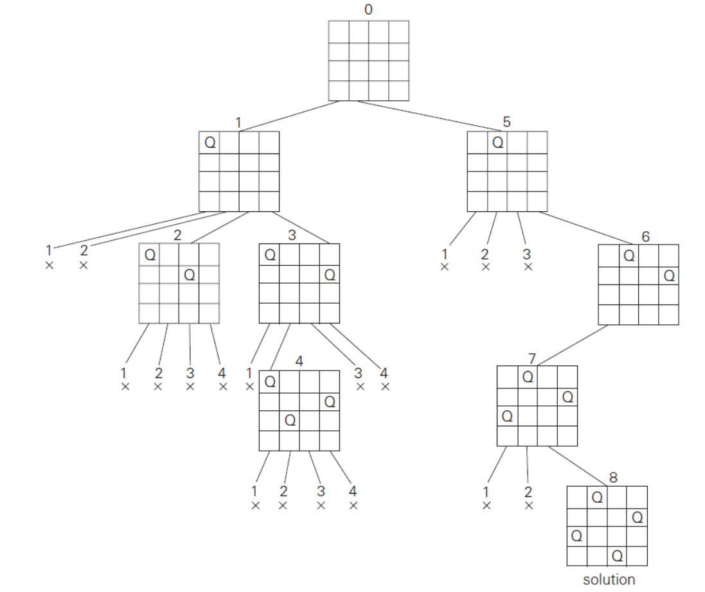
Four-Queens Problem

Slide 6
Algorithm-NQueen
Initial call Nqueen(1, n)
X[1..n]=result
NQueen(k, n)
{ for i = 1 to n do
{ if (Place(k, i)) then
{x[k]=i;
if(k==n) then print x[1..n]
else NQueen(k+1, n)
}
}
}
Place(k, i)
{
for j = 1 to (k-1)
{
if((x[j]==i) or
(abs(x[j]-i)==abs(j-k)))
return false;
}
return true;
}

Slide 7
Linear time algorithm for Nqueen
Approach is not backtracking
Pattern based linear time algorithm
i = 1 to N/2 even number column
i = N/2+1 to N queen at 2(i-N/2)-1

Slide 8
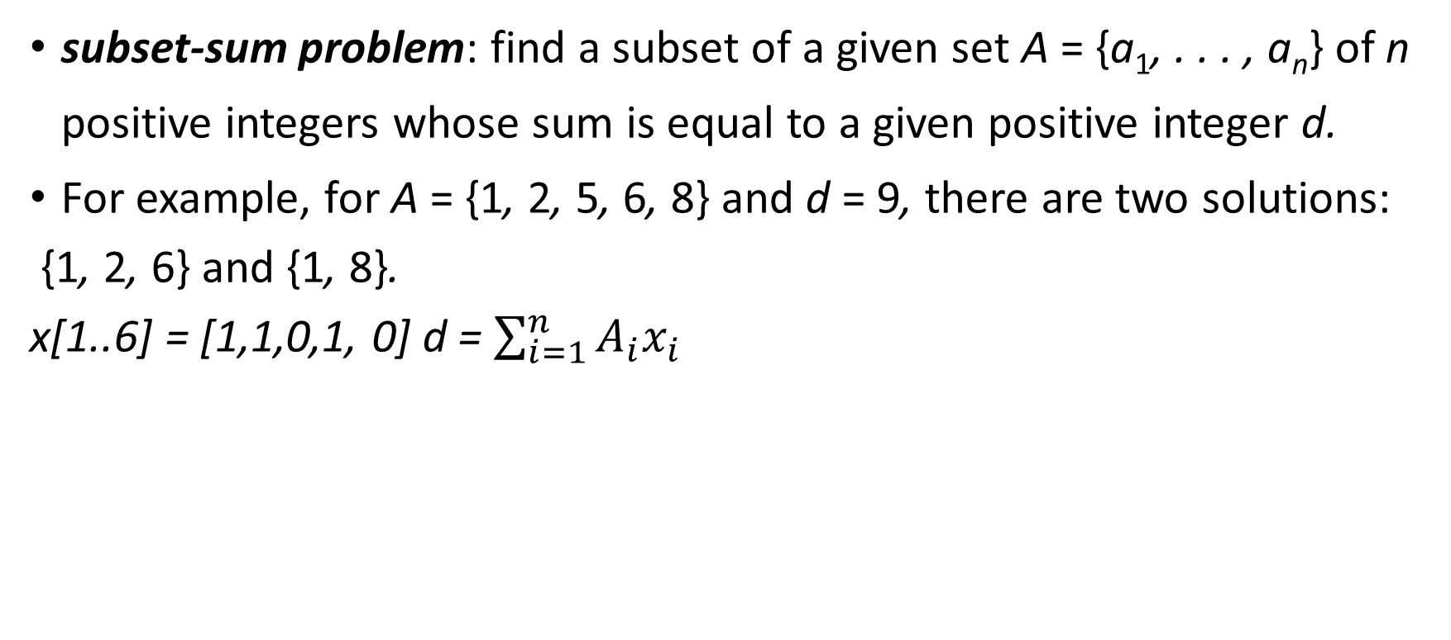
Subset sum problem
subset-sum problem: find a subset of a given set A = {a₁, . . . , a_{n}} of n positive integers whose sum is equal to a given positive integer d.
For example, for A = {1, 2, 5, 6, 8} and d = 9, there are two solutions:
{1, 2, 6} and {1, 8}.
x[1..6] = [1,1,0,1, 0] d = $\sum_{i=1}^{n}{A_{i}x_{i}}$

Slide 9

Subset sum problem
Bounding function
$\sum_{i=1}^{k}{w_{i}}x_{i}+w_{k+1}≤m$
$\sum_{i=1}^{k}{w_{i}}x_{i}+\sum_{i=k+1}^{n}{w_{i}}>m$

Slide 10
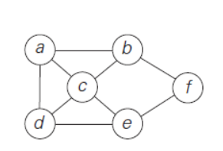
Hamiltonian Circuit

Slide 11
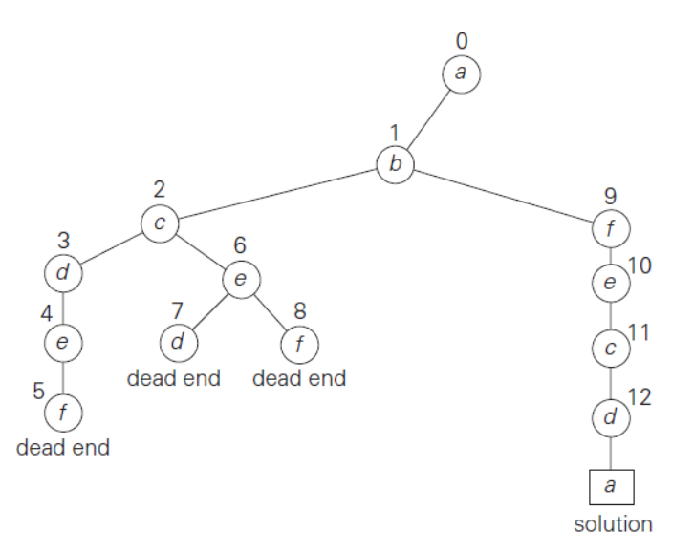
Hamiltonian Circuit

