Slide 1
Number Theory
Md. Rezaul Karim
CSE, DU

Slide 2
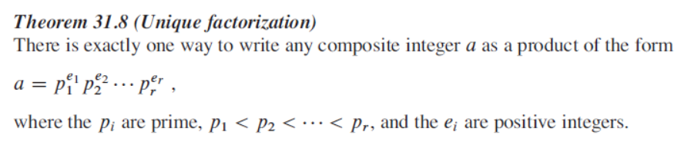

Slide 3
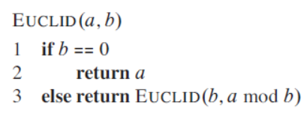
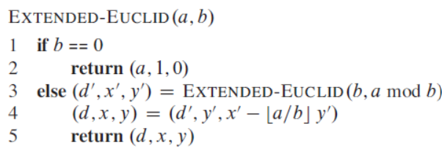
Euclid
Extended Euclid

Slide 4
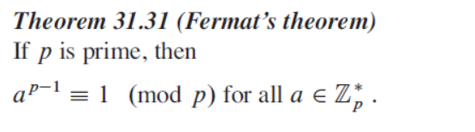

Slide 5
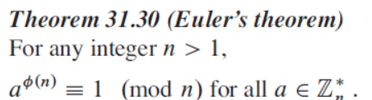
Euler's Theorem
Euler's Theorem is a fundamental result in number theory and is widely used in cryptography (especially RSA), modular arithmetic, and algorithms.
ϕ(n) is Euler's Totient Function, which counts the number of positive integers less than or equal to n that are relatively prime to n.

Slide 6
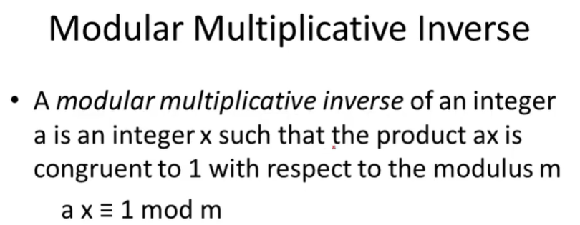
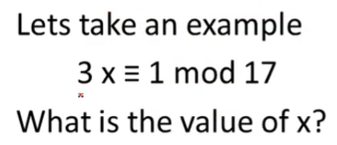

Slide 7
5x ≡ 1 mod 14 find x?
35x ≡ 1 mod 8 find x?
40x ≡ 1 mod 7 find x?
20x ≡ 1 mod 3 find x?

Slide 9
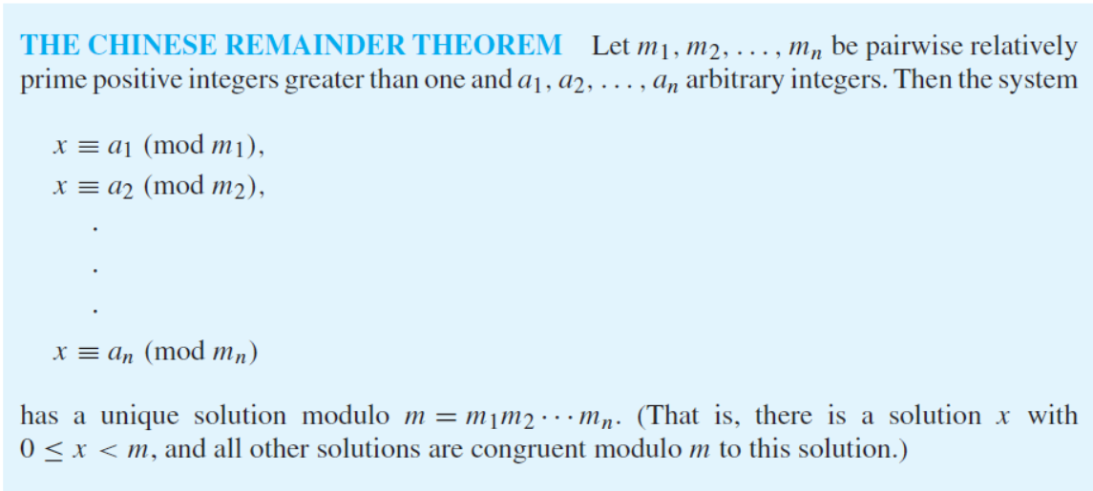

Slide 10
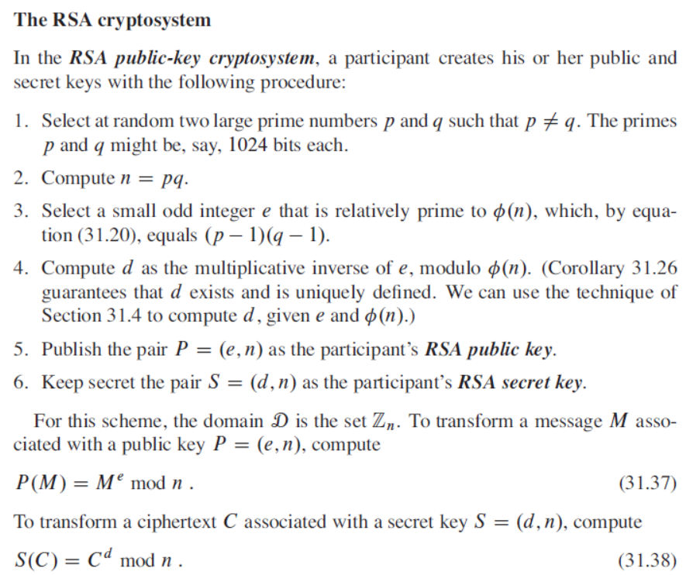

Slide 11
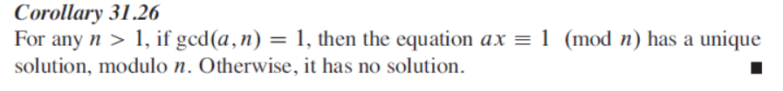

Slide 12
