Slide 1
Tries
Md. Rezaul Karim
CSEDU

Slide 2
The string algorithms like KMP involves preprocessing the pattern to speed up the search
Complementary algorithm is preprocessing the text.
This approach is suitable for applications where a series of queries is performed on a fixed text
The initial cost of preprocessing the text is compensated by a speedup in each subsequent query (for example, a Web site that offers pattern matching in Shakespeare's Hamlet or a search engine that offers Web pages on the Hamlet topic)

Slide 3
A trie (pronounced "try") is a tree-based data structure for storing strings in order to support fast pattern matching.
The main application for tries is in information retrieval.
Indeed, the name "trie" comes from the word "retrieval."
In an information retrieval application, such as a search for a certain DNA sequence in a genomic database, we are given a collection S of strings, all defined using the same alphabet
The primary query operations that tries support are pattern matching and prefix matching.
The latter operation involves being given a string X, and looking for all the strings in S that contain X as a prefix.

Slide 4
Standard Tries
Let S be a set of s strings from alphabet σ such that no string in S is a prefix of another string. A standard trie for S is an ordered tree T with the following properties
Each node of T, except the root, is labeled with a character of σ.
The ordering of the children of an internal node of T is determined by a canonical ordering of the alphabet σ
T has s external nodes, each associated with a string of S, such that the concatenation of the labels of the nodes on the path from the root to an external node v of T yields the string of S associated with v.
Create a standard tries bear, bell, bid, bull, buy, sell, stock, stop

Slide 5
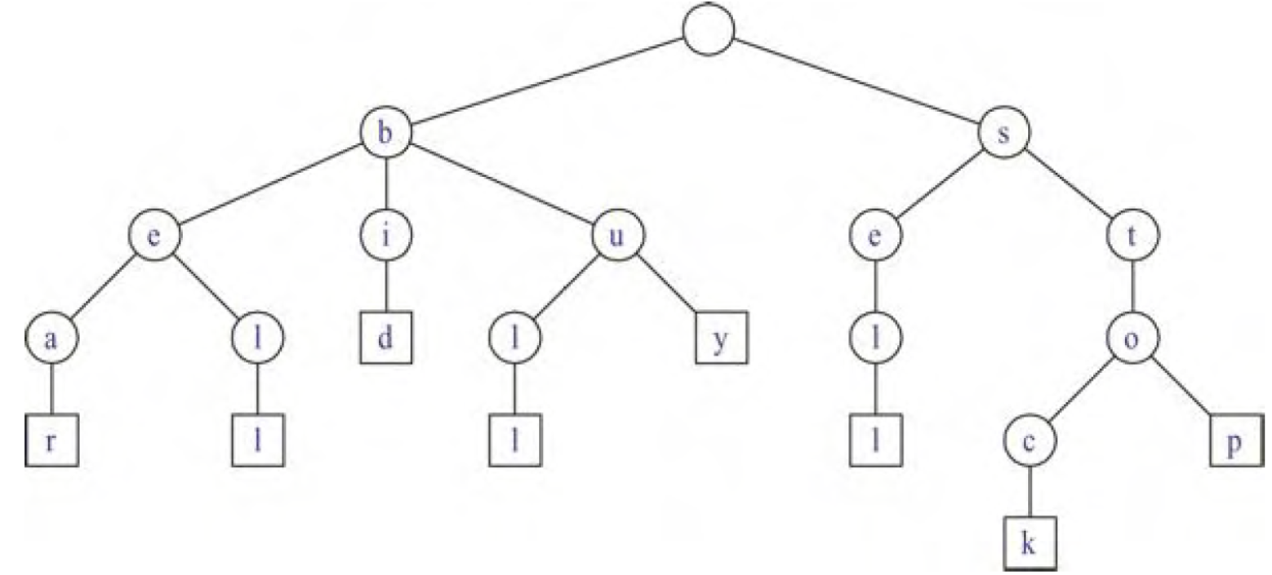
Standard Tries of strings {bear, bell, bid, bull, buy, sell, stock, stop}.

Slide 6
Standard Tries
An internal node in a standard trie T can have anywhere between 1 and d children, where d is the size of the alphabet.
There is an edge going from the root r to one of its children for each character that is first in some string in the collection S.
In addition, a path from the root of T to an internal node v at depth i corresponds to an i-character prefix X[0..i − 1] of a string X of S.
For each character c that can follow the prefix X[0..i − 1] in a string of the set S, there is a child of v labeled with character c.
A trie concisely stores the common prefixes that exist among a set of strings.

Slide 7
Standard Tries
Can a trie be a binary tree?
Alphabet set contains only two character
Is the trie be a multiway tree?
if there are d characters in the alphabet, then the trie will be a multi-way tree where each internal node has between 1 and d children.
There are likely to be several internal nodes in a standard trie that have fewer than d children
We can implement a trie with a tree storing characters at its nodes.

Slide 8
Proposition on structural Properties of standard Trie
A standard trie storing a collection S of s strings of total length n from an alphabet of size d has the following properties:
Every internal node of T has at most d children.
T has s external nodes.
The height of T is equal to the length of the longest string in S.
The number of nodes of T is O(n).
The worst case for the number of nodes of a trie occurs when no two strings share a common nonempty prefix; that is, except for the root, all internal nodes have one child

Slide 9
Application of Trie
A trie T for a set S of strings can be used to implement a dictionary.
we perform a search in T for a string X by tracing down from the root the path indicated by the characters in X.
If this path can be traced and terminates at an external node, then we know X is in the dictionary
The running time of the search for a string of size m is O(dm)

Slide 10
Standard Tries
See a bear? Sell stock! Sell a bull? Buy stock! Bid stock! Bid stock! Hear the bell? Stop!

Slide 11
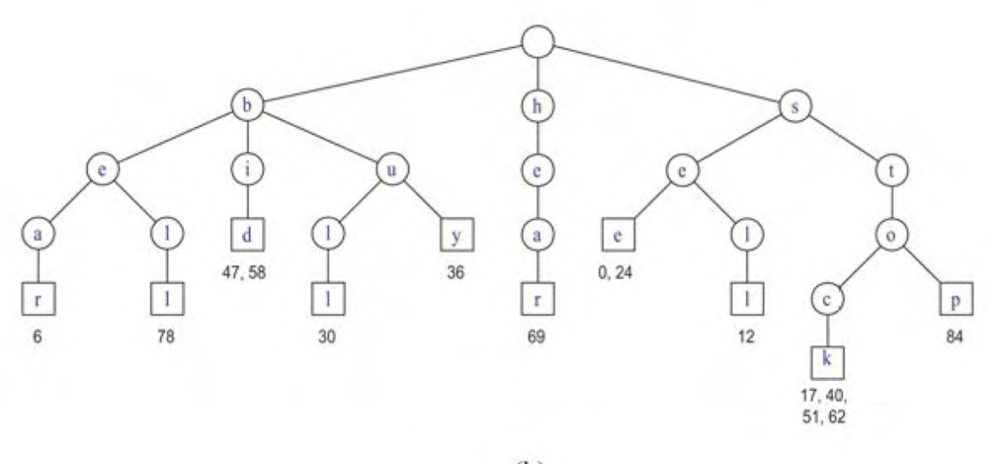
Standard Tries

Slide 12
Compressed Trie
A compressed trie is similar to a standard trie but it ensures that each internal node in the trie has at least two children.
It enforces this rule by compressing chains of single-child nodes into individual edges.

Slide 13
Standard Tries

Slide 14
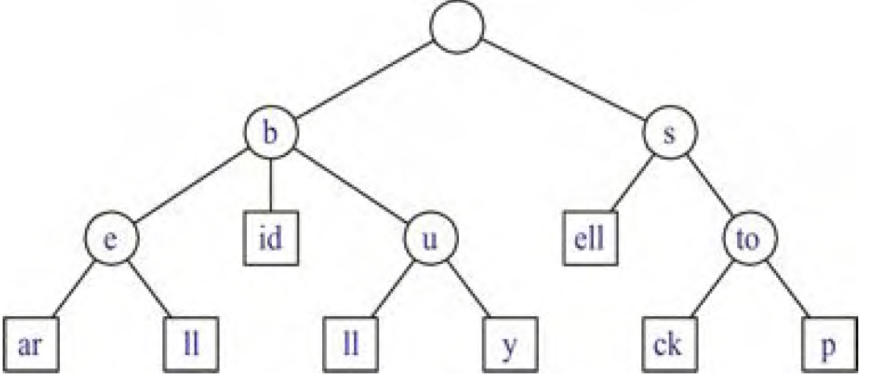
Compressed Trie

Slide 15
Compressed Trie
Let T be a standard trie. We say that an internal node v of T is redundant if v has one child and is not the root.
Let us also say that a chain of k ≥ 2 edges, (v⁰,v¹)(v¹,v²)…(v^{k−1},v^{k}),
is redundant if:
v^{i} is redundant for i = 1, …, k−1 1.
v⁰ and v^{k} are not redundant.
We can transform T into a compressed trie by replacing each redundant chain (v⁰,v¹) … (v^{k−1},v^{k}) of k ≥ 2 edges into a single edge (v⁰, v^{k}), relabeling v^{k} with the concatenation of the labels of nodes v¹,…, v^{k}.

Slide 16
Compressed Trie
A compressed trie storing a collection S of s strings from an alphabet of size d has the following properties:
Every internal node of T has at least two children and most d children
T has s external nodes.
The number of nodes of T is O(s).
A compressed trie is truly advantageous only when it is used as an auxiliary index structure over a collection of strings already stored in a primary structure, and is not required to actually store all the characters of the strings in the collection.

Slide 17
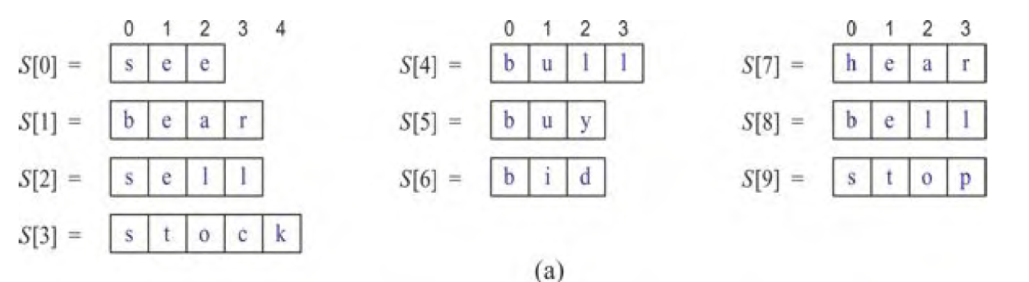

Slide 18
