Slide 1

LONDON BOROUGHS
Market snapshot & comparative analysis of boroughs
By
Robert Czikkel

Slide 2
Table of contents
Executive Summary
Introduction
Methodology
Results
Market – Visualizations and Findings
Demographics & Quality of Life – Visualizations and Findings
Business Demographics – Visualizations and Findings
Discussion
Market
Local Demographics
Business Environment
Conclusion
Appendices

Slide 3

EXECUTIVE SUMMARY
The report is based on current market data and various surveys by London councils and authorities.
In addition to the market snap-shot, the report provides an insight into the demographics and business demographics of the boroughs.
Results have shown that the prices of properties are not necessarily in alignment with the quality of life in a given borough.
According the market data, the largest category in the currently available stock are 2 bedroom flats by a large margin
Havering, Bexley and Bromley remain the most native boroughs
The level of active enterprises is a good indicator of average prices in the boroughs

Slide 4
INTRODUCTION
This report takes a look at the current property market of London by analyzing all current listings on a popular property website, complimented by data found in recent surveys done by councils and authorities.
The aim of this report is to provide the company with up-to-date, current market data across all London boroughs, along with quality of life and demographics data to assist in customer decisions
Questions the report will aim to answer are:
what areas of London provide the best price-value ratio in terms of quality of life?
which are the most lucrative boroughs in terms of prices and available house stock
where to do business in London

Slide 5
METHODOLOGY
DATA
The market data used for analysis was scraped from a mainstream property website, which is the largest of its kind in the current industry.
Quality of life, demographics, business demographics and other, non-market data were acquired from recent surveys done by the London councils, the MET police and NOMIS (ONS service).
PROCESSEs
Data has has been cleaned of missing values and also treated for outliers for analytical purposes
Due to working from multiple sources, datasets have been merged into one large set using boroughs as keys
Various sorting and ranking methods have been performed for better visualizations
In order to identify statistical relationships, methods such as correlation, covariance and multiple linear regression have been used
To achieve better results, polynomial regression and ridge regression models have been utilized

Slide 6

RESULTS

Slide 7
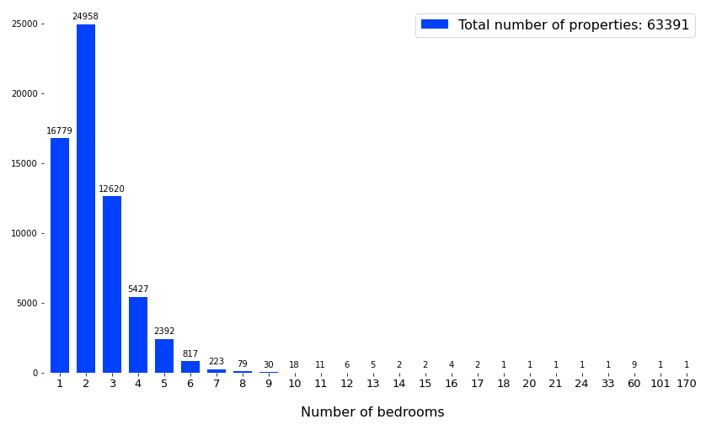
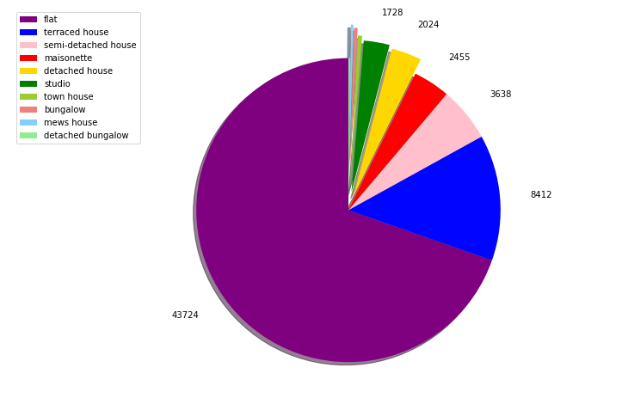
PROPERTY STOCK AND PRICES
Properties by number of bedrooms
Top 10 property types

Slide 8
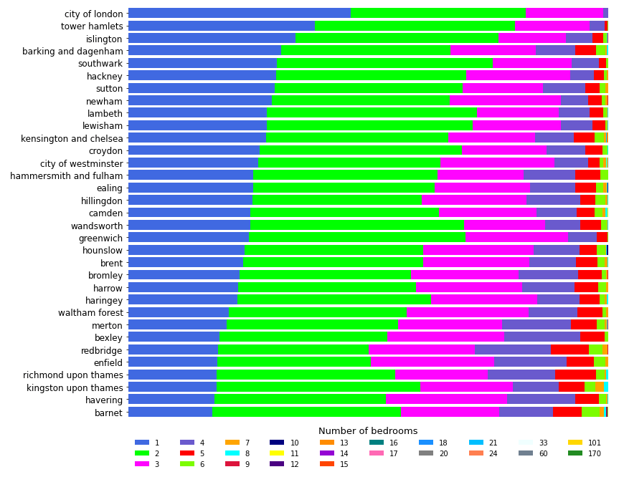
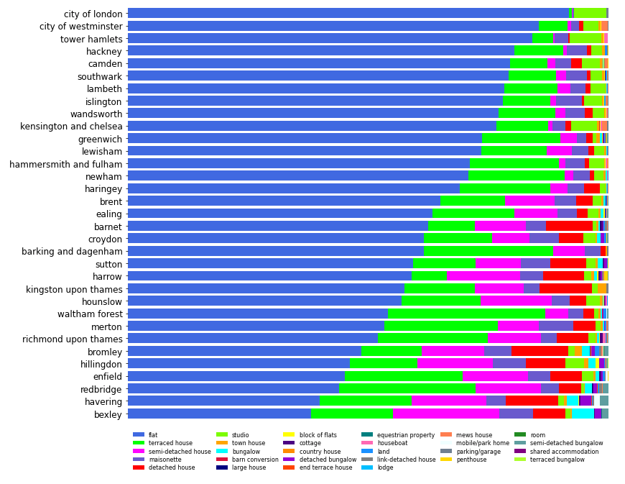
PROPERTY STOCK AND PRICES
Stock per number of bedrooms by borough
Stock per property type by borough

Slide 9
PROPERTY STOCK - FINDINGS
The total number of properties being advertised at this point in time is 63391.
More than 50K of the available stock are small sized properties of one to three bedrooms, with two bedroom properties being the most available with 24958 on the market.
Flats seem to be the most available category on the current market followed by terraced houses, which is typical in an urban environment such as London.
Nearly all advertised properties in the City are one or two bedrooms flats, which is also true for most inner city boroughs.
Boroughs on the outer rings of London have a more diverse stock of properties, which includes larger sized houses with more than three or four rooms

Slide 10
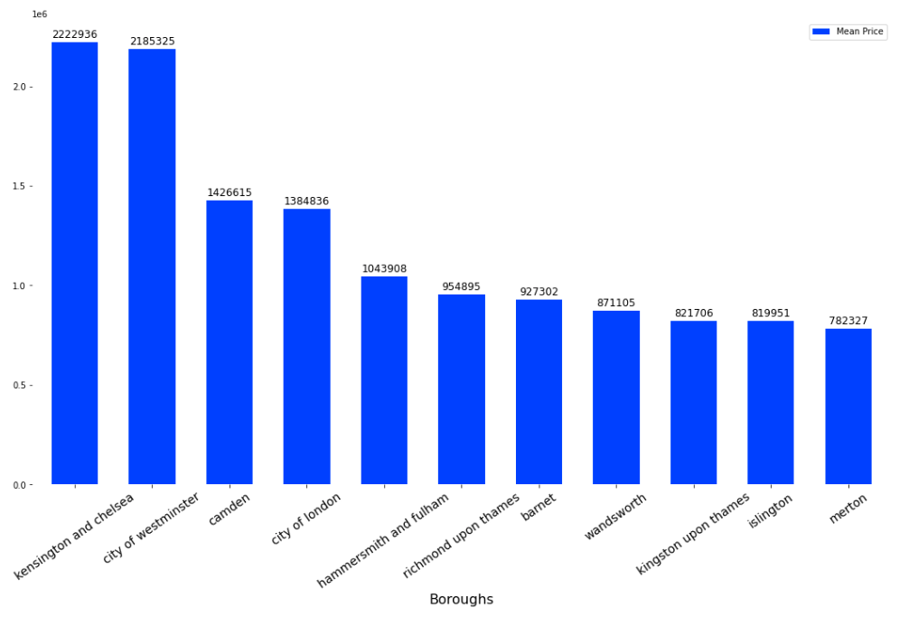
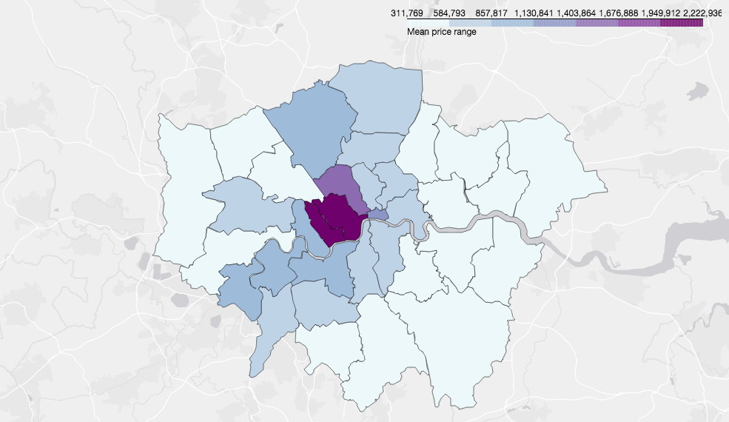
PROPERTY PRICES ON AVERAGE
Top 10 borough by mean price
Map of boroughs by mean price

Slide 11
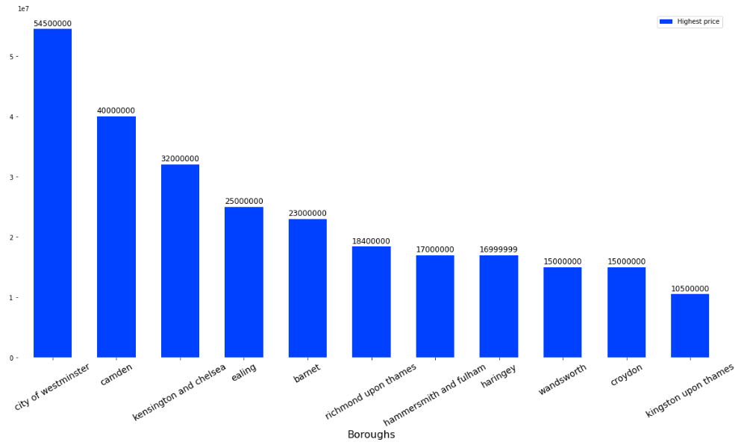
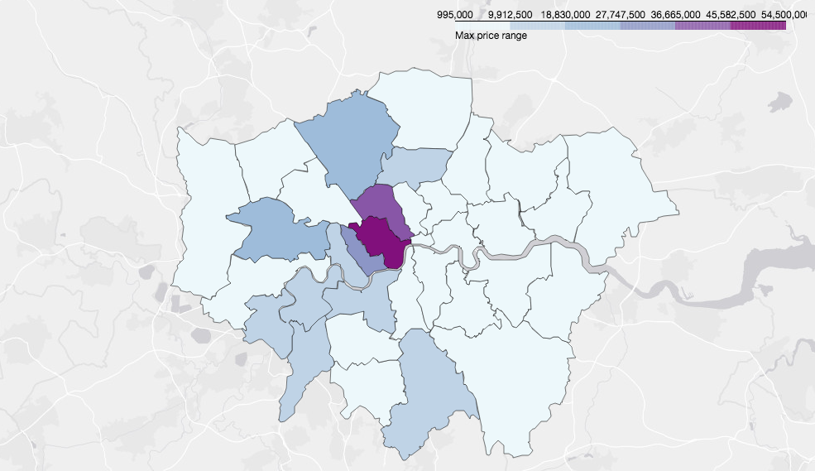
HIGHEST PROPERTY PRICES
Top 10 borough by highest price
Map of boroughs by top price

Slide 12
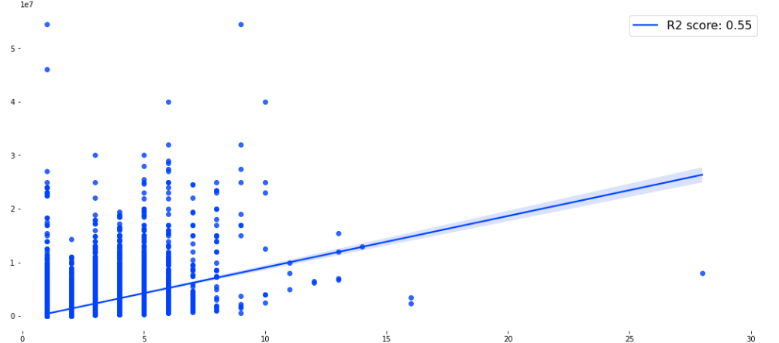
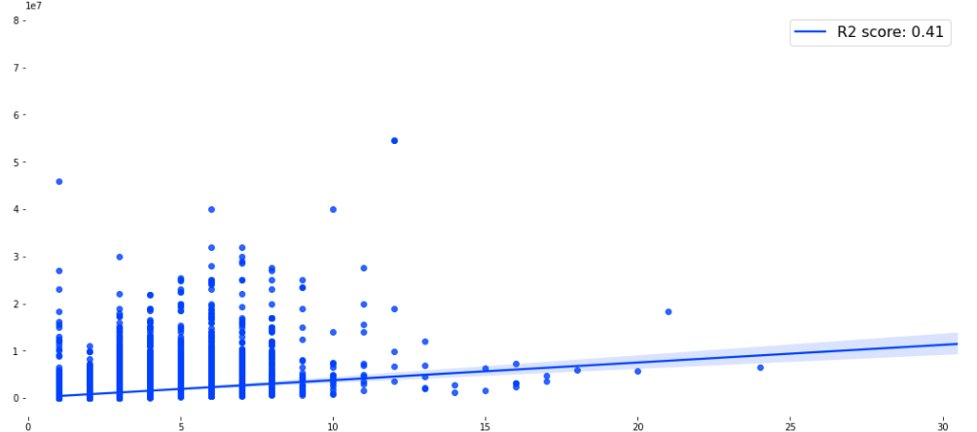
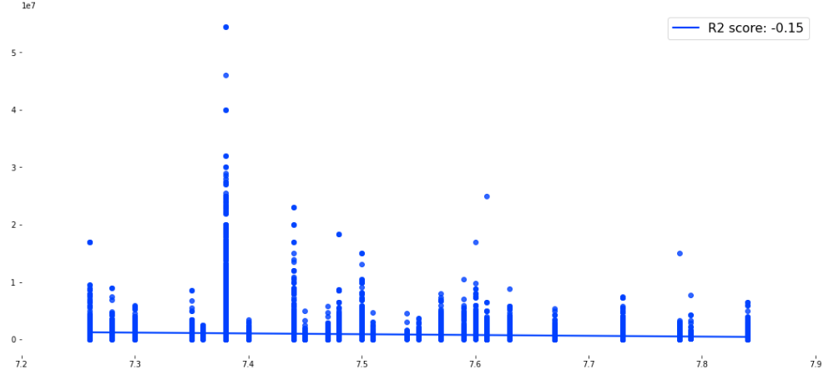
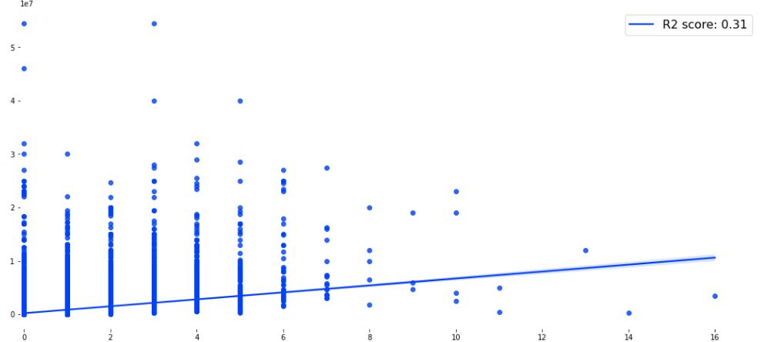
PRICE INDICATORS
Number of bathrooms vs. Price
Number of bedrooms vs. Price
Happiness vs. Price
Number of Reception rooms vs. Price

Slide 13
PROPERTY STOCK - FINDINGS
Average prices are the highest in the central London boroughs such as Kensington and Chelsea, Westminster and Camden, with Kensington and Chelsea having the highest average price at £2,222,938.
Average prices of properties are generally the lowest in the Eastern and Western boroughs of the outer zones of London, whereas boroughs on the North-South axis are relatively more expensive even on the outer skirts of London.
The most lucrative markets in terms of absolute prices are in the boroughs of Westminster, Camden and Kensington and Chelsea, with the most expensive property being in Westminster at an asking price of £54,500,000.
The best predictors of price, apart from location, are the number of bathrooms and the number of bedrooms, with an r2 score of 0.55 and 0.41, respectively. The number of receptions rooms also have a moderately strong correlation with price with an r2 score of 0.31.
Surprisingly, the happiness index has an inverse effect on prices, boroughs with lower prices seem to have a higher happiness index.

Slide 14

DEMOGRAPHICS AND QUALITY OF LIFE

Slide 15
DEMOGRAPHICS - VISUALIZATIONS

