Slide 1
Steam game sharing
A method of lending your digital game to peers

Slide 2
Background
Online vs. Brick and Mortar Stores
Convenience
Cost
Physical ownership
Sharing
Industry Standards
Single user accounts
EA Origin < Valve Steam

Slide 3
Problem Statement:
How do you share a digital game with friends or family?

Slide 4
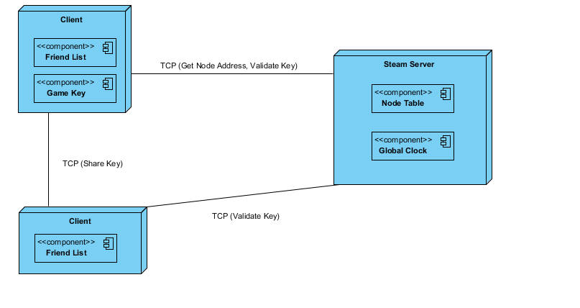
Proposed Solution

Slide 5
Proposed solution:
Users will be connected through the server to their friends list
Server controls who is and isn’t allowed to share games
MUST be friends with each other
On success, key will be transferred peer to peer
Server sets the duration of the key (GMT)
Save data is stored locally, game data persists after game is “returned”
Game can be shared again
Transfer of keys disables or enables access

Slide 6
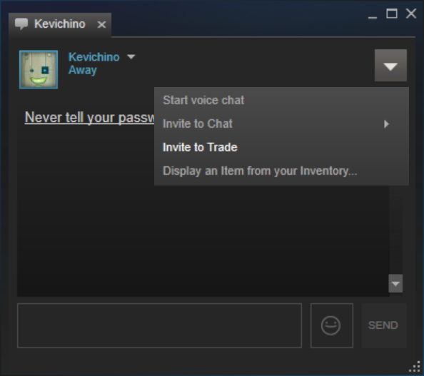

Slide 7
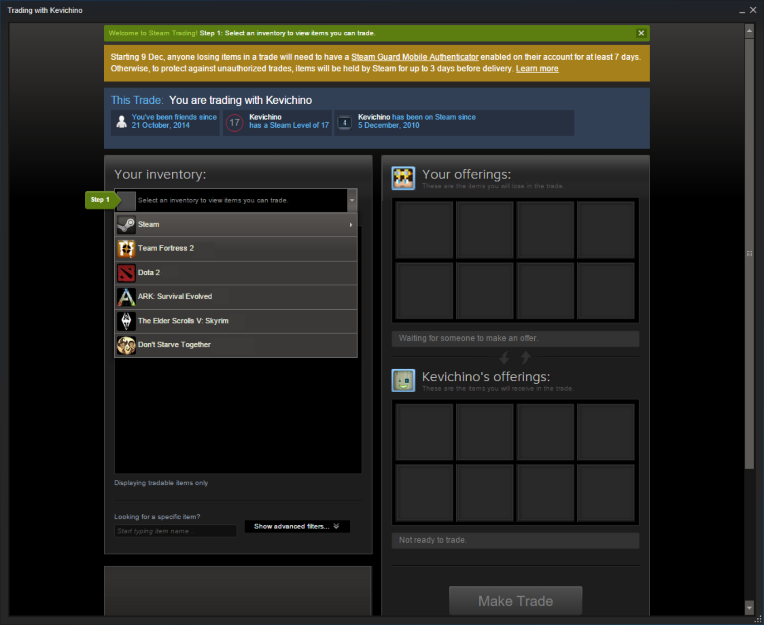

Slide 8
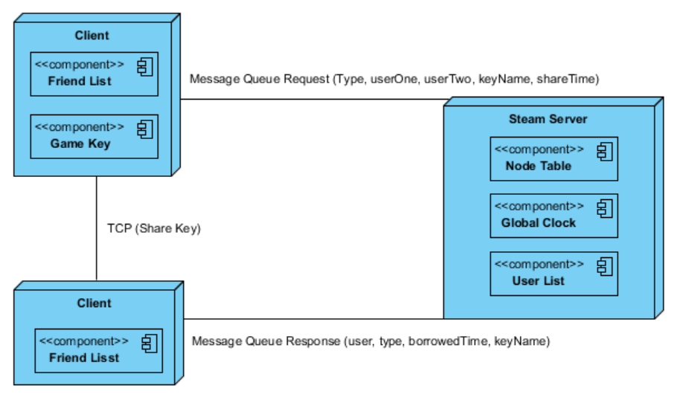
Final Architecture

Slide 9
Final Solution
Small changes made from proposed solution
TCP vs Message Queue
Request Response Queues
Sharing requests
User 1 asks server to share game
Server notifies User 1 & 2
TCP connection establishes between User 1 & 2

Slide 10
Demonstration

Slide 11
Concluding thoughts
Scalability Issues
Message Queues
Replication
Integration Issues
Co-operation with Valve

Slide 12



Questions? ( ͡°( ͡° ͜ʖ( ͡° ͜ʖ ͡°)ʖ ͡°) ͡°)

