Slide 1
Project 1
Team Members
Rajesh Pahari
Robert Fajardo
Mdakbar Sarkar
Platini Dacheu

Slide 2
Background:
Our current project aims to utilize rules based approach in order to generate the hotel rating based on customer review and classification & sentimental analysis of review. Rule based approach is used by defining various rules for getting the opinion, created by tokenizing each sentence in every document and then testing each token, or word, for its presence.

Slide 3
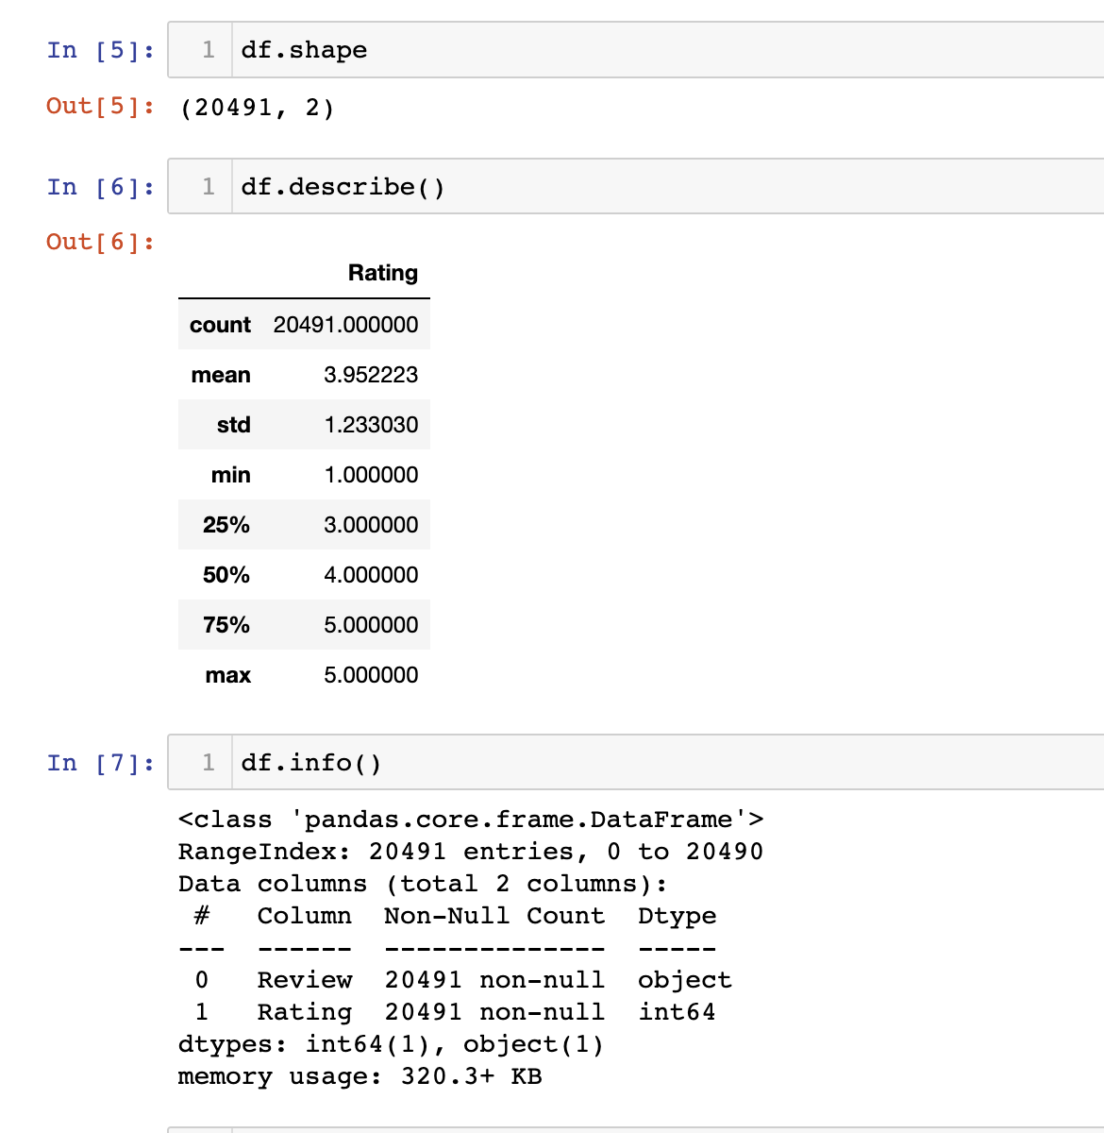

Slide 4
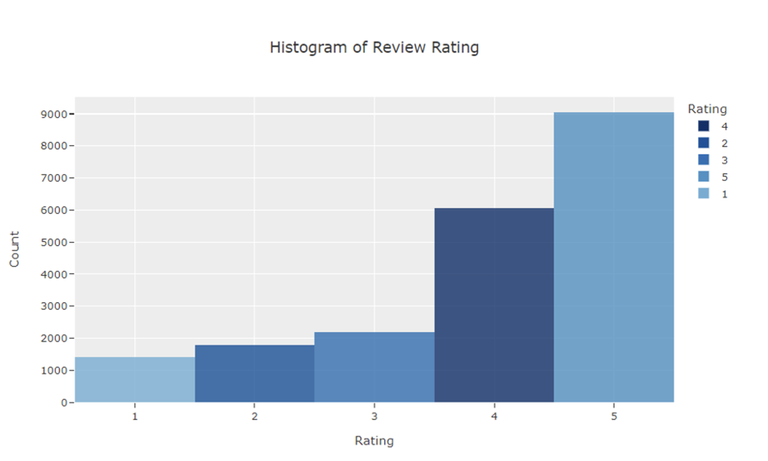

Slide 5
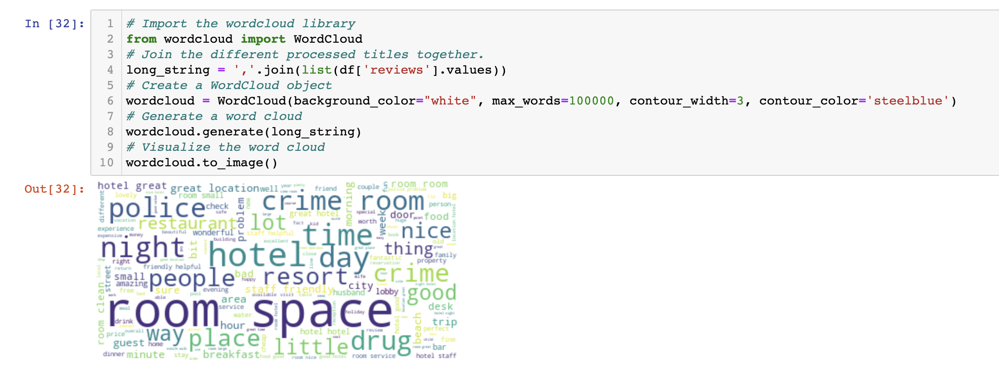

Slide 6
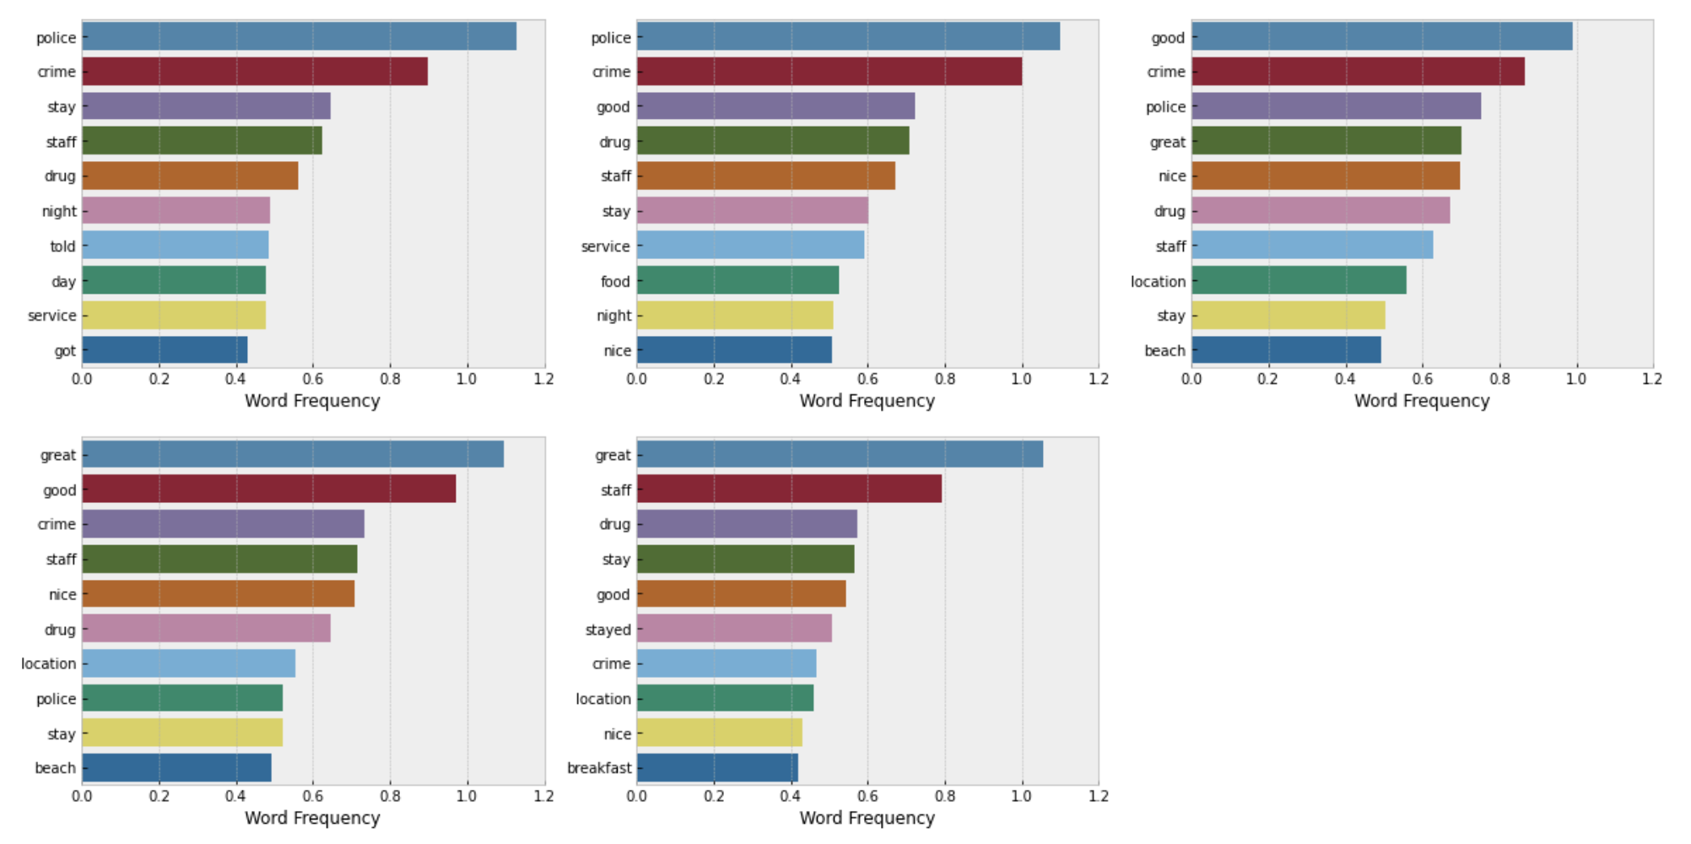

Slide 7
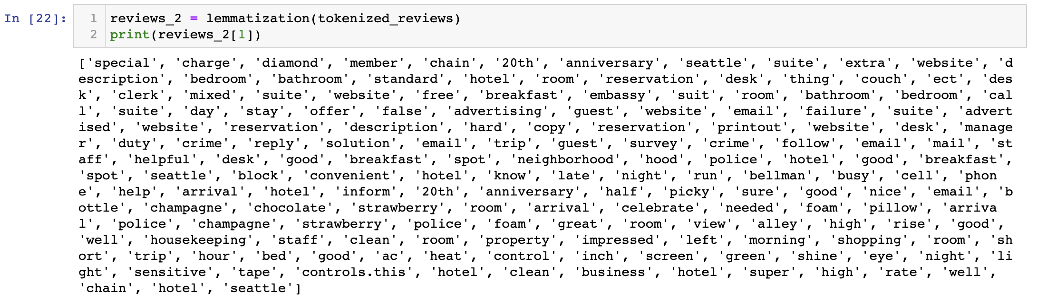
Topic Modeling

Slide 8
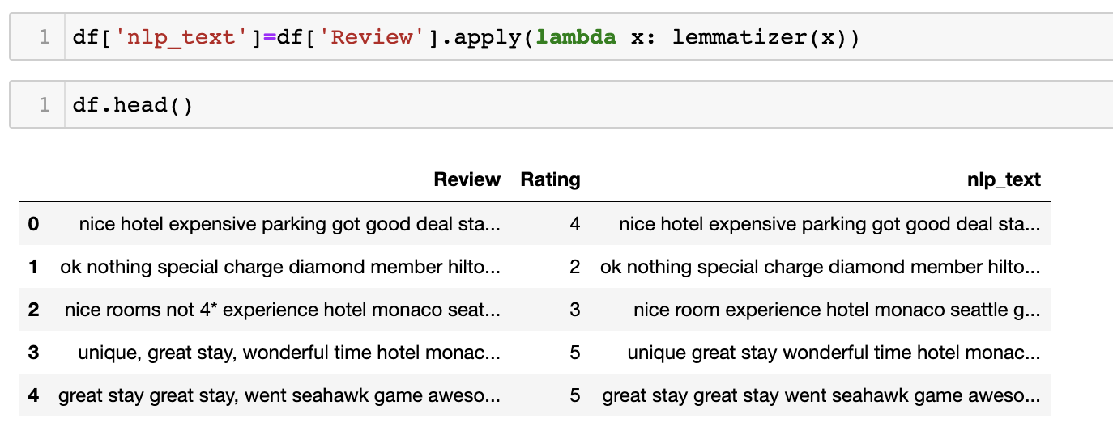
Text Classification

Slide 9
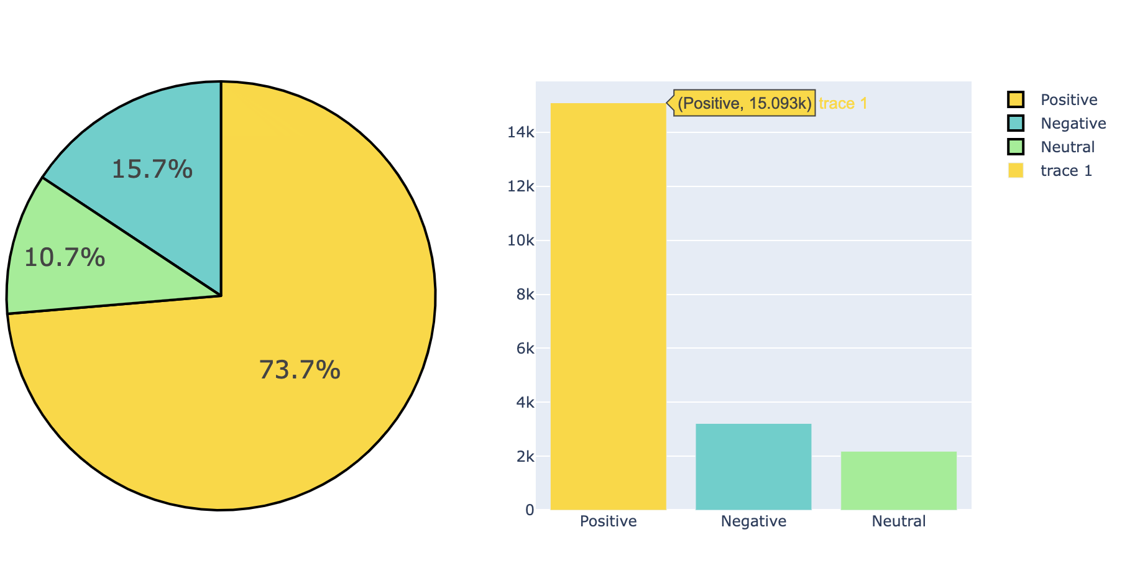
Sentiment Analysis

Slide 10
Project Management
In this section, we are uncovering what we have already done on our project. Briefly, the following points were addressed:
Background by Rajesh Pahari
Exploratory data analysis by Robert Fajardo
Feature Extraction by Mdakbar Sarkar
Project management by Platini Dacheu

