Slide 1
Carry trade and transition
Rob Hayward
Jens Hölscher

Slide 2
Capital flows and exchange rates
There has been a substantial inflow of capital to economies since the 2007-08 financial crisis
There are three factors that could encourage a reversal
International risk aversion
US monetary policy
International liquidity
This research seeks to understand more about how financial instability evolves and to assess the relative importance of these three factors

Slide 3
Sudden stops and the regimes
Sudden stops Calvo (1998, 1999) are composed of two regimes
Inflows
Outflows
Renewed interest, particularly after May 2013
Ahmed (2014) Panel of Gross and Net capital flows
Baele et al. (2014) Look at causes of Flight-to-Safety
Ceruttie et al. (2014) Measure global liquidity

Slide 4
Two Regime: Hidden Markov Chain Model
Unobserved Finance State
Calm
Crisis
Observed Carry Return
Large return
Small risk
Large loss Large risk

Slide 5
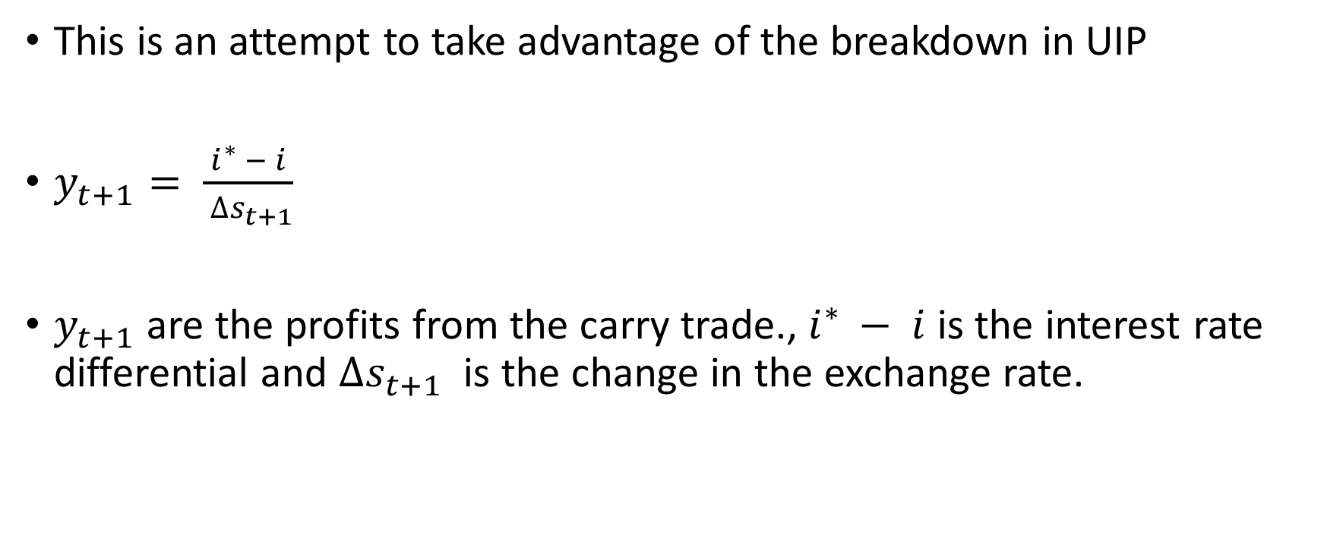
The carry trade
This is an attempt to take advantage of the breakdown in UIP
$y_{t+1}= \frac{i^{∗ }− i}{ ∆s_{t+1}}$
$y_{t+1}$ are the profits from the carry trade., $i^{∗ }− i$ is the interest rate differential and $∆s_{t+1}$ is the change in the exchange rate.

Slide 6
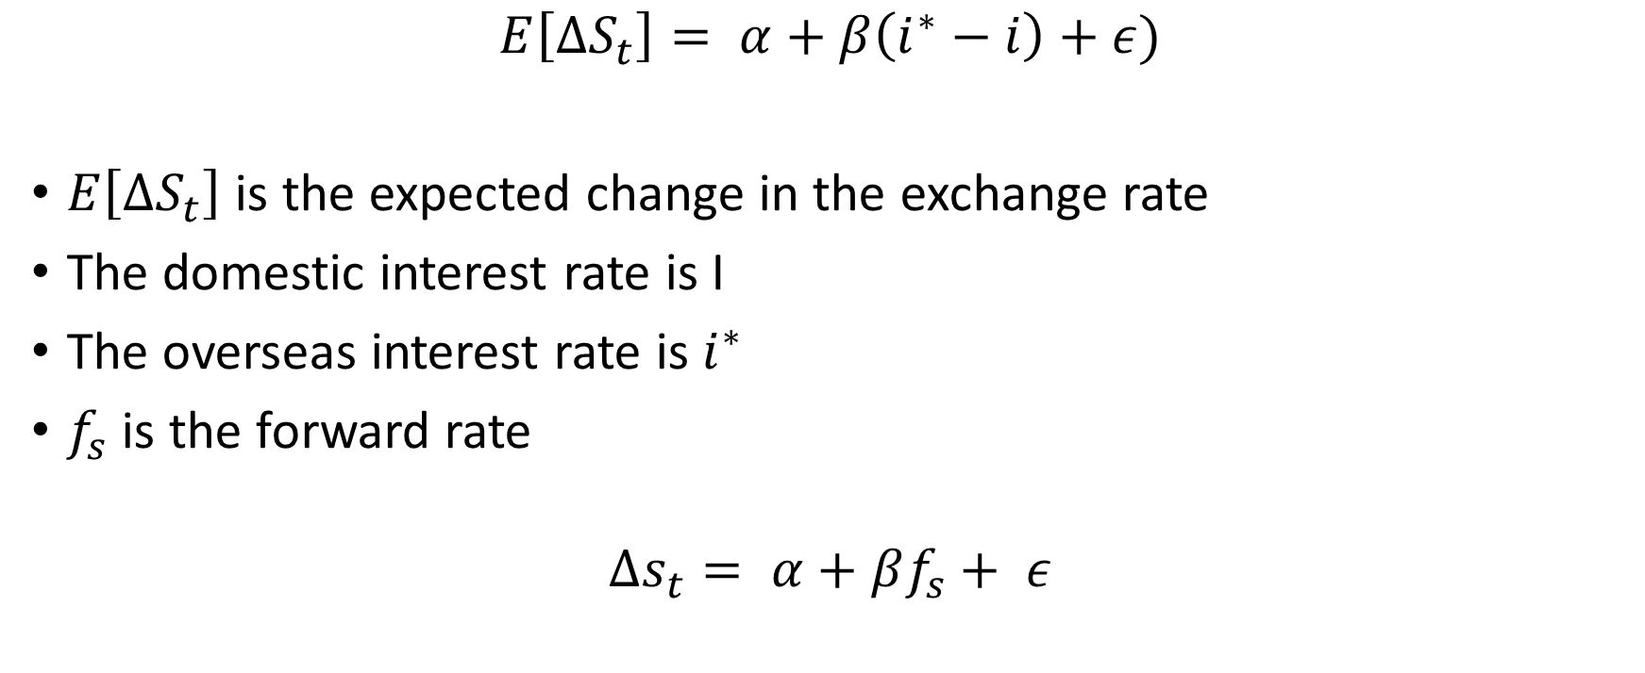
Failure of UIP
$$E\left[∆S_{t}\right]= α+β\left(i^{∗}−i\right)+ε)$$
$E\left[∆S_{t}\right]$ is the expected change in the exchange rate
The domestic interest rate is I
The overseas interest rate is $i^{∗}$
$f_{s}$ is the forward rate
$$∆s_{t}= α+βf_{s}+ ε$$

Slide 7

Risk
The explanation for the breakdown in UIP assumes that there is some risk
$$∆S_{t}= i^{∗}−i−rp$$
Where $rp$ is the risk-premium

Slide 8
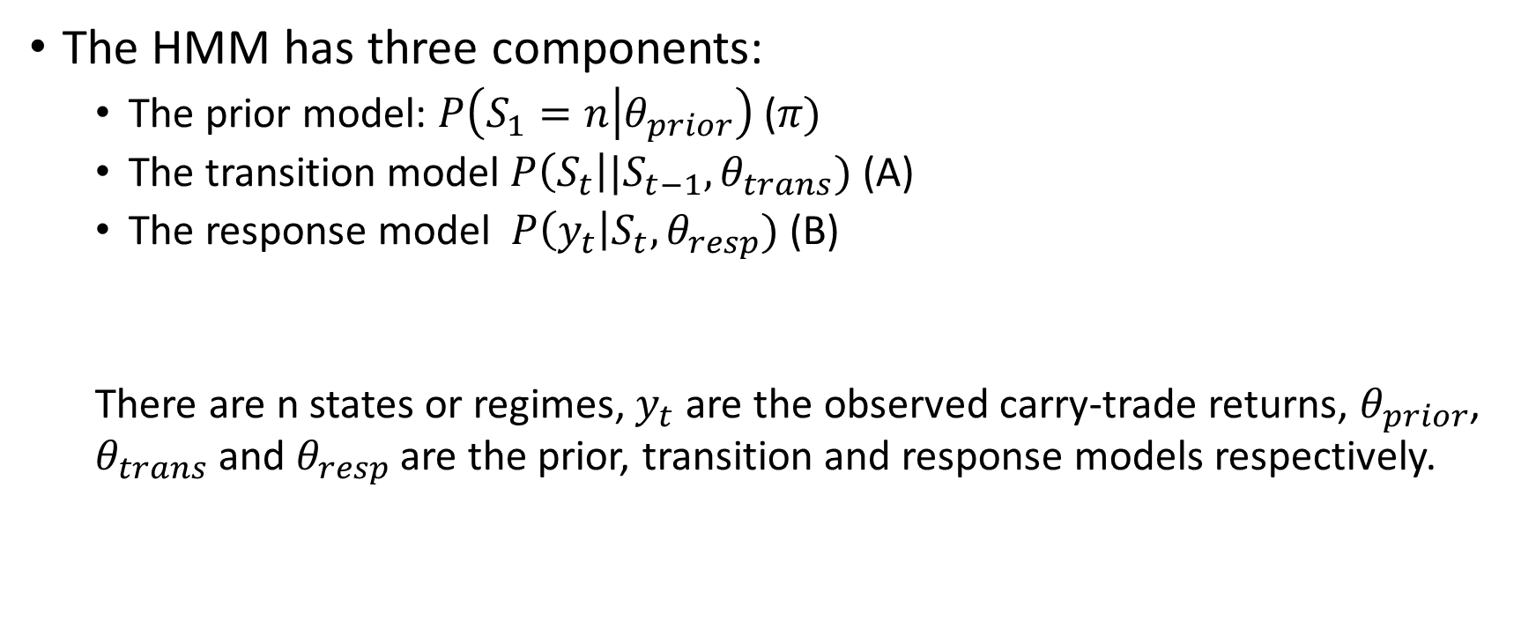
Three components of HMM
The HMM has three components:
The prior model: $P\left(S_{1}=n | θ_{prior}\right)$ ($π)$
The transition model $P\left(S_{t}\right|{|S}_{t−1}, θ_{trans})$ (A)
The response model $P\left(y_{t}\right|S_{t}, θ_{resp})$ (B)
There are n states or regimes, $y_{t}$ are the observed carry-trade returns, $θ_{prior}$, $θ_{trans}$ and $θ_{resp}$ are the prior, transition and response models respectively.

Slide 9

Response
For the simple case, the two-regime is modelled as
$$y_{t}= β_{0}+\sum_{i=1}^{i=n}{S_{i, t}+ ε_{t}}$$

Slide 10
Results
Regime |  | HUF | PLN | CZK | RON
Calm | Mean | 1.0165 | 1.0173 | 1.1029 | 1.0150
 | S-dev | 0.0519 | 0.0486 | 0.0542 | 0.0433
Crisis | Mean | 0.9950 | 0.9862 | 0.9963 | 0.9969
 | S-dev | 0.1085 | 0.1025 | 0.0886 | 0.0878
Mean and standard deviation in period of calm and crisis.

Slide 11
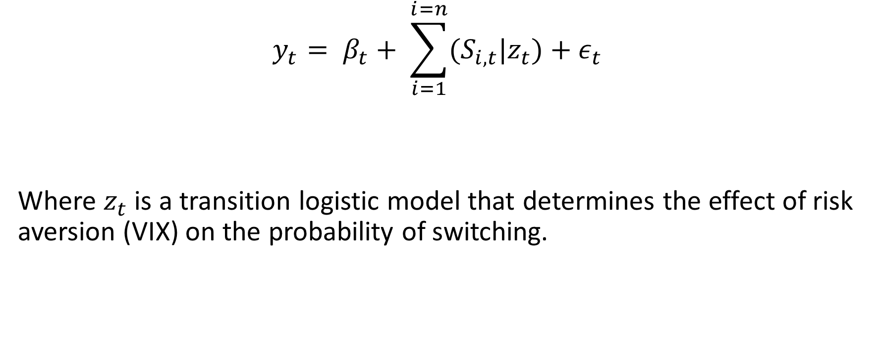
Transition models
$$y_{t}= β_{t}+ \sum_{i=1}^{i=n}{(S_{i, t}|z_{t})+ε_{t}}$$
Where $z_{t}$ is a transition logistic model that determines the effect of risk aversion (VIX) on the probability of switching.

Slide 12
Results 2
 | -3sd | -1sd | Mean | 1sd | 2sd | 3sd
HUF | 0.0020 | 0.0242 | 0.0807 | 0.2375 | 0.5249 | 0.7967
PLN | 0.0004 | 0.0063 | 0.0242 | 0.0887 | 0.2766 | 0.6003
CZK | 0.0000 | 0.0034 | 0.0717 | 0.6367 | 0.9755 | 0.9989
RON | 0.0014 | 0.0131 | 0.0392 | 0.1119 | 0.2799 | 0.5453
VIX is scaled to zero mean and unit standard deviation; these are the probabilities of switching to a crash once in a state of calm.

