Slide 1
A House Divided Feels Drafty: Understanding Intra-party Coldness
Rob Lytle

Slide 2
We know a lot about inter-party affect

Slide 3
Republicans and Democrats don’t like each other.

Slide 4
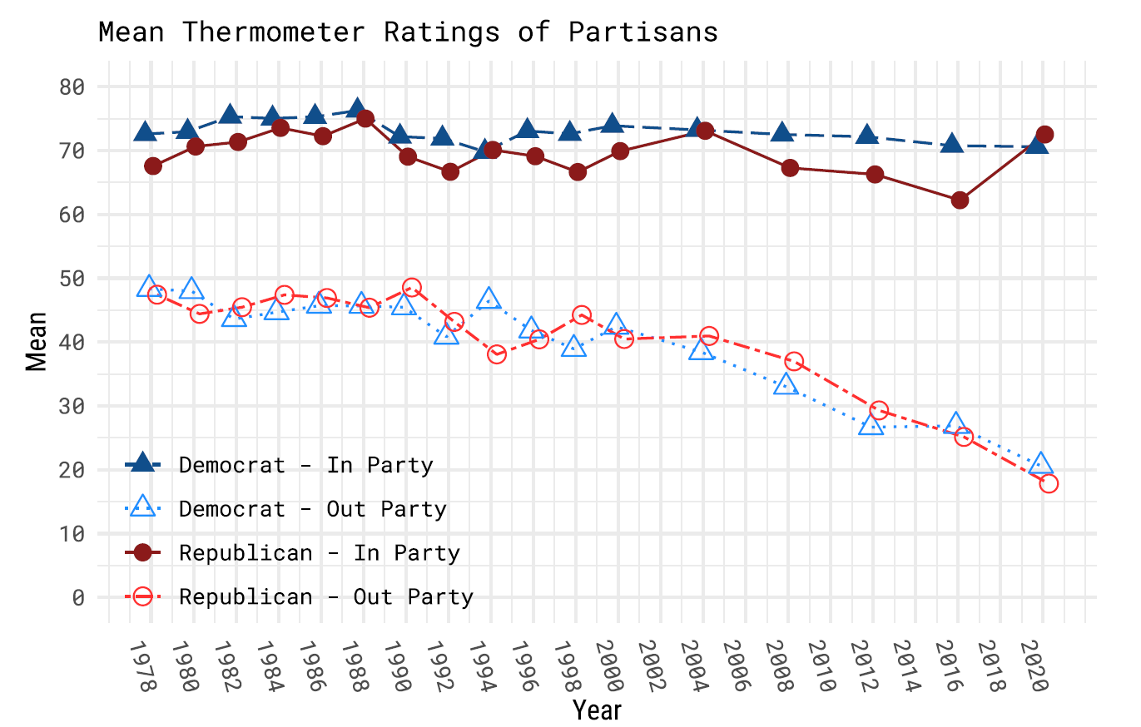

Slide 5
Scholars hold intra-party affect to be:

Slide 6
Scholars hold intra-party affect to be:
Positive.

Slide 7
Scholars hold intra-party affect to be:
Positive.
Stable.

Slide 8
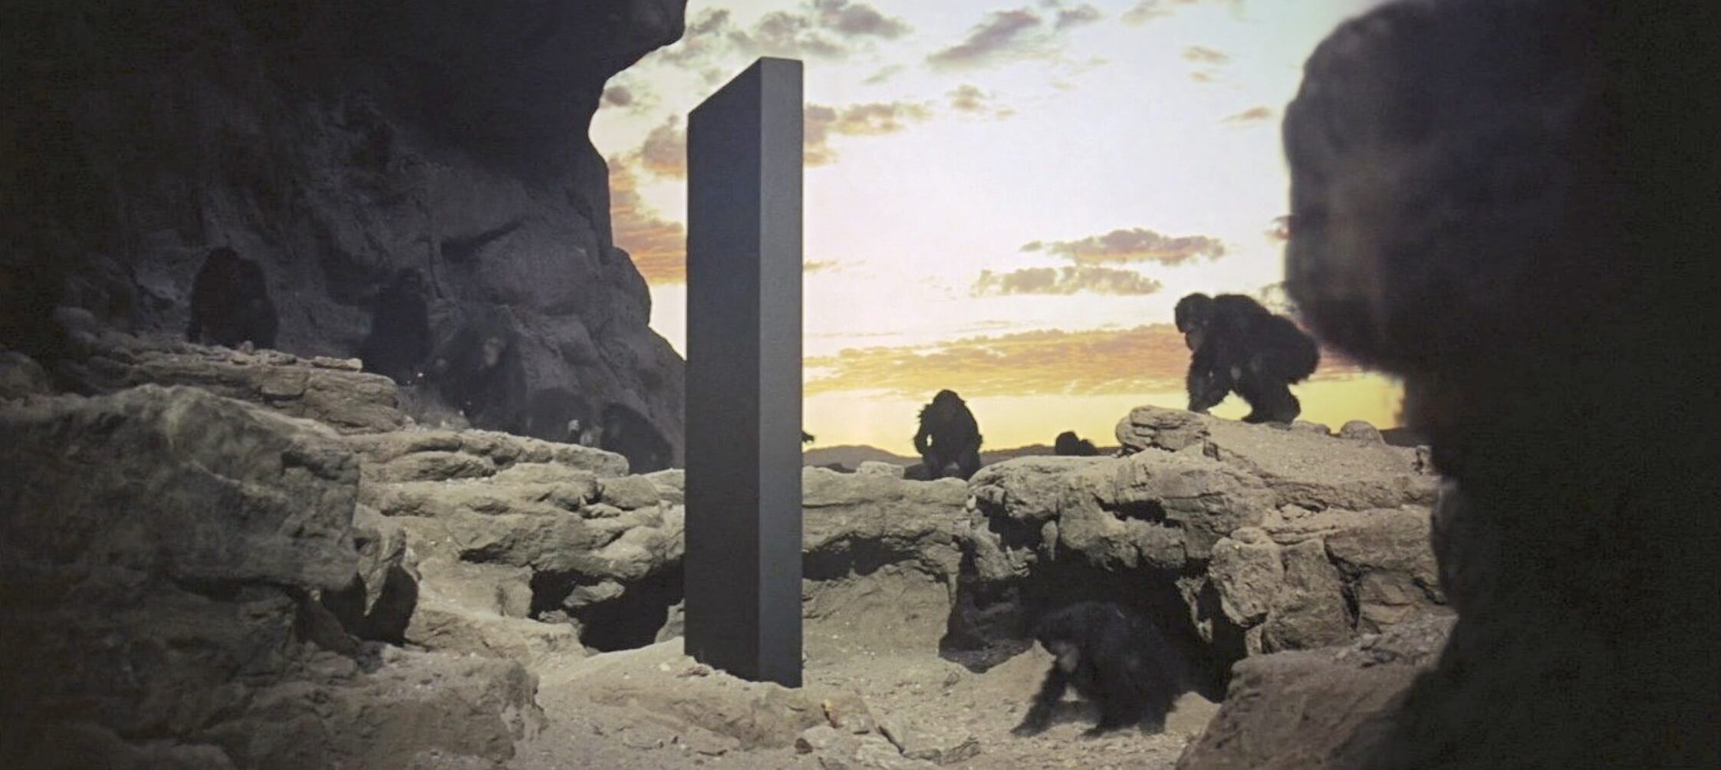
Scholars hold intra-party affect to be:
Positive.
Stable.
Homogenous.

Slide 9
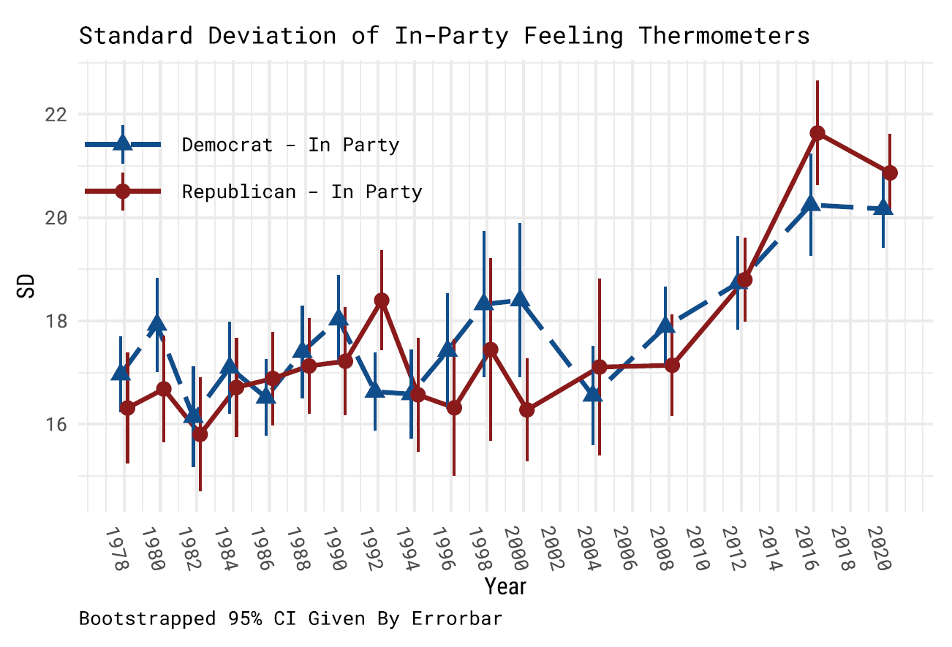

Slide 10
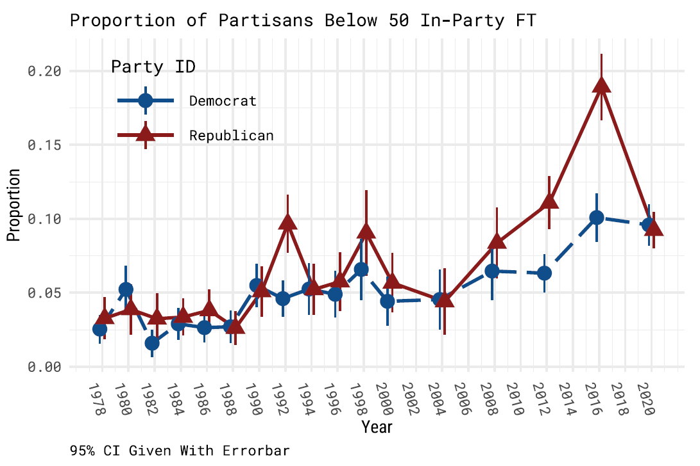

Slide 11
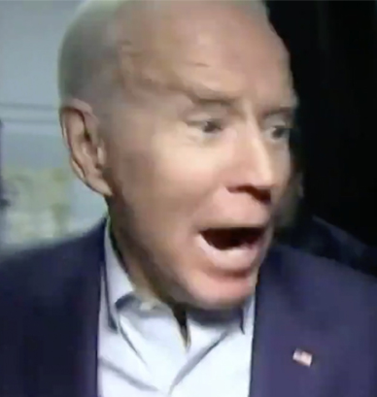
Why, why, why, why, why, why, why, why, why, why, why, why?
Notes:
Mention why you chose this picture

Slide 12
Intra-party competition
Voters cannot rely on the party-id heuristic for intra-party contests (primaries)
Candidates must differentiate themselves from their (in-party opponents)
Primaries upset the in-group/out-group partisan dynamic

Slide 13
Supporters of primary losers should
like their party less.

Slide 14
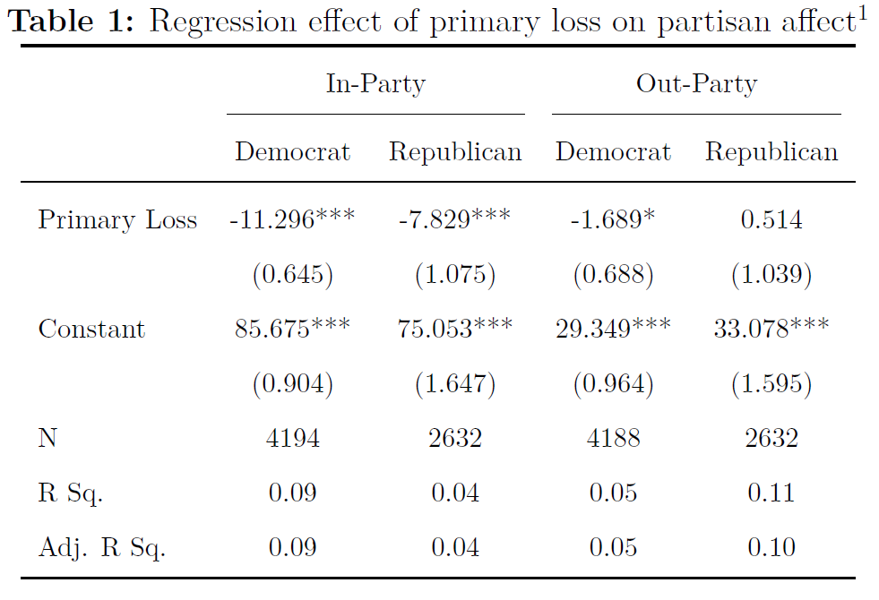

Slide 16
Do cold partisans pick losing candidates or do losing candidates make cold partisans?

Slide 17
Overcoming observational equivalence with a survey experiment.

Slide 18
3 Conditions:

Slide 19
3 Conditions:
Winners

Slide 20
3 Conditions:
Winners
Losers

Slide 21
3 Conditions:
Winners
Losers
Control

Slide 22
3 Outcomes:

Slide 23
3 Outcomes:
Affect

Slide 24
3 Outcomes:
Affect
Efficacy

Slide 25
3 Outcomes:
Affect
Efficacy
Voting

Slide 26
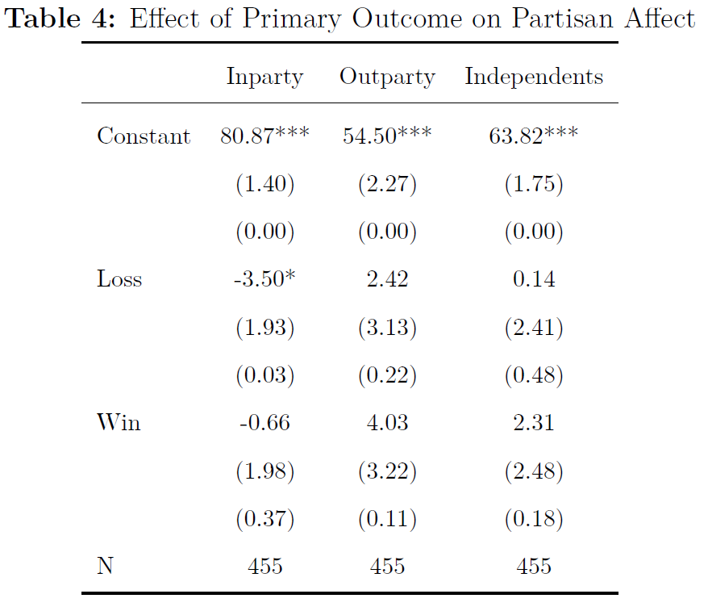

Slide 27
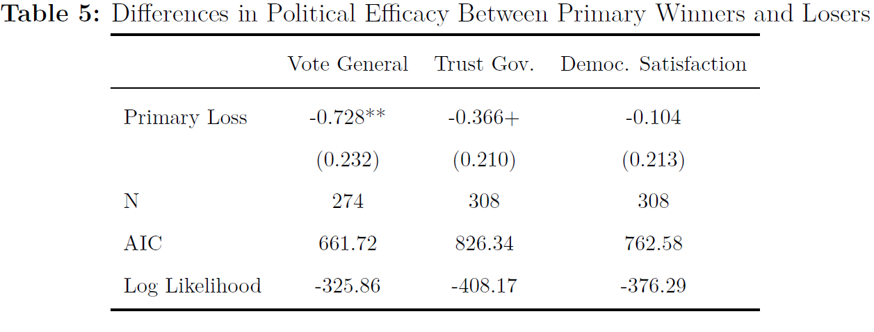

Slide 28
Who cares?

Slide 29
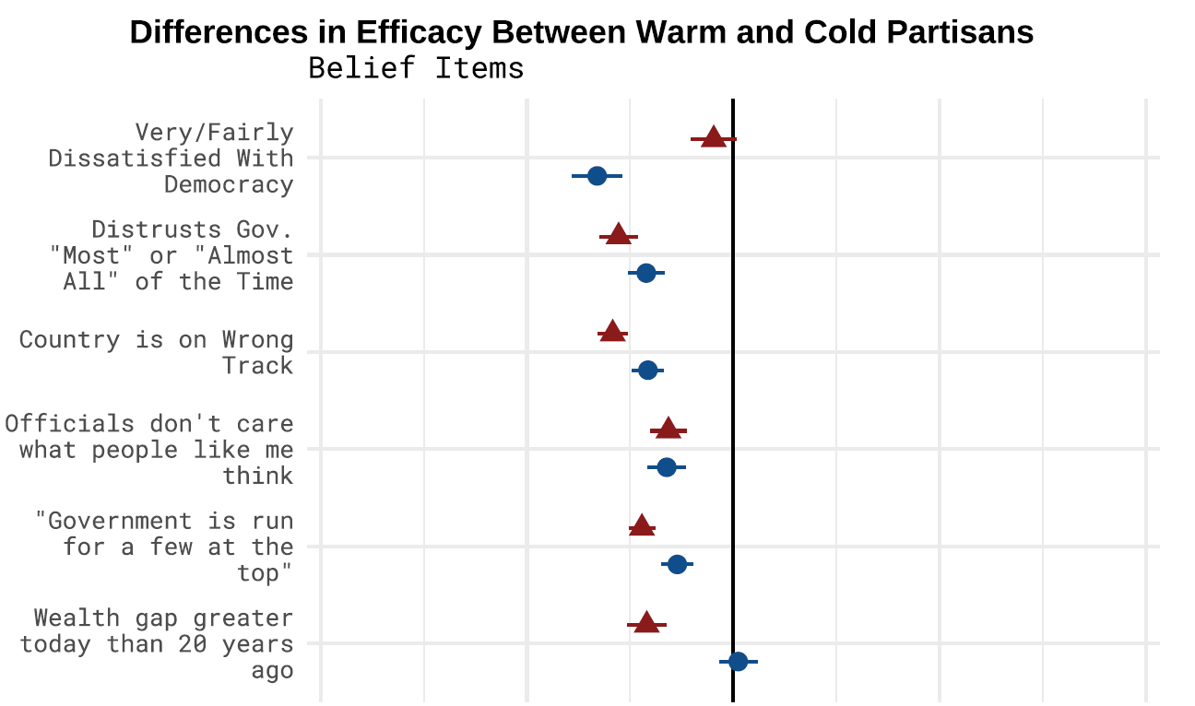

Slide 30
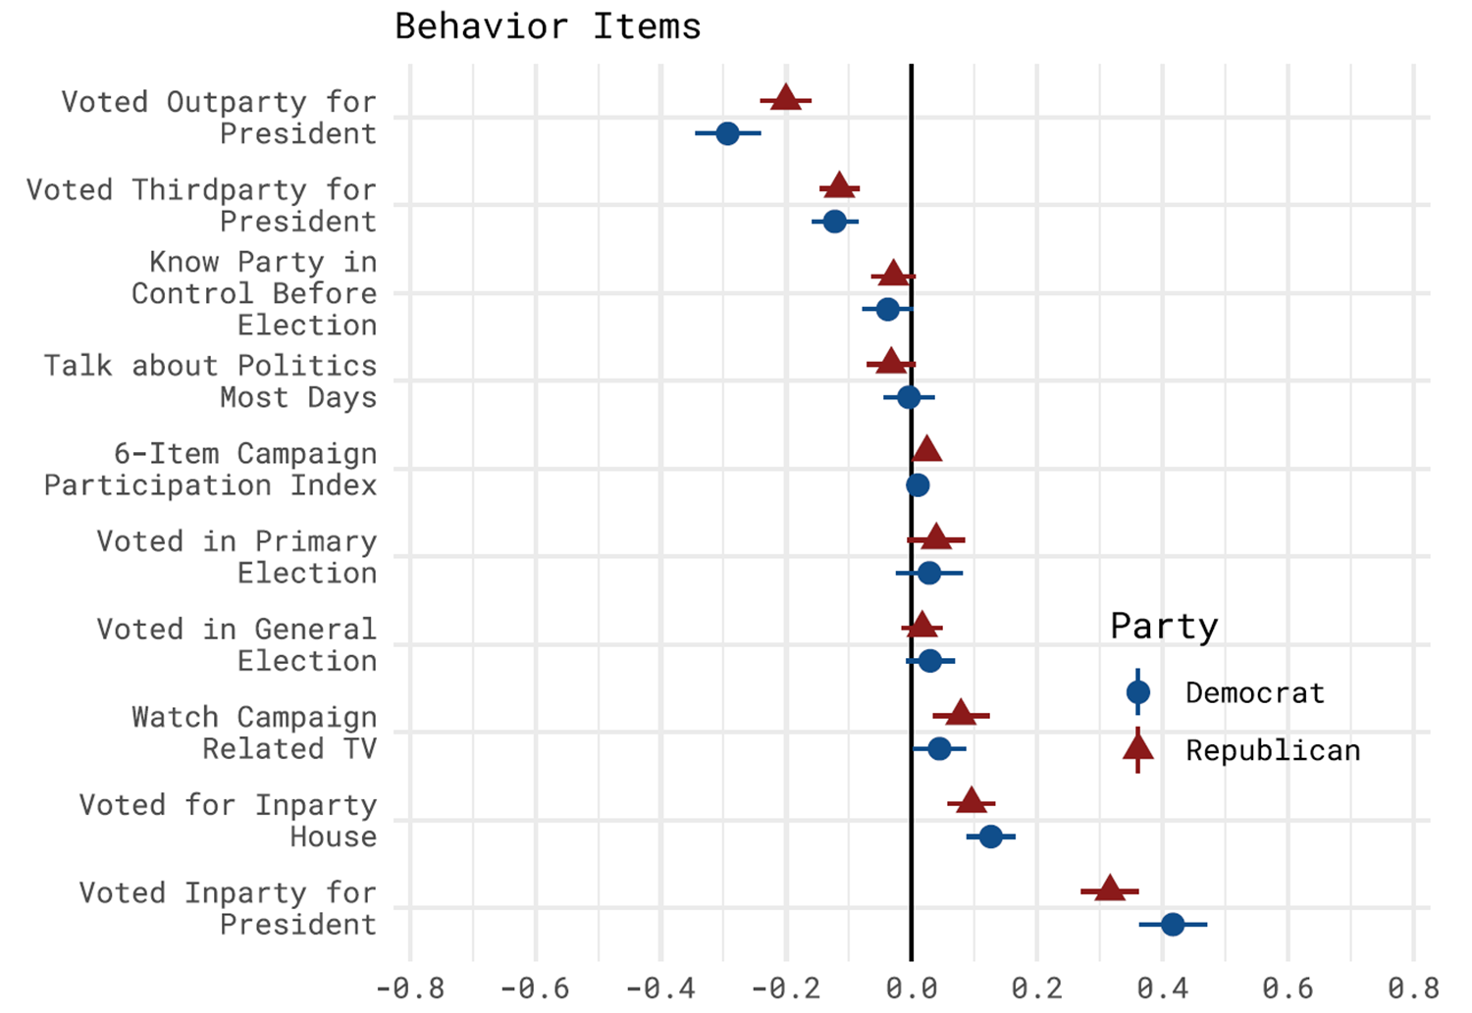

Slide 31
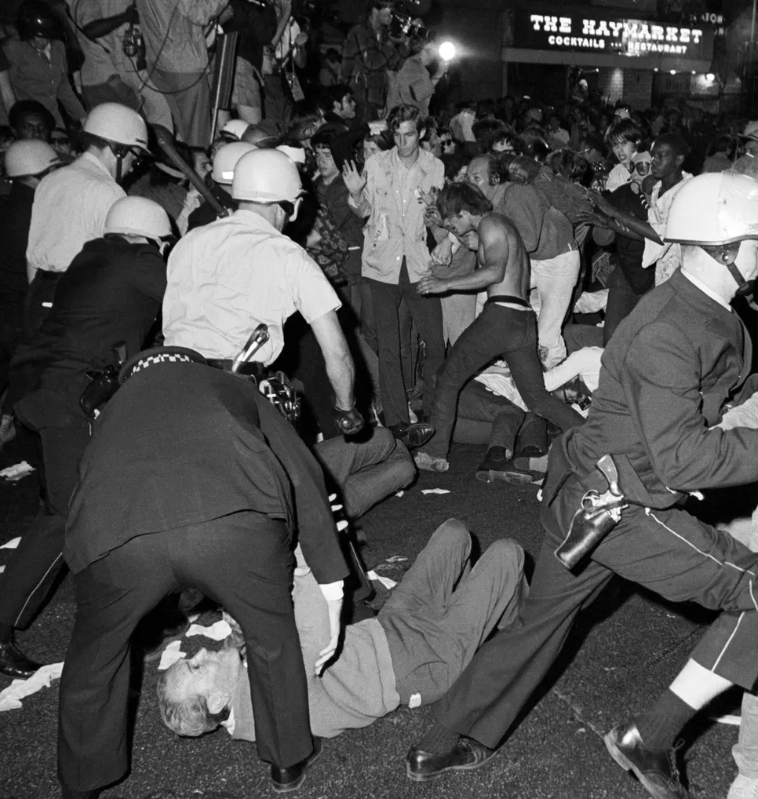
Primaries may reproduce the problems they were introduced to solve.

Slide 32
Questions

