Slide 1
A House Divided Feels Drafty: Understanding Intra-party Coldness
Rob Lytle

Slide 2
We know a lot about inter-party affect
We know less about intra-party affect

Slide 3
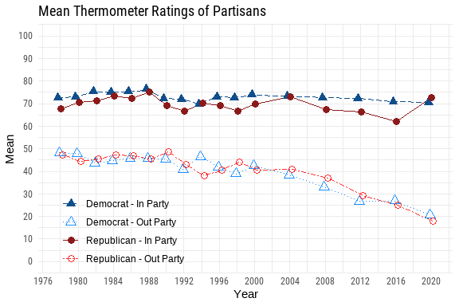
Time-series shifts in partisan affect.

Slide 4
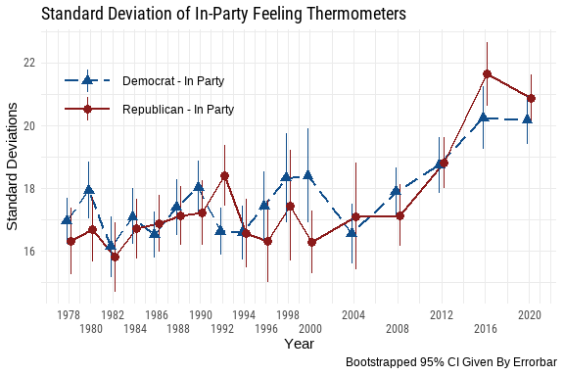
Changes in the standard deviation of in-party feeling thermometers.

Slide 5
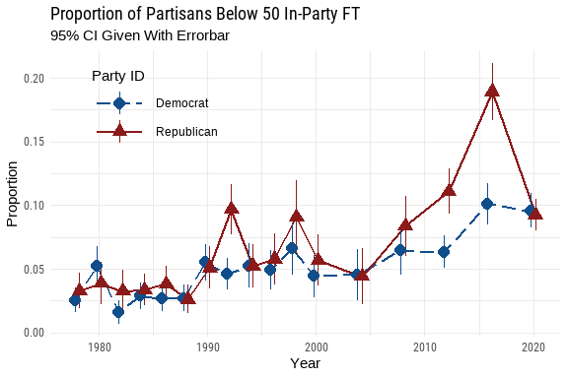
Proportion of cold partisans by party-year

Slide 6
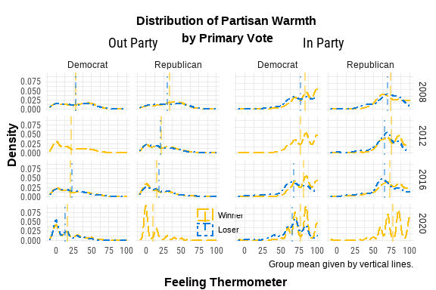
Distribution of partisan affect between primary candidate supporters 2008–2020

Slide 7
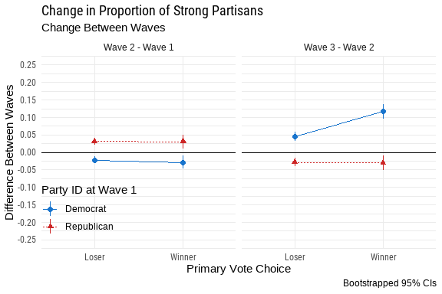
Three-wave test of primary outcome and strong partisanship

