Slide 1

The Efficacy of Modern Basketball Analytics in College Basketball Predictive Win-Probability Algorithms
By: Robert Mepham
Committee:
Dr. John Vile – Chair
Dr. Ramchandra Rimal - Advisor

Slide 2
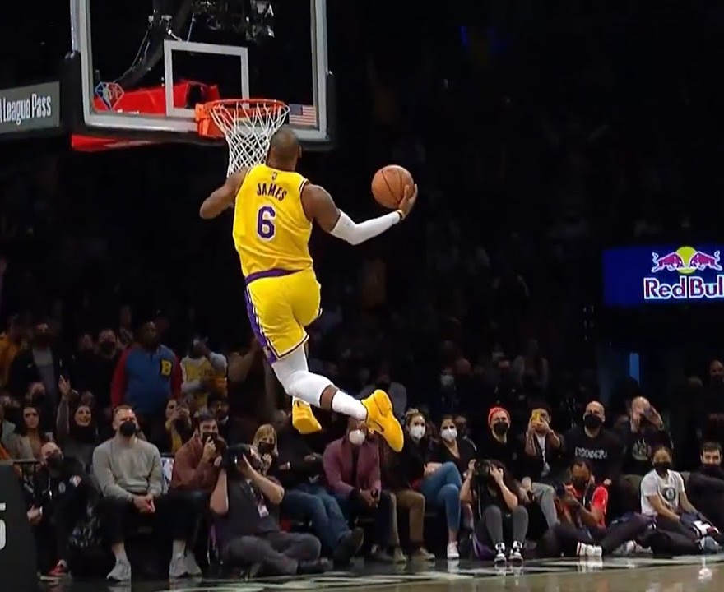
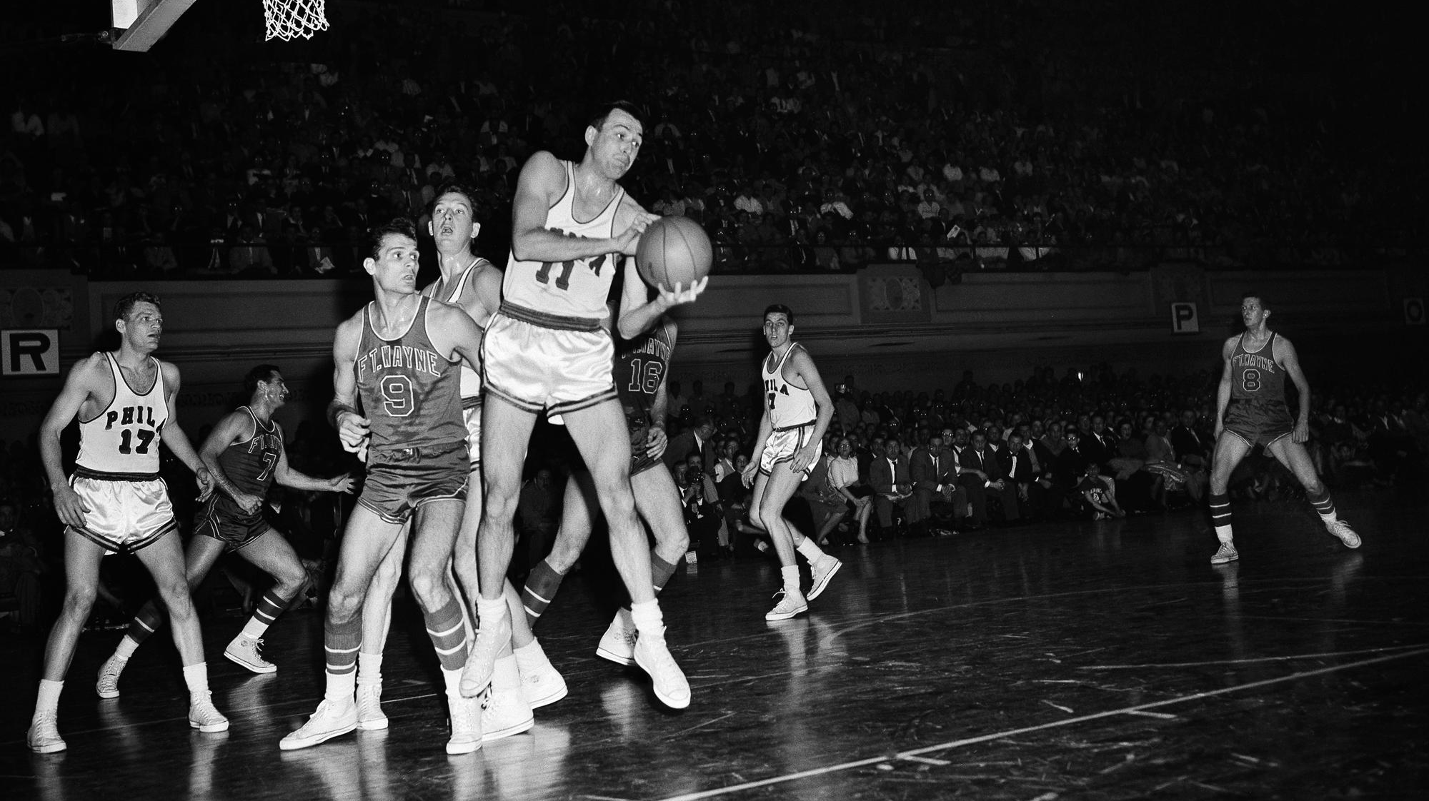
The Game Then vs. Now
Image Sources:
https://www.youtube.com/watch?v=HhOcZt61oxA
https://apnews.com/article/nba-sports-basketball-bob-cousy-naismith-memorial-basketball- hall-of-fame-2646c826182860a71240817e019cedb7

Slide 3
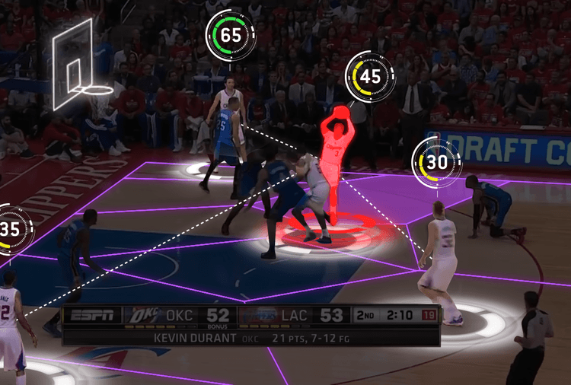
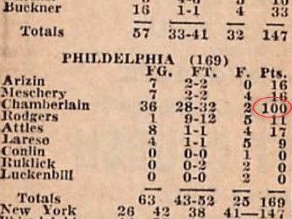
Analytics Then vs. Now
Image Sources:
https://www.businessinsider.com/every-nba-box-score-2012-1
https://d3.harvard.edu/platform-digit/submission/how-data-analytics-is-revolutionizing-the-nba/

Slide 4
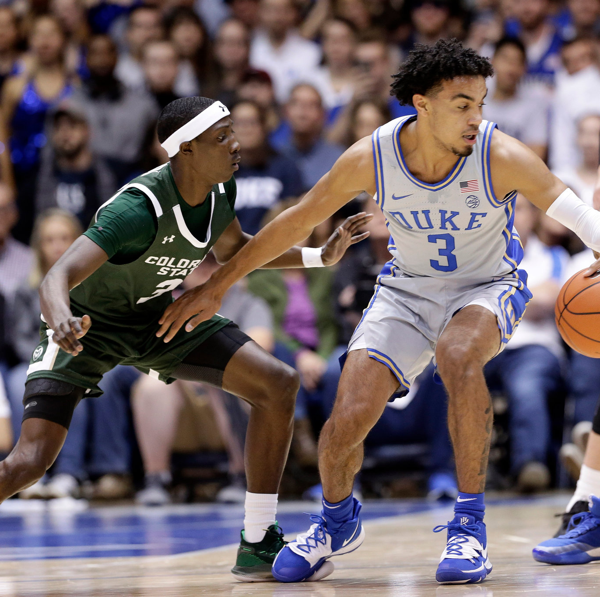
Importance Of Study
The Sports Betting Is Now an $86.5 Billion Industry (2022)
College Basketball Teams Are Spending ~$10,000 to $1,000,000 pers season on analytics
Image Source: https://www.nytimes.com/2019/11/16/sports/ncaabasketball/teams-to-watch-college-basketball.html

Slide 5
Introduction
Research Question:
Can quantitative statistics be used to model the outcome of collegiate basketball games? If so, which machine learning algorithm and hyperparameters work best.
Sub-Points
Which Statistics Are Significant Predictors?
How many previous games should we consider?
Which ML Algorithm Is Best?
Are ‘traditional’ statistics or ‘modern’ statistics better

Slide 6
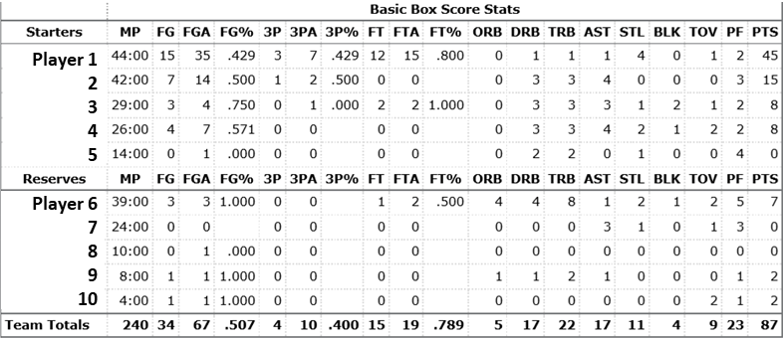
Introduction To The Data – Basic Box Score

Slide 7
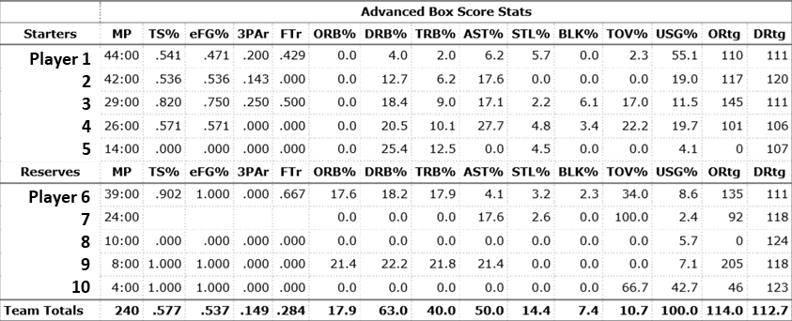
Introduction To The Data – Advanced Box Score

Slide 8
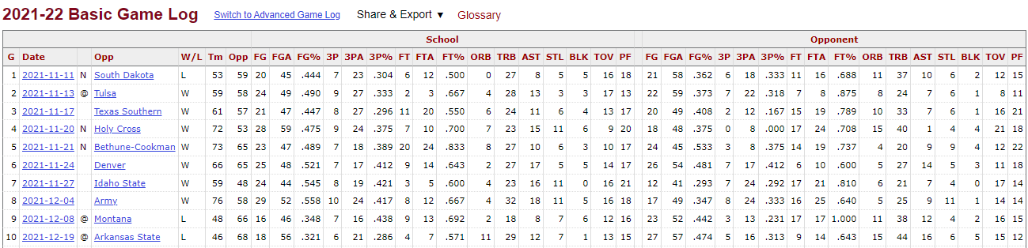
Game Log Data – Basic Box Score

Slide 9
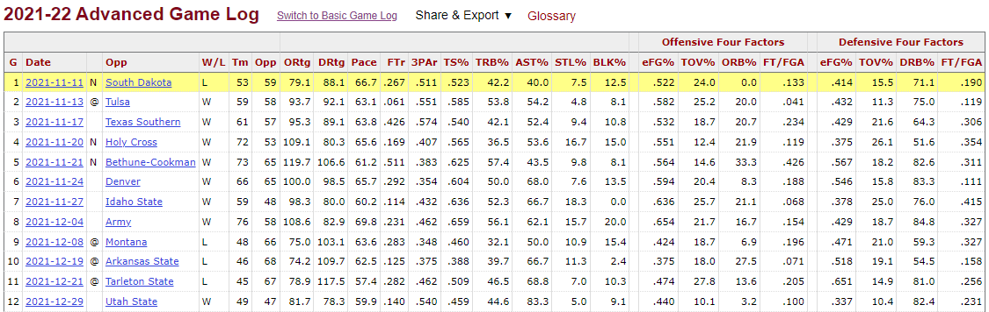
Game Log Data – Advanced Box Score

Slide 10
Metadata About The Data
Team Data (Bas & Adv)
Season-Long Average Performance For Every D1 Team Since 2010
Currently 358 D1 Teams (2022)
3532 Team-Seasons
Basic Statistics -> p = 42
Advanced Statistics -> p = 28
Gamelog Data (Bas & Adv)
Every Single D1 Game Since 2010
137872 Game-Sides (68,936 Games)
Basic Statistics -> p = 42
Advanced Statistics -> p = 28

Slide 11
Methodology – Season-Long W/L%
Candidate Models:
LASSO Regression
Random Forest Regressor
AdaBoost Regressor
Hyperparameters:
Basic vs. Advanced Statistics
Training/Testing Split
Train: 2010-2021 Season Test: 2022 Season

Slide 12
Methodology – Game Simulation
Candidate Models:
Logistic Regression
Random Forest Classifier
AdaBoost Classifier
Hyperparamters:
Optimal ML Algorithm
Basic vs. Advanced Statistics
Optimal Lag Term
Optimal Subset of Predictors
Training/Testing Split:
Train: 2010-2021 Season
Test: 2022 Season

Slide 13
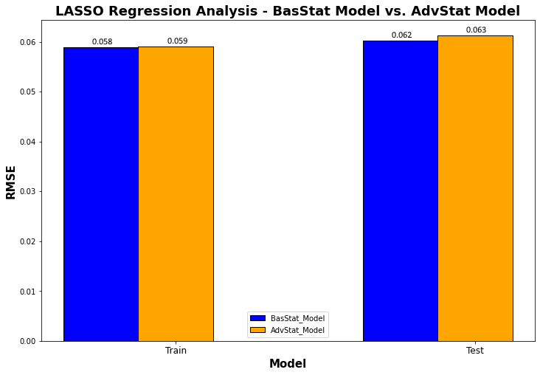
Results – Season-Long W/L% Model

Slide 14
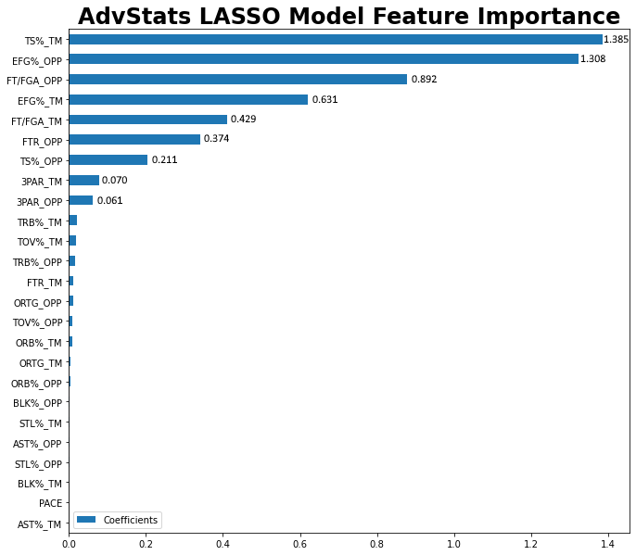
Significant Predictors

Slide 15
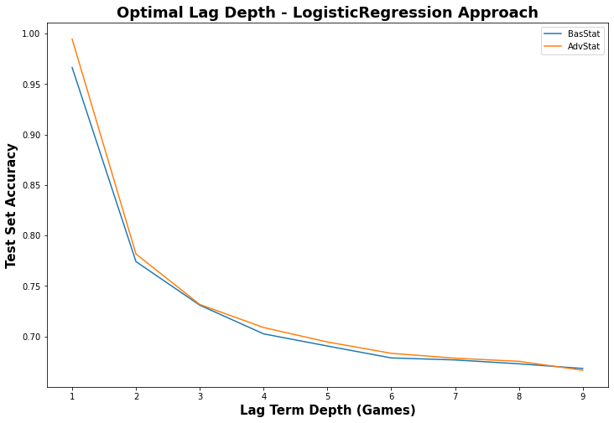
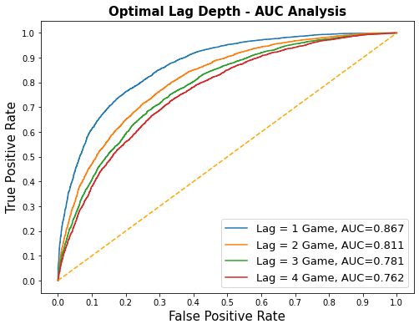
Results – Game Prediction Model

Slide 16
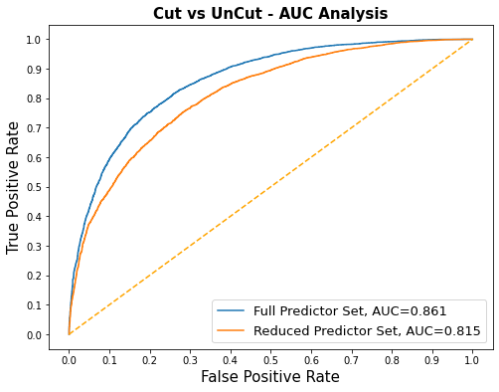
Results – Game Prediction Model
Full vs. Reduced Predictor Set
Full Predictor Set Performs Better

Slide 17
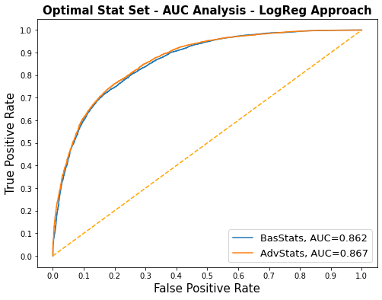
Results – Game Prediction Model
Base Box Score vs. Advanced Box Score
Advanced Stats Are Better

Slide 18
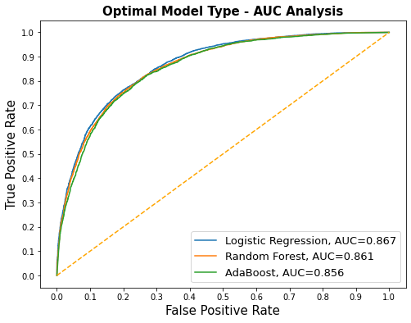
Results – Game Prediction Model
Optimal ML Algorithm
Logistic Regression

Slide 19

Recap Of Optimal Models
W/L% Model
Model Type: LASSO Regression
Lambda ( ) Value: 1E-16
Predictor Set: AdvStats
Significant Predictors:
TS%
eFG%
FT/FGA
TS%_OPp
eFG%_Opp
FTr_Opp
FT/FGA_Opp
Game Simulation Model
Model Type: Logistic Regression
Lag Depth: 1 Game
Predictor Set: Adv Stats
Number of Predictors: Full Set

Slide 20
Discussion
3 Deployable Models
Team Evaluation: Predicted W/L% Given Average Performance
Game Simulation: Predicted Win-Probability Given Previous Game’s Data
Game Recap: Predicted Win-Probability Given That Game’s Data
Special Use Case

Slide 21
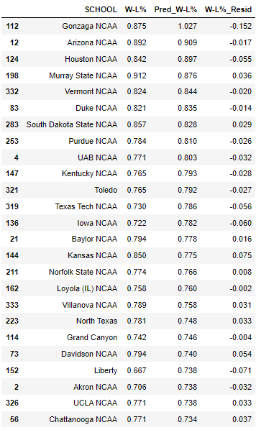
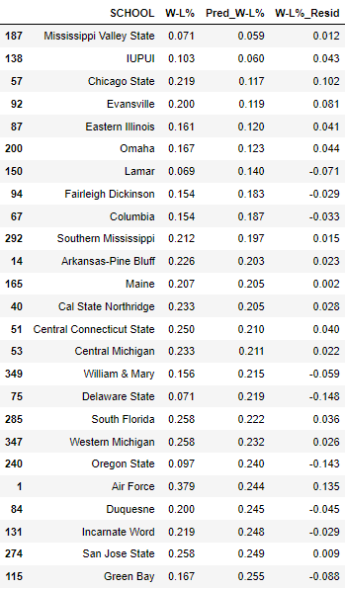
W/L% Model
Lowest Predicted W/L% In 2022
Highest Predicted W/L% In 2022

Slide 22
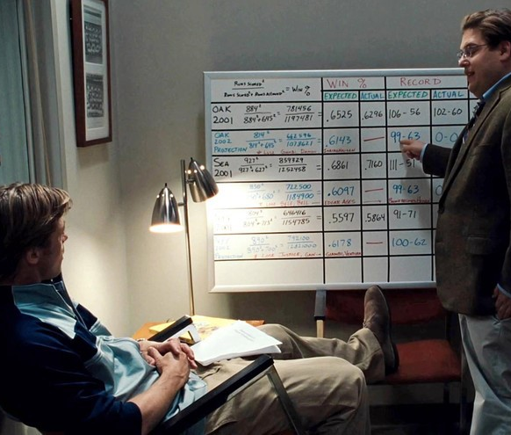
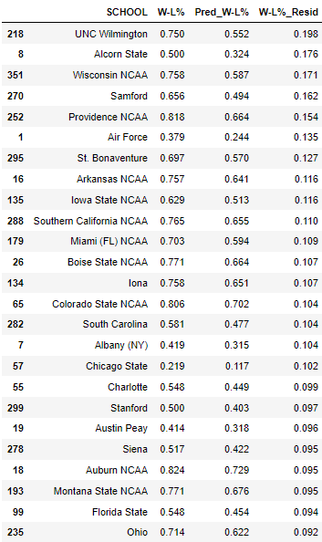
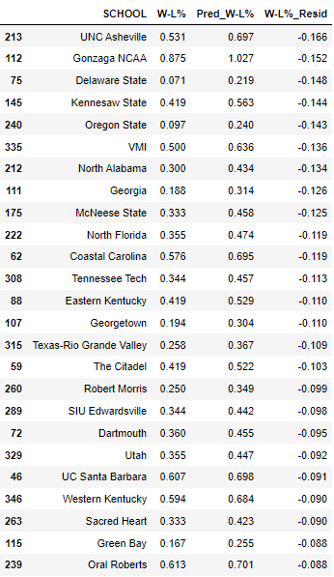
W/L% Model - Residuals
Most Underperforming Teams
Most Overperforming Teams
Most Underperforming Teams
Image Source: https://medium.com/world-of-ai/leadership-in-ai-watch-moneyball-85125c81e54d

Slide 23
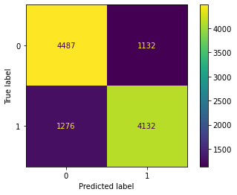
Game Simulation Model
Test Set Results For 2021-22 Games
Accuracy: 0.7816
Precision: 0.7849
TPR: 0.7640
FPR: 0.2015

Slide 24
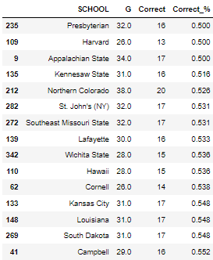
Worst Case Scenario…

Slide 25
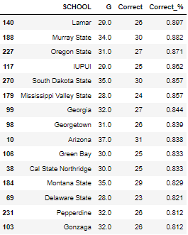
Best Case Scenario…

Slide 26
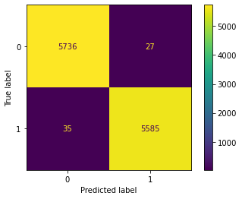
Game Recap Model
Test Set Results For 2021-22 Games
Accuracy: 0.9969
Precision: 0.9952
TPR: 0.9938
FPR: 0.0047

Slide 27
What’s The Use-Case Of This Model?
For Use By Coaches In Post-Game Analysis
Can Answer The Following Types of Questions:
Would We Have Won If We Took X-More 3-Pointers?
Would We Have Won If We Grabbed X-More Offensive Rebounds?
Would We Have Won If We Looked To Run More Iso-Plays Instead Of Passing?
Etc.

Slide 28


MTSU Case Analysis: 2021-22 Season

Slide 29
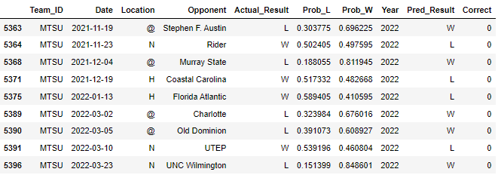




Game Simulation Model MTSU Played 37 Games Model Correctly Predicted 28 Games

Slide 30
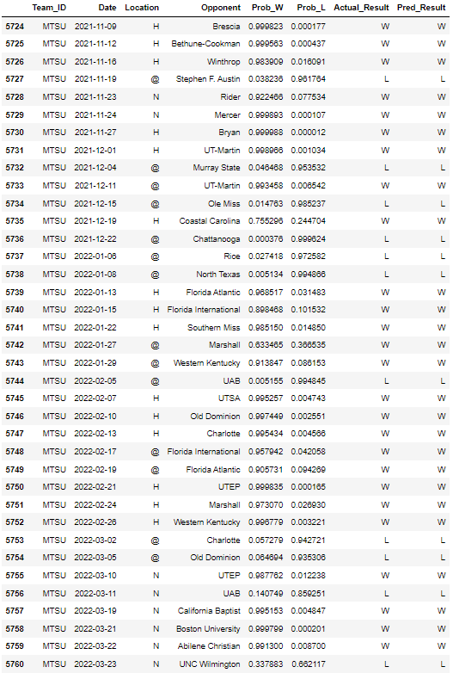
Post-Game Analysis Model
2 Losses Jump Out
3/11 vs. UAB
Result: L
p(win) = 0.140749
3/23 vs. UNC Wilmington
Result: L
p(win) = 0.337883

Slide 31
Limitations Of This Study
Access To Advanced Statistics pre-2010
Sparse Box Score Data pre-2010
Limited Computing Power For Exhaustive Neural Network Fitting
i7 CPU, 16 GB RAM, etc.

Slide 32
Future Direction Of Study
Additional ML Algorithm Approaches
Support Vector Machines
Leverage Principal Component Analysis To Reduce Dimensionality
Neural Networks
Unsupervised Learning Techniques
Additional Data Sources
Explore How Many Popular College Basketball Ranking Algorithms Correlate w/ Game Outcome
E.g. -> KenPom, Sagarin Index, ESPN RPI, etc.

Slide 33
Sources
https://www.sports-reference.com/cbb/schools/abilene-christian/2022-gamelogs.html
https://www.sports-reference.com/cbb/schools/abilene-christian/2022-gamelogs-advanced.html
https://www.sports-reference.com/cbb/seasons/2022-school-stats.html
https://www.sports-reference.com/cbb/seasons/2022-advanced-school-stats.html
https://www.npr.org/2022/06/18/1104952410/sports-betting-ads-sports-gambling

