Slide 1
Evolving The Punt Play
A proposal to reduce injuries while maintaining the integrity of the game
NFL 1st and Future / Kaggle Challenge
January, 2019

Slide 2
Our objective:
Evolve the way that players and coaches approach punt plays by incentivizing safer play and minimizing the potential for unnecessary* high velocity collisions.
*We define unnecessary as plays or actions on the field that have little impact on the game outcome or excitement of the game.

Slide 3
Understanding the punt play role in football
Football is a physically demanding and brutal sport. We should not attempt to eliminate all risk of injury but instead focus on moments of unnecessary risk.
The punt play currently has the potential for being some of the most exciting and momentum changing moments in a football game. We understand this and attempt to present rule changes that maintain the integrity of these plays.
Special teams players are often highly specialized positions who have spent their lives honing their skills. We want to avoid removing the ability for these players to showcase their talent.
While researching this project we were able to consult with College Football Hall of Fame coach Frank Beamer - known for his innovative approach to special teams. He passionately stated the importance of punt plays in football and stressed that the integrity of the game must be considered for any rule changes.

Slide 4
Our Analytical Approach
High Level understanding of all punt play data
Result of Punt play, common penalties, punt and return distances
Focused analysis of punt plays involved in concussions
Analysis of Fair Catch vs. Punt Returns
Analysis of Single/Double/Hybrid Coverage
Physics based approach to calculating player risk
Develop data drive rule changes:
Support solution efficacy
Support game integrity

Slide 5
Understanding the problem
Before forming opinions, in depth exploration of the data was conducted
Statistics on All Punt Plays
Understand Concussion Plays
Define “Risky Plays”
High level overview of all punt plays.
Result of plays and penalties
Punt and return distance
Fair catch / return
Analysis of Formations
Visualize player path by position.
Detailed review of concussion plays.
Review video footage
Plot player routes and positions during play.
Visualize the speed and direction of players during play.
Using Next Gen Stats data paired with a fundamental understanding of physics we can determine moments when players are at risk of high velocity collisions
Determine moments of high injury risk
Identify situations where risk is high but unnecessary.

Slide 6
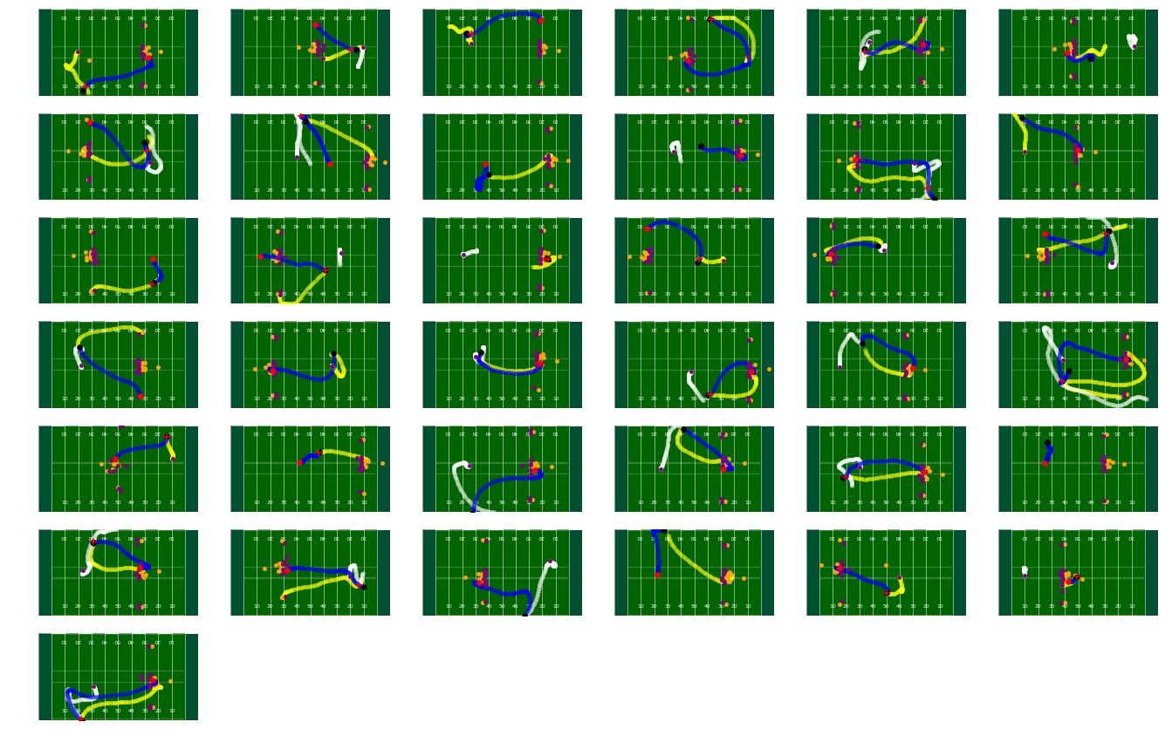
Understanding concussion plays
Every play is unique in some way!

Slide 7
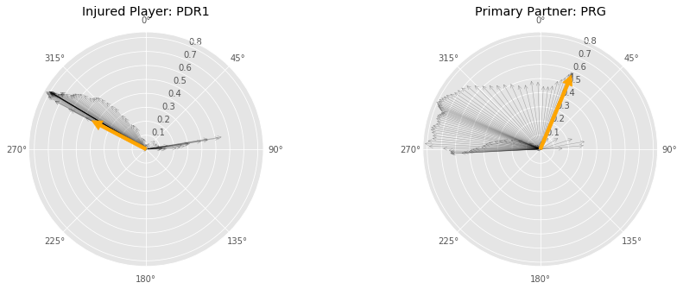
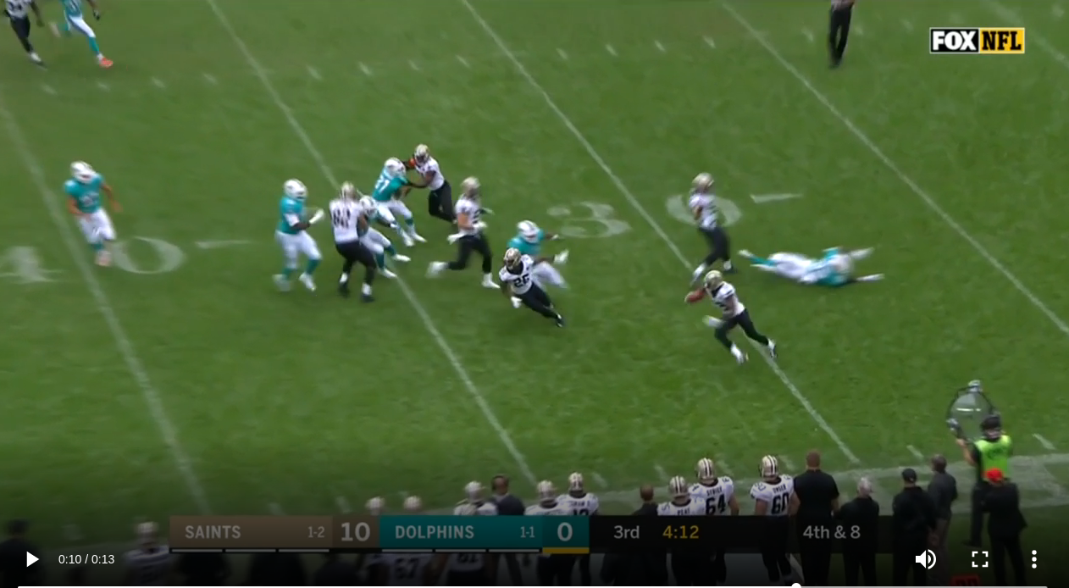
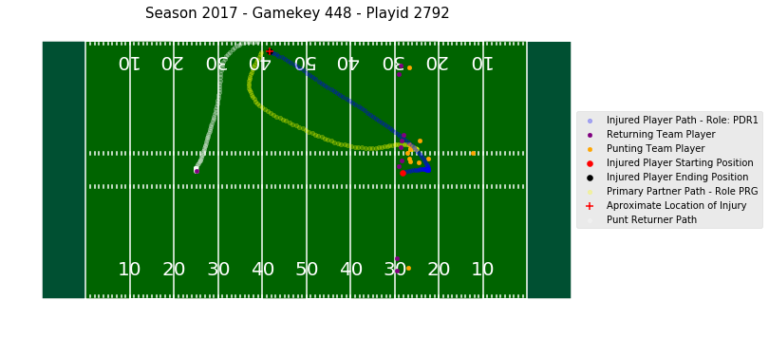
Understanding 37 Concussion Plays
Video Footage + Formations & Player Paths + Player Movement Patterns

Slide 8
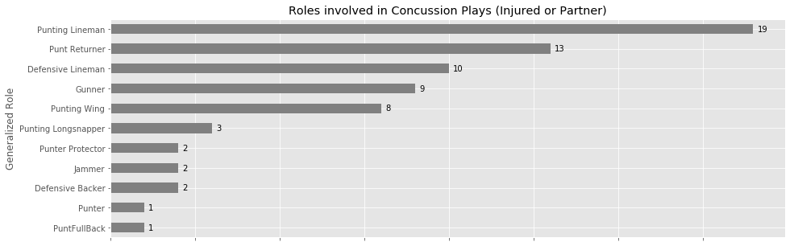
Roles of Players Involved in Concussions
Focus on Punting Team’s Linemen and Punt Returners as the data shows they are typically involved in injury plays.

Slide 9
Common Trends for Concussion involved Plays
Concussion a result of:
Direct hit on punt returner (13 Plays)
Hit on player in pursuit of punt returner (9 Plays)
Contact near line of scrimmage (3 Plays)
Gunners friendly fire when tackling returner (2 Plays)
Player fall / contact with ground (2 Plays)
Other/Inconclusive (8 Plays)
Fake Punt
Unclear from video

Slide 10
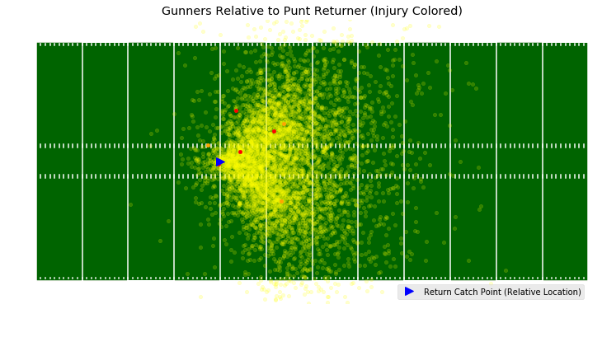
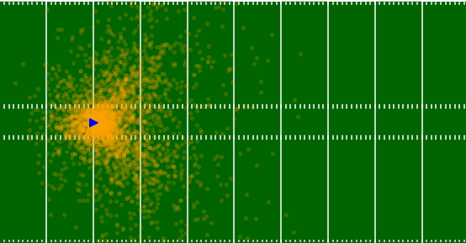
Fair Catch vs Returns
Punt returners are currently incentivized to only make a fair catch when coverage team’s gunners are extremely close to returner at the time of reception. - Median distance of 3.19 yards on fair catch - Median distance of 10.03 yards on return
Punt Returned
* Gunners Relative Position at Point of Catch
red and orange indicate involved in concussion
Punt Fair Caught
* Gunners Relative Position at Point of Catch

Slide 11
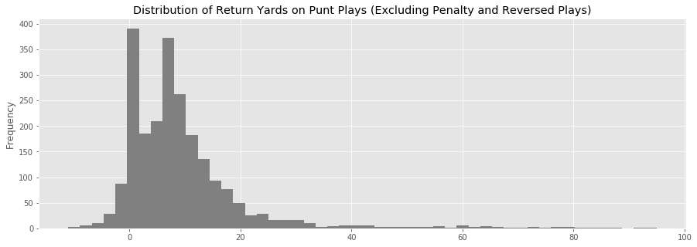
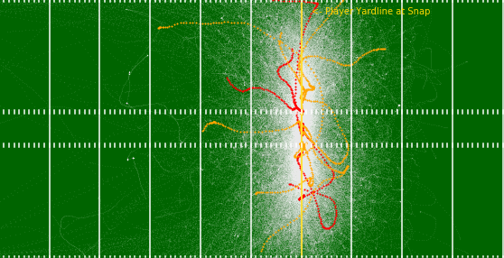
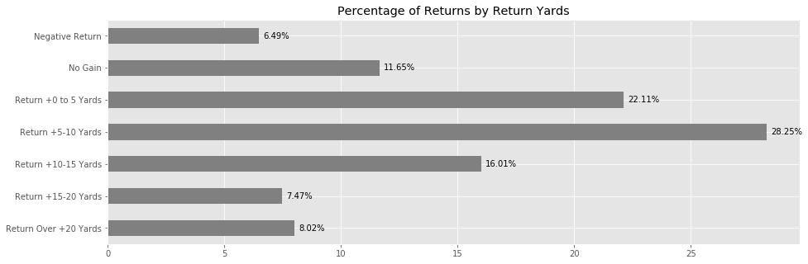
Punt Returner Routes
Punt returners tend to run sideline to sideline, with 19% of returns for no gain or negative yards.
Punt Returner Routes Visualized
*Injured Routes Red / Primary Partner Orange / All Others White

Slide 12
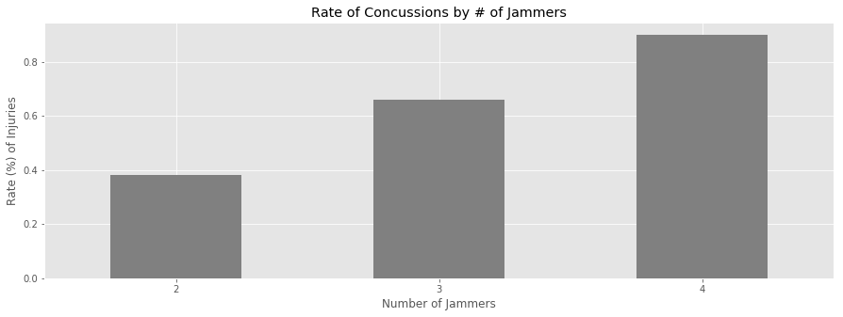
Double Teaming of Gunners
The rate of concussions when there are 4 jammers is more than double the rate then when there are 2 jammers
Rate of Concussions by # of Jammers

Slide 13
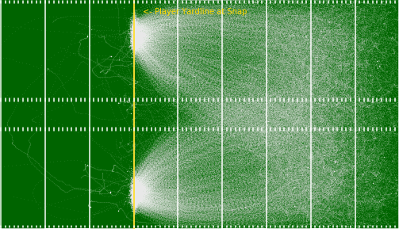
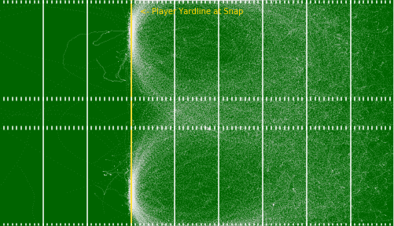
Gunners Routes when Single/Double Teamed
*Injured Routes Red / Primary Partner Orange / All Others White
The data clearly show gunners run very different routes when double covered vs single covered
Gunner Routes - Single Coverage
Gunner Routes - Double Coverage

Slide 14
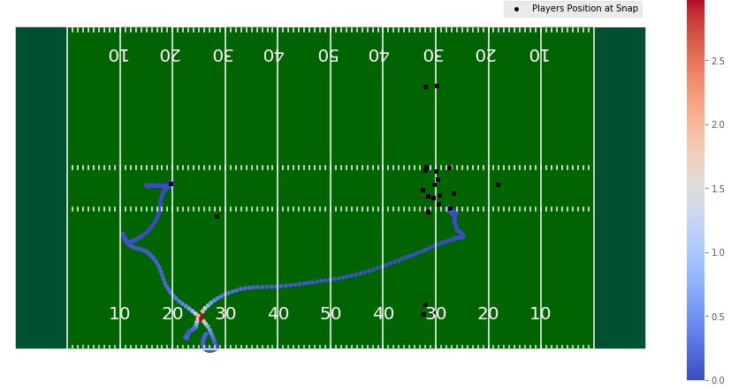
Physics approach to calculating player injury risk
Using simple understanding of physics we computed a Normalized Injury Risk metric of every combination of two players, for every datapoint (1 per 0.1 second), during a play.
Calculated Using:
Angular Momentum for every player at every moment of the play.
Distance of every in relation to each other
Over 2.8 Million combinations were evaluated.
Example visualization of injury risk

Slide 15
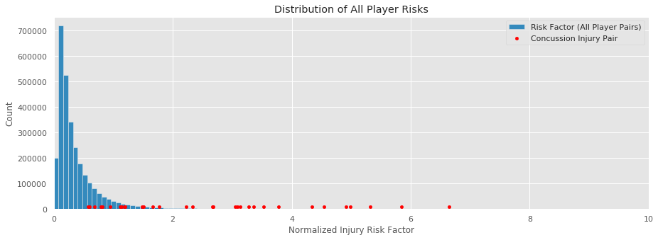
Injury Risk Metric and Play Outcome
Nearly all concussions occured when our Injury Risk metric was high for the pair of players involved in the injury.
Red dots indicate injury risk calculated for pairs involved in a concussion
Typical injury risk level of two players on punt plays

Slide 16
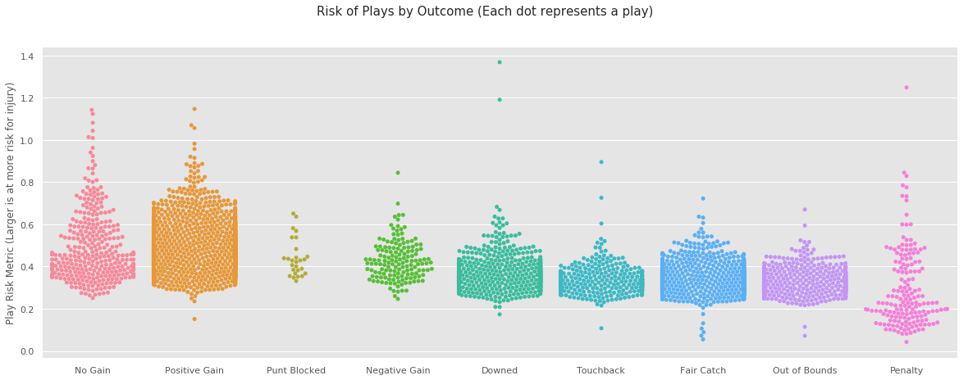
Injury Risk Metric and Play Outcome
Plays with high risk of injury that could be avoided
Fair Catches are not Risky
Injury Risk Increasing
Lower Risk of Injury
Higher Risk of Injury

Slide 17
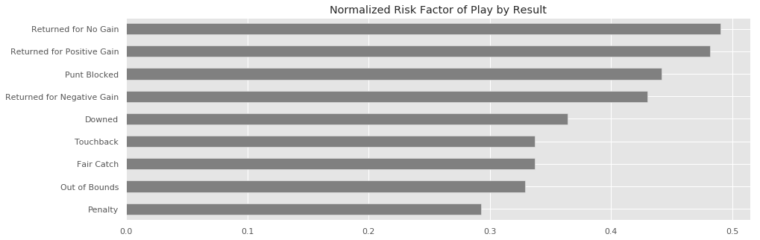
Injury Risk Metric Findings
Plays returned for no gain and positive gain have similar injury risk factors.
Fair catch and punts out of bounds have the lowest risk factors.
Therefore, incentivizing an increase in fair catches is one of the most effective ways to impact player safety.
Our model also shows a strong correlation between the number of jammers and the play’s risk

Slide 18
Narrowing the Focus of the Rule Change
1. Incentivizing punt returners to choose the safer play.
The data show that currently the incentives for fair catches does not promote safe plays. In contrast to kick returners who can choose to down kickoffs and are rewarded with 25 yards of positive field position, punt returners gain little incentive for fair catches.
2. Add verbiage to defenseless player rule to cover punting players in pursuit.
The data also show that punting linemen are the most likely to be involved in a punt play concussion. By updating the defenseless player rule officials can focus on penalizing blindside blocks on returns.
3. Eliminate or discourage double coverage of gunners.
A large portion of injuries occur when punting team linemen are able to run upfield at high velocity due to being unblocked. By eliminating double coverage of gunners, these defensive linemen would more often be blocked and hindered from high velocity collisions.

Slide 19
Rule Proposal 1
On a completed Fair Catch, the ball is awarded to the returning team 5 yards in advance of the fair catch location.
Evidence in support:
Approximately 35% of all returned punts are for less than 5 yards (ignoring plays with penalties).
On fair catches, the median distance of the closest opponent to the punt returns at the moment of the receiving the punt is roughly 3.19 yards (dangerously close) compared to 10 yards on punt returns.
Our Injury Risk Factor metric shows that plays that are Returned No Gain average the highest risk for injury and fair catches are among the plays that put players at the lowest risk for injury.
When reviewing visually the paths taken by punt returners we see a lot of sideline to sideline movement.
Conservatively we project 434 plays from two seasons would have resulted in a fair catch. These are plays that we consider unnecessary risky because they are associated with high risk of injury but produce no exciting, game-changing moments.

Slide 20
Rule Proposal 1
On a completed Fair Catch, the ball is awarded to the returning team 5 yards in advance of the fair catch location.
Impact to game integrity:
This rule's simplicity allows it to easily be implemented by the NFL.
Game dynamics will change as a result of this rule, but we believe the evolution of the punt play is necessary to increase player safety. Areas where we believe this rule change will have an impact are:
Punt returners must now consider and anticipate punting team's distance.
Coaches will need to calculate the benefits of punt returns
The new rule may increase the punting team to instead go for it on 4th down.
Punting teams may attempt "rugby" or other style punts in order to make fair catches harder to receive.
Potentially new risks to players
This added uncertainty may lead to more muffed punts, which could negate this benefit.
Punts landing near the endzone that would previously be left alone by the returning team (in hopes of a touchback) may now be fair caught. This could add some additional risk as opposed to a touchback.

Slide 21
Rule Proposal 2
Add verbiage to defenseless players to include punting team players in pursuit of punt returner during the return.
Evidence in support:
In reviewing the video footage and NGS path data of plays involving a concussion, we see that approximately 9 of these involve players that were running up-field in pursuit of the punt returner and then changed direction to follow the returner.
Only one play in the 37 provided resulted in a penalty of Unnecessary Roughness being called by officials.
Player velocity and direction data shows that many of the plays involving concussions also have players hit soon after changing direction.
We believe that by emphasizing the defenseless player verbiage to include players in pursuit of a punt returner officials would be more confident in calling roughness for these plays.

Slide 22
Rule Proposal 2
Add verbiage to defenseless players to include punting team players in pursuit of punt returner during the return.
Impact to game integrity:
This rule is actionable by the NFL, however, like all judgment calls is subject to interpretation by the officials calling the game. Our hope would be that officials, taking this as a point of emphasis would call these penalties more often therefore reducing their likelihood to occur in the future.
Potentially new risks to Players:
Punt coverage players may be more likely to put themselves at risk, believing they will not be blocked by the returning team. It is important for players to be aware of possible impact and have their "head on a swivel".
There is the potential that coverage players may gain a false sense of safety by this rule change. Still, we believe if these penalties are called correctly this will not be an issue.

Slide 23
Rule Proposal 3
When presenting a punt formation, the returning team can only have one player engaged with the punting team's gunners per gunner within 5 yards of the line of scrimmage
Evidence in support:
The data clearly shows the hybrid and double teaming of gunners significantly changes the paths taken by gunners.
The data also show that the rate of concussions increases when the number of jammers increases.
Our Injury Risk Metric is highest in plays where there are 4 jammers. Double coverage of gunners results in an imbalance on the field of offensive and defensive players in relationship to each other - allowing for punting linemen to gain more velocity and opening up the possibility for concussions.
Visualizing the routes of punting linemen and gunners we see that these players are commonly Punting Linemen 30 or more yards up field from their starting position. This shows the unblocked defenders reaching high velocity.
When modeling the injury risk of plays we find that having single coverage roles (VR and VL) is correlated with a decrease in injury risk.

Slide 24
Rule Proposal 3
When presenting a punt formation, the returning team can only have one player engaged with the punting team's gunners per gunner within 5 yards of the line of scrimmage
Impact to game integrity:
We believe this rule change would be the hardest for the NFL to implement. There are many factors to consider by both teams when deciding to line up for a punting play. When we consulted Frank Beamer he was not in favor of this rule change - saying it gave too much advantage to the punting team.
Regardless, the data points to this as a key factor and we would be remiss to not propose something surrounding the double teaming of gunners.
This rule change has the potential to be gamed by teams on fake punts. If they would like to take advantage of the one-on-one coverage. Additionally teams may show a punting formation on field goal attempts, restricting the defensive strategy on these types of plays.
While there are potential risks as a result of this change, the majority of punt plays already use single coverage.

Slide 25
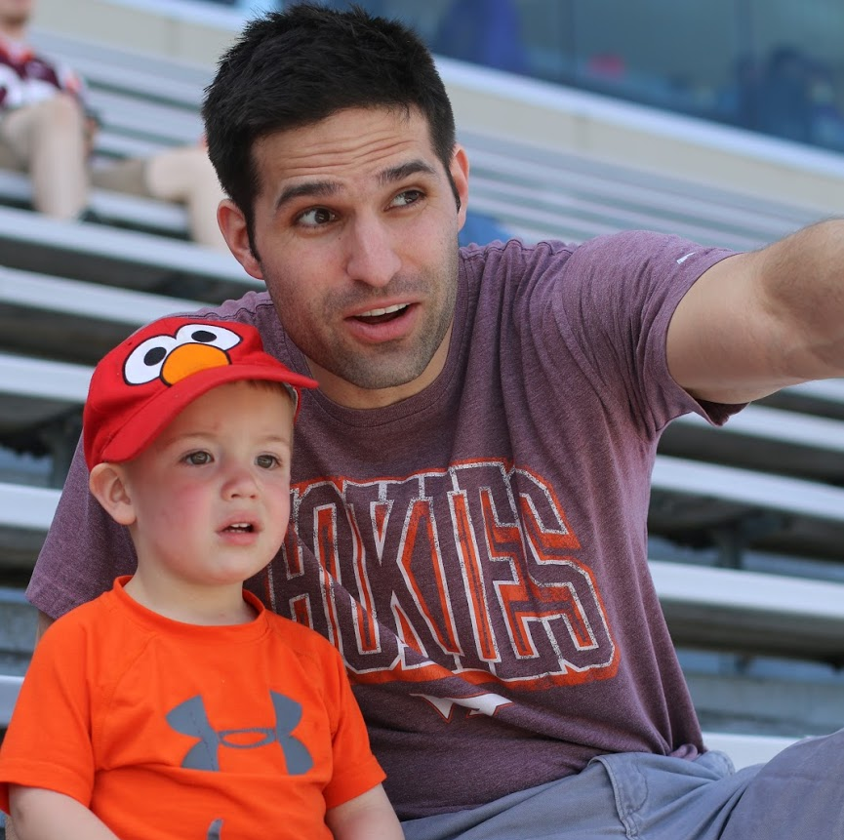
About me
Rob Mulla, Data Scientist
Data Scientist and avid football fan. B.S. in Electrical Engineering from Virginia Tech M.S. - Kansas State Masters in Information and Data Science - U.C. Berkeley

