Slide 1
JAVA versioning
Chaptermeeting 3 februari 2020
Rob Noort
https://github.com/RobNoort/java8-to-java11-demo

Slide 2
Subjects of this talk
JAVA versioning policy
Oracle versus Open JDK etc
JAVA versions
demo
ING versioning

Slide 3
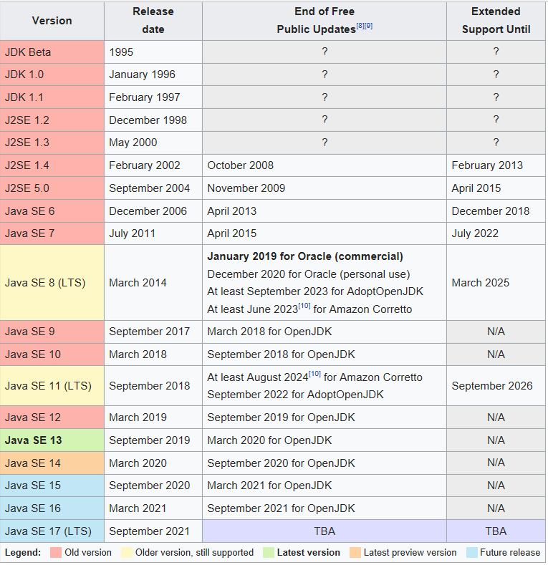
Version overview
Starting from 1995
One path until 2019
Oracle starts asking money
Choosing between

Slide 4
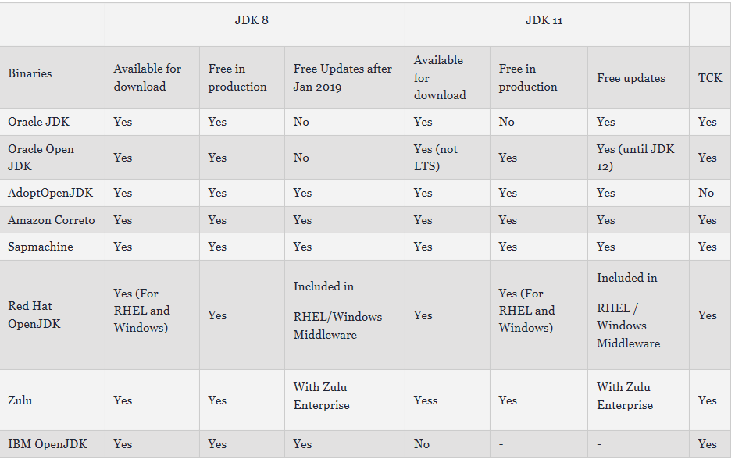
Different vendors

Slide 5
Choosing jdk after 2019: Oracle versus OpenJDK
License, no free commercial Oracle JDK
Release Rhythm
Preview features in openJDK
Performance (Oracle better)
Usage (More switching to OpenJDK)
Support
Notes:
As we mentioned, Oracle will deliver releases every three years, while OpenJDK will be released every six months.
Oracle provides long term support for its releases. On the other hand, OpenJDK supports the changes to a release only until the next version is released.
Oracle JDK was licensed under Oracle Binary Code License Agreement, whereas OpenJDK has the GNU General Public License (GNU GPL) version 2 with a linking exception.
There are some licensing implications when using Oracle's platform. Public updates for Oracle Java SE 8 released after January 2019 will not be available for business, commercial, or production use without a commercial license, as Oracle announced. However, OpenJDK is completely open source and can be used it freely.
Oracle JDK is fully developed by Oracle Corporation whereas the OpenJDK is developed by Oracle, OpenJDK, and the Java Community. However, the top-notch companies like Red Hat, Azul Systems, IBM, Apple Inc., SAP AG also take an active part in its development.
As we can see from the link from the previous subsection, when it comes to the popularity with the top companies that use Java Development Kits in their tools, such as Android Studio or IntelliJ IDEA, the Oracle JDK used to be more preferred, but both of them have switched to the OpenJDK based JetBrains builds.
On the other hand, major Linux distributions (Fedora, Ubuntu, Red Hat Enterprise Linux) provide OpenJDK as the default Java SE implementation.

Slide 6
Java 9
Jshell
Private methods in interfaces
Utility methods in Streams
Utility methods in Optionals
Collections "of" factory methods
StackWalker
Modules
Jlink

Slide 7
JShell Demo
Notes:
Start jshell "C:\Program Files\Java\jdk-13.0.1\bin\jshell.exe"
1+3
$1 zetten -> het zijn gewoon variabelen
Str -> aanvullen
import java.time.LocalDateTime -> dat kan
LocalDateTime time = LocalDateTime.now()
Ook in Intellij
Windows + zoom in

Slide 8
Private methods in interfaces
Try with resource
New optional methods
Stream news
Collectors
Notes:
Java9
Java 9 introduces the or() method that returns another Optional lazily if our Optional is empty. If our first Optional has a defined value, the lambda passed to the or() method will not be invoked, and value will not be calculated and returned:

Slide 9
JAVA 10
Local Variable Type Inference
Immutabilty helpers
Optional.orElseThrow
Improved container awareness
Open sourced root certificates in OpenJDK
Graal compiler introduced
Notes:
JVMs are now aware of being run in a Docker container and will extract container-specific configuration instead of querying the operating system itself – it applies to data like the number of CPUs and total memory that have been allocated to the container.
With Java 10, Oracle has open-sourced the root certificates in Oracle's Java SE Root CA program in order to make OpenJDK builds more attractive to developers and to reduce the differences between those builds and Oracle JDK builds. Easier to implement security

Slide 10
JAVA 11 LTS
Java HTTP/2 client
var in lambdas
Shebang
New String methods
Optional.isEmpty()
Predicate.not()
Java Flight Recorder
TLS 1.3
Reading/Writing Strings to and from the Files

Slide 11
JAVA 12
String functions indent and transform
Improved garbage collection
Java constants API

Slide 12
JAVA 13
Switch Expressions (preview)
Unicode 12.1

Slide 13
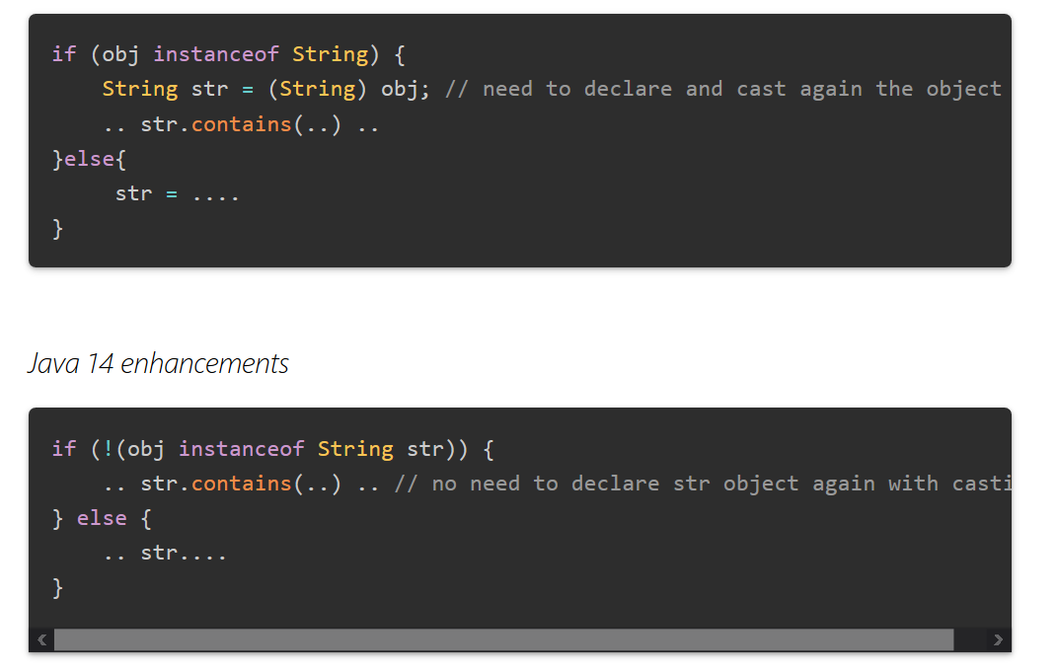
Java 14 (no demo)

Slide 14
Java 14
The jpackage tool bundles a Java application into a platform-specific package containing all the dependencies required. As a set of ordinary JAR files or as a collection of modules. The supported platform-specific package formats are:
Linux: deb and rpm
macOS: pkg and dmg
Windows: msi and exe
Swich expressions are not review anymore

Slide 15
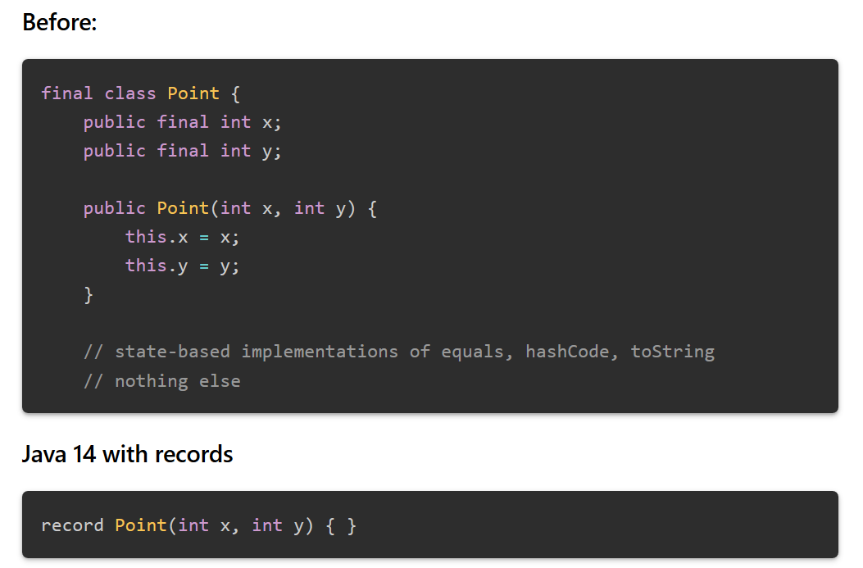
Records (preview)

Slide 16
JAVA 17 next LTS roadmap
Project Amber
Syntactic sugar
Project Valhalla
Valued types and specialized generics
Project Loom
Improving multithreading performance
Project Metropolis
JVM rewritten in Java

Slide 17
Upgrading itself
What to do
Choose way to install Java
Execute maven project to Java 11
Upgrade maven project
Tried it with
Calculate
Merak default
https://confluence.europe.intranet/display/PSEP/Java+11+running+APIs
https://developer.ibm.com/tutorials/migration-to-java-11-made-easy/
Oracle migration guides:
Migrate to 9
Migrate to 11

Slide 18
Check these out
https://www.baeldung.com/java-8-new-features
https://www.baeldung.com/new-java-9
https://www.baeldung.com/java-10-overview
https://codete.com/blog/java-8-java-11-quick-guide/
https://medium.com/criciumadev/its-time-migrating-to-java-11-5eb3868354f9
https://blog.codefx.org/java/java-11-migration-guide/
https://es.slideshare.net/YujiKubota/migration-guide-from-java-8-to-java-11-jjug
https://www.reddit.com/r/java/comments/a7kt5m/migrating_from_jdk_8_to_jdk_11/

Slide 19
Why upgrade from JDK 8 to JDK 11?
Next LTS version (if you own a commercial license).
Full support for Linux containers (Docker included).
Support parallel full garbage collection on G1.
Free Application Class-Data Sharing feature.
Free low overhead Flight Recorder and Heap Profiler.
Heap allocation on alternative memory devices.
New default set of root authority certificates.
New ZGC and Epsilon garbage collectors.
Ahead-of-time compilation and GraalVM.
Transport Layer Security (TLS) 1.3.
JShell.
Advance HTTP client
Support for “shebang” Java files! #!/bin/java

Slide 20
ING
Mattermost JAVA: Fortify is legacy and does not support it, wait for Checkmarx
Some colleagues tried it without much success
Merak is ready for it.

Slide 21
https://github.com/RobNoort/java8-to-java11-demo
https://confluence.europe.intranet/display/PSEP/Java+11+running+APIs
https://confluence.europe.intranet/display/CYRS/Java+11+experiences
https://en.wikipedia.org/wiki/Java_version_history
https://www.baeldung.com/oracle-jdk-vs-openjdk
https://dzone.com/articles/an-overview-on-jdk-vendors
https://javatutorial.net/java-9-jshell-example
https://howtodoinjava.com/java9/java9-private-interface-methods/
https://www.baeldung.com/java-9-optional And more.. Search java 9 on site
https://blogs.oracle.com/jtc/openjdk-10-now-includes-root-ca-certificates
https://mkyong.com/java/java-11-httpclient-examples/
https://www.journaldev.com/24601/java-11-features
https://stackify.com/java-12-new-features-and-enhancements-developers-should-know/
https://www.journaldev.com/33204/java-13-features
https://www.techgeeknext.com/java/java14-features#pmi

