Slide 1
Twin Cities Code Camp, April 2015
by Rob Robinson

Slide 2
Introduction
Creating games in HTML5 that run in any recent browser on any platform of any device requires planning and a few special techniques.
This paper describes the steps and techniques required to develop a simple animated game.
The goal: Use a single set of source code to detect the device and respond appropriately to setup, display and execute the game.

Slide 3
Developing an Animated Game in HTML5
Planning the scenes and interactions
Designing the layout
Detecting the device and window size
Sizing the canvas and scaling the graphics
Performing the animations
Responding to the keyboard and mouse events
Responding to touch events
Making the interactions work appropriately

Slide 4
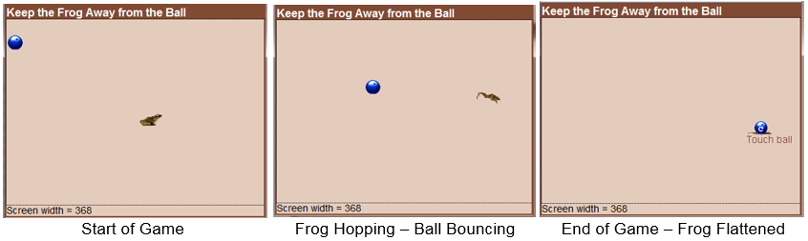
A Simple Animated Game - Bowling for Frogs
To illustrate the process a simple, animated, 2-D game is discussed.
The entire court must always be visible on any device.
The ball always bounces toward the frog.
PC and laptop users control the frog with the mouse or keyboard.
SmartPhone and tablet users control the frog by tapping or swiping.
The ball will flatten the frog if it bouces on it.
Keep the frog away from the ball.

Slide 5
Scenes and Interactions
A single scene starts with:
A rectangular two-dimensional court.
A frog placed in the center of the court.
A bowling ball in the upper-lefthand corner.
Types of interactions:
Keyboard and mouse events for PC and laptop users
Touch and tap events for smartphone and tablet users
Timer events that are used to create the animations

Slide 6
Event Responses
On the first user event
Continuous timer events are scheduled for constant intervals.
The ball will detect the location of the frog and start a 3-frame bounce.
The frog will start a 3-frame hop in the direction indicated by the user.
After each hop and bounce if no new user event occurs.
The ball detects the location of the frog at the end of each bounce and resets its direction for the next bounce
If the ball touches the frog it will be flattened and the game will stop.
The frog starts its next hop and the ball starts its next bounce.
When a new user event occurs.
The frog will change it's direction as indicated by the user event

Slide 7
Planning the Screen Size
A 700 x 500 pixel court will be ideal for devices that provide at least that much space.
Scrolling must be prevented to keep the full court visible at all times.
On smaller devices, the screen must be scaled appropriately.
All images must be scaled to match the reduction in screen size.

Slide 8
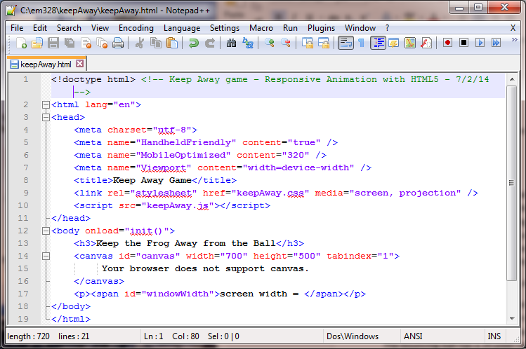
Designing the Layout with HTML5
Keep HTML code simple and format with CSS3!!!
Meta tags for mobile devices
Links to the style sheet and JavaScript code
Page heading
Canvas tag with default ideal size. tabindex="1" will direct keyboard events to the canvas.
Span tag is for debugging only.

Slide 9
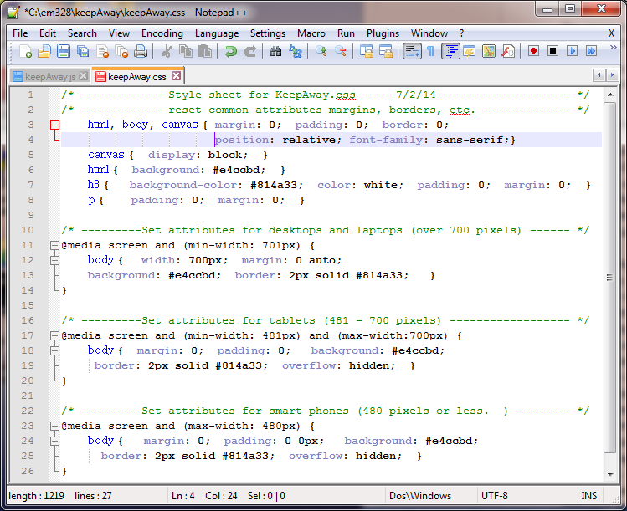
Detecting Window Size with CSS3
Window size queries usually work better than device detection.
Common formatting for all screen sizes
Media queries detect the device screen size
Devices with more than 700 pixels (PCs) will have a body width of 700 pixels
Tablet-size devices can have their own set of formatting styles
Phone-size devices can have their own styles.

Slide 10
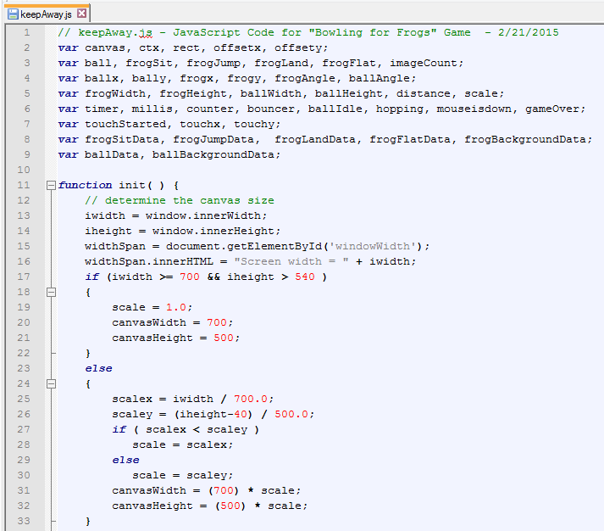
Sizing the Canvas with JavaScript
The canvas size and scaling factor are adjusted to fit the window size
Determine and display the available window size
Large window sizes will use the default 700x500 pixel canvas with a scale factor of 1.0
Scale factors are computed for both the width and height.
The smallest of the two scale factors is used, so the canvas will fit in both the width and height of the window.

Slide 11
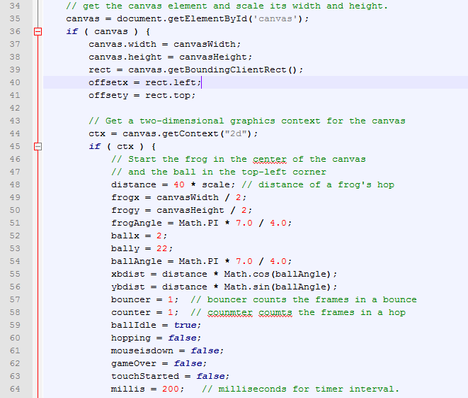
Scaling the Graphics
All graphics and movements must be scaled to fit the canvas size
Get a reference to the canvas and resize it.
The offset values indicate the top and left margins where the canvas was placed.
The context object provides methods and properties for drawing on the canvas.
All movements and images must be scaled to the screen sizes.
Default directions and distances are used for the first hop and bounce.
Counters and logical variables are used to determine the actions for each timer event.

Slide 12
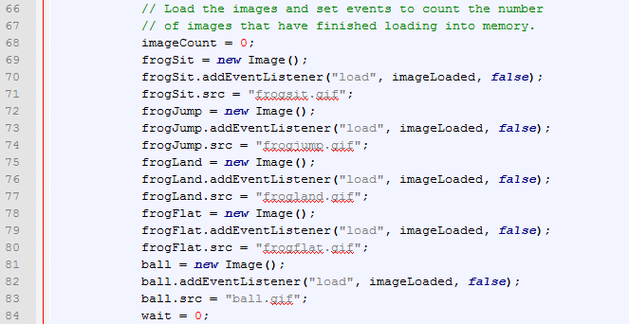
Loading Images
All images must be completely loaded before they are displayed on the canvas.
ImageCount will count the number of completed images.
The imageLoaded function will be called when each image is completed. The program must wait to display the initial images until all five have been loaded.

Slide 13
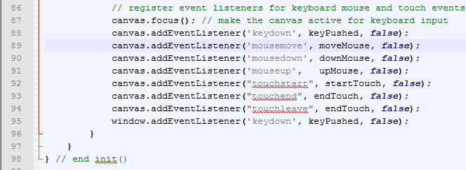
Registering Event Listeners for User Actions
EventListeners must be added for each type of user interaction.
keyPushed handles key events when the canvas is active.
moveMouse, downMouse and upMouse handle mouse events.
startTouch and endTouch handle touch, tap and touchLeave events
keyPushed also handles key events from the window.

Slide 14
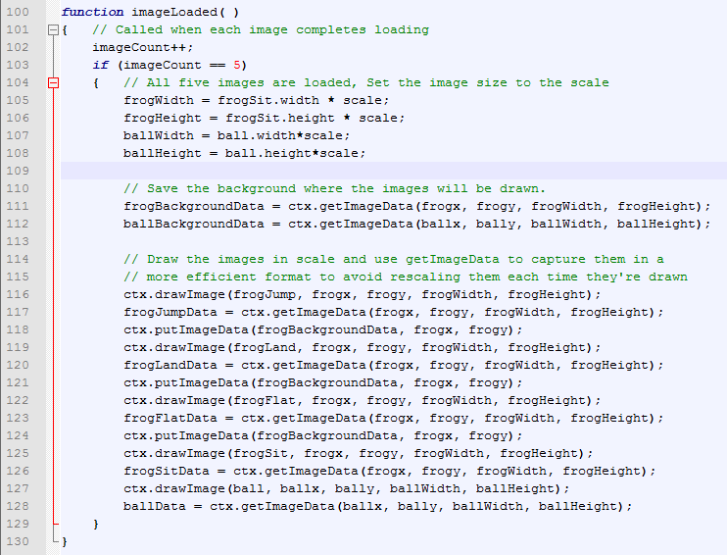
Responding to the ImageLoaded Event
ImageLoaded is called each time an image is completely loaded.
ImageLoaded will only increment imageCount and return until all five images have finished loading.
The width and height of the images are scaled to match the screen size then displayed on the screen.
The backgrounds are saved where the images will be drawn.
Each image is drawn to scale then captured as ImageData for performance.

Slide 15
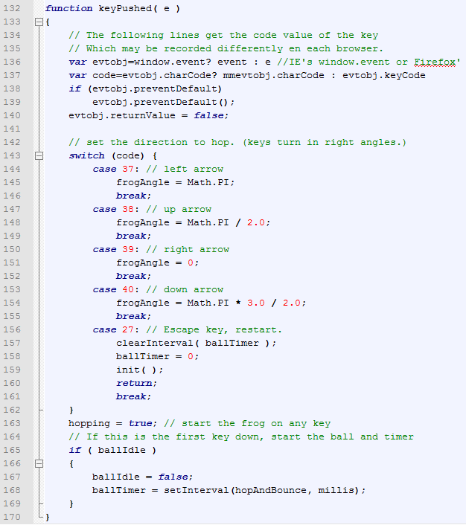
Keyboard Events
Respond to left, right, up, down and Escape.
The event object in Internet Explorer is accessed differently in Firefox.
The frog's direction will be at 0, 90, 180 or 270 degrees depending on the arrow key's direction.
The Escape key will stop the timer and restart the game.
The game starts when the first user event occurs along with the ball, frog and the timer.
Start the timer at intervals defined by millis (200 milliseconds)

Slide 16
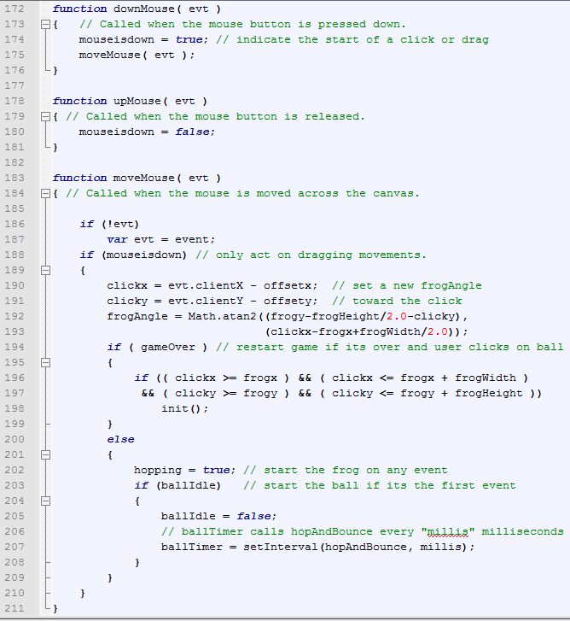
Mouse Events
Mouse Event Handlers are for PCs and laptops.
When a button is pressed down, set the mouseDownflag to true and call moveMouse.
When a button is released, set the mouseDownflag to false and return
When the mouse moves and the button is down, save the coordinates of the mouse and change the hopping angle to hop toward the mouse.
If the game is over and the mouse is on the ball, restart the game.
The first event will start the frog, the ball and the timer events.

Slide 17
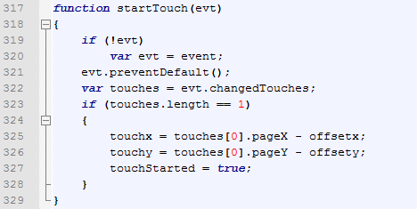
Handling the startTouch Event
Touch event handlers are for tablets and smartphones
Accessing the event object is different on different browsers.
Retrieve the array of touches that have occurred so far.
If there is only one touch in the array, record the coordinates for the start of a touch or swipe, relative to the top-left corner of the canvas (offset)

Slide 18
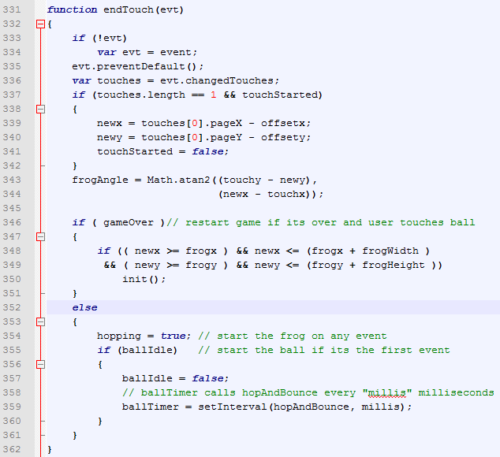
Handling the EndTouch Event
The end of the touch can be for a tap or a swipe.
Retrieve the array of touches that have occurred so far.
Save the new coordinates at the end of the touch and set the frog's angle to hop the direction indicated
If the game is over and the touch is on the ball, restart the game.
The first event will start the frog, the ball and the timer events.

Slide 19
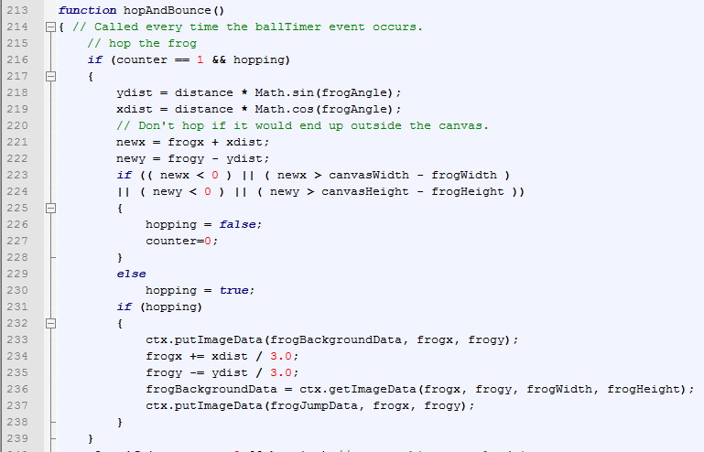
Animating the Frog - First Part of the Hop
The hopAndBounce function is called at each timer event to perform the animation sequences.
if counter is one the first part of the frog's hop will occur.
Calculate the frog's new position at the hop’s end.
Don't let the frog hop out of the court.
Erase the sitting frog image and draw the jumping frog in the new location (1/3 the distance).

Slide 20
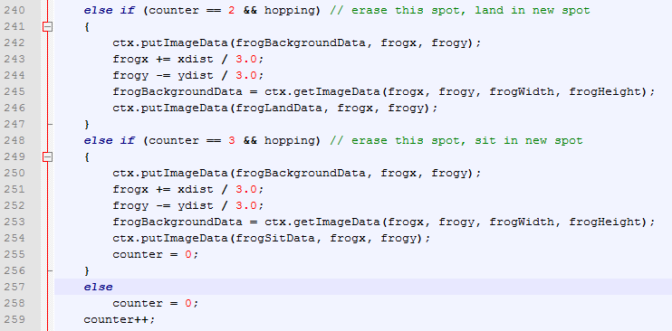
Animating the Frog - Second and Third Parts
If counter is two, the second part of the hop will occur.
Erase the jumping frog image and draw the landing frog in the new location.
If counter is three, the third part of the hop will occur.
Erase the landing frog image and draw the sitting frog in the new location.
If counter is four, reset it to zero.
increment counter for the next hop.

Slide 21
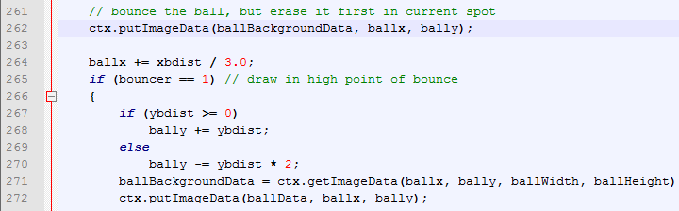
Animating the Ball - First Part of the Bounce
Erase the ball from it's current location.
Calculate the new x and y coordinates for the first part of the bounce.
Draw the ball at its new location.

Slide 22
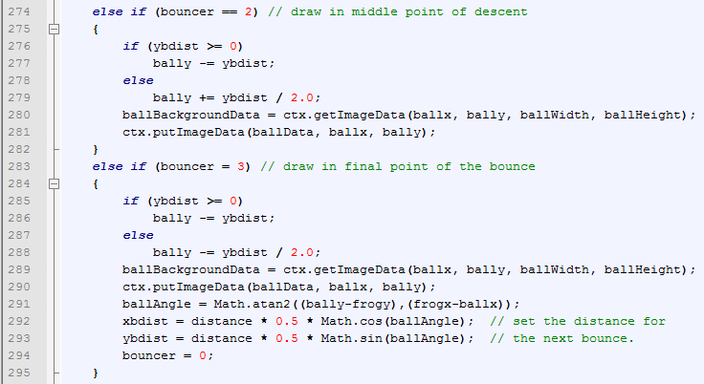
Animating the Ball - Second and Third Parts
Calculate the new y coordinate for the second part of the bounce.
Draw the ball at its new location.
Calculate the new y coordinate for the third part of the bounce.
Draw the ball at its new location.
Set the angle of the next bounce to aim it to the frog's new location.

Slide 23
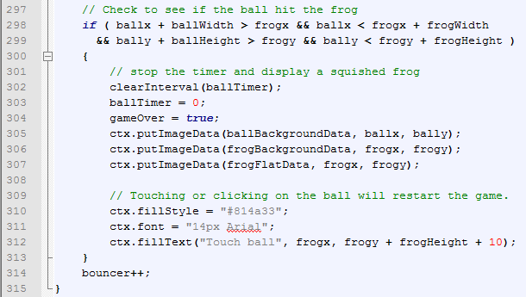
Detecting a Collision
If the ball touches the frog it's game over.
If the ball area overlaps the frog area, a collision will occur.
Stop the timer and set the gameOver flag.
Erase the current frog and ball images from the canvas and draw the flattened frog.
Tell the user to touch the ball to start a new game.
increment the bounce counter.

Slide 24
Improving the Animation
Test it on more browsers, more devices and more users.
Don't resize images at every timer event. Use getImageData to capture a resized image at initialization time and putImageData to draw the resized image when needed.
Erasing and redrawing only works on simple apps with a solid color blank canvas. Double-buffering works best with complex scenes.
Rotate the frog so it will always face the direction it's hopping.
Improving the ball bouncing so it always bounces the same height.
Add levels of difficulty
Add sound
Keep score and records
Compile the code to keep it from being pirated

Slide 25
Digging Deeper
Try it
http://www.learnmorecode.com/ra/keepAway.html
Download files.zip
http://www.learnmorecode.com/ra/files.zip
These presentation slides
12-page tutorial
Project code files (html, css and JavaScript)
Image files
Ask questions or provide advice
robrobinson47@gmail.com

