Slide 1

Classification with Decision Trees and Random Forest
Eindhoven Data Science

Slide 2

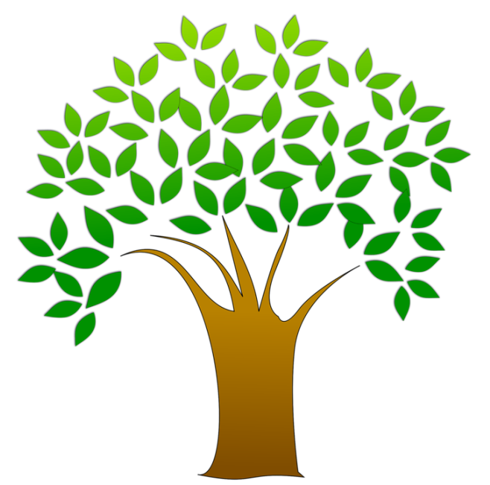
Overview
Classification
Introduction to Decision Trees
Bagging
Random Forest
Classification with Titanic data set
Notes:
http://www.freestockphotos.biz/stockphoto/15347
https://www.slideshare.net/DerekKane/data-science-v-decision-tree-random-forests

Slide 3
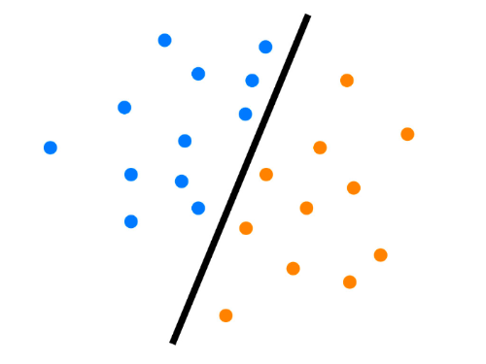
Classification
2 class task

Slide 4
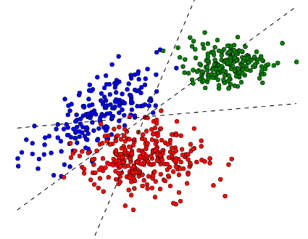
Classification
Multi-class task
Notes:
http://dalab.github.io/dissolve-struct/examples/multiclass-classification/

Slide 5

Introduction to Decision Trees
Decision Trees are a decision support tool which uses a tree-like graph of decision and their possible consequences.
A Decision Tree creates a type of flow chart which consists of nodes or leafs and a set of decisions or branches.
The leaf and branch structure forms a representation that mimic the form of a tree.
Decision Tree is one of the most widely used methods in Machine Learning and Data Science.
The algorithm can be used for classification or regression tasks.
Notes:
https://images-na.ssl-images-amazon.com/images/I/61xriayY9wL._UL1500_.jpg

Slide 6
Introduction to Decision Trees
Advantages
They are simple to understand and interpret. People are able to understand produced models after a brief explanation.
Have value even with small data. Can be generated based on data or manually constructed by experts.
Model can be tuned to be robust to noisy data.
Disadvantages
For data including categorical variables with different number of levels, information gain in decision trees are biased in favour of those with more levels.
Calculation can get very complex if a data set has many properties or outcomes are difficult to distinguish.

Slide 7
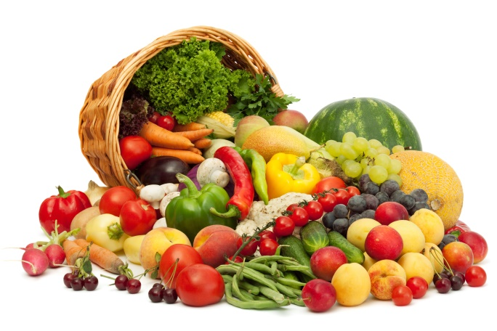

Introduction to Decision Trees
Examples of Splitting criterion
Information Gain - Criterion that uses the entropy measure as the impurity measure.
Gini index - Indicator that measure the divergence between the probability distributions of the target attribute's values.
Gini Ration - Normalizes the information gain by taking the information gain divided by the entropy.
Notes:
http://sufru.net/wp-content/uploads/bigstock-Rainbow-heart-of-fruits-and-ve-54003457.jpg
http://suppliersayurjatim.com/wp-content/uploads/photo-gallery/alami.jpg

Slide 8
Bagging
What is Bagging?
A method used to boost single trees into strong learning algorithms.
The basic workflow
Generate n bootstrap samples.
Choose randomly m inputs m << P.
Fit a tree on each bootstrap sample with the m inputs. Do not prune them.
Notes:
https://www.slideshare.net/LonghowLam/machine-learning-overview

Slide 9
Random Forest
The Random Forest algorithm builds the resulting model by taking into account a number of Decision Tree models.
It takes a random sample of data and identifies a key set of features to grow each decision tree.
These decision trees then have their error rate of the model and then the collection of decision trees are compared to find the joint set of variables that produce the strongest classification model.

Slide 10
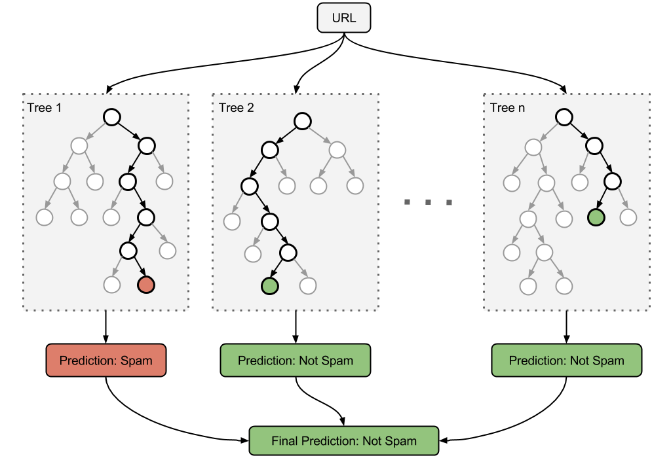
Random Forest
The Random Forest prediction is the majority vote of all trees.
Notes:
https://adpearance.com/blog/automated-inbound-link-analysis

Slide 11
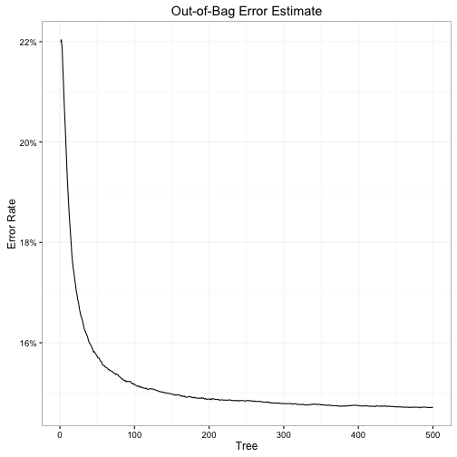
Random Forest
Notes:
http://www.bensoltoff.com/figs/2016-01-18-timeout-value-part-ii/oob_error_rate-1.png

