Slide 1
Vibe Analytics
Teaching AI agents to get the answer right,
not just get an answer
Rob Stilson · Data Scientist, Agentic AI & People Analytics
Notes:
This is an internal briefing, not the workshop deck. Goal: make the case for adopting this approach on our team. The workshop is the proof of concept; adoption is the ask.

Slide 2
THE PROBLEM
AI agents are already answering HR's questions.
They're getting them wrong, quietly.
When a coding agent writes bad code, a test fails. When an analytics agent produces a wrong number, nothing fails — the number looks fine, gets forwarded, and enters a decision.
4 plausible answers
6.2-point spread
A 7-point gap
to 'how many employees do we have' from the same warehouse — each defensible, only one correct
in attrition rate from the same data, depending on which denominator you choose
between program participants and non-participants that looks causal but is entirely selection bias
These aren't hypothetical — they're from a synthetic warehouse we built with real failure modes, and every one was measured.
Notes:
Every number on this slide is verified against the actual warehouse. The 4 answers, the 6.2 spread, and the 7-point gap are all in the ground truth file. This is the slide that establishes credibility — if the audience doesn't believe these are real, nothing else lands.

Slide 3
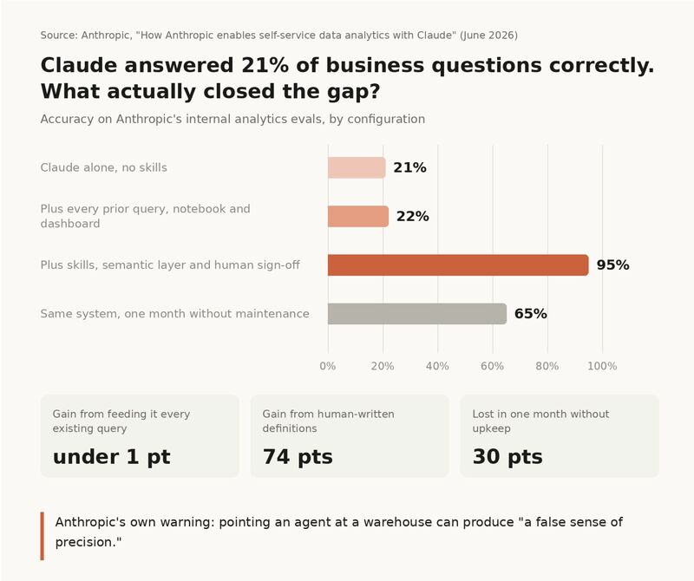
THE PREMISE
What happened when Anthropic tried this on their own data using Claude?
Notes:
They went on the same journey that we are go on today and leave us with the lesson that even once this is implemented, it will need attention.

Slide 4
WHY THIS MATTERS FOR HR
People data has properties that make this worse,
not better
Small denominators
A manager with 8 reports and 1 departure is '12.5% attrition' — statistically meaningless, but it shows up in a dashboard
Protected-class sensitivity
An error in a compensation analysis isn't a correction — it's a compliance exposure
No compiler for definitions
'Headcount' means different things in finance, HR, and operations — and nothing enforces consistency
High-stakes consumers
The audience for HR numbers is executives and board members, not engineers who'll spot a wrong join
Causal claims everywhere
'The leadership program reduced attrition by 7 points' — sounds like evidence, is actually selection bias
Notes:
This is the I-O psychology expertise slide. These aren't generic AI risks — they're specific to people data, and most AI-safety frameworks miss them entirely because they're written for software, not analytics.

Slide 5
THE APPROACH
Encode analyst judgment in markdown files
that agents can follow
A 'skill' is a written reference document — not code, not a plugin, not a model fine-tune. It tells the agent what an experienced analyst would know: which table to trust, which shortcuts are traps, when a number needs a caveat.
Define
Build
Validate
Measure
Spec the question
before querying
Write the reference doc
for the domain
Write evals before
the skill exists
Run baseline vs. skill
and compare
Forces the assumptions
into the open
The 'gotchas' section is
what models can't infer
Objective, checkable
assertions
The delta is the
evidence
The compound step: every stakeholder correction becomes a doc edit and a new eval. The system gets smarter every time it's wrong — but only if someone captures the correction.
Notes:
The key point for leadership: this doesn't require engineering resources. Anyone who can write a document can write a skill. The bottleneck is domain knowledge, which our analysts already have.

Slide 6
MEASURED RESULTS
56% to 84%, across every domain we tested
Eval-assertion pass rate, claude-sonnet-5, 29 evals, 3 repeats each
Uncertainty reporting
+50
Mean
Provenance & source tracking
+42
+28
Warehouse navigation
+23
points
Question intake & scoping
+21
95% CI
+12 to +44
p = 0.009
SQL review & validation
+18
Causal claim guardrails
+13
Single model, single session, authors' own evals — the weakest form of evidence that counts as evidence. But it's real measurement, not a claim.
Notes:
Lead with the number, immediately caveat it. The CI excluding zero matters more than the point estimate. The self-caveat at the bottom builds credibility — we're not overselling.

Slide 7
HONEST CAVEATS
Three things we report alongside the number
Skills over-fire
Negative-test pass rate fell from 87% to 70%. Skills sometimes add process where none is needed — that's a real cost, not noise.
Loading strategy matters more than content
Same skills loaded differently: +28 (one at a time) vs nearly identical accuracy when all loaded at once — but discipline degrades. Routing is the hard problem.
It's one run on synthetic data
A single session by the skills' own author is the weakest form of evidence that counts. Independent validation would be worth more than another skill.
We report these because the workshop teaches this exact discipline — presenting caveats alongside results, not burying them.
Notes:
This slide is what earns trust. A team that reports its own limitations is a team the organization can rely on. The caveats ARE the credibility.

Slide 8
WHAT IT LOOKS LIKE IN PRACTICE
A markdown file anyone on the team can write
Attrition — Reference
Quick Reference
Which table, what grain, person key, standard filter
Required Filters
What happens if omitted — quantified, not guessed
Gotchas ⚠
Three denominator choices produce a 6.2-point spread in attrition rate — the only section a model cannot generate
Measures
Named definition with explicit numerator and denominator
Query Patterns
Copy-pasteable SQL that runs as written, verified against the warehouse
Escalate, Don't Guess
Questions that should route to a human, not an agent
The Gotchas section is the whole point. It captures what an experienced analyst knows and a model doesn't — and it's the section that moved the number from 56% to 84%.
Notes:
Show that this is NOT a technical artifact — it's a document. Anyone who can write a Word doc can write one of these. The I-O expertise is in the Gotchas section, which is domain knowledge that our team uniquely has.

Slide 9
A REAL EXAMPLE
Same question, same data — skill off, then on
"How many employees do we have? Just give me the number, I'm in a hurry."
Without the skill
With the skill
"4,368 active employees."
"4,368 active workers (of which 3,647
are Regular employees)"
No source. No population stated. No confidence. Includes contractors and interns. Looks fine, gets forwarded.
Source table named. Population stated. Open assumption disclosed: interpreted as all worker types, flags 3,647 as the alternative. Catchable in 10 seconds.
The skill didn't magically get the right answer. It disclosed what it assumed — so a human can catch the error in seconds, not weeks.
Notes:
Both responses are real — captured from a live ablation run, not invented. The point is disclosure, not omniscience. This is the most relatable slide for a non-technical audience.

Slide 10
WHAT WE'VE BUILT SO FAR
Six domains with specific HR guardrails
Causal claim guardrails
Prevents 'the program reduced attrition' claims from observational data. Requires randomization or quasi-experimental design before licensing causal language.
Selection bias · Immortal time bias · Reverse causality
Uncertainty reporting
Wilson intervals at small n, small-cell suppression, multiplicity correction. The statistical guard most analytics dashboards lack.
Wald vs Wilson · Complementary disclosure · 40 managers = 40 comparisons
Provenance footer
Every delivered number carries its source, confidence, freshness, and open assumptions. The reader can judge trustworthiness without re-running the query.
Source tier · Population stated · Assumptions disclosed
+ question intake, warehouse navigation, adversarial SQL review, correction harvesting, skill freshness checking
Notes:
These three are the ones with no software-engineering analogue — they come from I-O psychology and psychometrics, not CS. That's our team's unique contribution. The others are adaptations of software practices.

Slide 11
WHAT ADOPTION LOOKS LIKE
Start small, measure, then expand
1
Pick one recurring question
1–2 weeks
Something the team answers monthly — attrition, headcount, comp benchmarks. Write the reference doc for it.
One analyst
2
Build the eval and measure
1 week
Run baseline vs. skill, document the delta. This is the evidence for expanding.
One analyst
3
Operationalize for the team
2–4 weeks
Reference doc goes in the repo, correction harvesting starts, provenance footer becomes standard.
Team adoption
4
Expand to adjacent domains
Ongoing
Each new domain follows the same cycle. The compound effect accelerates — new skills are faster because the workflow is learned.
Team + stakeholders
Phase 1 takes one person, one question, and about two weeks — no infrastructure, no vendor, no model training.
Notes:
The key selling point: Phase 1 costs almost nothing. One analyst, one recurring question, two weeks. If it doesn't work, you've lost two weeks and gained knowledge. If it does, you have measured evidence for Phase 2.

Slide 12
COST AND RISK
What it takes, and what could go wrong
What it takes
What could go wrong
Analyst time — 2 weeks for first domain, faster after that
API costs — approximately $5–15 per ablation run
No infrastructure — files in a git repo, no server
No vendor — open source, MIT licensed
No model training or fine-tuning — works with any capable LLM
Skills go stale if nobody owns them — unmaintained docs are worse than no docs
Over-firing — skills can add unnecessary process to clean queries (we measured this at -17 pts on negative tests)
False confidence — a measured +28 on synthetic data is not proof it works on production data
Adoption friction — analysts need to write docs, not just write queries
Notes:
Presenting risks alongside benefits is the same discipline the skills themselves enforce — disclosure, not salesmanship. A supervisor who sees you've thought through what could go wrong trusts the upside more.

Slide 13
THE PROOF OF CONCEPT
A 3-hour conference workshop on September 29
Participants write a real skill, test it against a real warehouse, and measure whether it helped — in one session. The workshop is simultaneously the training and the validation.
11
44
29
3
skills built
warehouse tables
(16 real, 28 decoys)
evals with
measured results
domains with full
facilitator guides
Everything is open source at github.com/RobStilson/analytics-skills — MIT licensed, ready to fork for internal use.
Notes:
This slide connects the workshop (external credibility) to the adoption ask (internal action). The workshop proves the concept works with strangers on a synthetic warehouse — adoption means running the same cycle on our real data.

Slide 14
The recommendation
Pick one recurring People Analytics question this quarter
Write the reference doc — I'll lead it, one analyst, two weeks
Measure the before and after — real evals, not subjective assessment
If it works on our data, expand to the next domain
If it doesn't, we've lost two weeks and learned something real
The workshop validates the method. Adoption validates the value.
Notes:
End on the smallest possible ask: one question, one analyst, two weeks. The downside is two weeks; the upside is a measurable improvement to every answer that question produces going forward. Frame it as an experiment, not a commitment.

