Slide 1
Vibe Analytics
Reimagining the analytics lifecycle in an AI era
Define → Build → Validate → Operationalize → Monitor → Compound
3-hour hands-on workshop
Notes:
Open with the promise: everyone leaves with a working skill in their own repo, and a measured before/after from a real warehouse. Set expectation that we will run one workflow end to end rather than skim five.

Slide 2
THE PREMISE
Coding agents worked first for a structural reason
Software
Analytics
Open-ended solution space
Many valid answers
Tests, types, compilers catch errors
Wrong code usually fails loudly
Usually one correct answer
From one correct source
No deterministic way to prove it
Wrong queries run cleanly
Data is not software. Skills written for software development do not transfer.
Notes:
This is the framing that earns permission for everything else. Ask the room: who has shipped a number that was wrong and nobody noticed for weeks? Most hands go up.

Slide 3
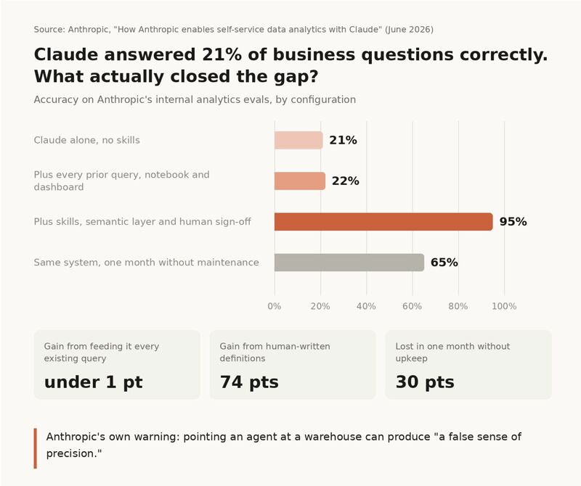
THE PREMISE
What happened when Anthropic tried this on their own data using Claude?
Notes:
They went on the same journey that we are go on today and leave us with the lesson that even once this is implemented, it will need attention.
From: https://lnkd.in/p/eY4fByDH
Anthropic pointed Claude at their own data warehouse and it answered business questions correctly 21% of the time.
So they fed it everything. Thousands of existing SQL queries, notebooks, dashboards. Every bit of institutional knowledge the company had accumulated.
Accuracy moved by less than a percentage point.
What eventually got them above 95% wasn't a better model. It was people sitting down and writing what a metric actually means.
I've built self-serve tooling before. People could get to the data on day one. What they couldn't do was tell me whether the number in front of them was the right number, because "active user" meant three different things in three different teams and nobody had ever written down which one was correct.
Two other details from their writeup.
They tried letting a model generate the metric definitions in the semantic layer. It made things worse. So now humans define and Claude documents, not the other way round.
And when the documentation stopped being maintained, accuracy dropped from roughly 95% to roughly 65% inside a month.
That second one doesn't make it onto the sales slide. Self-serve isn't a project you finish. It's something someone owns forever, and if that person leaves, your numbers quietly go wrong.
Olga Berezovsky wrote about this in her newsletter last week. Her read is that this is the clearest admission any AI lab has made that you can't point a model at a warehouse and get reliable answers out of it. I think that's right.
Most companies have never agreed on what their own numbers mean. AI just makes that disagreement happen faster.
If you've rolled out self-serve analytics, what did you have to fix first before it actually worked?

Slide 4
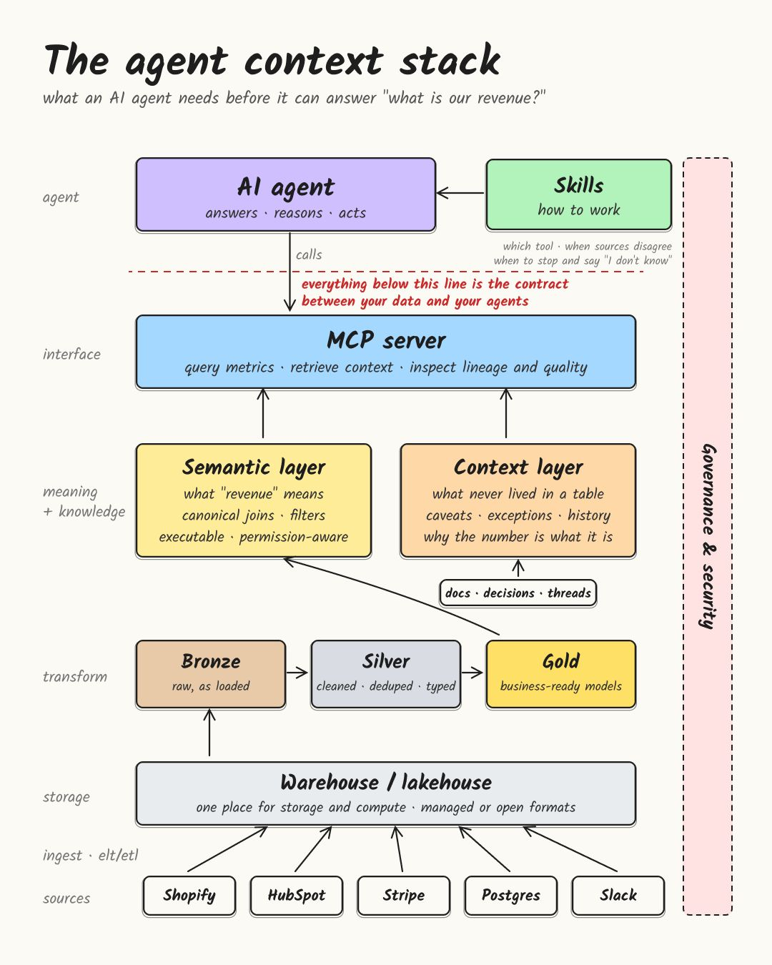
OVERVIEW
Big Picture - The Agent Context Stack
Here is what I have already created and what you can help to improve and make your own.
This is the area where we are going to spend most of today and that you will be able to customize for your own role.
We will work out of a simulated DB with Headcount, Attrition, Compensation, and Employee Engagement data
Notes:
From: https://lnkd.in/p/eHE7f8uz
Jonas Thordal
"I gave the agent the same prompt twice, and it came back with two different answers"
"The agent's numbers don't match my UI. I will keep using the UI for now, thank you"
"I don't trust the agent's answer"
I've been helping a bunch of data teams roll out agents to business users this year, and these are the kinds of comments that keep coming up. The technology has gotten much better, but adoption is still a struggle for many data teams.
The "semantic layer," and now a broader "context layer," has been gaining so much attention for a good reason. The problem isn't new. Humans needed the same context too. We just carried most of it in our heads. So we didn't "need" to do all the hard work of maintaining an "extra" layer, and focused on the very basic "need-to-haves."
If you ask me, this work has always been undervalued, but since data teams have historically been so overwhelmed with ad hoc tasks, it's understandable that it has taken a backseat.
Now, with AI agents, we want to make sure they have the same context we humans have about everything from data relationships and business definitions to exceptions to the rules, which source to trust, and why the numbers are what they are.
An analyst usually knows that "revenue" excludes refunds and test accounts. An agent doesn't know that unless you tell it. At the same time, an analyst will usually catch a bad number before it reaches the CFO. With agents, you don't have that backstop anymore, so the data and definitions the agent works from have to be right.
So what does work? This is roughly the stack I've seen work best so far ( see image below)
Give your agents the right skills, ideally one top-level skill that routes to domain-specific ones (e.g., Finance, Customer Success, Sales). Then give them a way to access semantic and broader business context, and keep the existing data foundation and permissions underneath.
Where do your agents break first: metric definitions, business context, data quality, or access?

Slide 5
DIAGNOSIS
Three failure modes, and one that hides
Entity ambiguity
Staleness
Retrieval failure
Forty plausible tables could answer 'headcount'. The agent picks one.
Definitions and schemas change. Docs and agent knowledge rot.
The right answer is documented. The agent never finds it.
Silent wrongness
The answer is wrong, looks plausible, and is used without objection. None of the three fixes above fully catch it — and nothing in your stack raises an alarm.
Notes:
The first three are tractable with better routing. The fourth is why provenance and review exist. Everything in the pack attacks at least one of these.

Slide 6
THE WORKFLOW
Five stages, and the one that compounds
Define
Build
Validate
Operationalize
Monitor
Spec the question
→
Find and query
→
Check and doubt
→
Ship with provenance
→
Watch for drift
Compound
Every correction becomes a doc edit and an eval. Skip this step and you have done traditional analytics with an AI typing for you.
Notes:
Credit Every's compound engineering for the loop shape. The fourth step is what separates this from ordinary AI-assisted work. A stakeholder correction is a labeled error diagnosed for free by someone with domain authority — throwing it away after patching the answer wastes the best signal you get.
https://every.to/guides/compound-engineering
https://github.com/EveryInc/compound-engineering-plugin/blob/main/README.md

Slide 7
THE REFRAME
A skill is markdown, not code
The agent doesn't need you to write code anymore.
It needs you to write down what you know.
Anyone can contribute
The bottleneck is judgment
Deployable Monday
A SQL analyst and a senior DS both ship a real artifact in 90 minutes
Which analysts have, and models don't
A folder of .md files, versioned in your repo
Notes:
This is the moment the room relaxes. Most arrive expecting to write Python. The hard part is domain knowledge, which they already have and have never written down.

Slide 8
THE PACK
What you're getting
11
44
29
skills
tables
evals
Full lifecycle plus two reviewer personas
Synthetic warehouse, eleven engineered traps
Pinned ground truth, six negative tests
github.com/RobStilson/analytics-skills · MIT · contributors credited in the README
Everything open. You leave as a contributor, not an attendee.
Notes:
The expense-justification line: they leave as a named contributor to an open-source pack, not with a certificate of attendance.

Slide 9
THE SANDBOX
A warehouse built to be wrong in specific ways
A clean warehouse teaches nothing. Ours has the ambiguities a real HRIS accumulates.
Four answers to "how many employees?"
12,282 / 4,368 / 4,168 / 3,647
A column renamed but never dropped
54% populated, silently drops 1,668 people
A rollup that stopped refreshing
Frozen 2026-02-28, still looks current
A join that fans out
2.32x inflation, no error raised
A program with a true effect of zero
Shows a 7-point gap from selection alone
Notes:
One DuckDB file, no server, works offline. Reproducible from a fixed seed. Participants get no reference docs — writing one is the exercise.

Slide 10
LIVE DEMO
Same question. Same warehouse. Skill off, then on.
"How many employees do we have? Just give me the number, I'm in a hurry."
Without the skill
With the skill
0 / 4
4 / 4
No source. No confidence. No population stated. A number that will be forwarded.
Source table, confidence, freshness, population — attached despite the time pressure.
Measured on claude-sonnet-5 against the workshop warehouse. Single slice, single run.
Notes:
Show the actual response text from results/baseline.json next to results/skills.json. Real output beats any abstract argument. Caveat honestly: one slice, one run.

Slide 11
WHAT ANALYSTS BRING THAT MODELS DON'T
Two skills with no software-engineering analogue
causal-claim-guardrail
uncertainty-reporting
Licenses causal language by design, not by correlation size.
Denominators, intervals, suppression, multiplicity.
Selection into treatment
Reverse causality
Immortal time bias
Survivorship, range restriction
Compositional shift
Wilson, not Wald, at small n
Small-cell suppression is a legal duty
Complementary disclosure
Ranking 40 managers is 40 comparisons
"No difference" vs "no evidence"
Notes:
This is the I-O contribution. A software engineer would not think to write down immortal time bias or why Wald intervals fail exactly where workforce data lives.

Slide 12
HANDS ON — 45 MINUTES
You write the reference doc
Quick Reference
5 min
Which table, what grain, person key
Required Filters
10 min
Largest source of silently wrong numbers
Gotchas
15 min
The only section a model cannot generate
Measures
10 min
Stops two teams reporting two rates
Query Patterns
5 min
Saves the next person the same join
What would you tell a new analyst in week one so they don't embarrass themselves?
Notes:
Sections are ordered by how much each reduces wrong answers. If someone runs out of time at minute 30, the parts they finished are the parts that mattered. The Gotchas prompt is the one that unlocks the room — everyone has twenty of these in their head.

Slide 13
THE DISCIPLINE
Write the evals before you write the skill
Same 29 questions, run twice. Skills off, then on. The difference is the measurement.
1
2
3
Pin ground truth
Write negative tests
Run the ablation
Generated from the database, never hand-typed
Evals the skill should NOT change
Baseline, then skills, then compare
A skill that fires on everything is indistinguishable from a skill that works. 21% of our evals test that the skill stays quiet.
Notes:
Evals-before-skill is the TDD analogy and it earns credibility with a rigorous audience. Nobody gets to claim their skill 'feels better'.

Slide 14
WHAT WE MEASURED
56% to 84%, across every slice
uncertainty-reporting
43%
93%
+50
provenance-footer
39%
82%
+42
warehouse-navigation
61%
83%
+23
question-intake
61%
82%
+21
adversarial-sql-review
54%
72%
+18
causal-claim-guardrail
74%
87%
+13
29 paired observations · mean +28 pts · 95% CI +12 to +44 · p = 0.009
Single model, single session, synthetic warehouse, authors' own evals.
Notes:
Lead with the number, then immediately give the caveats on the next slide. The mean and median agree (+28.2 / +27.8), so it is not one outlier carrying the result. Say plainly that this is one run by the people who wrote the skills.
The title is the aggregate figure, not one skill's number. It's the overall pass rate across all 29 eval assertions pooled together: 56% when no skill is loaded, 84% when the relevant skill is loaded. The six rows underneath show that same effect broken out per skill, so you can see it's not being driven by one outlier — everything moved in the same direction, from a low of +13 to a high of +50.
What "pass rate" means concretely
Each of the 29 evals has 2–3 specific, checkable assertions (e.g., "the response states which table the number came from"). An LLM grader checks each assertion PASS/FAIL against the agent's response. The percentage is just: assertions passed ÷ assertions graded, once with no skill loaded and once with the skill loaded, same questions both times.

Slide 15
WHAT THE HEADLINE HIDES
Three things that belong with that number
Skills over-fire. Negative tests fell 87% to 70%.
The worst case attaches a full provenance footer to a schema lookup. A real cost, not noise.
Five runs died on the turn budget — and not at random.
Four of the five were in the slice reporting the largest gain. Losing the hardest runs biases the estimate upward.
It survives the sensitivity analysis anyway.
Drop every eval with a failed run: +22. Assume every lost run scored zero: +23. The honest headline is roughly +20 to +28 with a measurable over-firing cost.
Notes:
This slide is the point of the workshop. Anyone can report +28. Reporting +28 alongside the over-firing cost, the non-random missing data, and a sensitivity analysis is what makes it trustworthy. Note that the censoring problem here is exactly pattern 2 in analysis-patterns.md — we hit it in our own measurement.

Slide 16
ONE VARIABLE, ISOLATED
Loading everything doesn't break accuracy. It breaks discipline.
Same skills, same model, same warehouse. Only the loading strategy changed: one relevant skill vs. all six, every question.
ACCURACY
DISCIPLINE
EFFICIENCY
No measurable difference
Erodes as loading gets less targeted
More context, more wasted turns
-3.1 pts · 95% CI -10.3 to +4.2
87% → 83% → 74%
4 runs lost vs. 0
Crosses zero. 8 up, 10 down, 11 flat — indistinguishable from noise.
Negative-test pass rate, baseline → per-slice → load-all. Monotonic.
Turn-budget exhaustion under load-all. Same cap, more to wade through.
The routing argument isn't “dilution makes the model dumber.” It's “dilution makes the model less careful about when to apply what it knows.”
Notes:
This is the sharper, more defensible version of the routing argument. The earlier broken run suggested loading everything tanks accuracy outright (-9) -- that was a harness bug, not a finding. The clean isolation shows something more interesting and more true: raw task performance barely moves, but the agent's judgment about when a rule applies degrades measurably, and it burns more of its own turn budget doing so. That is a better argument for a thin router than a scarier, less accurate one would have been.

Slide 17
WHAT KEPT HAPPENING
Five fabrications, all caught only by running the query
An invented performance-tier table
Looked entirely plausible. Wrong in every cell.
A wrong department-drop figure
Right shape, wrong number.
A correct figure in the wrong context
2,008 quoted where 1,668 applied.
A skew example with no skew
The data was symmetric. The claim implied otherwise.
A 0/0 result written to disk
Zero evals ran. It reported as a 0% score.
Every one was fluent, plausible, and would have passed review. Run the query.
Notes:
These happened while building the pack whose entire purpose is preventing them. That is not embarrassing, it is the point — the failure mode is structural, not a matter of care. Tell this story; it lands harder than any abstract warning.

Slide 18
TODAY
Three hours
0:00
Why coding agents worked first
Framing
0:20
The failure demo
Watch an agent answer confidently and wrong
0:40
Define — your own recurring question
Hands on
1:00
Validate — write the evals first
Hands on
1:30
Build — author the skill
Hands on, the main block
2:15
Run the ablation
Measure it
2:35
Operationalize and compound
How skills stay alive
2:50
Contribute and wrap
PR to the repo
Notes:
One workflow end to end. Everything else ships as reference material they take home. Depth over coverage.

Slide 19
What you take home
A skill you wrote, running in your own environment
An eval that proves it does something
A reference doc for a domain you actually own
A merged PR and your name in the README
The habit of running the query instead of trusting the number
github.com/RobStilson/analytics-skills
Notes:
Close on the habit, not the artifact. The skills will go stale; the discipline of verifying instead of eyeballing is what survives.

Slide 20
BLOCK OVERVIEW
Block 1: Framing (1:00 - 1:20 - 20 min)
For this block going to listen to why analytics agents fail differently than coding agents in order to understand the problem we're solving today.
What's happening
Rob presents the core idea: coding agents worked first because code has compilers and tests
— if the code is wrong, something breaks. Analytics has no compiler. One correct answer,
many plausible wrong ones, and nothing flags the difference. That's the gap skills fill.
What you're creating
Nothing yet. This is context-setting. You're watching, not working. The hands-on starts in
20 minutes.
What to pay attention to
The specific claim being made: an AI agent can give a confident, precise, well-formatted
answer that is silently wrong — and the only way to catch it is to have encoded what "right"
looks like before the agent ran.
If you have a question, try framing it as multiple choice:
"Is the problem that the agent picks the wrong table, that it picks the wrong rows, or that it doesn't
know which definition to use?" is easier for everyone to learn from than "I don't get it."

Slide 21
BLOCK OVERVIEW
Block 2: Failure Demo (1:20 - 1:40 - 20 min)
For this block we're going to watch an AI agent answer the same question twice — once with no instructions and once with a skill loaded — in order to see the difference a reference doc makes before we build one ourselves.
What's happening
Rob asks the agent: "How many employees do we have? Just give me the number, I'm in a hurry." The agent answers confidently both times, but the two answers look very different. One gives a bare number with nothing to check. The other names its source, states its assumptions, and flags what it's uncertain about.
What you're creating
Nothing yet. Still watching. But notice what specifically made the first answer worse — you'll use those observations as raw material in the Validate block.
What to pay attention to
Did the first answer name where the number came from?
Did it say who was counted?
Did it say what it assumed?
What changed in the second answer — and could a reader tell?
If you have a question, try framing it as multiple choice:
"Was the second answer better because it used a different table, because it added a footer, or because it clarified the population?" gives you a concrete answer.

Slide 22
BLOCK OVERVIEW
Block 3: Define (1:40 - 2:00 - 20 min)
For this block we're going to specify a question before looking at any data and create a Question Spec in order to pin down what we're actually asking — and what we're assuming — before the numbers bias us.
What's happening
You pick one of three domains (Attrition, Compensation, or Engagement), take its seed question, and fill in: who counts, what time period, what measure, what comparison, and what you're assuming. This choice carries through the rest of the day.
What you're creating
A completed Question Spec — a structured document that names every assumption behind your question. The most useful field is the last one: Open Assumptions — the things you resolved by guessing rather than confirming.
What to pay attention to
The Define Worksheet (printed or on screen)
The Data Dictionary print out — your map of the warehouse
If you have a question, try framing it as multiple choice:
"Should I define 'attrition rate' as voluntary only, all separations, or regrettable only?" lets Rob help you fast. "I'm not sure what to write" takes longer to untangle.

Slide 23
BLOCK OVERVIEW
Block 4: Validate (2:00 - 2:30 - 30 min)
For this block we're going to write the test before we write the answer and create an eval file (evals/my-eval.json) in order to define what "good" looks like before the data can bias our judgment.
What's happening
You write 2–3 assertions — specific, checkable statements about what a good answer to your question should include. Then you predict whether a plain agent with no instructions would pass or fail each one. You haven't queried the database yet, and that's by design.
What you're creating
A JSON file saved as evals/my-eval.json containing your question, a description of a good answer, and your checklist of assertions. This file is what the ablation script will use to score your reference doc later.
What to pay attention to
The Validate Worksheet
Your completed Question Spec from Define
If stuck on the JSON format: ask Rob for the Example Evals handout
If you have a question, try framing it as multiple choice:
"Is my assertion too vague, too specific, or checking the wrong thing?" gets you a concrete fix. "Is this right?" gets you a shrug

Slide 24
BLOCK OVERVIEW
Block 5: Build (2:30 - 3:15 - 45 min)
For this block we're going to query the warehouse and discover what it gets wrong and create a reference doc (references/.md) in order to teach the agent what an experienced analyst would already know about this data.
What's happening
Now you open the database. You run queries, find discrepancies, and write them up. The Gotchas section — where you document two plausible answers that disagree — is the core exercise and gets the most time (15 minutes).
What you're creating
A reference doc saved as attrition.md, compensation.md, or engagement.md inside the references/ folder. This is the document the ablation script will load alongside the agent to see if your Gotchas, filters, and query patterns actually improve its answers.
What to pay attention to
The Build Worksheet
The Data Dictionary — your column and table reference
Your explore.py file set up and running from the terminal
If stuck on SQL: ask Rob for the Starter Queries handout
If you have a question, try framing it as multiple choice:
"Am I getting the wrong number because I'm using the wrong table, missing a filter, or double counting from a join?" narrows the problem to one fix. "My number looks wrong" doesn't.
Notes:
Domain
First trap they'll hit
Second trap (if they get further)
Engagement
Scale 5→7 across waves
Row count ≠ respondent count
Compensation
USD/EUR/SGD mixed in one column
Historical rows mixed with current
Attrition
Contingent + interns included
No denominator for rate; must choose headcount definition

Slide 25
BLOCK OVERVIEW
Block 6: Ablation (3:15 - 3:35 - 20 min)
For this block we're going to run the same question with and without our reference doc and create a measured comparison in order to find out if what we built actually helped — and check our Validate predictions.
What's happening
You run one command. The script asks your question twice — once with no reference doc (baseline), once with yours loaded — and scores both against the assertions you wrote in Validate. Then you compare the result to your prediction.
What you're creating
A side-by-side result: baseline score vs. with-doc score, plus a comparison against the prediction you wrote 45 minutes ago. Were you right about which assertions would fail?
What you need
Your evals/my-eval.json (from Validate)
Your references/<domain>.md (from Build)
Your Validate Worksheet with your predictions written on it
A terminal open in the repo folder
The command
cd workshop
python run_my_ablation.py
If you have a question, try framing it as multiple choice:
"Did my baseline fail because my assertion is too strict, because the agent genuinely missed it, or because my JSON has a typo?" tells Rob exactly where to look.

Slide 26
BLOCK OVERVIEW
Block 7: Operationalize (3:35 - 3:50 - 15 min)
For this block we're going to learn how a reference doc stays alive after today in order to understand the difference between a one-time fix and a system that improves over time.
What's happening
Rob covers three ideas: the provenance footer (how every delivered answer discloses its source and assumptions), correction harvesting (turning stakeholder corrections into new Gotchas and assertions), and freshness checking (how to catch a doc that's gone stale).
What you're creating
Nothing — this is a talk-through block. You're connecting what you built today to how it would actually work in a production analytics environment. No worksheet, no file to save.
The key takeaway
A reference doc written once and never updated is worse than no doc at all — it becomes a confident, authoritative source of wrong answers. The correction loop (stakeholder says you're wrong → you add a Gotcha → you add an assertion → the next run catches it) is what turns a static document into a system that learns.
If you have a question, try framing it as multiple choice:
"Does correction harvesting happen automatically, does someone have to do it manually, or does the agent do it itself?" gets you a clear answer.
Notes:
Q: "Does correction harvesting happen automatically, does someone have to do it manually, or does the agent do it itself?"
A: "The correction comes from a person, that's the part you can't automate. The harvesting, turning that correction into a doc edit and an eval, is the agent's job. And over time, you can automate the detection too: an agent scans Slack for correction language and opens draft PRs. But someone still has to review them, because the domain owner is the one who knows whether 'we don't count it that way' means the doc is wrong or the stakeholder is confused."
Q: "What do I actually do when I get back to the office?"
A: Pick one question your team gets asked repeatedly and write a question spec for it. Not the hardest question, not the most political — the one that comes up every month and gets re-answered from scratch each time. Run it through the 10-field template. That spec becomes the seed of your first reference doc, and the repetition means you'll get correction signals fast.
Find the table everyone uses and write down one gotcha that isn't in the schema. Every warehouse has a department column that's half-populated, or a report that stopped refreshing, or a metric that means something different than its name suggests. Write it in the Do/Don't format — one directive, one wrong query, one right query. That single gotcha, documented, is already more institutional knowledge than most teams have written down.
Run the question with and without your doc, and show someone the difference. Not a presentation, not a proposal — just the two outputs side by side. The ablation sells the system better than any explanation, because the person seeing it can judge for themselves whether the doc-loaded answer is the one they'd trust. That's how you get a second doc written by someone who isn't you.
The thread connecting all three: start with one question, one doc, one gotcha, one demo. The system scales by repetition, not by a big rollout.

Slide 27
BLOCK OVERVIEW
Block 8: Contribute and Wrap (3:50 - 4:00 - 10 min)
For this block we're going to contribute our reference doc to the open-source repo and create a pull request (or send an email) in order to make today's work available to everyone who uses this pack after us.
What's happening
The repo is real, public, and MIT-licensed. Your reference doc is a real contribution. You can open a pull request from your browser in about 8 clicks — no git commands needed. If you're not comfortable making a GitHub account, emailing your file to Rob works just as well.
What you're creating
A pull request (or an email attachment) containing your references/.md. When it's merged, your name goes in the README's Contributors section.
What to pay attention to
A GitHub account (free — sign up at github.com if you don't have one)
Your completed reference doc from Build
The PR Flow Cheat Sheet if you've never opened a pull request before
If you have a question, try framing it as multiple choice:
"Do I upload to the main page, the references folder, or my own fork?" is answerable in one sentence. "How does GitHub work?" is a workshop unto itself.
Notes:
Q: "Do I upload to the main page, the references folder, or my own fork?"
A: "You go to the references folder on the repo's main page and click 'Add file.' GitHub sees you don't have write access and silently creates a fork for you — you never have to find or click a Fork button. Then it turns your upload into a pull request back to the original repo. So the answer is: you upload to the references folder, and the fork happens automatically. The cheat sheet walks you through it step by step."

