Slide 1
<Intentionally Blank>

Slide 2
Visualising Your Service
Rob Taylor

Slide 3
Who am I?
Professional Ranter
Contract Developer
Not an expert – just opinionated
20+ years Developer/Support Experience
  British Airways/Sage/HMRC/Nissan
  24*7 On call support for 7yrs

Slide 4
Agenda
What's The Problem?
Where the hell are my logs?
What the hell was the app doing?
What the hell was the server doing?
Where can I see pretty pictures?
How does this all fit together?
Who thought a live demo was a good idea?
Q/A

Slide 5
What's the Problem?
Application running in the wild and it tanks!
What the hell do I do now?
  Run round servers looking for logs
    Can I even access the bloody servers?
  Typical... nowt in server logs
    What now?

Slide 6
Where the hell are my logs?
Large number of servers
  Probably now in the cloud
  No way you're trusted to access them
  Wtf?
Log information from single logs isn't helpful in isolation

Slide 7
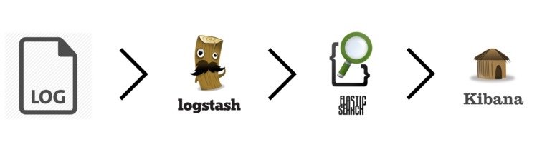
logstash – elasticsearch - kibana
Consolidate log files in a central/accessible area
  logstash reads logs and writes them to elasticsearch
  Can write to logstash over TCP/UDP directly
Information from multiple sources accessible in Kibana to query

Slide 8
What the hell was the app doing?
Memory usage?
  JVM – heap usage, garbage collection
    Can run VisualVM to peek inside running app
      Requires JMX ports for remote servers. No sysadmin in right mind giving you that! Plus firewalls and which server should I connect to?
How long did x take?
  Is the API it talks to taking 40+ seconds to respond?
How many times did a user do x or y?

Slide 9
Metrics Library For JVM apps
Dropwizard Mertrics library
  https://dropwizard.github.io/metrics/3.1.0/
  Metrics is a Java library which gives you unparalleled insight into what your code does in production.
Monitors the JVM
Can create custom counter/timer metrics
Can write the results directly to Graphite!

Slide 10
Graphite
Graphite does two things:
  Store numeric time-series data
  Render graphs of this data on demand
Graphite consists of 3 software components:
  carbon - a Twisted daemon that listens for time-series data
  whisper - a simple database library for storing time-series data
  graphite webapp - A webapp that renders graphs on-demand (it's abit shite)

Slide 11
What the hell was the server doing?
Application logs don't show anything
Maybe the box ran out of memory/disk space/cpu?
  Where the hell do I start?
  How do I measure these things?
  I still don't have access to the bloody boxes...

Slide 12
Server Stats – collectd
collectd gathers statistics about the system it is running on and stores this information.
Everything in collectd is done in plugins.
  Cpu/memory/disk space monitoring + loads more
  Output is via plugins
    Can write to CSV :(
    Can write to Graphite Server :)

Slide 13
Where can I see pretty pictures?
Graphite Server
- crude graphing interface...
Grafana
  Fast and flexible client side graphs with a multitude of options.
  Can export data in JSON
Dasher
  Ruby dashboard app. Can show data from multiple sources.
Kibana
  Can create graphs the data from logs

Slide 14
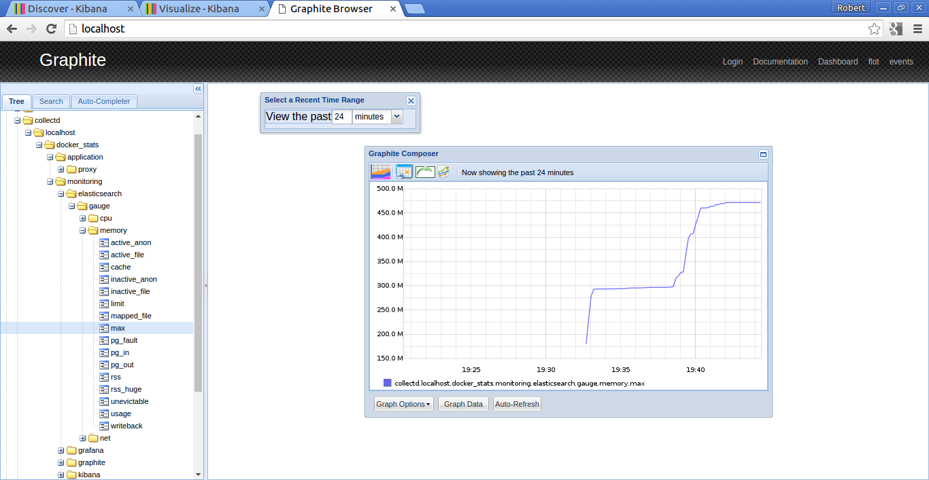
Graphite

Slide 15
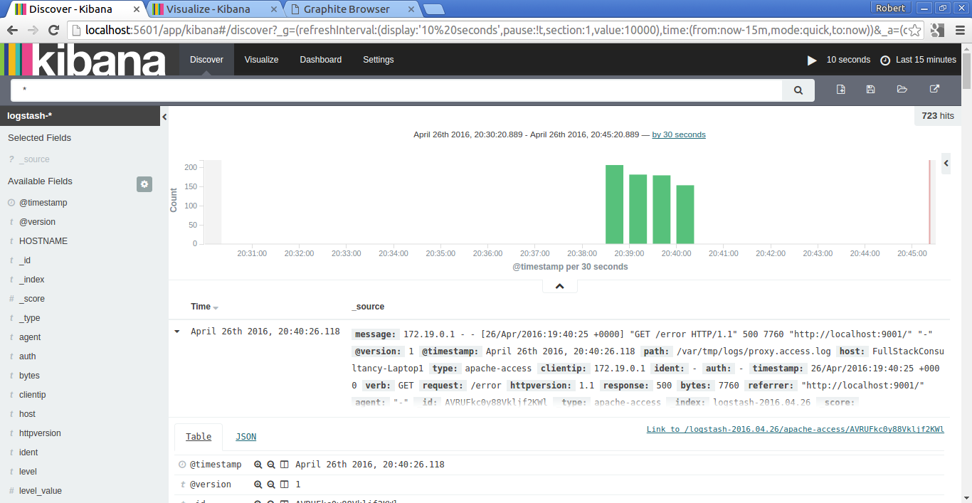
Kibana

Slide 16
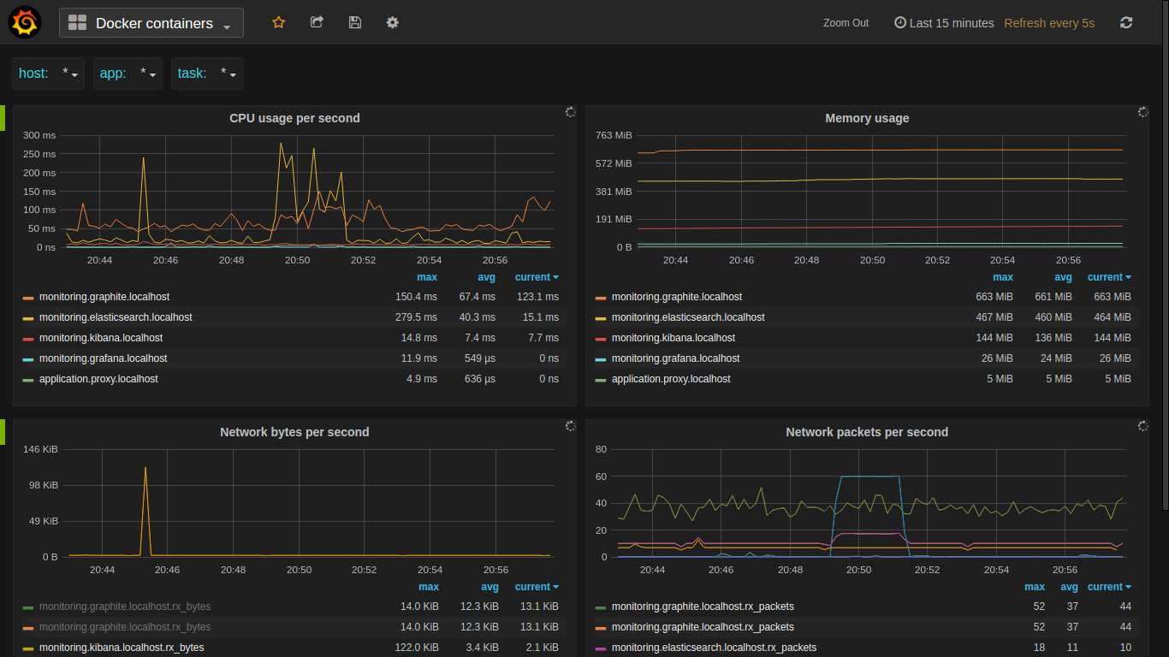
Grafana

Slide 17
How does this all fit together?
Standard Server
  Run collectd / logstash on your server
  Push metrics/logging to separate server
Docker Server
  For collectd you are interested in container metrics not just box metrics.
  Want Logstash to pull together logs from multiple containers
  Push metrics/logging to separate server

Slide 18
Infrastructure
Your App
Server
Logstash
elasticsearch
kibana
Logs
Your App
collectd
graphite
grafana

Slide 19
Server
Infrastructure
Docker Container
Logstash
Your App
Logs On Mounted Volume
App 1
elasticsearch
kibana
App 2
Docker Daemon
graphite
grafana
Docker collectd

Slide 20
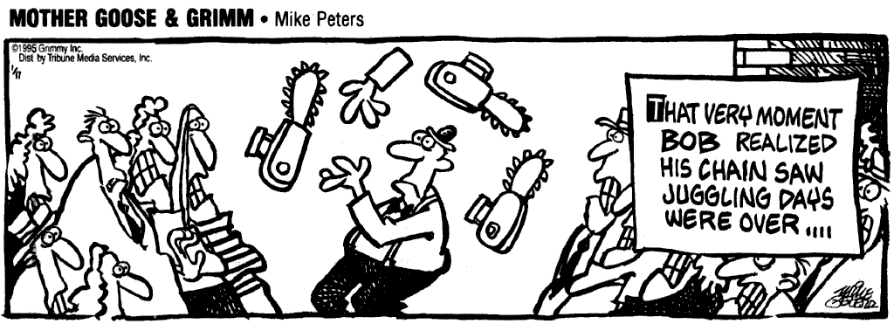
Who thought a live demo was a good idea?
Run the entire visualisation suite via Docker
Show Kibana view of consolidated logs
Show Grafana
  Docker Container Stats
    Memory / CPU
  Show application Stats
    JVM Stats

Slide 21
Summary
What's The Problem?
Where the hell are my logs?
What the hell was the app doing?
What the hell was the server doing?
Where can I see pretty pictures?
How does this all fit together?
Who thought a live demo was a good idea?
Q/A

Slide 22
Q & A

Slide 23
<Intentionally Blank>

