Slide 1
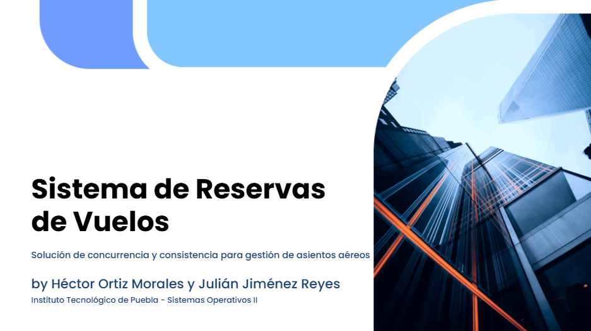
por Héctor Ortiz, Julián Jiménez y Giovany Félix

Slide 2
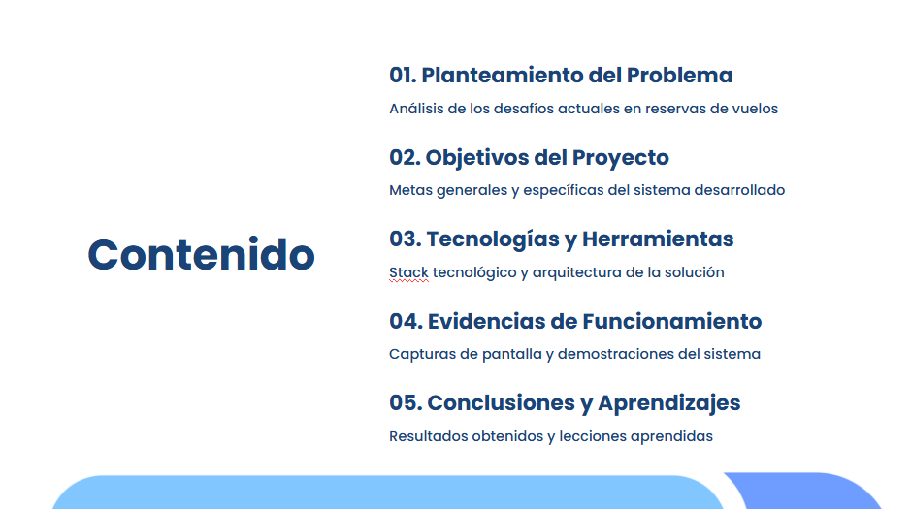

Slide 3
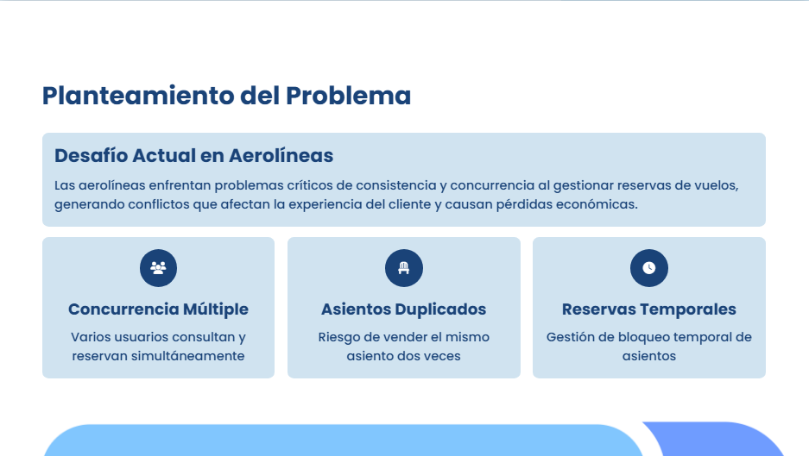

Slide 4


Slide 5


Slide 6
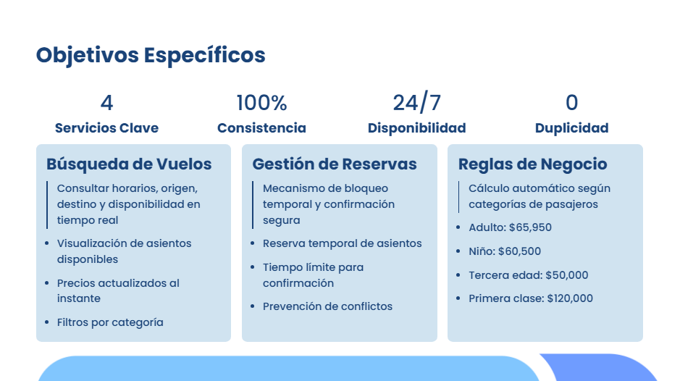

Slide 7
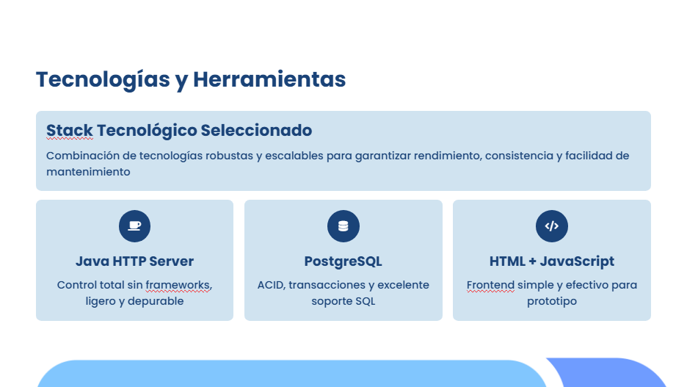

Slide 8
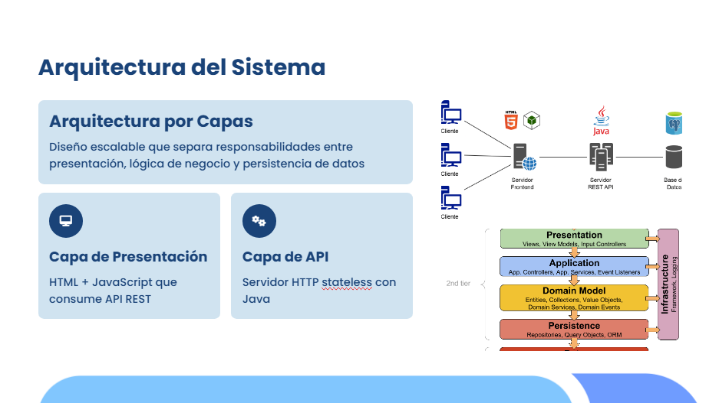

Slide 9
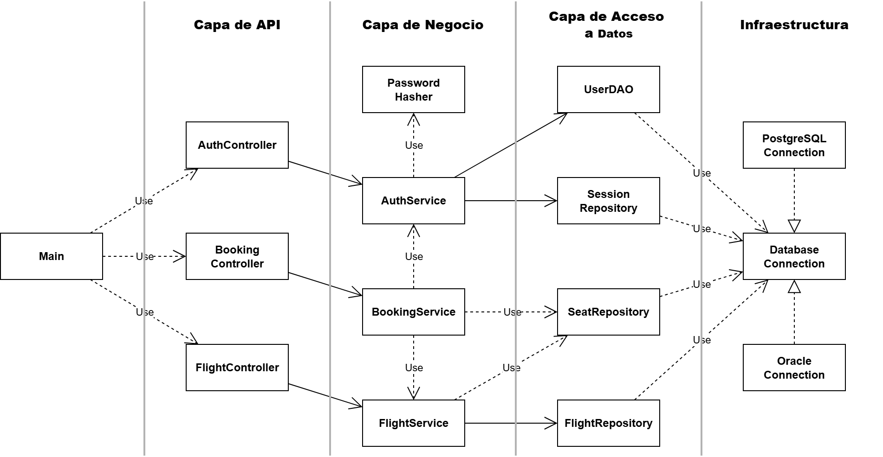

Slide 10
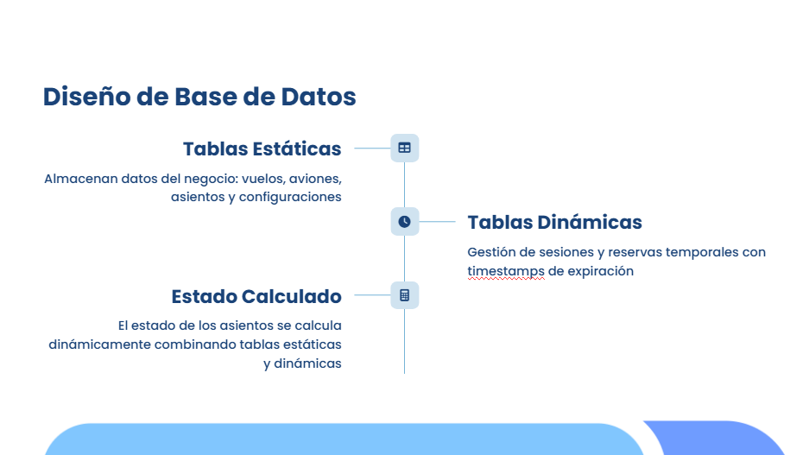

Slide 11

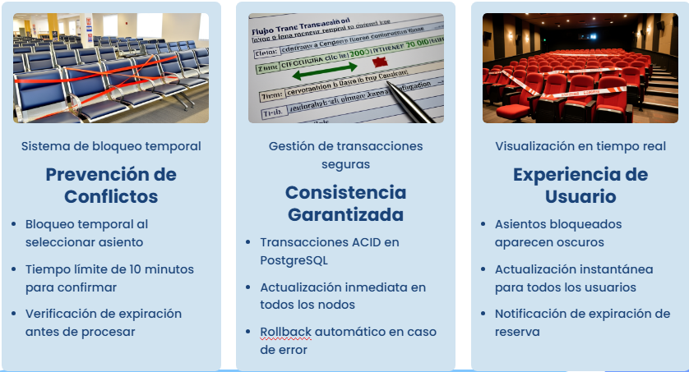
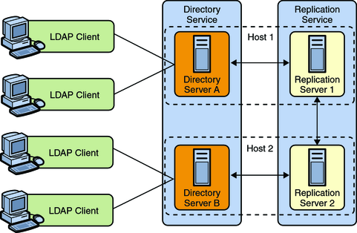


Slide 12
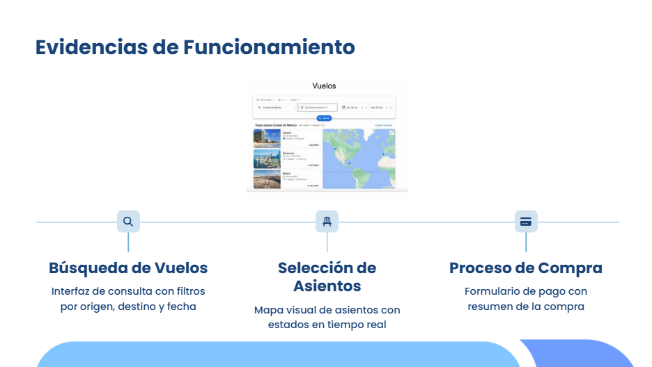
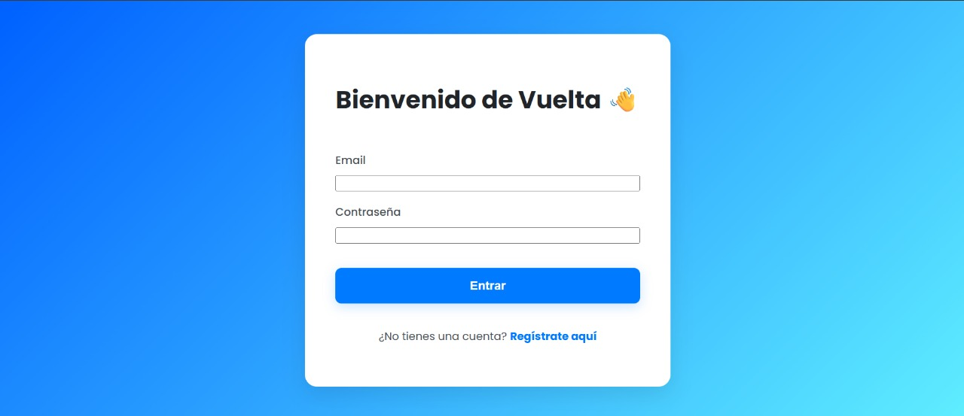

Slide 13

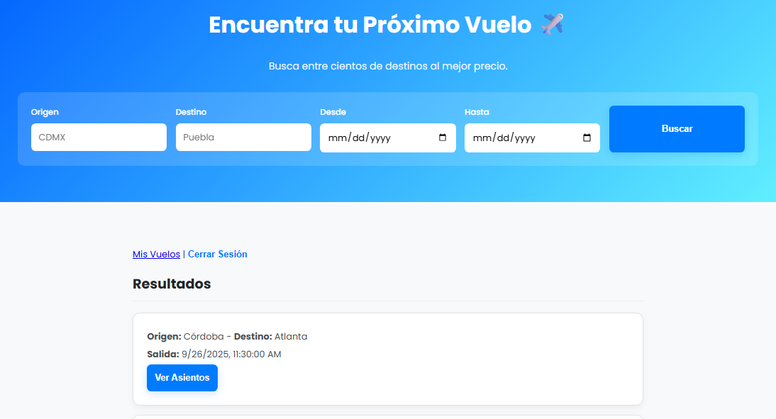
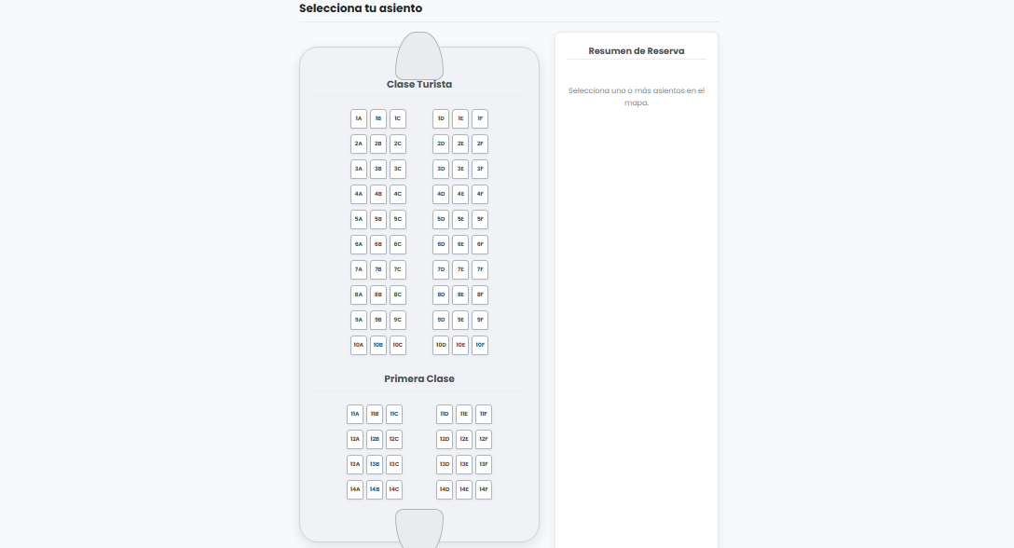

Slide 14

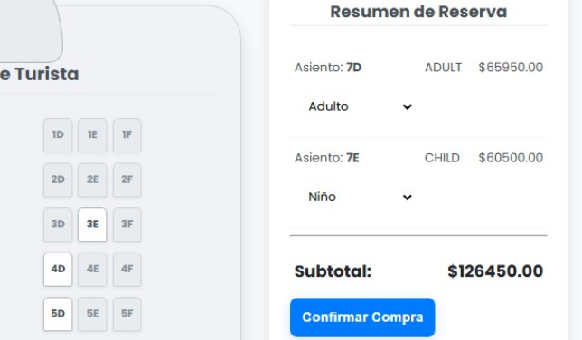
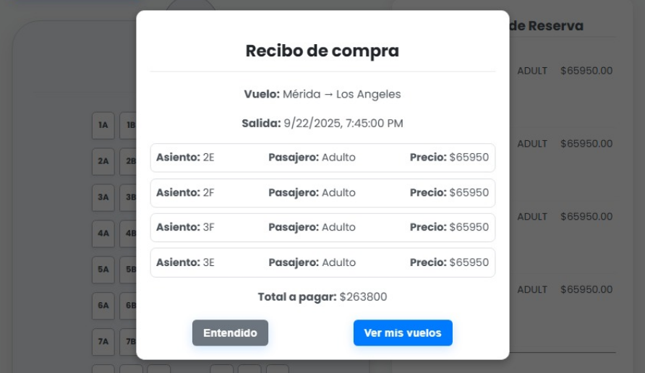

Slide 15
1 2 3 4 5 6 7 8 9 10 11 12 13 14 15 16 17 18 19 20 21 22 23 24 25 26 27 28 29 30 31 32 33 34 35 36 37 38 | public class FlightService { private final FlightRepository flightRepository; private final SeatRepository seatRepository; public FlightService(FlightRepository flightRepository, SeatRepository seatRepository) { this.flightRepository = flightRepository; this.seatRepository = seatRepository; } public Result<List<Flight>> search(Map<String, String> queryParams) { return Result.of(() -> { FlightFilter filter = FlightFilter.fromQuery(queryParams); return flightRepository.findFlights(filter) .orElseThrow() .orElseGet(List::of); }); } public Result<Optional<FlightDetails>> getFlightDetails(int flightId) { return Result.of(() -> { Optional<Flight> flightOpt = flightRepository.getFlight(flightId).orElseThrow(); if (flightOpt.isEmpty()) return Optional.empty(); Flight flight = flightOpt.get(); Optional<List<Seat>> seats = seatRepository.getSeatsForFlight(flight.id()).orElseThrow(); return Optional.of( new FlightDetails(flight, seats.get()) ); }); } }

Slide 16
1 2 3 4 5 6 7 8 9 10 11 12 13 14 15 16 17 18 19 20 21 22 23 24 25 26 27 28 29 30 31 32 33 34 35 36 37 38 39 40 41 42 43 44 45 46 47 48 49 | public Result<Optional<Booking>> bookSeat(int flightId, String seatId, PassengerType passengerType, String sessionId) { return Result.of(() -> { Optional<User> userOpt = authService.validateSession(sessionId).orElseThrow(); if (userOpt.isEmpty()) return Optional.empty(); User user = userOpt.get(); Optional<FlightDetails> flightOpt = flightService.getFlightDetails(flightId).orElseThrow(); if (flightOpt.isEmpty()) return Optional.empty(); FlightDetails flightDetails = flightOpt.get(); Optional<Seat> seatOpt = flightDetails.seats().stream() .filter(seat -> seat.id().equals(seatId)) .findAny(); if (seatOpt.isEmpty()) return Optional.empty(); Seat seat = seatOpt.get(); if (seat.status() == Status.BOOKED) return Optional.empty(); Optional<Integer> ownerIdOpt = seatRepository.getReservationOwnerId(flightId, seatId).orElseThrow(); if (ownerIdOpt.isPresent() && ownerIdOpt.get() != user.id()) return Optional.empty(); Booking booking = new Booking( user.id(), flightId, flightDetails.flight().airplaneId(), seatId, LocalDateTime.now(), passengerType, seat.seatClass() == Seat.Class.FIRST? new BigDecimal("120000.00") : passengerType.price ); seatRepository.book(booking).orElseThrow(); return Optional.of(booking); }); }

Slide 17
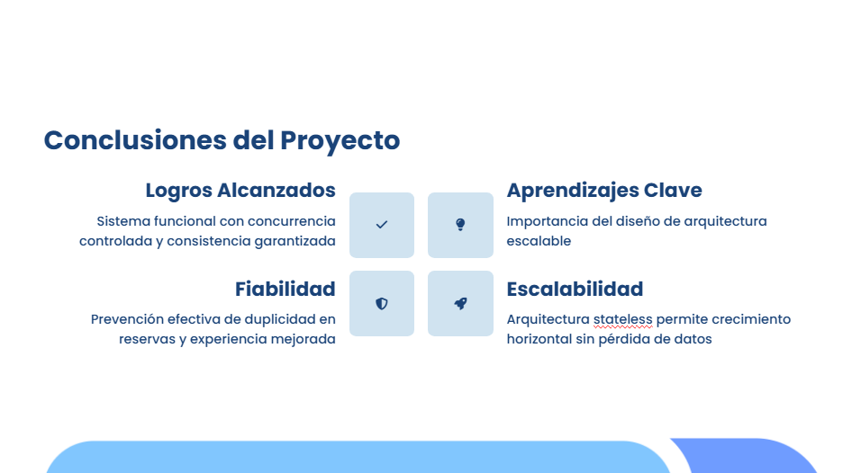

Slide 18
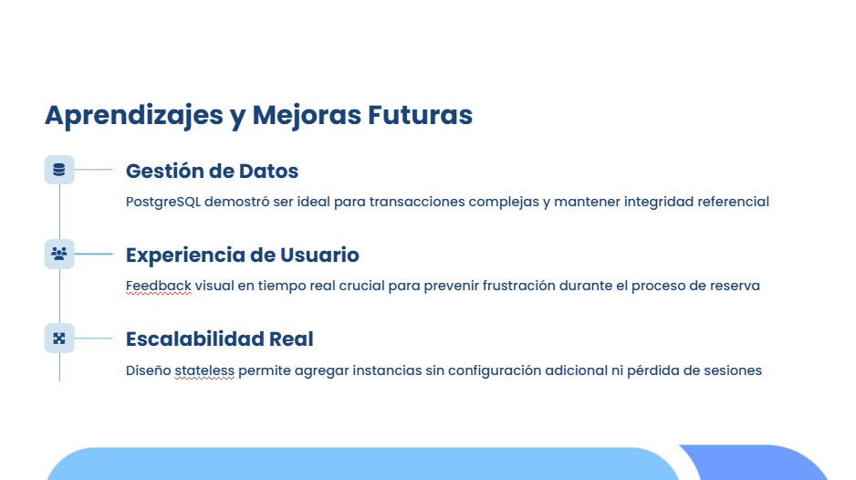

Slide 19


