Slide 1

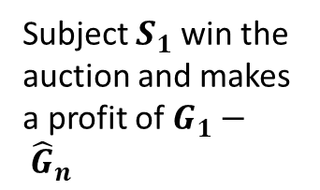

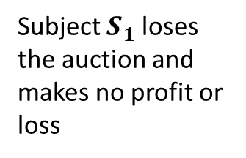


A
B
C
$$B_{max}$$
$$B_{subject}:G_{1}$$
$${\hat{B}}_{opponents}:{\hat{G}}_{n}$$
$$B_{min}$$
Subject $S_{1}$ win the auction and makes a profit of $G_{1}− {\hat{G}}_{n}$
Subject $S_{1}$ loses the auction and makes no profit or loss

Slide 2

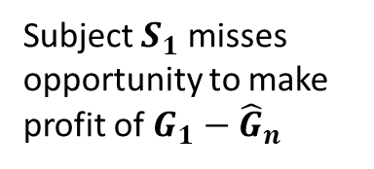



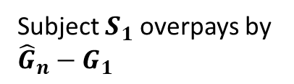
D
E
F
G
$$H_{1}$$
$$H_{1}$$
$$I_{1}$$
$$I_{1}$$
No difference between realised and optimal result
Subject $S_{1}$ overpays by ${\hat{G}}_{n}−G_{1}$
No difference between realised and optimal result
Subject $S_{1}$ misses opportunity to make profit of $G_{1}−{\hat{G}}_{n}$

Slide 3

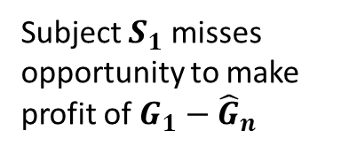

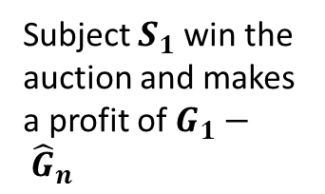


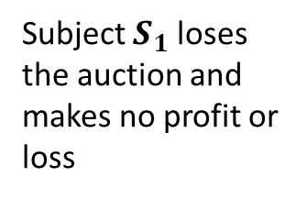


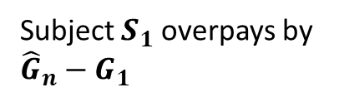


Scenarios where subject $S_{1}$bids their true utility $G_{1}$
A
B
C
$$B_{max}$$
$$B_{subject}:G_{1}$$
$${\hat{B}}_{opponents}:{\hat{G}}_{n}$$
$$B_{min}$$
Subject $S_{1}$ win the auction and makes a profit of $G_{1}− {\hat{G}}_{n}$
Subject $S_{1}$ loses the auction and makes no profit or loss
Scenarios where subject $S_{1}$does not make their optimal bid $G_{1}$
D
E
F
G
$$H_{1}$$
$$H_{1}$$
$$I_{1}$$
$$I_{1}$$
No difference between realised and optimal result
Subject $S_{1}$ overpays by ${\hat{G}}_{n}−G_{1}$
No difference between realised and optimal result
Subject $S_{1}$ misses opportunity to make profit of $G_{1}−{\hat{G}}_{n}$

