Slide 1
SCHOLARSHIP MANAGEMENT SYSTEM
HUMAN COMPUTER INTERACTION
Point sharp scolarship

Slide 2
Presented by:
JOHN NDUNG’U SCT222-0145/2019
NEWTON MUTUMA SCT222-0454/2017
SHARON CHERONO SCT222-0204/2019
PENINA MUMBI SCT222-0175/2019
NELIUS WANGARI SCT222-0415/2019

Slide 3
Problem space
Managing scholarship programs can be tedious and time consuming for both the administrator and applicants. The legacy system is cluttered and brings confusion to users. The system has many links that are unnecessary.

Slide 4
Personas
We have two personas
applicant
administrator

Slide 5
administrator
Administrators are the ones concerned with all the applications globally.
They are responsible for:
Posts scholarship opportunities and deletes those that are taken
View applications
Filter on who is to be awarded the scholarship programs

Slide 6
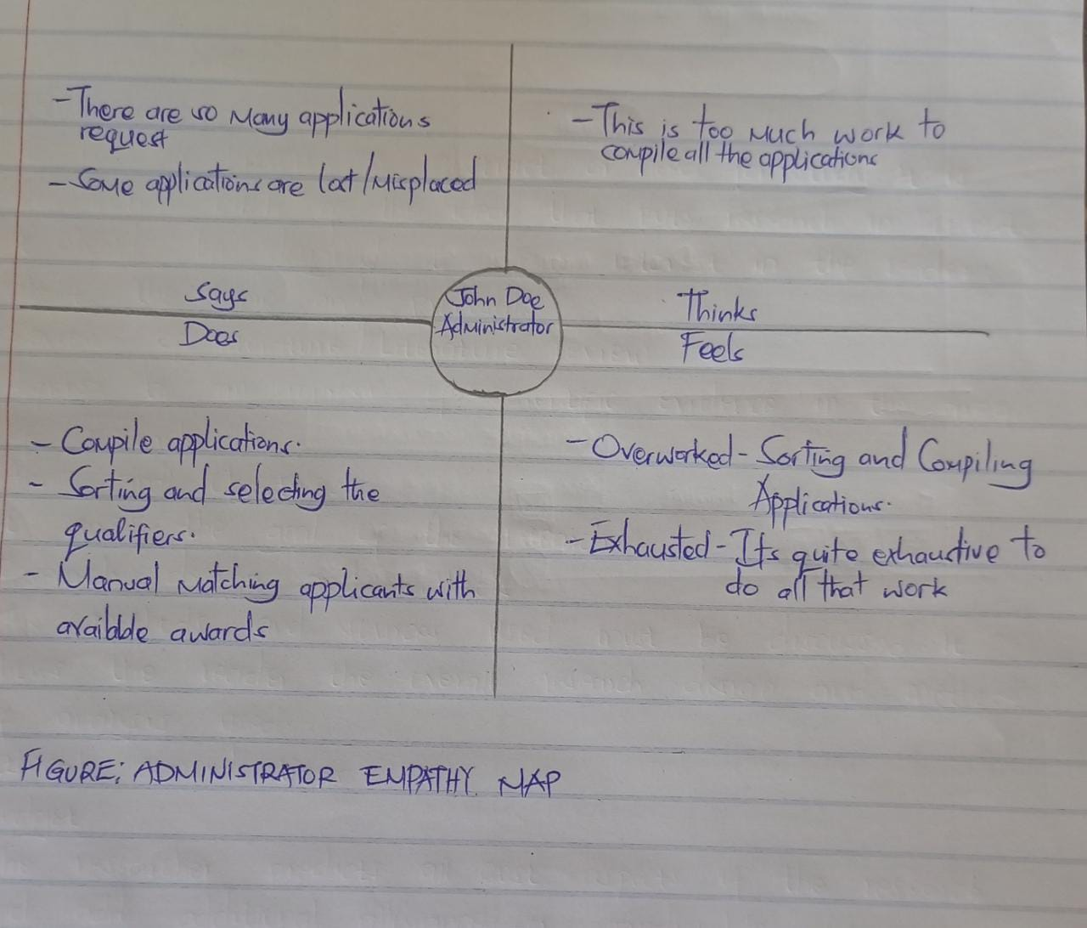
Administrator empathy map

Slide 7
ADMINISTRATORS PROBLEMS
From the administrator's side:
Wasted administrative hours is lost in manual processing
Information needed is all over the place
Low application rates

Slide 8
Applicant
Is a student who is interested and wants to register with the system
The applicant can either be an undergraduate or a post graduate student
The applicant can apply for a scholarship by browsing the scholarship information and manage the application process.

Slide 9
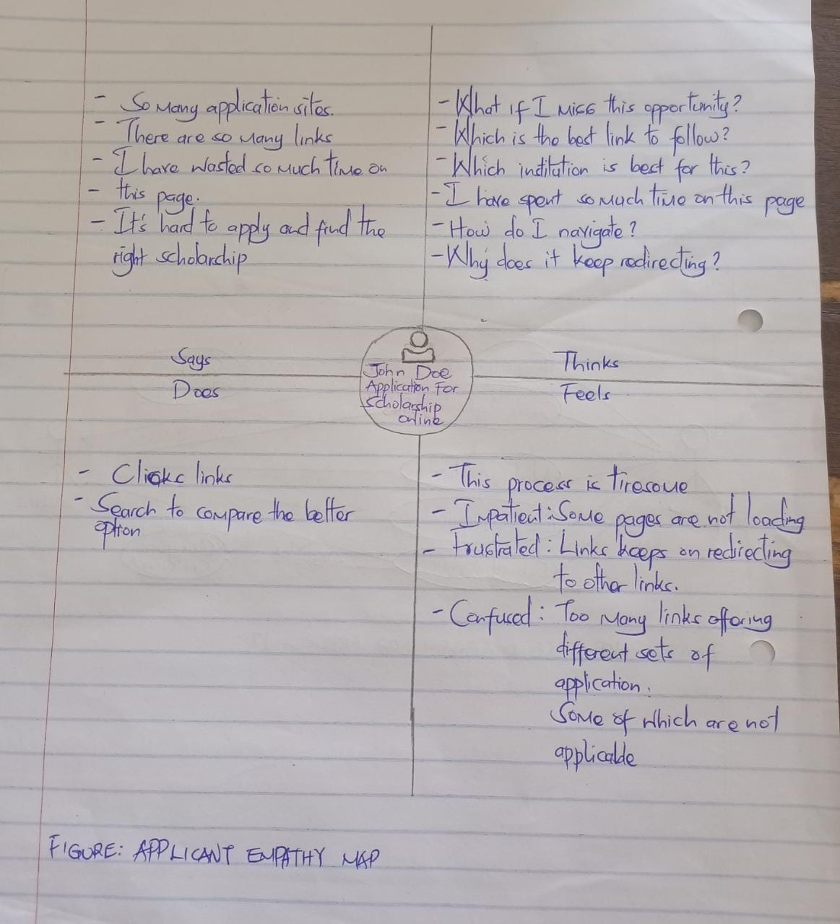
Applicant empathy map

Slide 10
PROBLEMS FACED BY THE APPLICANT
From the legacy system we identified the following problems from the applicant side:
Overwhelemed by the number of awards that are not applicable
Repetitive process of finding appropriate awards they qualify for
Missing out on scholarship opportunities
To much time spent trying different search parameters

Slide 11
User analysis
Our user is a student of any age who falls under the brackets of undergraduate or postgraduate and has already passed the requirements needed that is:
Computer literate
Of sound mind
When interacting with the interface the user is prompted to do the following
Search scholarships
Registering
Create an application
Modify the application
Submit the application

Slide 12
Task analysis
How does the user interact with the system and how responsive the elements in the page are to the user.
The submit button should respond with the first click and the search space should respond to the strokes from the keyboard.
The search icon should redirect the user to the page needed.

Slide 13
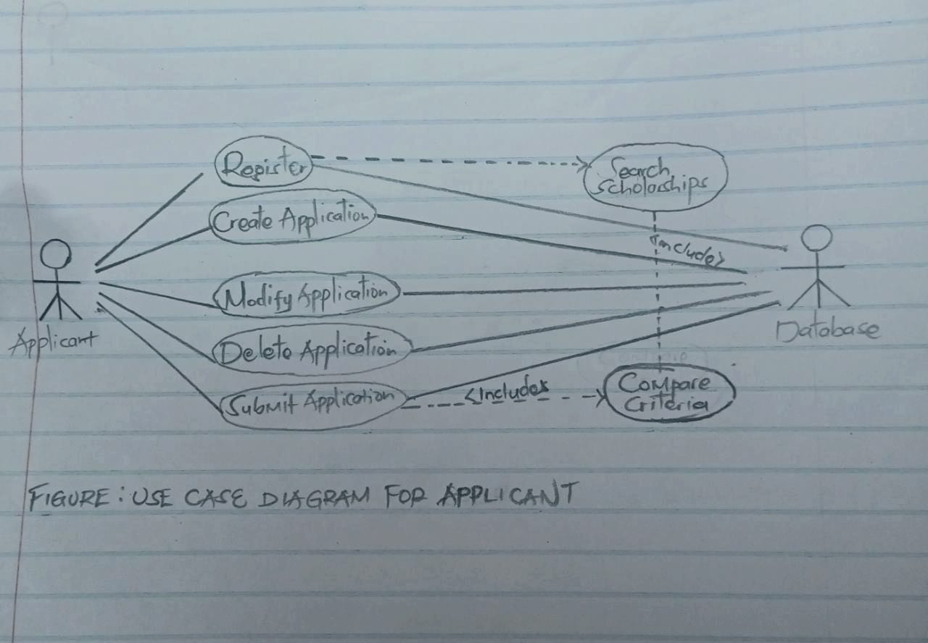
Domain analysis

Slide 14
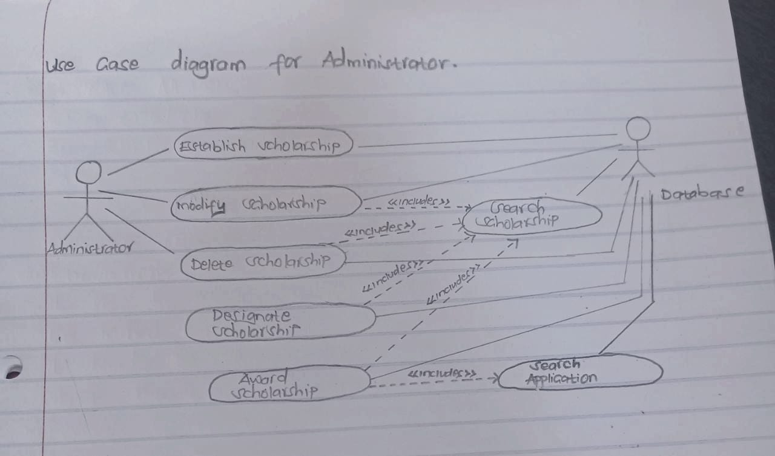
Domain analysis

Slide 15
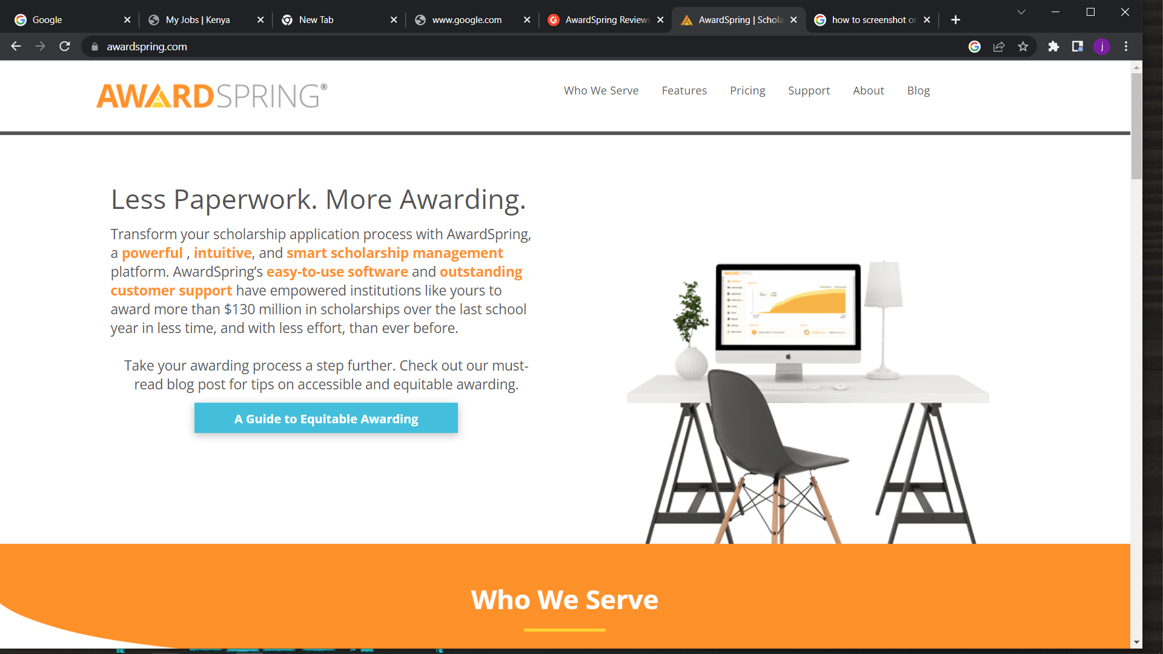
The problem as is

Slide 16
Proposed solution
Come up with a platform that is user friendly, reliable and meets what the user asked for
The system we came up with solves the cluttering of the ‘AS-IS’ website.
The proposed system;
Reduces time spent searching for scholarships
It simplifies and makes the application process efficient
It provides applicants with the opportunity to get notified incase of new scholarship opportunities
Applicants receive scholarship they deserve with the appropriate funding

Slide 17
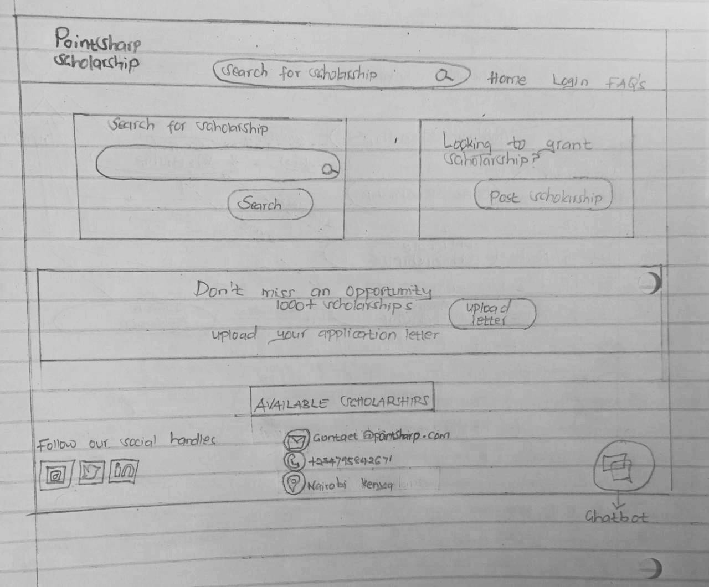
TO BE SYSTEM

