Slide 1
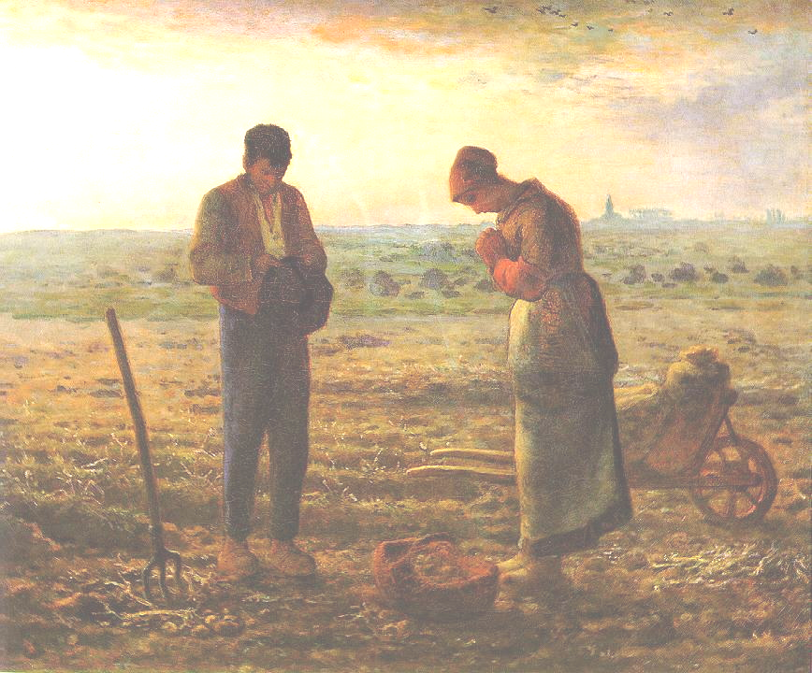
Agrarian Crisis
Rural
Depopulation
Small
Farmers
Robert Schwartz
Mount Holyoke College

Slide 2
Rural depopulation
State of the question
Rural mobility: significant but not new, 1820s-1920s.
New after 1850s: shift from temporary to definitive moves
Returns: up to 40% of individual migrants move back by age 45 [findings from studies based on samples, e.g., A. Rosental; J-C Farcy and A. Faure].
“Rural exodus” 1860s-1920s? Not a sudden, massive departure and uprooting everywhere . . . .
But a gradual, uneven redistribution of the rural population that varied over time and space during this period.
Evidence?

Slide 3
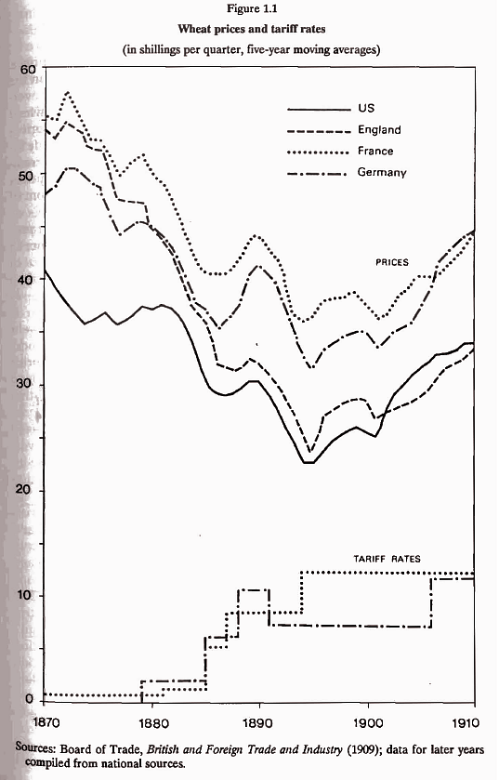
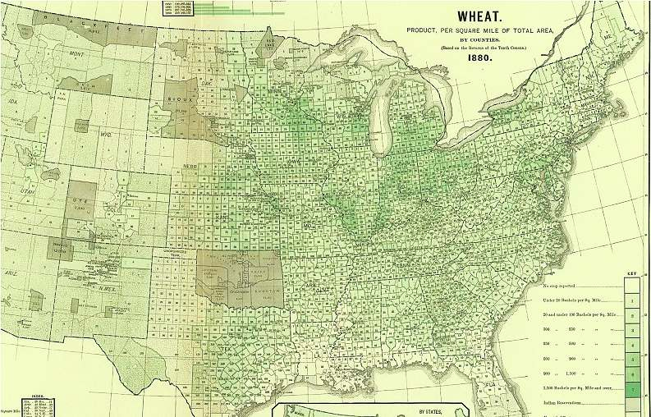

Slide 4
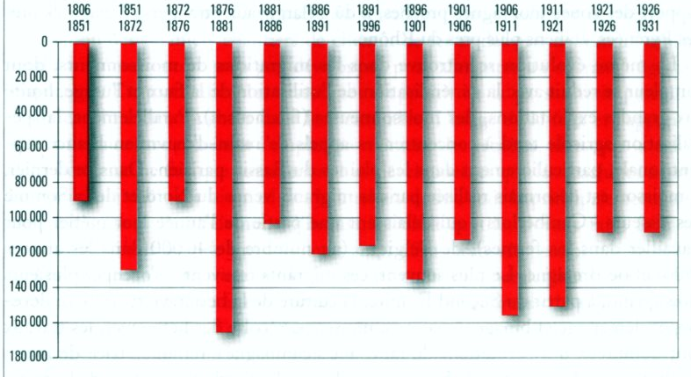
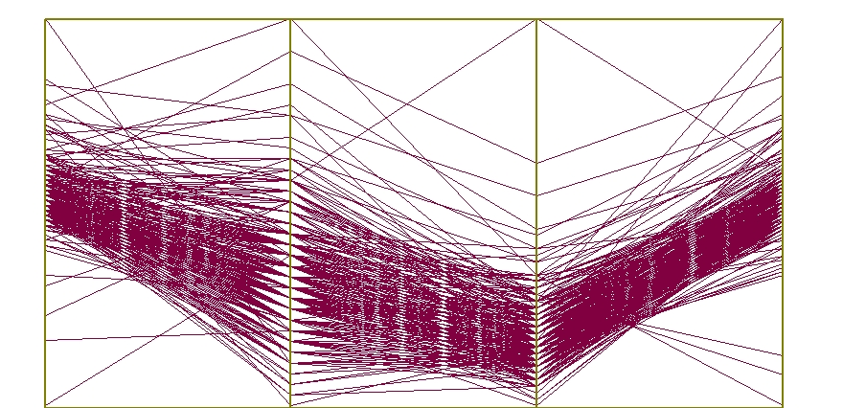
Net Migration in France and England & Wales
France
Percentage Population change due to out migration
1860-70 1870-80 1880-90 1890-1900
Registration Districts in England & Wales

Slide 5
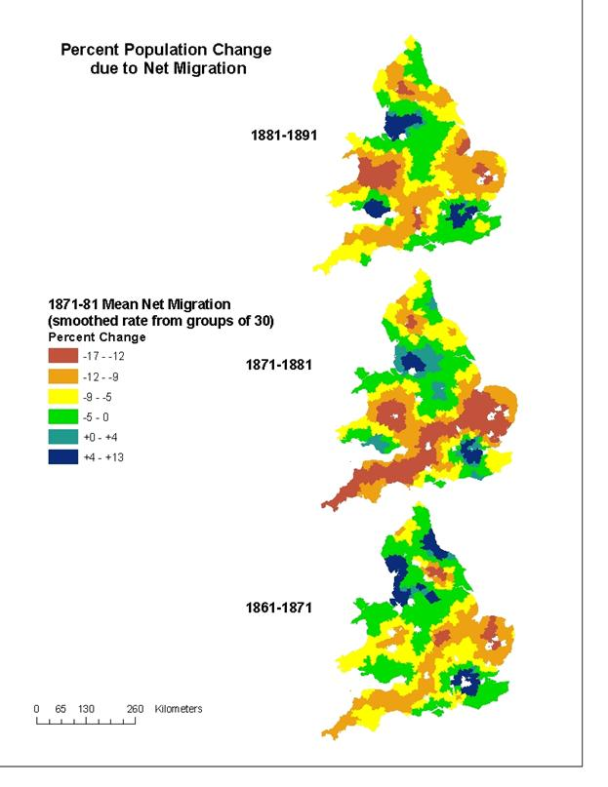
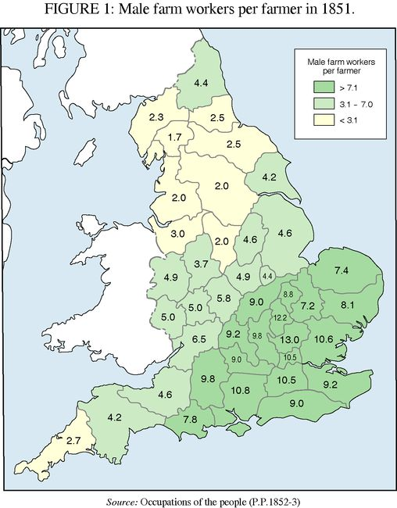
The Release of Agricultural Labor, 1861-1891
Out migration

Slide 6
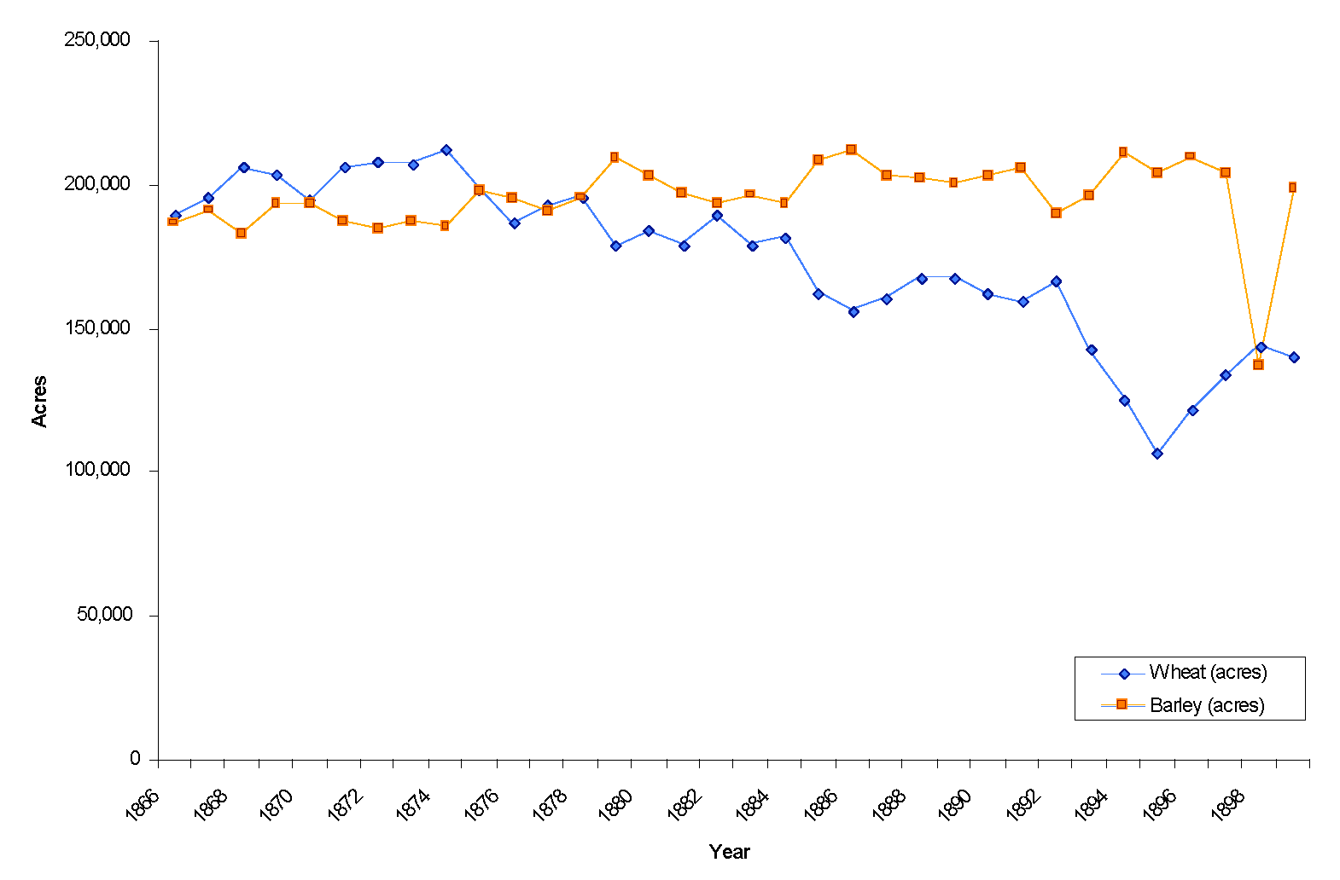
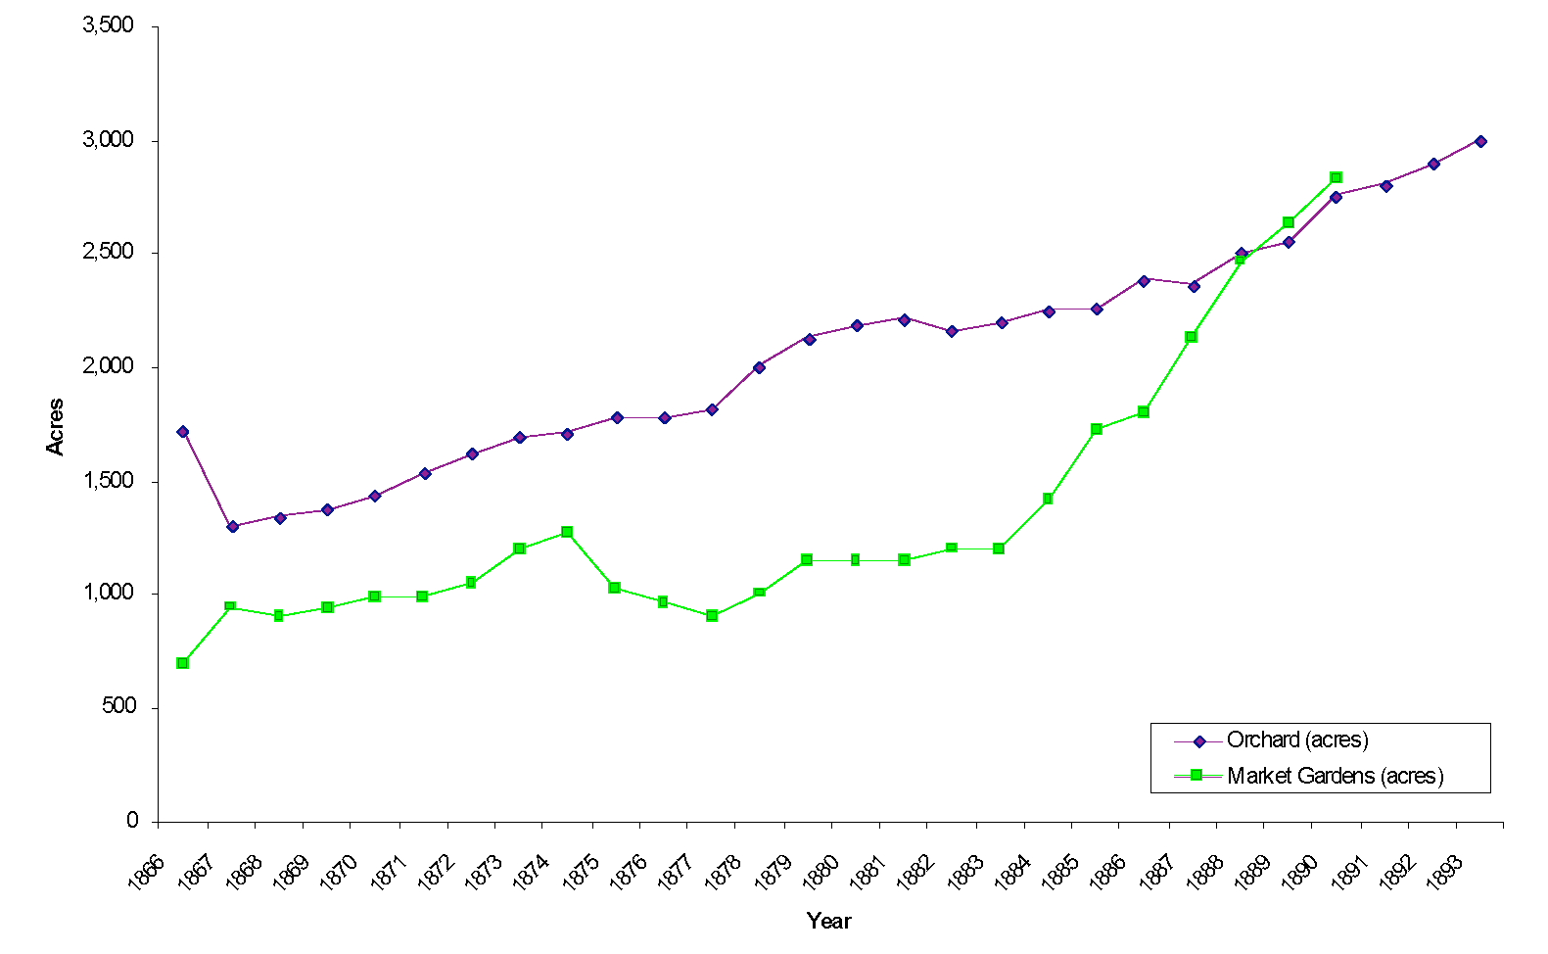
Shift from Grains to Perishables: Norfolk County
Barley and Wheat
Orchard and Market Gardens

Slide 7
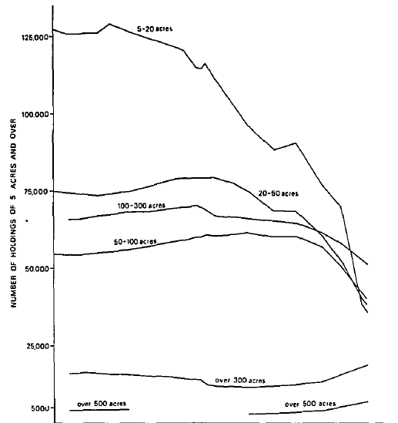
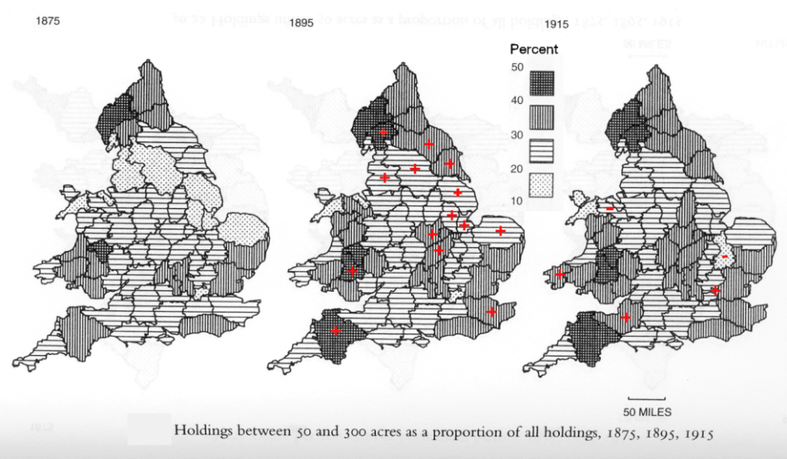
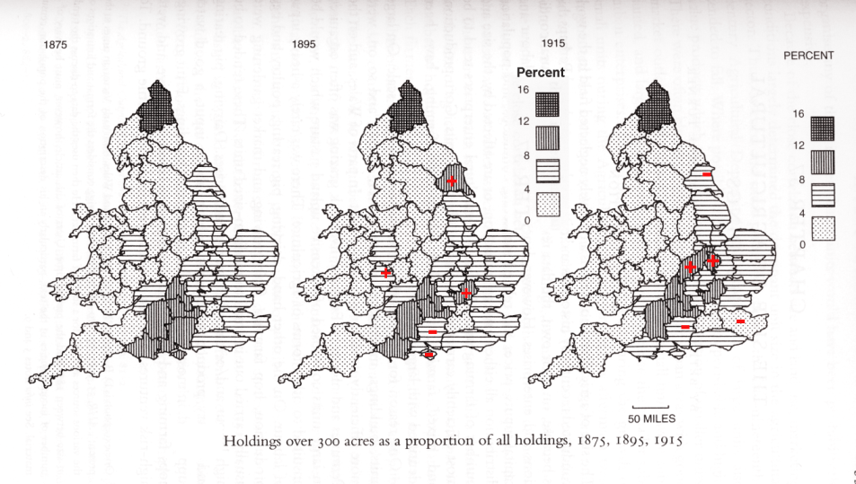
Increase of Small and Medium Holdings
Agrarian
Crisis
1873-1896
Number of Holdings by Category in England & Wales, 1875-1914
Year | 50-300 Acres | Index 1875=100 | 300 Acres & above | Index 1875=100
1875 | 120264 | 100 | 16106 | 100
1880 | 120742 | 100.4 | 16747 | 104.0
1885 | 121961 | 101.4 | 16608 | 103.1
1895 | 125068 | 104.0 | 16021 | 99.5
1903 | 126980 | 105.6 | 15351 | 95.3
1908 | 127864 | 106.3 | 15041 | 93.4
1913 | 128718 | 107.0 | 14513 | 90.1
1914 | 128989 | 107.3 | 14413 | 89.5
Depression
Holdings of 50 to 300 acres as percentage of all holdings
1870 1890 1910 1930 1950 1970
Number of Holdings by Category in England & Wales, 1875-1914
Year | 20-50 Acres | 50-300 Acres | Index 1875=100 | 300 Acres & above | Index 1875=100
1875 |  | 120264 | 100 | 16106 | 100
1880 |  | 120742 | 100.4 | 16747 | 104.0
1885 | 73472 | 121961 | 101.4 | 16608 | 103.1
1895 | 74846 | 125068 | 104.0 | 16021 | 99.5
1903 |  | 126980 | 105.6 | 15351 | 95.3
1908 |  | 127864 | 106.3 | 15041 | 93.4
1913 | 78027 | 128718 | 107.0 | 14513 | 90.1
1914 | 78545 | 128989 | 107.3 | 14413 | 89.5
Holdings of over 300 acres as percentage of all holdings

Slide 8
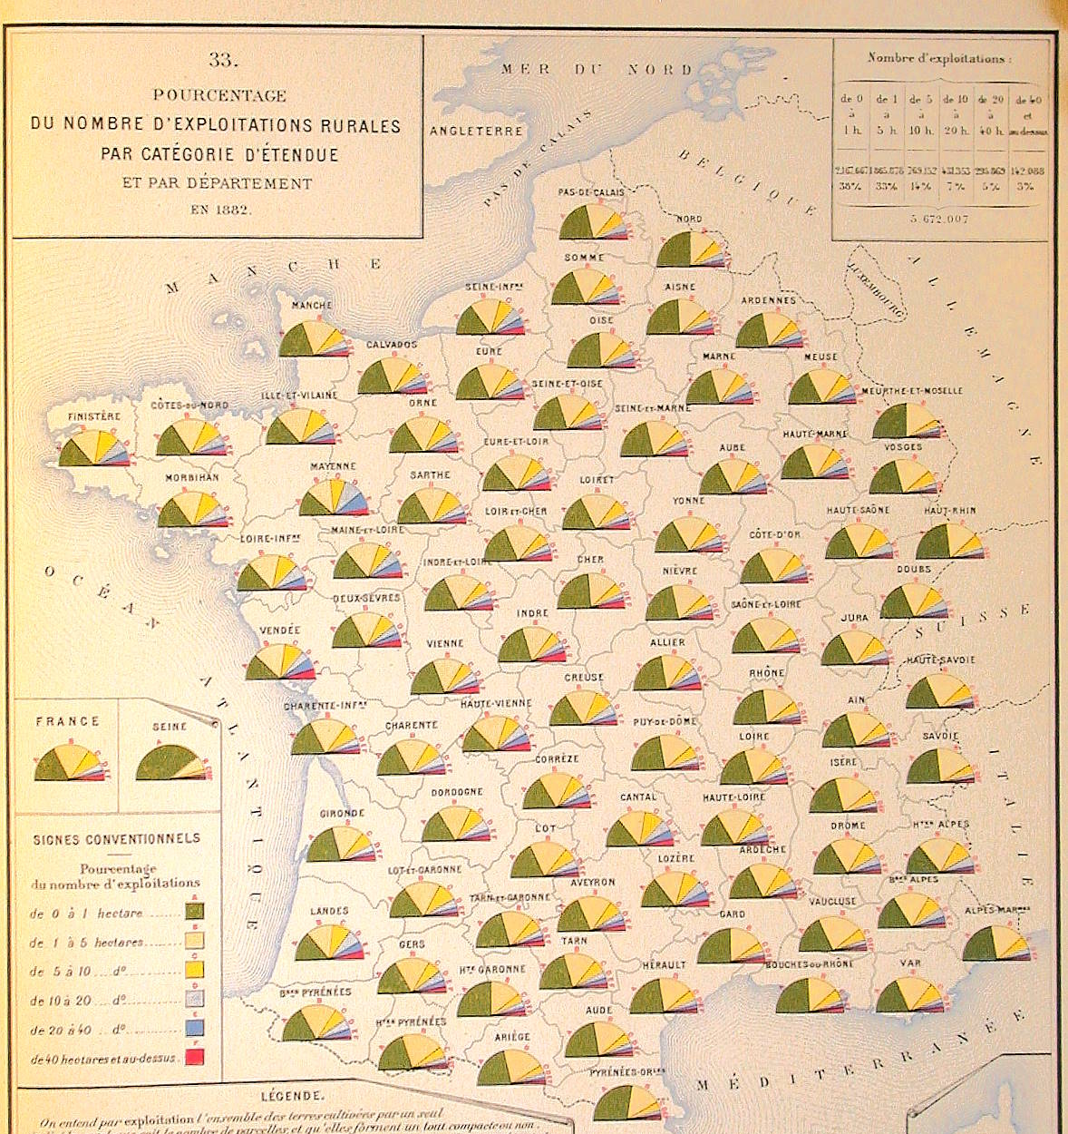
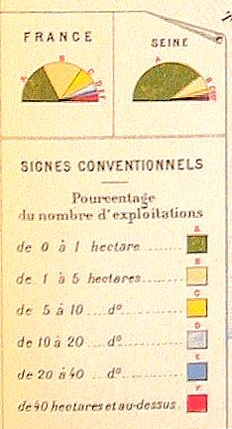
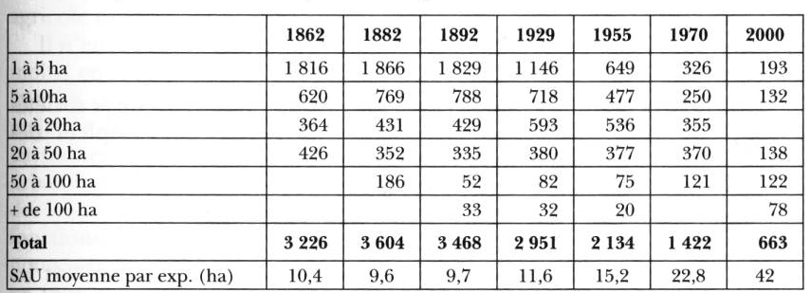
Size of Farms in France
Distribution of Farms by size in Departments, 1882
Increase in Middling Farms, 5-20 hectares

Slide 9
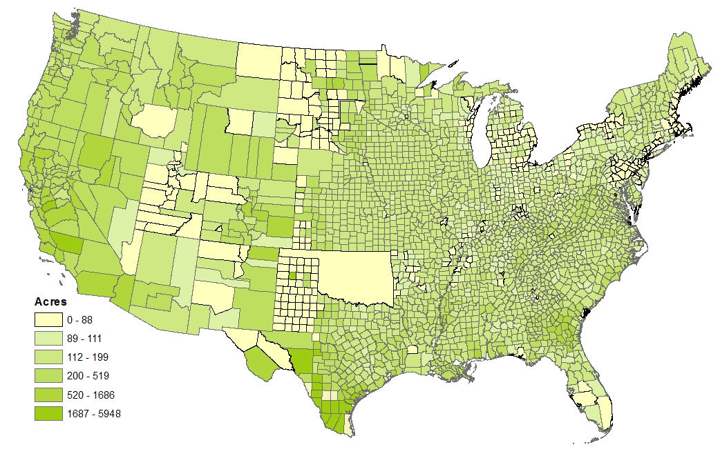
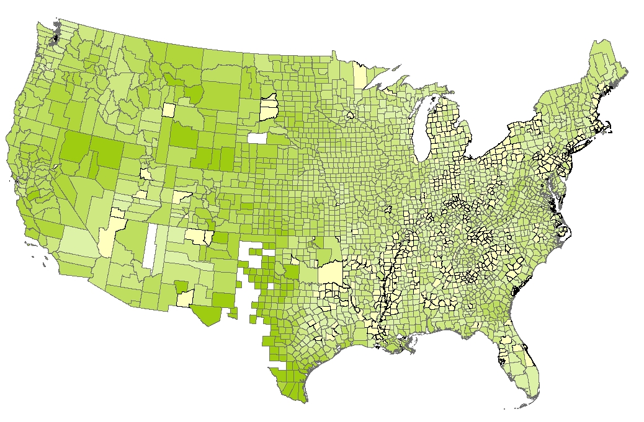
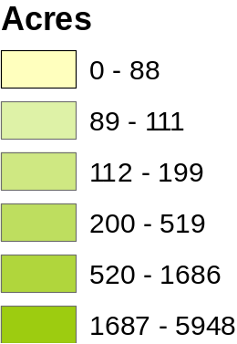
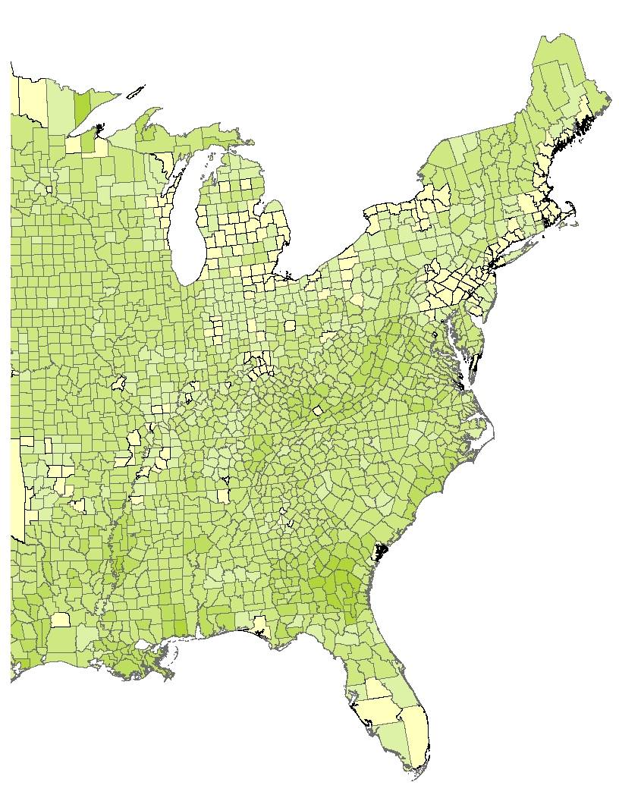
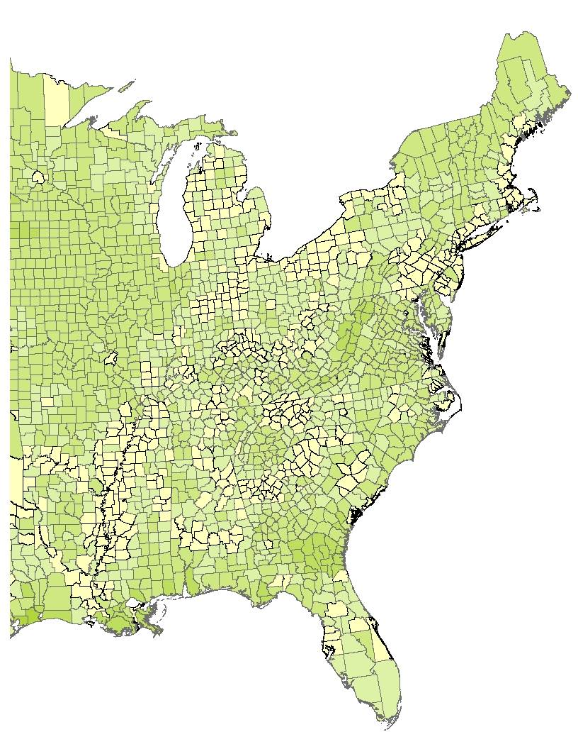
Increase in Small Farms 1880 to 1900
Average Size of Farms by Counties (Acres)
1880
1900

Slide 10
Agrarian Crisis
Rural
Depopulation
Small
Farmers
Robert Schwartz
Mount Holyoke College

