Slide 1
Data Center for health care Supervised By: Dr Ashadun Nobi Associate Professor Department of CSTE, NSTU Presented By: Md Bohan Uddin Robaith Hossain Farhabi Kamal Roll: ASH1601040M Roll: ASH1601052M Roll: BKH1601056F

Slide 2
Project Outline
Introduction
Existing System
Proposed system
Statement of the problem
Objectives
Tools
Feasibility Study
System Design
Conclusion and future work
Reference

Slide 3
Introduction
The project ‘Data Center for Health Care’ includes registration of patients, pharmacies and doctors and storing their details into the Database using an user interface.
A patient can take appointment for doctor.
A doctor can check patients historical records and prescribe medicine easily.

Slide 4
Introduction (continued)
Pharmacist can view prescription using Email id of patient.
It is named as ‘data center’ because its main purpose is to store historical records of patients to minimize the use of hard copies.

Slide 5
Existing system
We have seen many hospital management systems and medical assistance related web applications .These are helpful but still lack of some facilities.
All the functionalities like taking an appointment, prescription keeping, etc. are done manually.
These existing systems are failed to solve the problem of long term storage of medical history.
Pharmacies provide medicine with a hard copy of prescription

Slide 6
Proposed system
All the entities can enter their personal field in the central database.
Doctors will be able to type a prescription easily with a template which will save automatically and send to the patient id.
Pharmacies will be able to search a patient’s prescription by his Email only. Hard copy is not needed.

Slide 7
Statement of the problem
There is a huge problem in interaction between medical services and the patients.
Appointment system in our country is still manual
If a patient lost his prescription/medical reports there is no way to get it back.
Pharmacies face problem while selling medicine with hard copy of prescription. Most of the time they cannot understand the medicine names because of hand writing.

Slide 8
Objectives
Implement better interactions between doctors, patients, and pharmacies.
To provide better services to the patients.
To provide better services to the doctors.
Preservation of prescriptions in the online profile.
To provide access of prescriptions to the pharmacy.

Slide 9
Feasibility study
Our goal is to make a feasible project such that it is economically and systematically affordable for the average internet users.
We have tried to build a friendly graphical user interface.
We kept the requirements low such that with minimum device configuration one can access the facilities provided by our system.

Slide 10
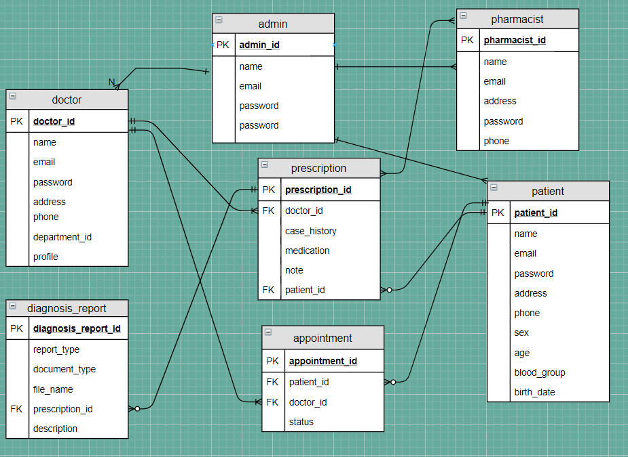
System design Database Design

Slide 11
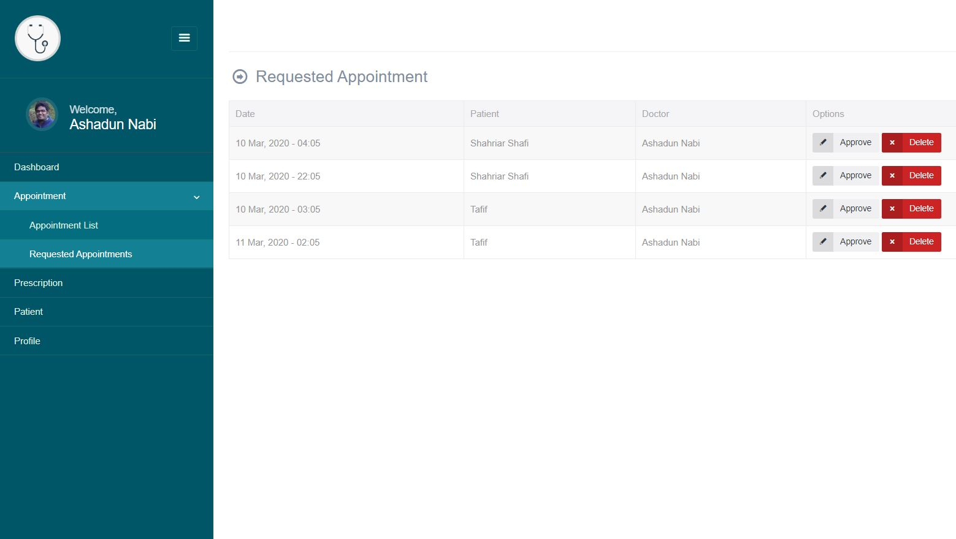

Slide 12
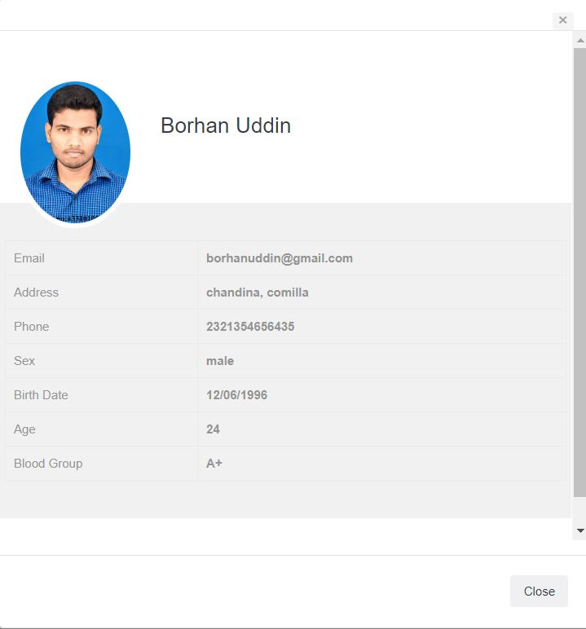

Slide 13
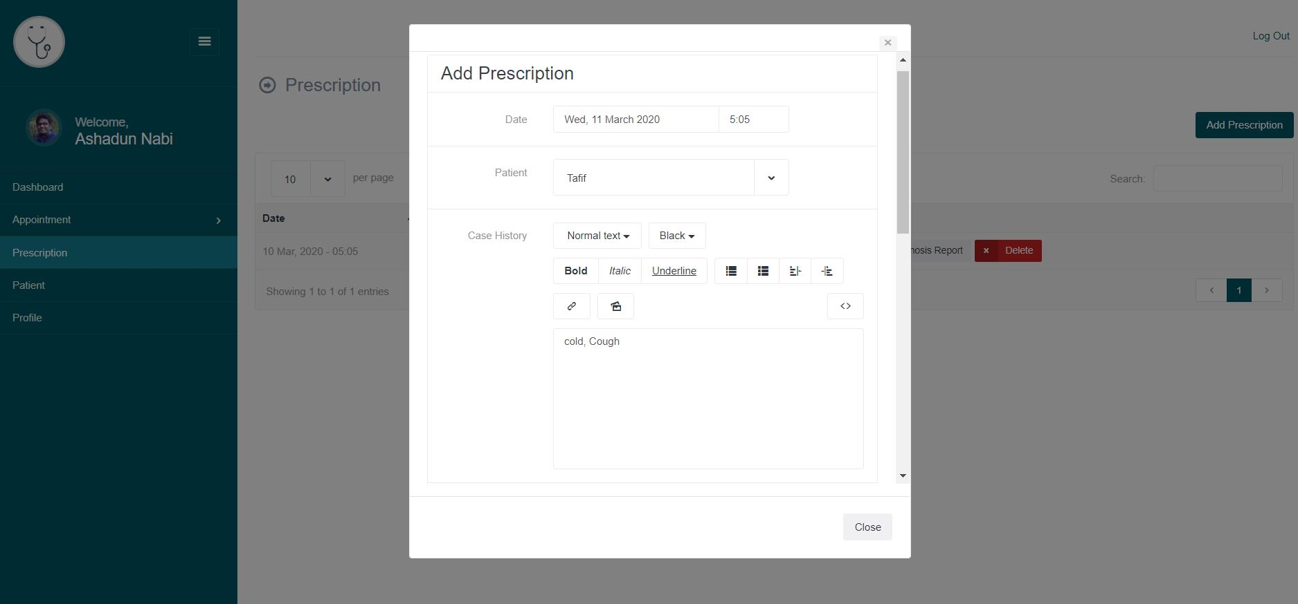

Slide 14
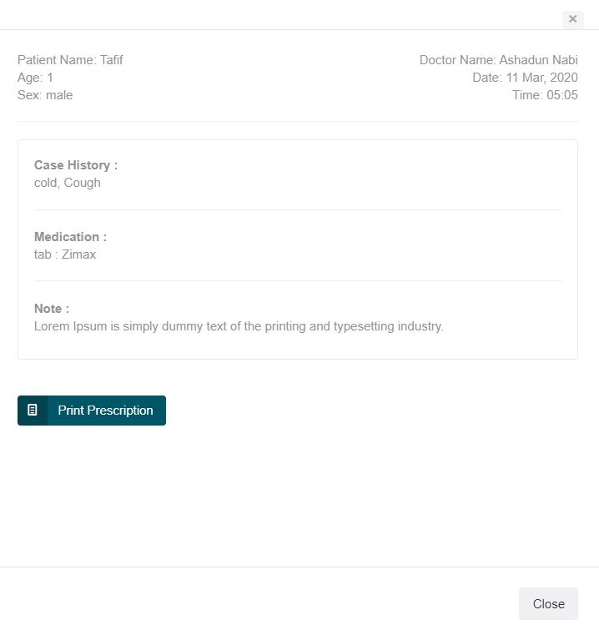

Slide 15
Conclusion and future work
In this project we have created one database which is helpful for doctor, patient and pharmacies.
The database keeps a record of prescriptions and other related information which includes patients details. Since we are entering details of the patients electronically, data will be secured.
Using this database or website a doctor can retrieve patient’s history with a single click. Also patient doesn’t have to go to doctors chamber for taking an appointment.
This project work will save one’s valuable time. Use of the website will easily reduces paper work and thus reduces the human effort.

Slide 16
Future Work
This project has gone through extensive research work. Nevertheless, some more feature or implementation can take place in the project.
We will provide access to the medical researchers in the database so that, they can easily find desired data in one place.
We will also try to create an Email system for the entities.
In the project we are not able to create communication among hospital and other entities. In future we will try to connect Hospitals with the three entity ( Doctor, Patient and Pharmacy).

Slide 17
Reference
1. Software Engineering by Roger S Pressman
2. http://www.w3schools.com/howto/howto_css_login_form.asp
3. http://www.stackoverflow.com/tags/javascript/info
4. Database Systems Models,Languages,Design and Application Programming, RamezElmasri and Shamkant B. Navathe, 7th Edition, 2017, Pearson.
5. http://www.sebaghar.com

