Slide 1
mhw1 https://gcds.com/eu-it
Roberto Aliberti
1000022021

Slide 2
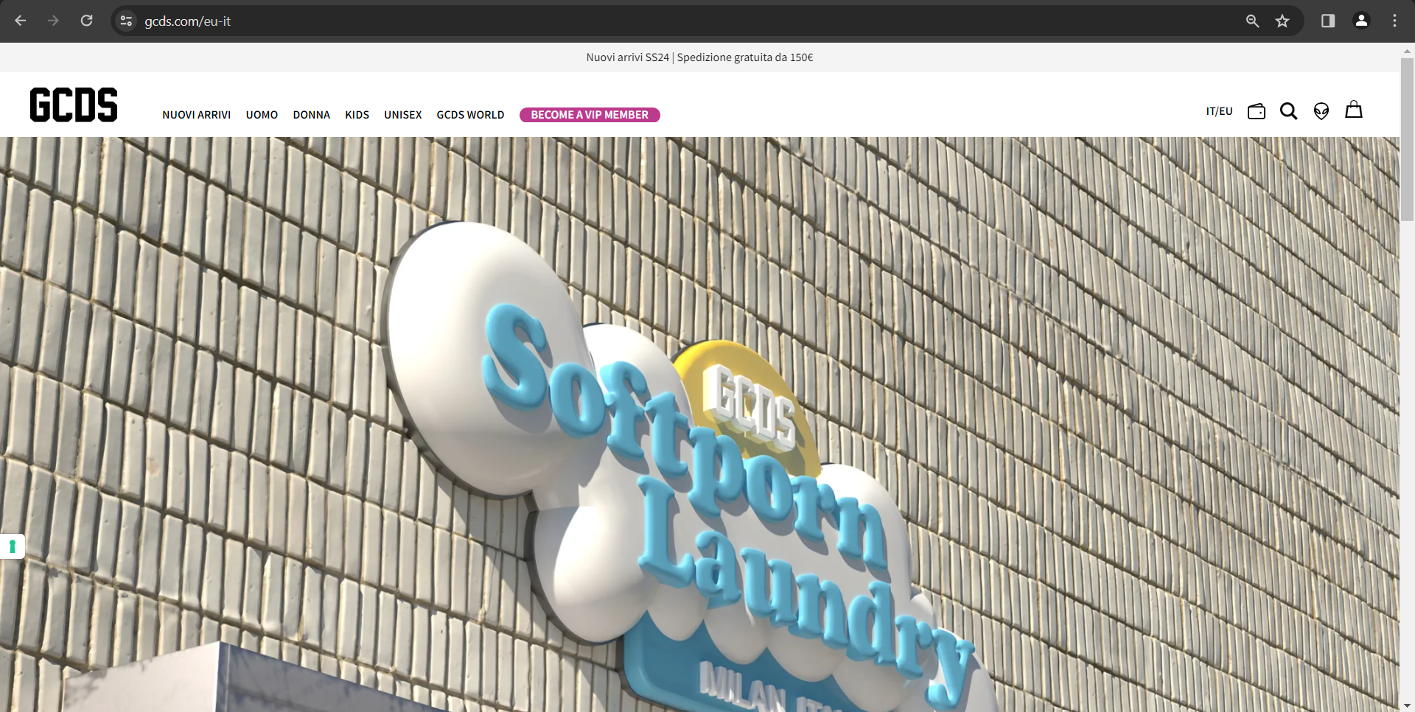

Slide 3
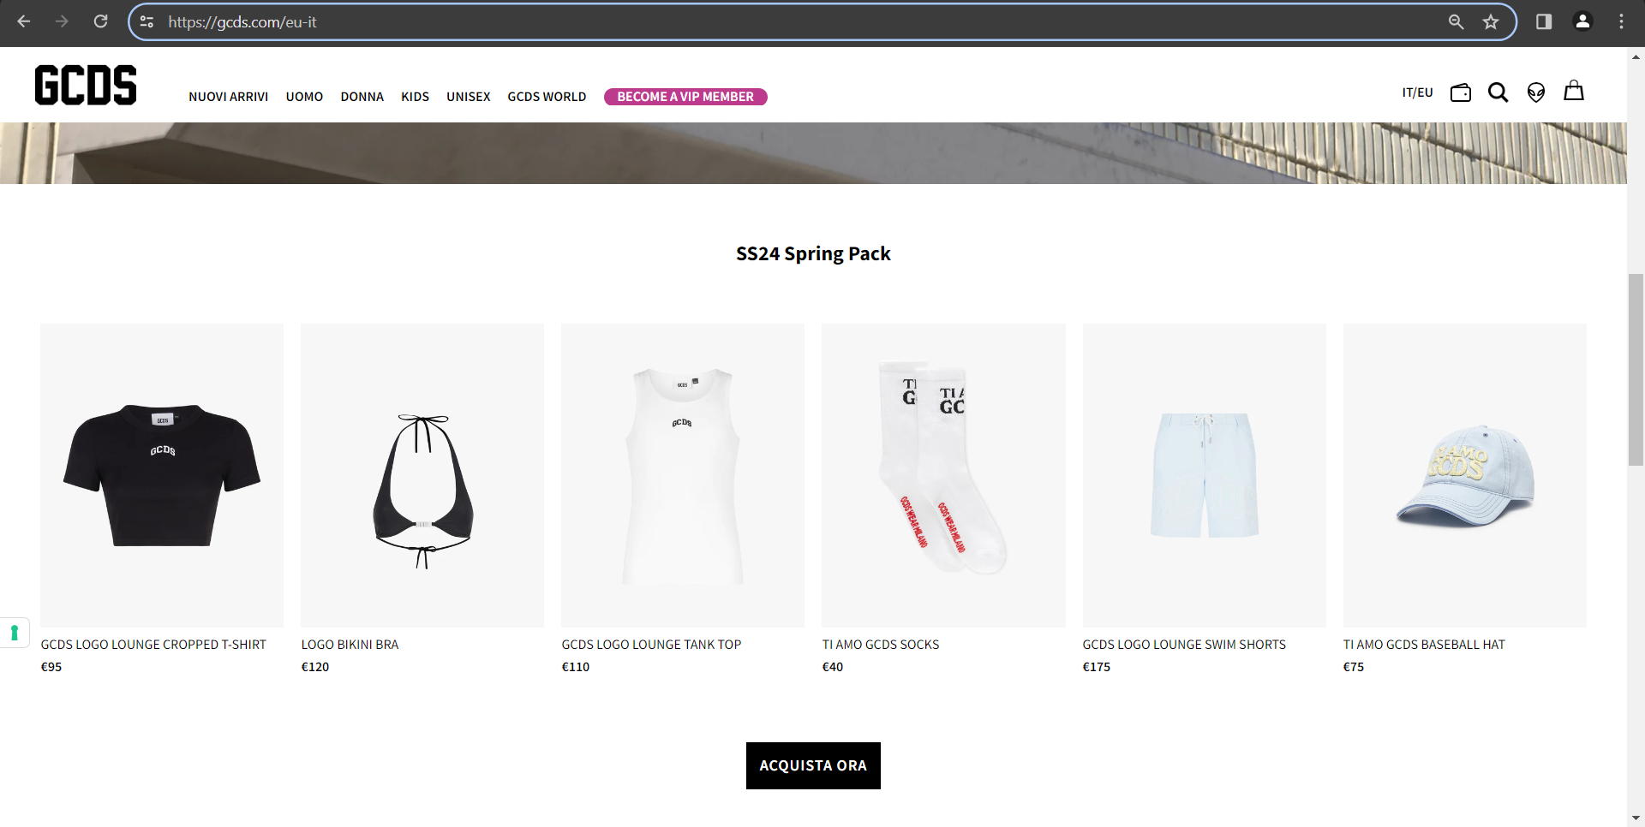

Slide 4
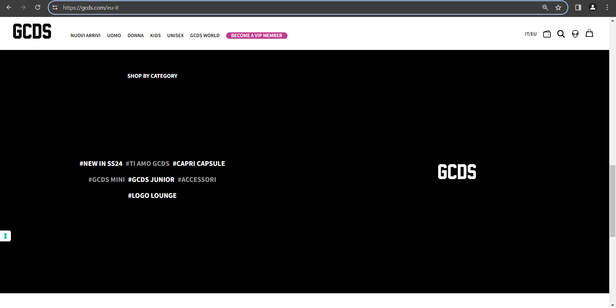

Slide 5
