Slide 1
Causal analysis of immune cell composition in systemic lupus erythematosus disease
Robbe Dufoort
Promoters: Prof. Dr. Oliver Dukes & Dr. Koen Van den Berge

Slide 2
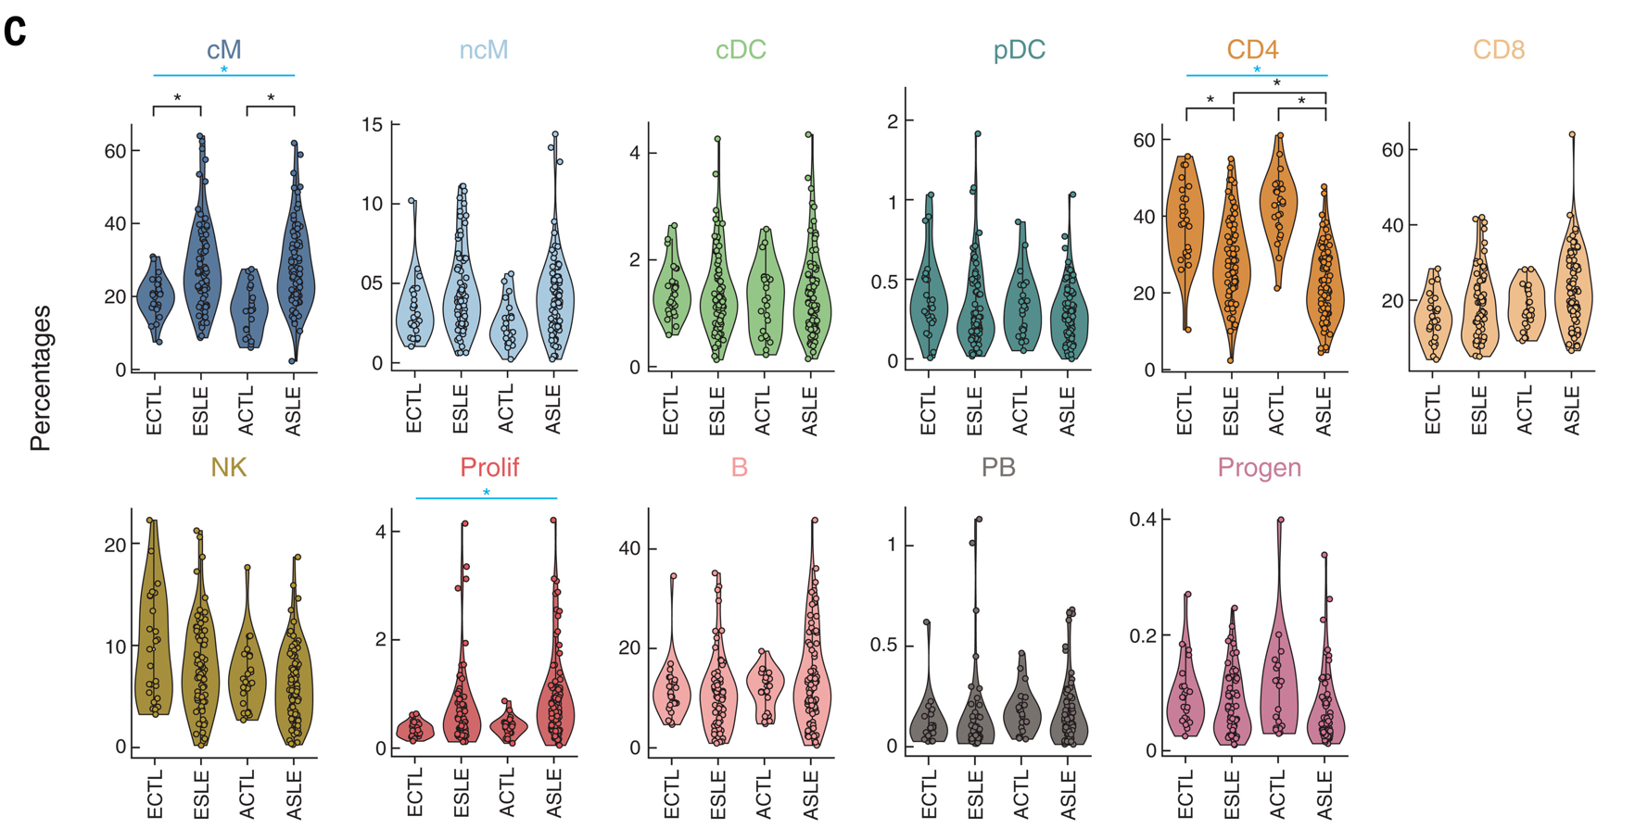
Introduction
Single-cell RNA-seq reveals cell type-specific molecular and genetic associations to lupus (Perez et al.)
Notes:
Notes:
SLE is an autoimmune disease that affects multiple organ systems.
Using sc-RNA seq they determined the immune cell composition in 162 SLE patients and 99 healthy controls.
They compared the abundance of 11 cell types between cases and controls, separately for Asians and Europeans.
They found that there was for both populations an increase in cM and Proliferative cells and a decrease in CD4+ T-cells in the cases compared to the controls.
They also noticed that the decrease in CD4+ T-cell abundance was much bigger in the Asian cases compared to the European population

Slide 3
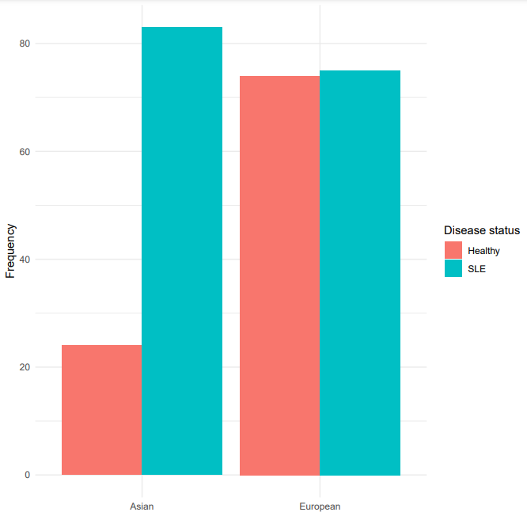
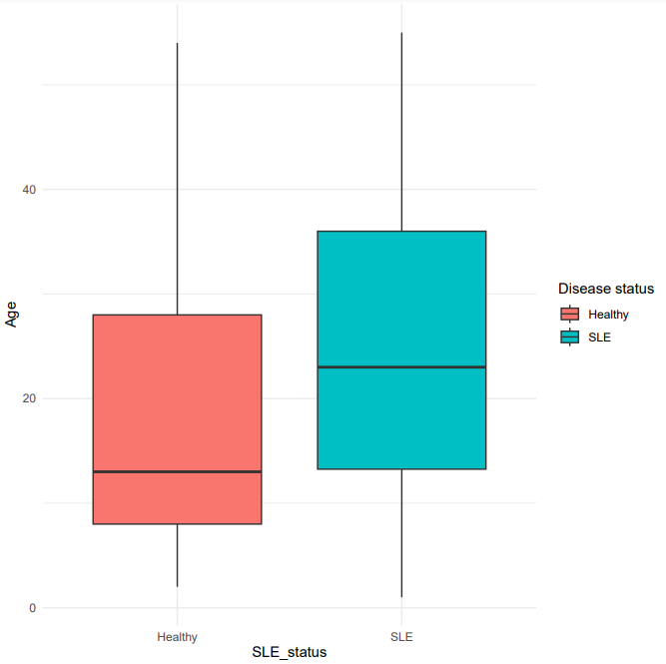
Introduction
Confounding!
Notes:
Notes:
However, Perez disregarded confounders in their data. As a reminder, confounding occurs when a variable is related to both an outcome and an exposure.
They did assess the ethnicity separately, but this is not the ideal way to go.
We incorporated confounding variables in one modelling approach,
Confounders were: Age, Ethnicity and Sex. The data came from 4 processing cohorts, which were also corrected for as they could introduce batch effects.

Slide 4




Introduction
The challenge of compositional data
Unobserved Absolute count
Expected probability
Observed sample
30
10
1/3
30
12
1/3
30
8
1/3
Healthy
Diseased
30
6
3/10
40
14
2/5
30
10
3/10
Notes:
Situation of not being able to assess the absolute counts but only a sample
Negative correlation between the cell types
Even if only our red cell type changes in abundance, the relative abundance changes for all cell types

Slide 5
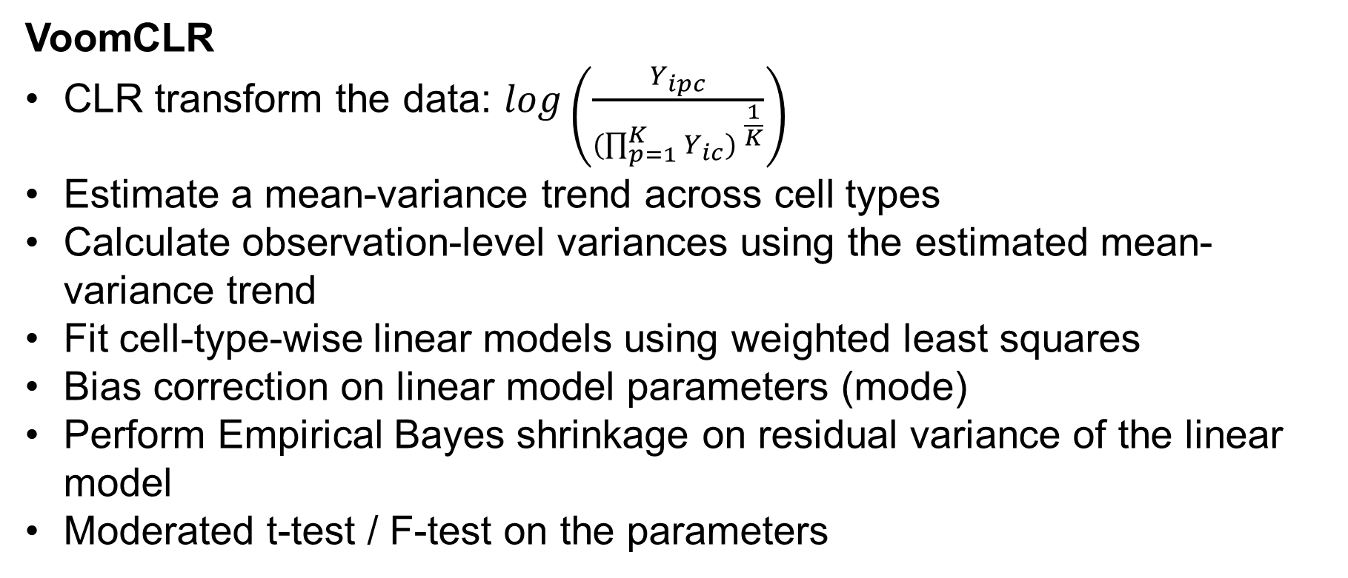
Methods
VoomCLR
CLR transform the data: $\log\left(\frac{Y_{ipc}}{{(\prod_{p=1}^{K}{Y_{ic}) }}^{\frac{1}{K}}}\right)$
Estimate a mean-variance trend across cell types
Calculate observation-level variances using the estimated mean-variance trend
Fit cell-type-wise linear models using weighted least squares
Bias correction on linear model parameters (mode)
Perform Empirical Bayes shrinkage on residual variance of the linear model
Moderated t-test / F-test on the parameters

Slide 6
Methods
Causal Inference
Find cause-and-effect relationships between variables
ATE = E(Y|A=1) – E(Y|A=0)
Inverse Probability Weighting | G-computation | Targeted Maximum Likelihood Estimation
Fit a logistic regression model to model the disease status (Treatment modeling) Derive propensity scores and convert to inverse probability weights. Balance the population using the weights to get an ATE. | Fit a linear regression model to model the cell counts (Outcome modeling) Compute counterfactuals and use them to get an ATE. | Combines treatment and outcome modeling Uses a very clever way to update the outcome model counterfactuals using the propensity scores Double-robust!

Slide 7
Methods
Causal Inference – Identifiability assumptions
Consistency
Positivity
Exchangeability
Correct model specification
Violation of at least one of these assumptions leads to biased results.

Slide 8
Results
Data Exploration

Slide 9
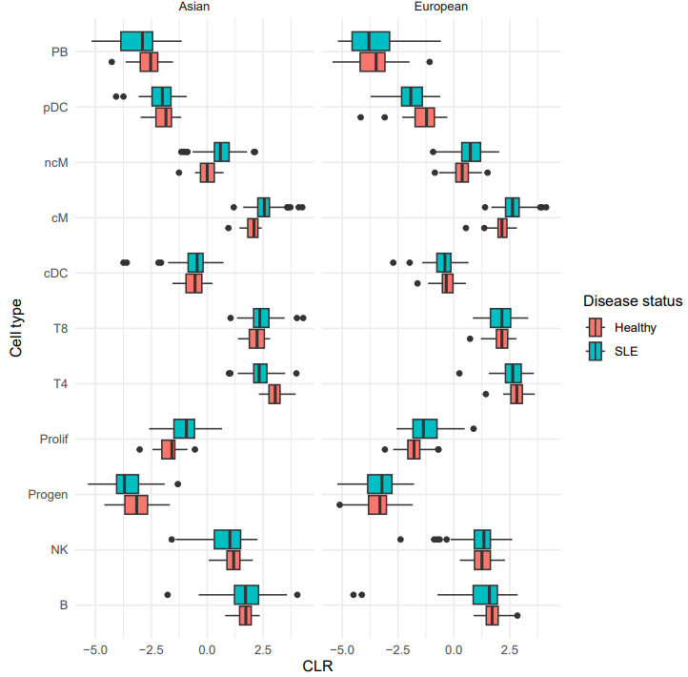
Results
Data exploration
CLR-transformed counts show slight differences between ethnicities.

Slide 10
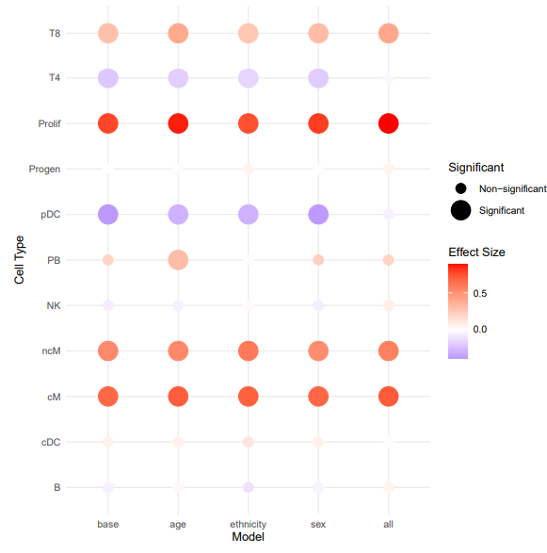
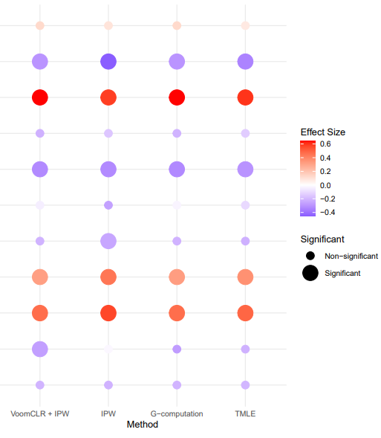
Results
VoomCLR and Causal Inference Analysis

Slide 11
Conclusions
Accounting for compositionality bias is needed in scRNA-seq cell type composition studies
Causal inference enables to correct for confounding in the data
Importance of identifiability assumptions

Slide 12
Robbe Dufoort Supervisors: Prof. Dr. Oliver Dukes Dr. Koen Van den Berge
Thank you for your attention!

Slide 13
Extra slides
Causal vs associations
Empirical bayes
Linear model assumptions
TMLE in depth

Slide 14
Corrections
Formula CPM → 10 should be 1.0

