Slide 1
Causal analysis of immune cell composition in systemic lupus erythematosus disease
Robbe Dufoort
Promoters: Prof. Dr. Oliver Dukes & Dr. Koen Van den Berge

Slide 2
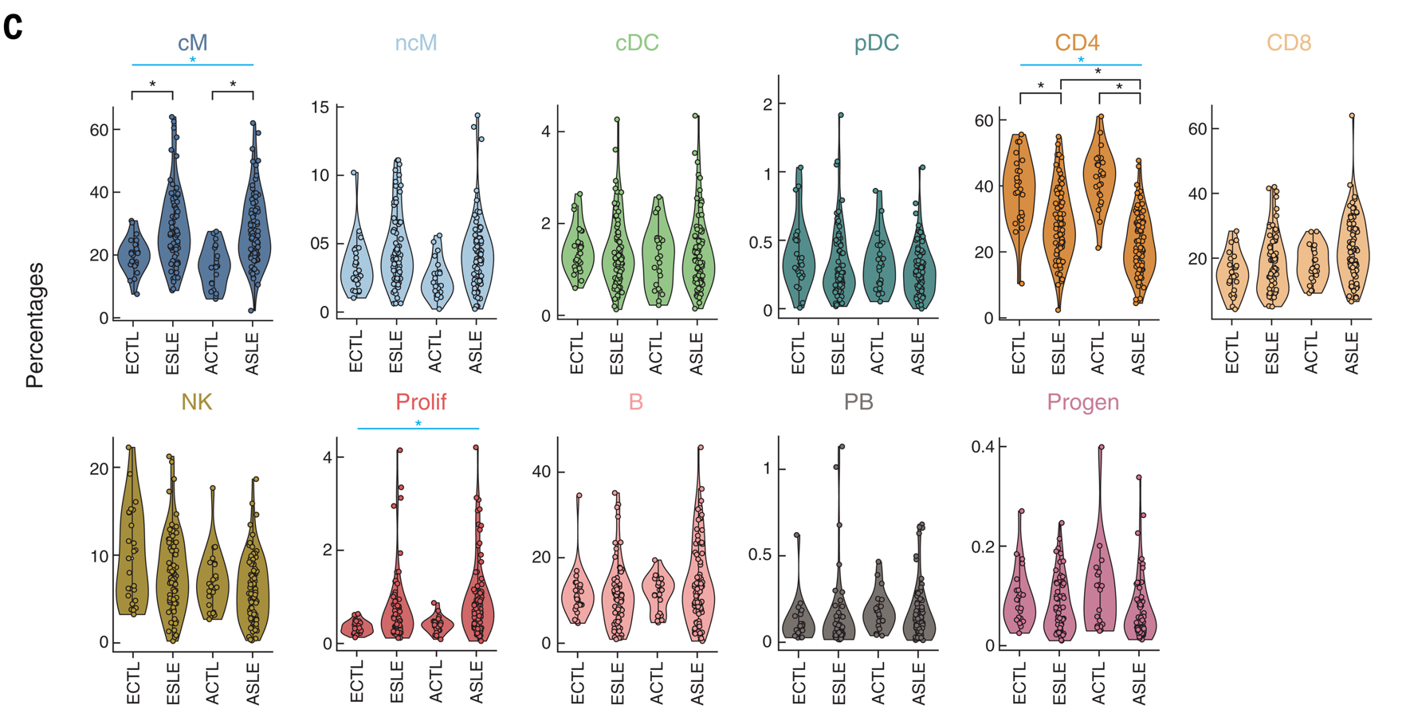
Introduction
Single-cell RNA-seq reveals cell type-specific molecular and genetic associations to lupus (Perez et al.)
Notes:
Notes:
SLE is an autoimmune disease that affects multiple organ systems.
Using sc-RNA seq they determined the immune cell composition in 162 SLE patients and 99 healthy controls.
They compared the abundance of 11 cell types between cases and controls, separately for Asians and Europeans.
They found that there was for both populations an increase in cM and Proliferative cells and a decrease in CD4+ T-cells in the cases compared to the controls.
They also noticed that the decrease in CD4+ T-cell abundance was much bigger in the Asian cases compared to the European population

Slide 3
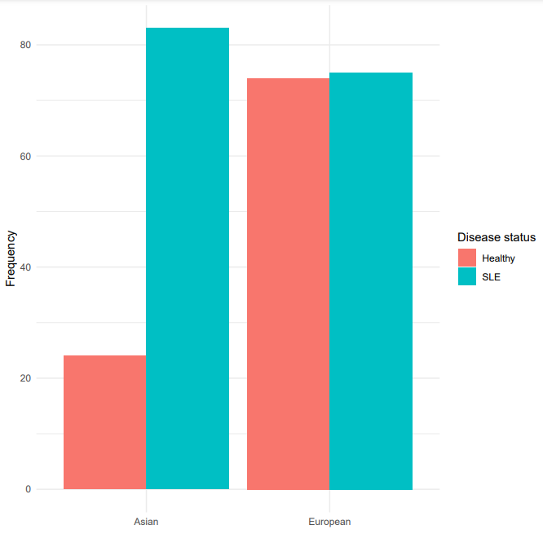
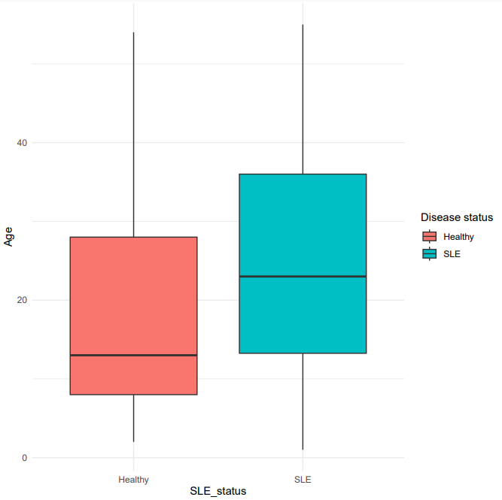
Introduction
Confounding!
Notes:
Notes:
However, Perez disregarded confounders in their data. As a reminder, confounding occurs when a variable is related to both an outcome and an exposure.
They did assess the ethnicity separately, but this is not the ideal way to go.
We incorporated confounding variables in one modelling approach,
Confounders were: Age, Ethnicity and Sex. The data came from 4 processing cohorts, which were also corrected for as they could introduce batch effects.

Slide 4




Introduction
The challenge of compositional data
Unobserved Absolute count
Expected probability
Observed sample
30
10
1/3
30
12
1/3
30
8
1/3
Healthy
Diseased
30
6
3/10
40
14
2/5
30
10
3/10
Notes:
Situation of not being able to assess the absolute counts but only a sample
Negative correlation between the cell types and arbitrary sum of the cells in the observed sample
Even if only our red cell type changes in abundance, the relative abundance changes for all cell types

Slide 5
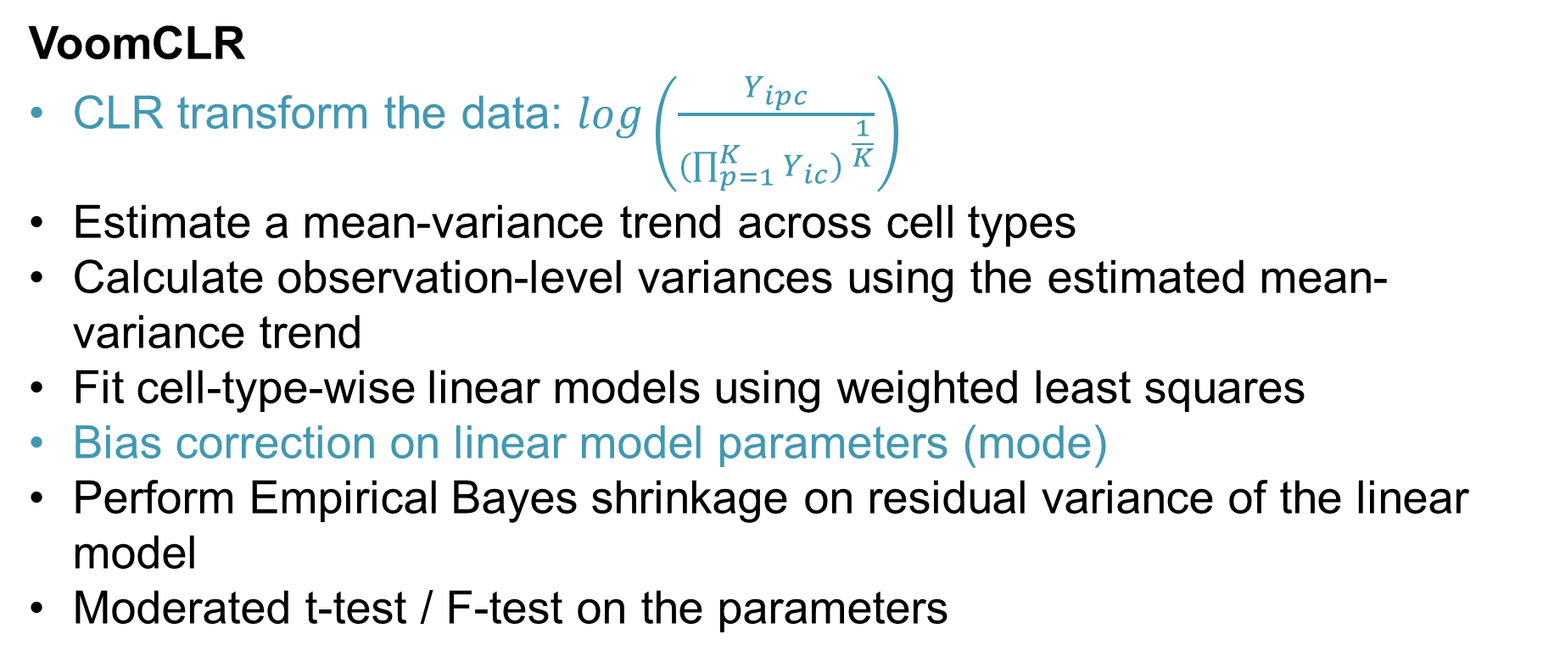
Methods
VoomCLR
CLR transform the data: $\log\left(\frac{Y_{ipc}}{{(\prod_{p=1}^{K}{Y_{ic}) }}^{\frac{1}{K}}}\right)$
Estimate a mean-variance trend across cell types
Calculate observation-level variances using the estimated mean-variance trend
Fit cell-type-wise linear models using weighted least squares
Bias correction on linear model parameters (mode)
Perform Empirical Bayes shrinkage on residual variance of the linear model
Moderated t-test / F-test on the parameters
Notes:
Use CLR transformation to account for composition bias.
Mean-variance trend is estimated and the inverse of the interpolated standard deviation is used as a weight in the cell-type-wise linear models.
There exists bias on the found effect sizes compared to what one would find when you would use absolute counts, thus in order to correct for this, the mode is subtracted.

Slide 6
Methods
Causal Inference
Find cause-and-effect relationships between variables
ATE = E(Y|A=1) – E(Y|A=0)
Techniques:
Inverse Probability Weighting
G-computation
Targeted Maximum Likelihood Estimation
Notes:
Causal inference is the field of study that uses statistical techniques to find cause-and-effect relationships between variables. This differs from normal regression approaches that only look at the correlation between variables.
ATE = the change the average individual would see if you impose the treatment on everyone.

Slide 7
Methods
Causal Inference – Identifiability assumptions
Consistency
Positivity
Exchangeability
Correct model specification
Violation of at least one of these assumptions leads to biased results.

Slide 8
Results
Data Exploration

Slide 9
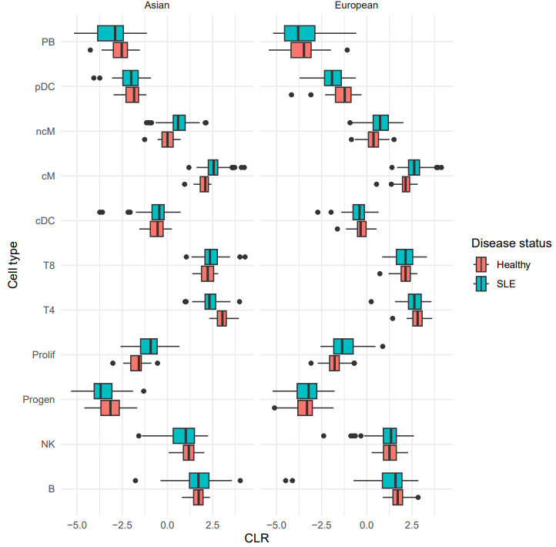
Results
Data exploration
CLR-transformed counts show slight differences between ethnicities.
Notes:
Visual difference in ncm, cm, prolif
T4 only in Asian
pDC only in European

Slide 10
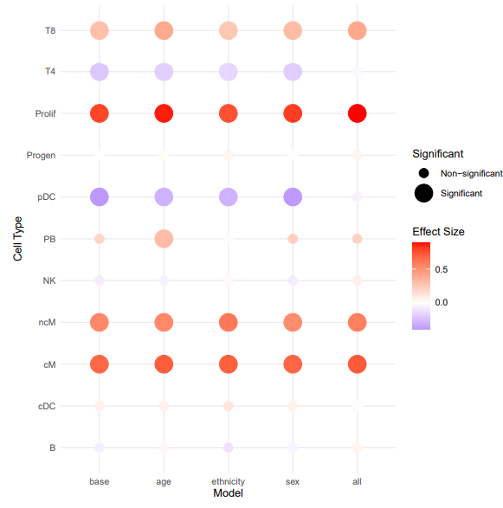
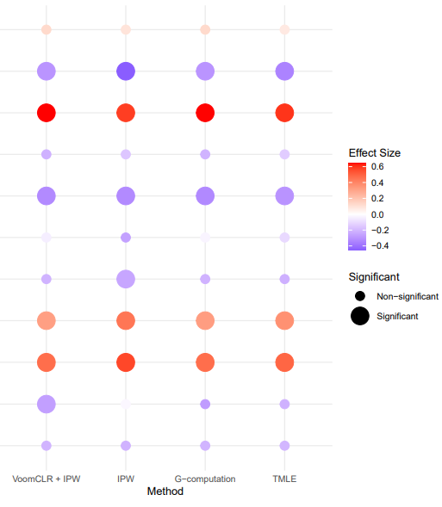
Results
VoomCLR and Causal Inference Analysis
Notes:
What do we see:
This is the effect size of the SLE status on the cell type abundance found by using the different methods.
Colour points to the value of the effect size
Size shows significance from zero
Methods:
VoomCLR containing only sle_status as predictor in the model
VoomCLR containing age, ethnicitym and sex separately
VoomCLR containing all inferred confounders, processing cohort and interaction between SLE_status and ethnicity
VoomCLR containing all confounders and IPW weights
CI methods separately.
Results:
We look at the effect size of the SLE in the models, and test if it is different from zero.
Prolif, Cm everywhere
T4 and pDC everywhere except for voomCLR containing all covariates. Full model does not find that the association is signficant. Could be do to difference in ethnicities
T8 shown to be signficant only when not using CI. This shows that the T8 was actually confounded.
The IPW method shows differences in results compared to g-comp and tmle. As TMLE is the most relieable model, we assessed IPW more, and found out that it suffered from an incorrect model assumption due to a positivity violation when using the ‘correct’ model.

Slide 11
Conclusions
Accounting for compositional bias is needed in scRNA-seq cell type composition studies
Causal inference enables to identify causal effects
Importance of identifiability assumptions

Slide 12
Robbe Dufoort Supervisors: Prof. Dr. Oliver Dukes Dr. Koen Van den Berge
Thank you for your attention!

Slide 13
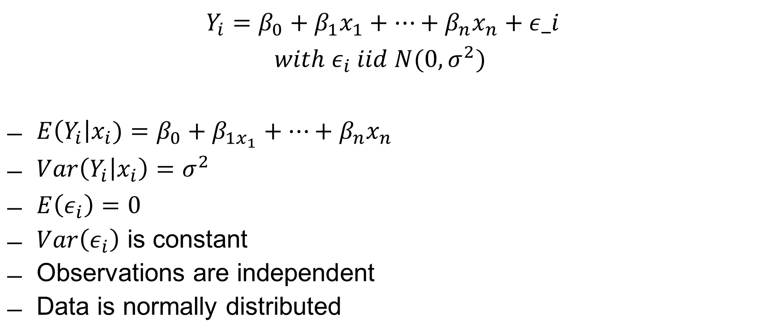
Linear Models
$$Y_{i}=β_{0}+β_{1}x_{1}+…+β_{n}x_{n}+ε_i$$
$$with ε_{i} iid N(0, σ^{2})$$
$E\left(Y_{i}\right|x_{i})=β_{0}+β_{1x_{1}}+…+β_{n}x_{n}$
$Var\left(Y_{i} | x_{i}\right)=σ^{2}$
$E\left(ε_{i}\right)=0$
$Var\left(ε_{i}\right)$ is constant
Observations are independent
Data is normally distributed

Slide 14
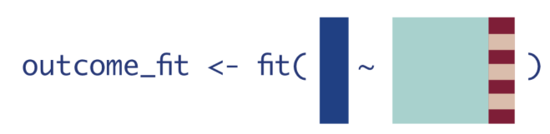
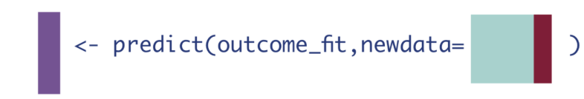
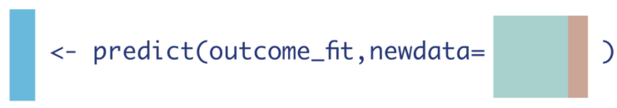

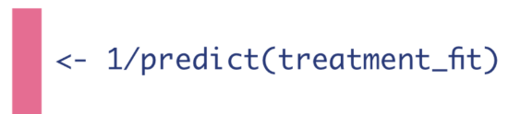
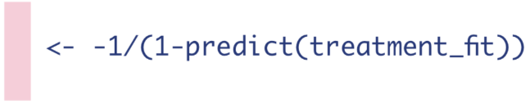

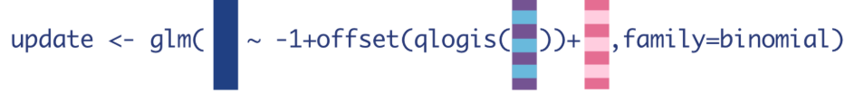
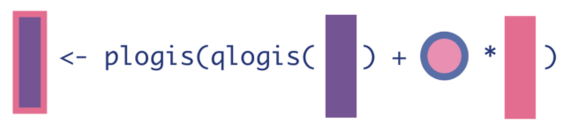
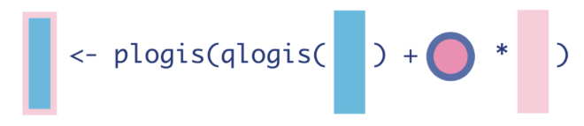
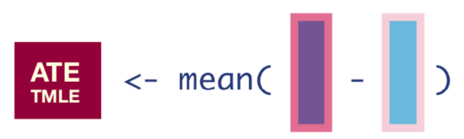
TMLE in more detail
1.
&
2.
&
3.
→
4.
&
5.
Notes:
Fit an outcome model
Predict counterfactuals
Fit treatment model
Calculate IPW for each observation (Clever covariate)
Fluctuation parameter derived from logistic regression model using logit transformed outcome as an offset
Update the initial outcome estimates.

Slide 15
Corrections
Formula CPM → 10 should be 1.0
Bootstrap t-test could have been done fully non-parametric

