Slide 1
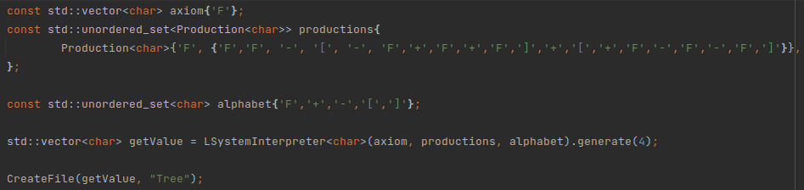
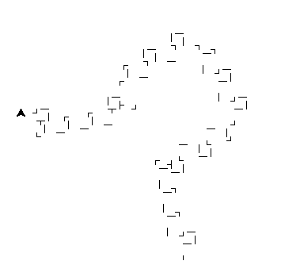
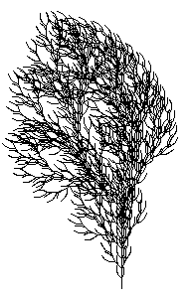
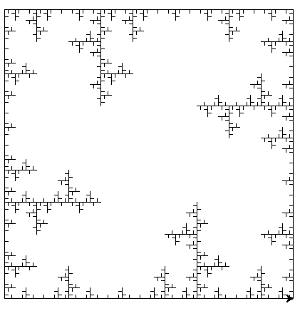
L-System
Whole L-System
  Given format
  Production
  Validation
  Constructor checks
  Generation (With Template)
Unit tests of L-System
Graphical output with Python
Notes:
Hello everyone,
-------------------------------------------------------------------
I have chosen the project L-system because it looked fun to make a tree on its own.
-------------------------------------------------------------------
I completed all the tasks that were listed in the assignment such as the given classes and methods formats. This was a production, validation and L-system classes with each their own unit test.
-------------------------------------------------------------------
All the productions are stored in an unordered list. For this I had to make a hash function.
-------------------------------------------------------------------
To make things al little easier, I made a small console program so that the user can choose witch item it wants to generate.
-------------------------------------------------------------------
To see whats going on, I created a Python script that reads the generated file and draws it with turtle.

Slide 2
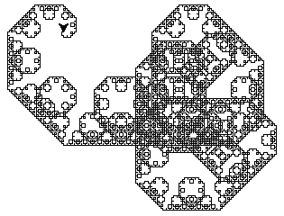
L-System
1 control GUI for L-System
Own geometric interpretation
Notes:
The things I haven’t done but wanted to do are:
-------------------------------------------------------------------
A control GUI for the whole L-system so that the user can select an item and the GUI draws it.
-------------------------------------------------------------------
I also wanted to create an own geometric implementation of a system.
-------------------------------------------------------------------
The picture on the side is something I found when I was experimenting with the productions sets.
-------------------------------------------------------------------
Give demo

