Slide 1
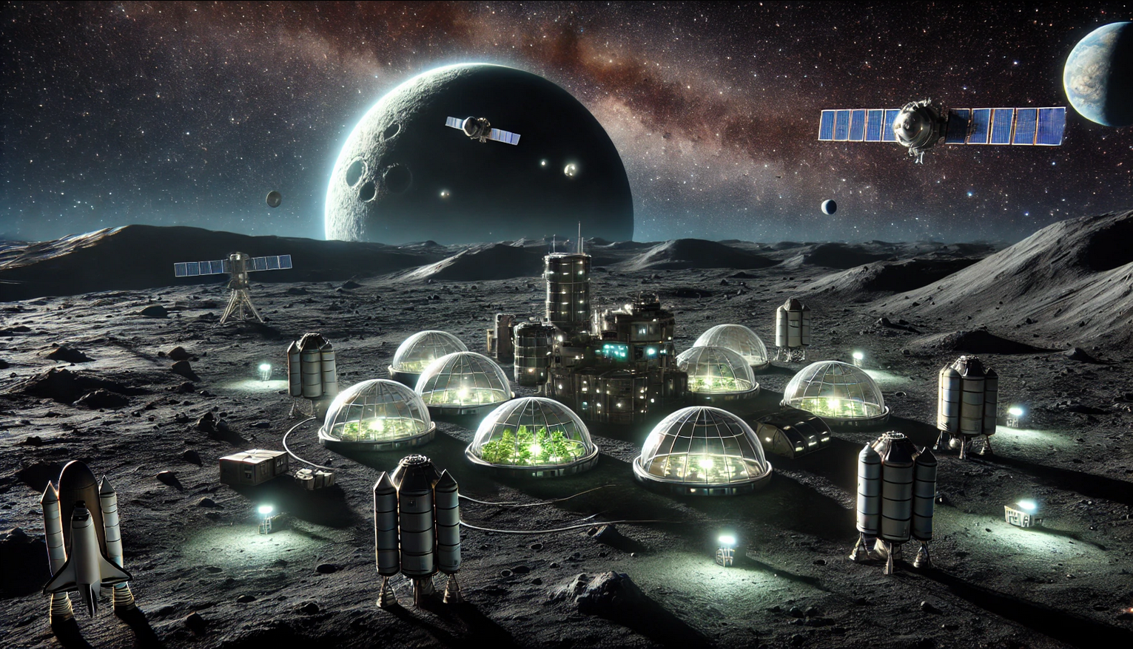
Dark Farmers
I-MBSE Ahmad Shakleya, Berkay Yildirim, Rehmat Khan, Robbe Elsermans

Slide 2
The presentation itself introduces the mission and the system requirements and constraints, the logical architecture, the physical architecture, and the controller. Finally, a small (recorded) demo of the mission is required. Please highlight the different choices you have made during the design and why you made them. Do think about the link with the theory. You will get extra questions that link the presentation and the work with the theory. Your presentation should be around 20 minutes without questions.

Slide 3
Mission
Experimental farm module on the dark side of Mun

Slide 4
System requirements and constrains
Bring experimental farm module to Mun
Provide constant communication between Kerbin and Mun
Deploy 3 satellites at GEO distance arround mun
...

Slide 5
Logical Architecture

Slide 6
Physical Architecture

Slide 7
Controller Architecture

Slide 8
Demo
Some video of a rocket launching and deploying the 3 satellites, and lastly landing on the Mun with the last part.

Slide 9
