Slide 1

Money Tracker
Thomas Kramp
Robbe Elsermans

Slide 2
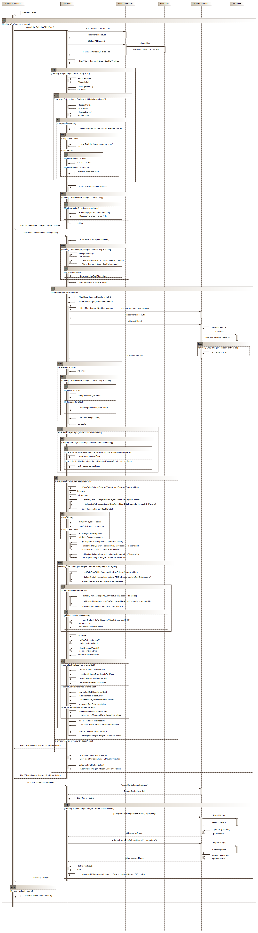
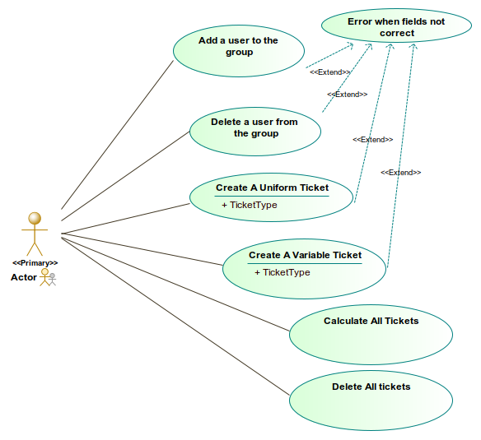
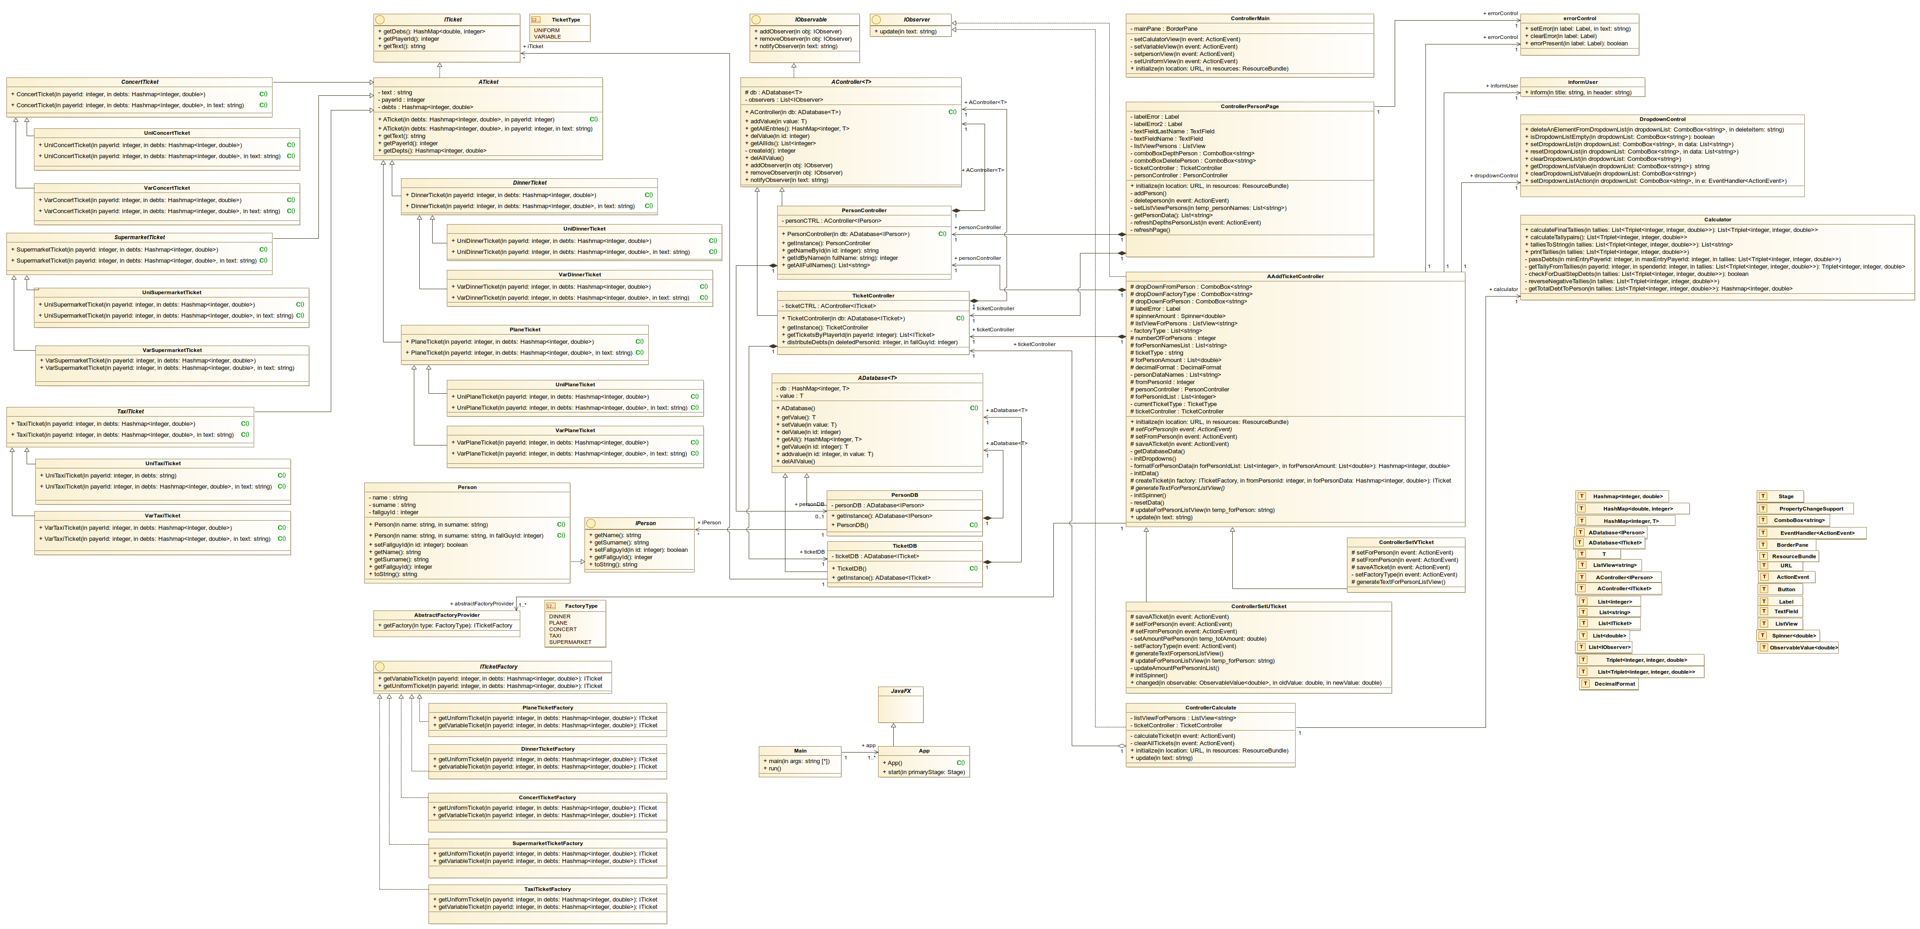
UML
Use case diagram
Class diagram
Sequence diagram of calculator

Slide 3
Patterns
*Singleton Pattern → Database
*Observer Pattern → User alert
*(Abstract) Factory → Ticket Types
*MVC Pattern → GUI
Strategy Pattern → The base-line of tickets
Template Method → Database and database controller

Slide 4
Tests
└── java
├── calculator
│ └── IntegrationTest_Tallies.java
├── database
│ ├── UnitTest_PersonDatabase.java
├── factory
│ ├── facts
│ │ ├── UnitTest_ConcertFactory.java
│ │ ├── UnitTest_DinnerFactory.java
│ │ ├── UnitTest_PlaneFactory.java
│ │ ├── UnitTest_SupermarketFactory.java
│ │ └── UnitTest_TaxiFactory.java
│ └── UnitTest_AbstactFactoryProvider.java
├── person
│ └── UnitTestPerson.java
└── ticket
├── concert
│ ├── UnitTestUniConcertTicket.java
│ └── UnitTestVarConcertTicket.java
├── dinner
│ ├── UnitTestUniDinnerTicket.java
│ └── UnitTestVarDinnerTicket.java
├── plane
│ ├── UnitTestUniPlaneTicket.java
│ └── UnitTestVarPlaneTicket.java
├── supermarket
│ ├── UnitTestUniSupermarketTicket.java
│ └── UnitTestVarSupermarketTicket.java
└── taxi
├── UnitTestUniTaxiTicket.java
└── UnitTestVarTaxiTicket.java
Almost every class, Unit tested
Integration test of Calculator

Slide 5

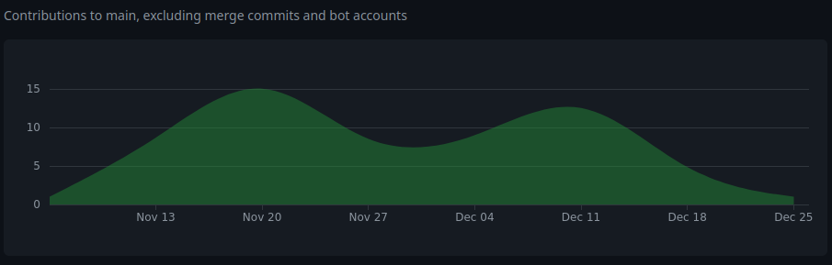
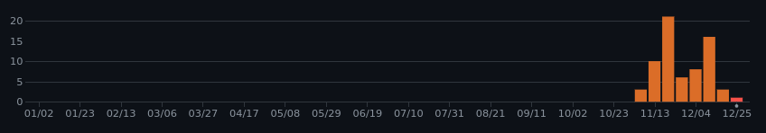
Specials
JavaFX with Scenebuilder
Full Git, hosted on GitHub

