Slide 1
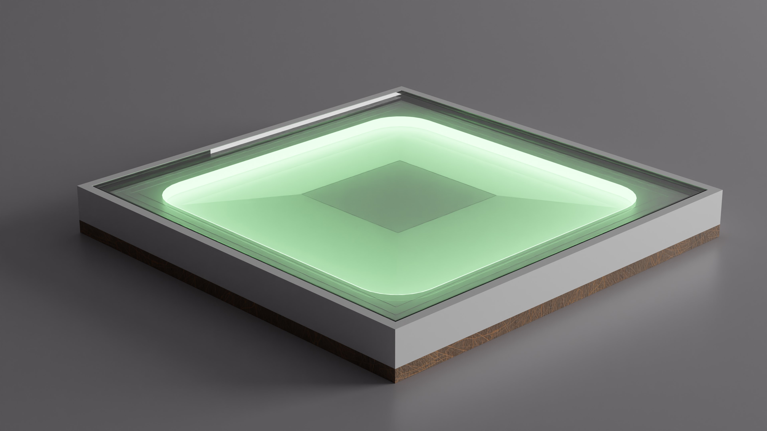
dsfsdf
Music Light Tiles

Slide 2
What is our project?

Slide 3
TeamMembers
Rob Cocquyt
MQTT Communication
Programming
General tasks

Slide 4
Ruben Belligh
Person Detection
Documentation
TeamMembers

Slide 5
TeamMembers
Luca De Clerck
Led strip
Web-socket
Test-Script

Slide 6
TeamMembers
Alberiek Depreytere
Elektronica
Speaker

Slide 7
Materials
Shelf (400 x 400mm)
PLA
Speaker
Led
ESP-32
DC DC Step Down
Media Player
Aluminium Tape
Ruberen Strip
Polycarbonate (5mm)
Power Supply

Slide 8
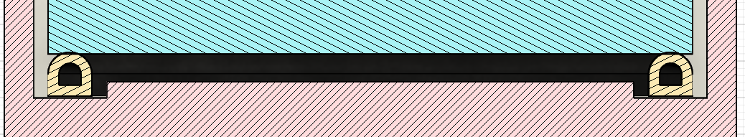
Person Detectie
Rubber strip
Aluminium strips
For Childeren!!!

Slide 9
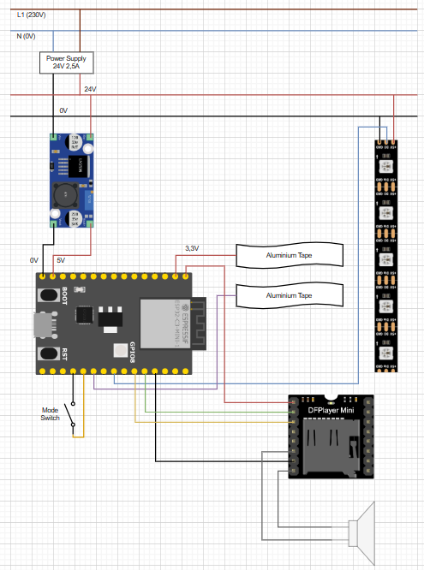
Elektrisch Schema

Slide 10
Problems

Slide 11
Demo

