Slide 1
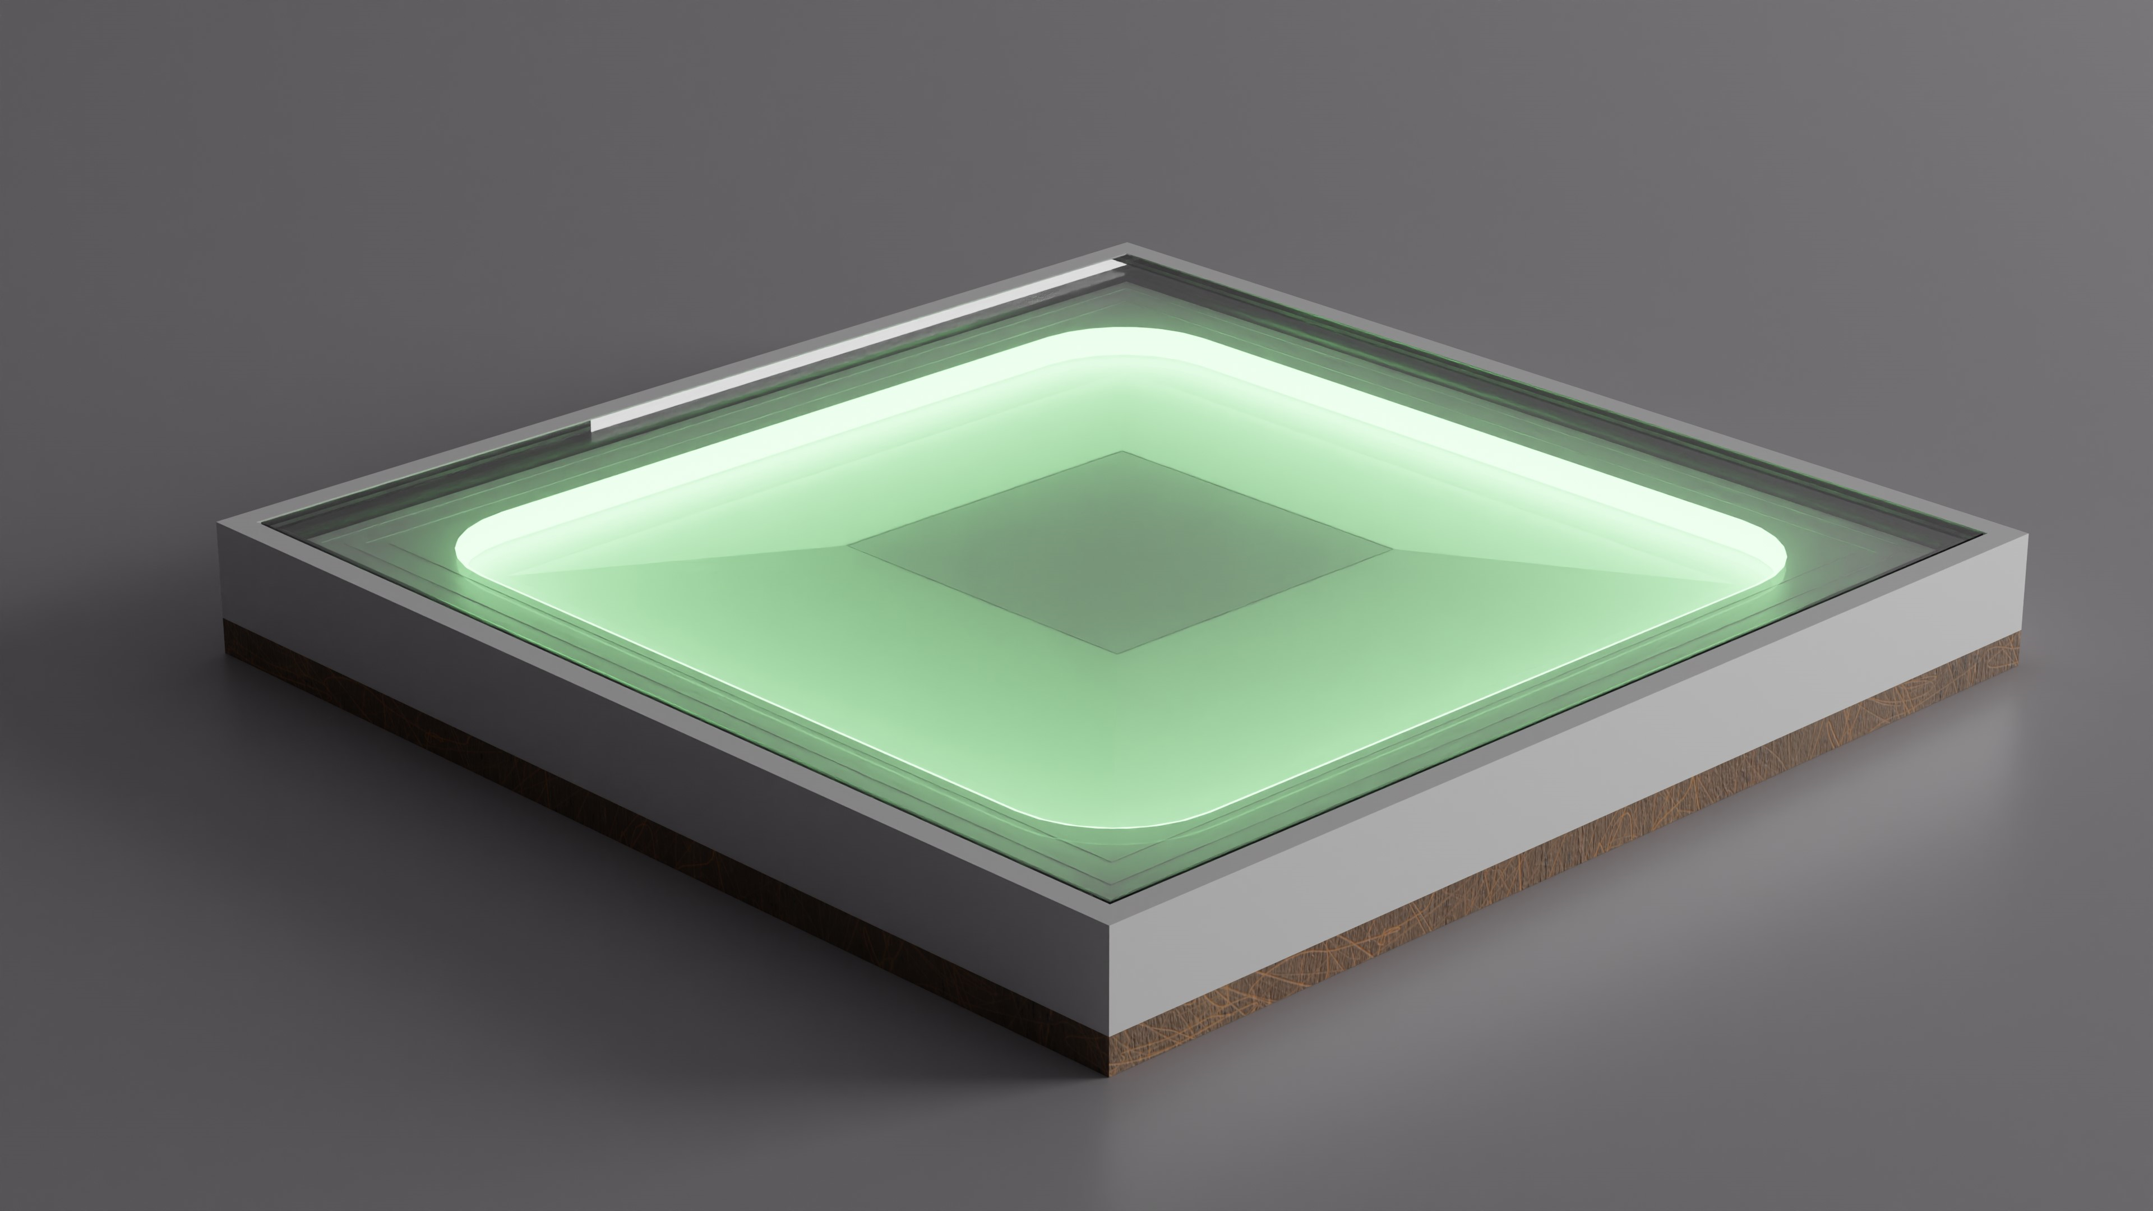
dsfsdf
Music Light Tiles

Slide 2
TeamMembers
Rob Cocquyt
MQTT Communication
Programming
General tasks

Slide 3
Ruben Belligh
Person Detection
Documentation
TeamMembers

Slide 4
TeamMembers
Luca De Clerck
Led strip
Web-socket
Test-Script

Slide 5
TeamMembers
Alberiek Depreytere
Elektronica
Speaker

Slide 6
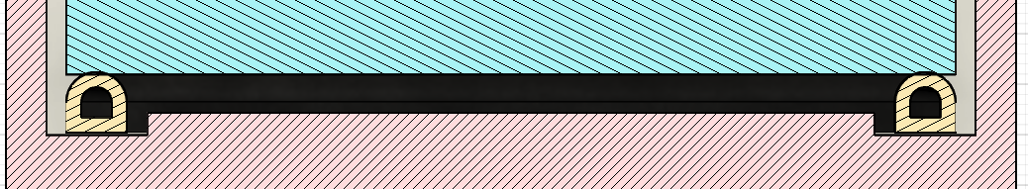
Person Detectie
Rubber strip
Aluminium strips
For Childeren!!!

Slide 7
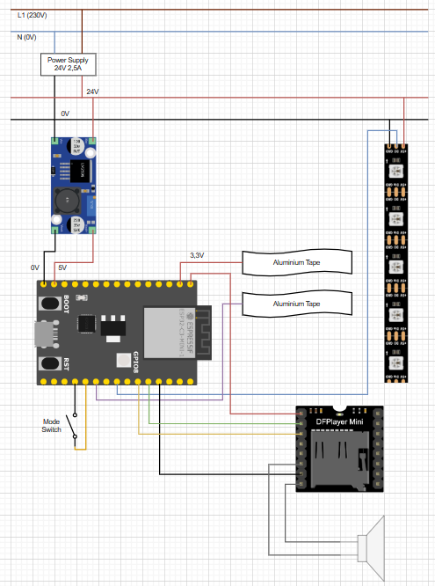
Elektrisch Schema

Slide 8
Materials
Shelf (400 x 400mm)
PLA
Speaker
Led
ESP-32
DC DC Step Down
Media Player
Aluminium Tape
Ruberen Strip
Polycarbonate (5mm)
Power Supply

