Slide 1
Data Pipeline Design
Pipeline Architecture, Processing Strategy, and Storage Format

Slide 2
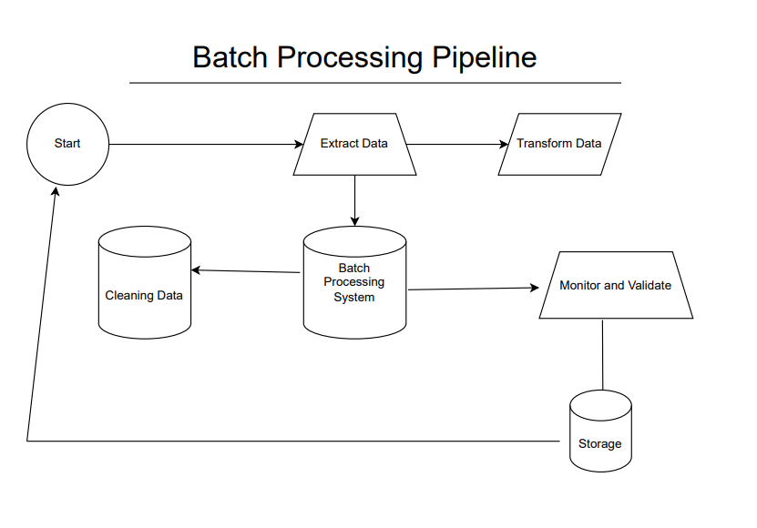

Slide 3
Data Pipeline Overview
1. Extract Data from Relational DB
2. Transform Data (Cleaning, Normalization, Feature Engineering)
3. Store in DB for Analytics
Notes:
Extract Data from Relational DB
Retrieve data from MySQL, PostgreSQL, etc.
Ensure data integrity with optimized queries.
Transform Data (Cleaning, Normalization, Feature Engineering)
Handle missing values, duplicates, and outliers.
Normalize data for consistency.
Store in DB for Analytics
Load cleaned data into a data warehouse.
Enable efficient queries and reporting.

Slide 4
Pipeline Type: Batch Processing
• The data is historical and does not require real-time ingestion.
• Periodic batch updates (daily/hourly) ensure efficient processing.
• Suitable for analytics and machine learning workflows.
Notes:
Historical Data – No Real-time Ingestion
Data remains static, eliminating the need for real-time streaming.
Periodic Batch Updates (Daily/Hourly)
Ensures efficient processing without overwhelming resources.
Optimized for Analytics & Machine Learning
Structured for insightful analysis and model training.

Slide 5
Chosen Data Format: PostgreSQL Table
• Processed data will be stored in another PostgreSQL table.
• Enables easy querying, indexing, and integration with BI tools.
• Supports schema enforcement and transactional consistency.
Notes:
Stored in Another PostgreSQL Table
Processed data is kept separate from raw data to maintain clarity and version control.
Helps in organizing structured datasets for further analysis.
Easy Querying & BI Tool Integration
Indexing allows faster searches and optimized queries.
Easily connects with Business Intelligence (BI) tools like Tableau and Power BI for visualization.
Schema Enforcement & Consistency
Ensures that data follows a strict format to avoid inconsistencies.
Supports ACID (Atomicity, Consistency, Isolation, Durability) properties for reliable transactions.

Slide 6
Three Key Data Quality Issues
✅ Missing Values: Ensure no gaps exist in critical columns.
🚨 Outliers: Detect extreme values in 'cnt', 'casual', etc.
📊 Categorical Consistency: Validate predefined category values
Notes:
Missing Values
Identify and fill gaps in key columns to prevent incomplete analysis.
Outliers
Detect extreme values in cnt, casual, etc., to avoid skewed insights.
Categorical Consistency
Ensure category values match predefined labels to maintain data integrity.

Slide 7
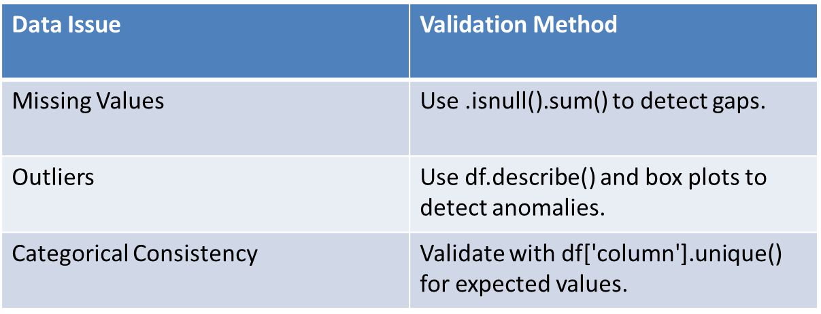
Validation and Monitoring

Slide 8
Detecting Data Drift and Schema Changes
📌 **Schema Validation**: Regularly check column names and data types.
📈 **Distribution Monitoring**: Track mean, median, and category frequencies.
⚠ **Automated Alerts**: Implement anomaly detection to flag unexpected changes.
Notes:
Schema Validation
Regularly verify column names and data types to prevent structural issues.
Distribution Monitoring
Track mean, median, and category frequencies to detect data drift.
Automated Alerts
Implement anomaly detection to flag unexpected changes in data patterns.

Slide 9
