Slide 1
Data Engineering Week 2 Assignment
Submitted by: Rabin Acharya
Submitted to: Christy Pearson

Slide 2
Introduction to dataset (Bike rental data)
Dataset Overview: Contains hourly bike rental data, combining temporal (e.g., season, hour, weekday), weather (e.g., temperature, humidity), and user-related features.
Target Variable :cnt (total bike rentals), representing the combined count of casual and registered users.
Purpose: Supports predictive modeling to optimize bike allocation, analyze demand trends, and improve operational efficiency.
Source: https://archive.ics.uci.edu/dataset/275/bike+sharing+dataset
Dataset Description: Given below on a table

Slide 3
Feature | Description | Type | Example Values
instant | Record index (row number). | Integer | 1, 2, 3, ...
dteday | Date of the record. | Date | 2011-01-01
season | Season of the year (1: Spring, 2: Summer, 3: Fall, 4: Winter). | Categorical | 1, 2, 3, 4
yr | Year (0: 2011, 1: 2012). | Binary | 0, 1
mnth | Month (1 to 12). | Categorical | 1, 2, ..., 12
hr | Hour of the day (0 to 23). | Categorical | 0, 1, ..., 23
holiday | Whether the day is a holiday (1: Yes, 0: No). | Binary | 0, 1
weekday | Day of the week (0: Sunday to 6: Saturday). | Categorical | 0, 1, ..., 6
workingday | Whether the day is a working day (1: Yes, 0: No). | Binary | 0, 1
weathersit | Weather condition (1: Clear, 2: Mist, 3: Light rain, 4: Heavy rain). | Categorical | 1, 2, 3, 4
temp | Normalized temperature in Celsius (divided by 41). | Continuous | 0.2, 0.5, ...

Slide 4
Feature | Description | Type | Example Values
atemp | Normalized "feels like" temperature in Celsius (divided by 50). | Continuous | 0.3, 0.6, ...
hum | Normalized humidity (divided by 100). | Continuous | 0.4, 0.8, ...
windspeed | Normalized wind speed (divided by 67). | Continuous | 0.1, 0.3, ...
casual | Count of registered users. | Integer | 50, 100, ...
registered | Count of registered users. | Integer | 200, 400, ...
cnt | Total bike rentals (sum of casual and registered users). | Integer | 250, 500, ...

Slide 5
Problem Statement
Objective: Develop a machine learning model to predict hourly bike rental demand, supporting better resource allocation and improved user experience.
Stakeholder Alignment:
Collaborate with operators to align with business goals (e.g., optimize bike distribution, reduce wait times).
Feasibility Analysis:
Assess data availability (temporal, weather, user-related features).
Identify technical constraints for scalability and deployment.
Outcome Clarity:
Deliver accurate predictions for total rentals(cnt)
Establish clear success metrics to drive data-informed decisions.

Slide 6
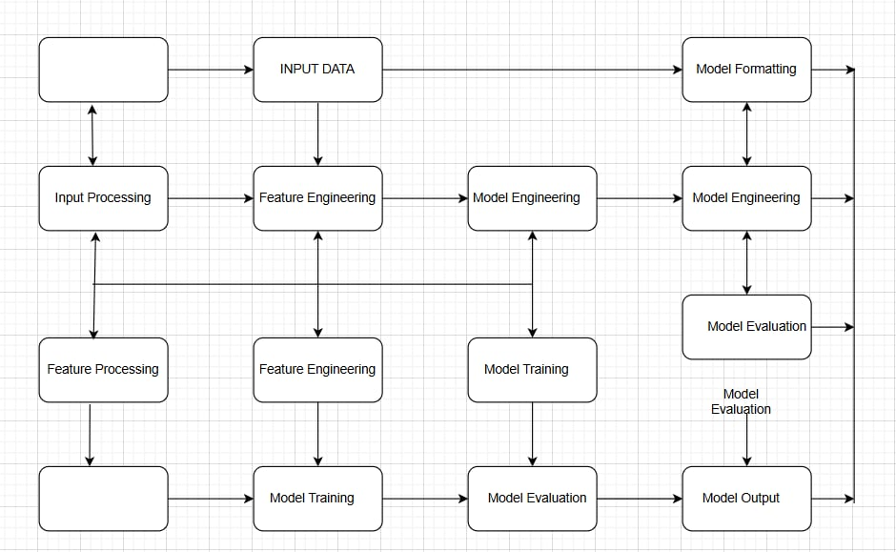
MLS system

Slide 7
