Slide 1
Sensors and Control for Mechatronic Systems
Name | SID
Maximilian Deda | 14267924
Milo Boyd | 14265185
Robert Howe | 14288841

Slide 2
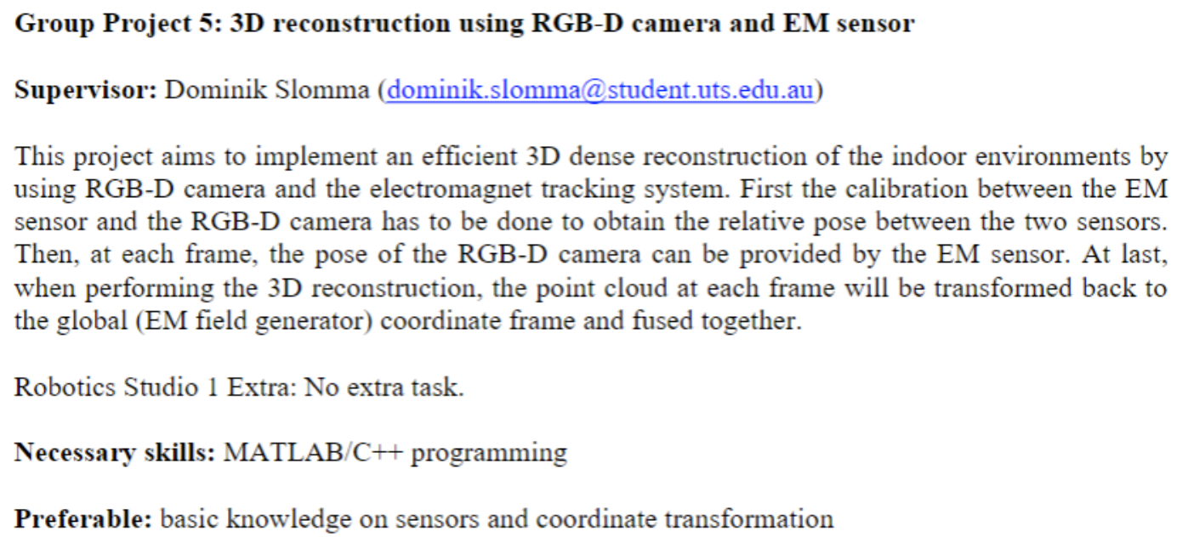
Project Description

Slide 3
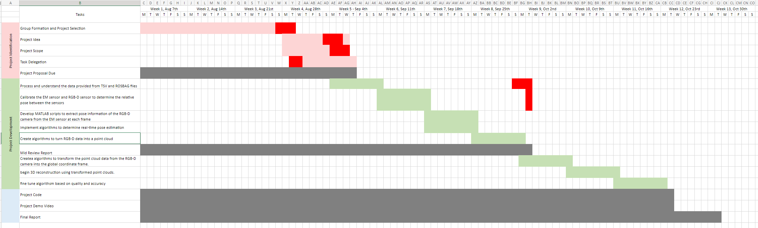
Project Timeline

Slide 4
Psuedo code, Flowchart

Slide 5
Methodology
Extract Depth images from Rosbag
Read Images and generate a point cloud for each to be assigned into an array.
Merge point clouds into one Master Cloud using ICP

Slide 6
Experiments
Multiple Point Cloud Generation Methods
Different Methods of filtering interference
Region of Interest Testing

Slide 7
Demo Vid

Slide 8
Thank You for watching

