Slide 1

Sensors and Control Final Project
/ 41014
Robert Howe (14288841)
Max Deda (14267924)
Milo Boyd (14265185)
/ 2023
Notes:
We are a digital twin company that provides digital twin bases and helps to integrated and overlay all the required functionality and information you might need withing your clone of the real world. Streamlining information flow to increase efficiency and cohesion in any project from real estate to city scale issues

Slide 2

Contents //
1
2
3
4
5
Introduction
k
k
k
Q&A

Slide 3
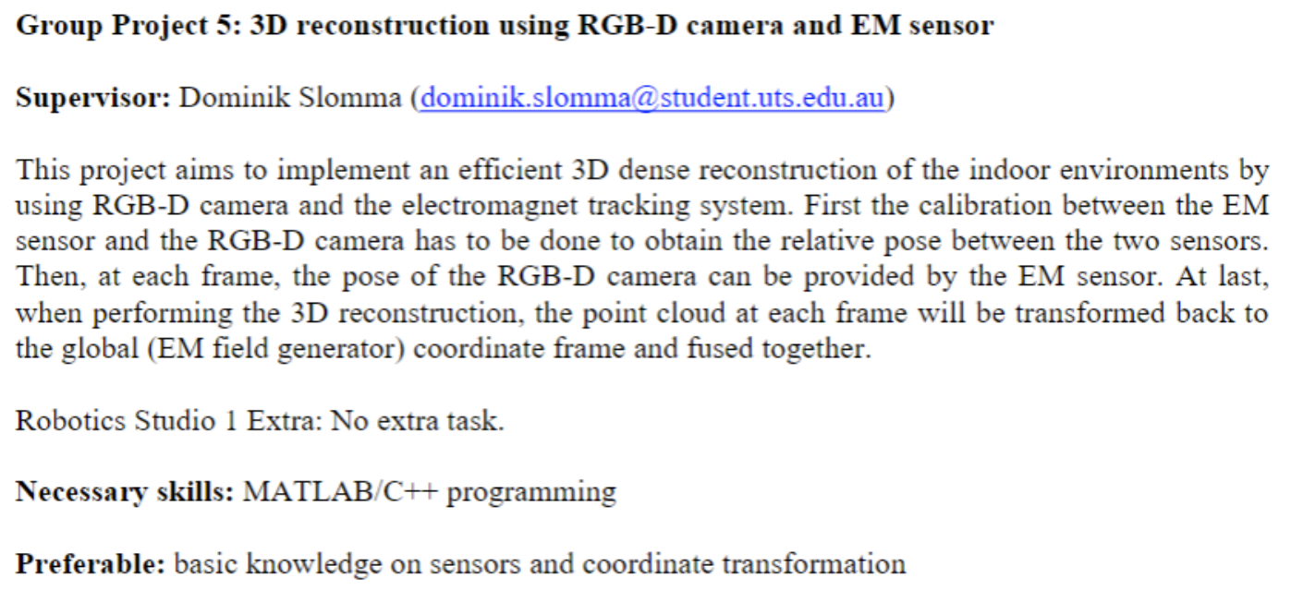
Project Description
Notes:
Recently expanded into turkey to work on creating a digital twin of Istanbul for the government also recently partnered with companies in Japan such as soft bank creating a ditial twin of Tokyo

Slide 4
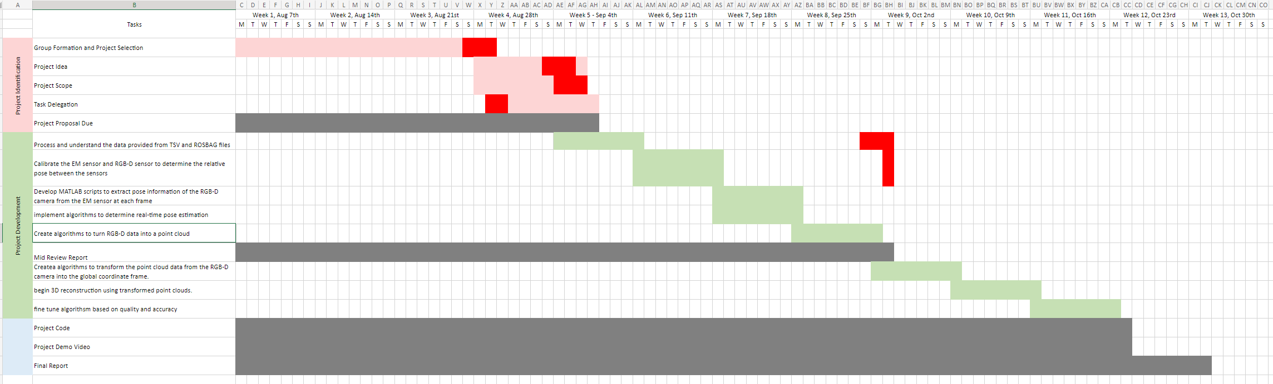
Project Timeline
Notes:
Recently expanded into turkey to work on creating a digital twin of Istanbul for the government also recently partnered with companies in Japan such as soft bank creating a ditial twin of Tokyo

Slide 5
Pseudo Code and Flow Chart
Notes:
All in one folder

Slide 6
Methodology
Extract Depth images from Rosbag
Read Images and generate a point cloud for each to be assigned into an array.
Merge point clouds into one Master Cloud using ICP
Notes:
All in one folder

Slide 7
Experiments
Multiple Point Cloud Generation Methods
Different Methods of filtering interference
Region of Interest Testing

Slide 8
Demo vid

Slide 9
Thank You
For

