Slide 1
MVC
Robbie Talbot

Slide 2
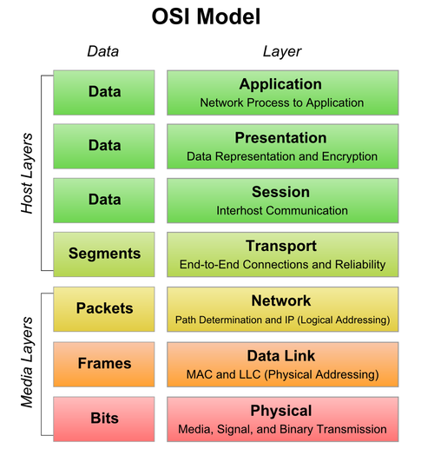
Remember this?

Slide 3
Intro to MVC
MVC, or Model-View Controller, is an application design model that has three parts:
Model (data)
View (user interface)
Controller (processes the input)

Slide 4
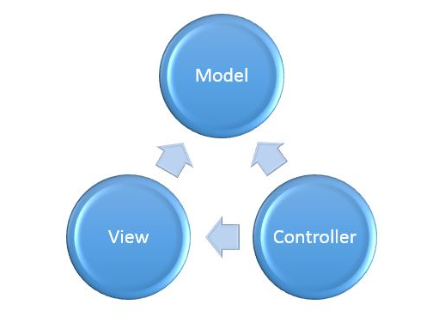

Slide 5
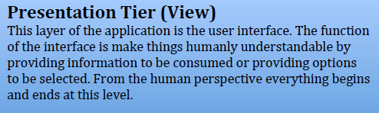
Presentation Tier

Slide 6
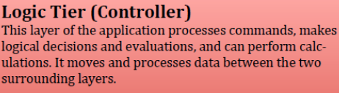
Logic Tier

Slide 7
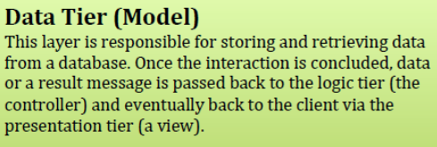
Data Tier

Slide 8
