Slide 1

Wine Chemical Analysis
Ed Haracz & Rob Zifchak

Slide 2
Question:
Can The Quality Rating of Wine Be Predicted By Chemical Composition?

Slide 3
Data
Data Source: UCI Repository
2 datasets containing red and white “Vinho Verde” wines from Portugal.
Chemical composition of wines are recorded by a computerized system and given a blind taste test score of 0-10.
Each data entry denotes a unique wine.
6497 total observations

Slide 4
Variables
Initial Variables:
Dependent: Quality Score
Independents: Fixed Acidity, Volatile Acidity, Citric Acid, Residual Sugar, Chlorides, Free Sulfur Dioxide, Total Sulfur Dioxide, Density, pH, Sulphates, Alcohol, Color
  12 total

Slide 5
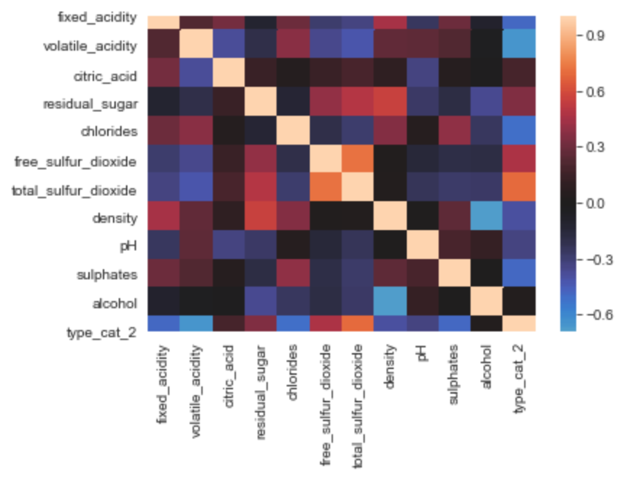
Exploratory Data Analysis
Created dummy variables to categorize color
Looked at correlation between all variables
Observed distributions of each variable
Pairplot of all variables
Dropped one independent due to multicollinearity

Slide 6
Normalization and Standardization
All independents are log-transformed and then mean-normalized (other than color)
Dependent is mean normalized

Slide 7
Feature Engineering
After performing polynomial transformation (degree of 2) and Interaction analysis:
  65 independent variables
Performed backward recursive elimination of variables
  Ran a model
  Variable drop based on p-value
  Check for multicollinearity
Repeated process until no multicollinearity existed and all p-values were sufficiently low
  Result: 16 independent variables

Slide 8
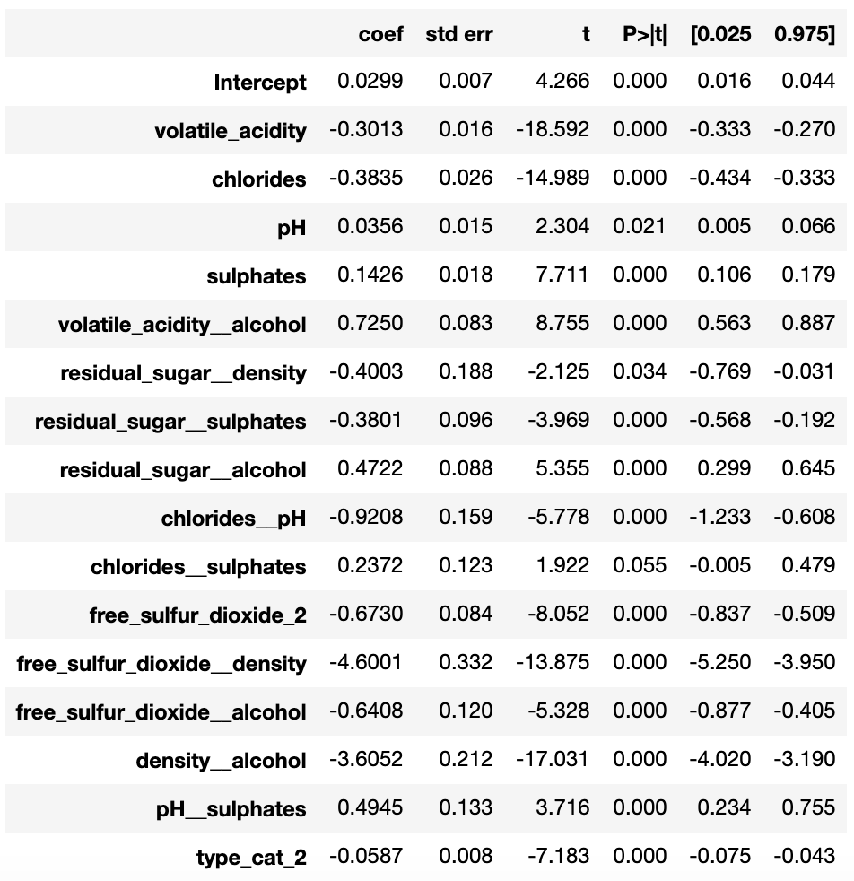
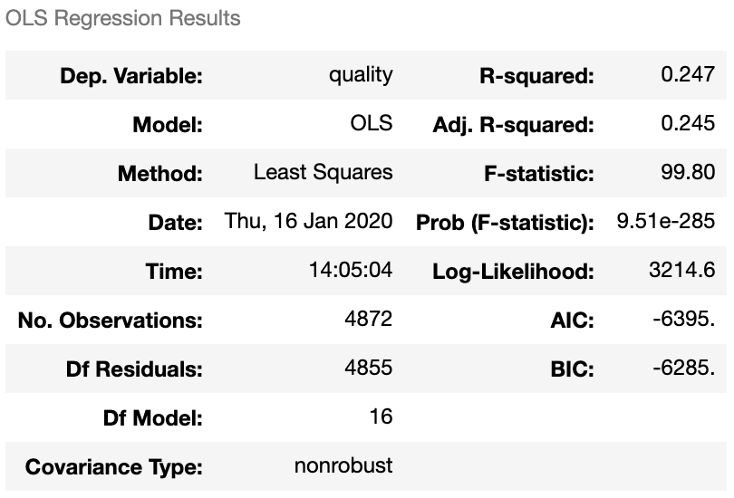
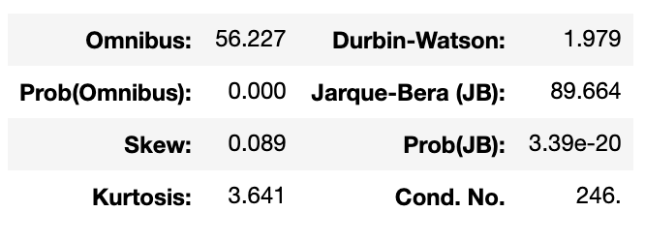
Model Results

Slide 9
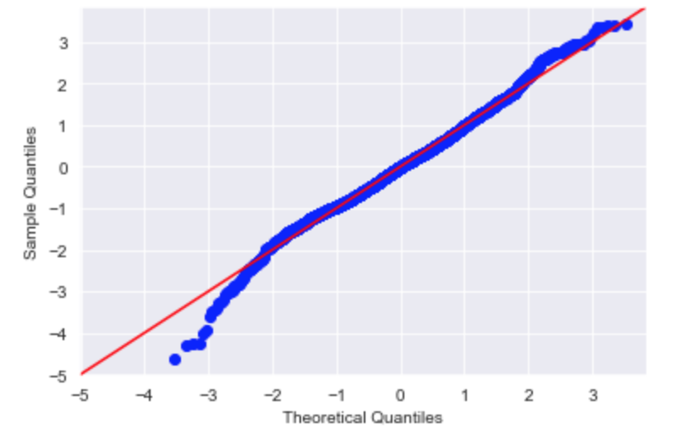
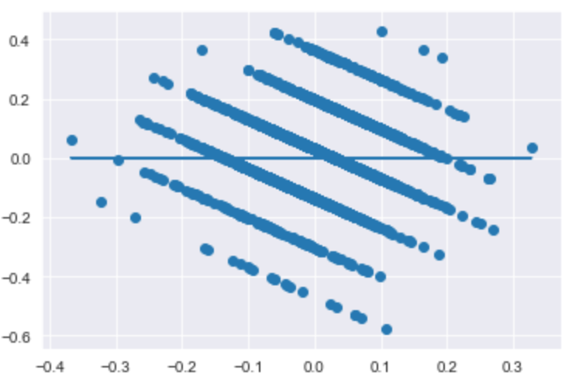
Assumption Plots
Normality
Homoscedasticity

Slide 10
Validation Results
Mean Squared Errors:
Train : 0.015952
Test : 0.015927

Slide 11
Conclusion
Interactions between chemical components were the overall most important group of variables in our model
We determined that the chemical composition alone can account for a approximately a quarter (24.7%) of the quality rating.
  We can predict that same percentage of the overall quality rating given the chemical inputs
The model has a low R-squared value due to all the factors leading to wine quality that were not included in the dataset such as (grape, weather conditions, etc.)

