Slide 1
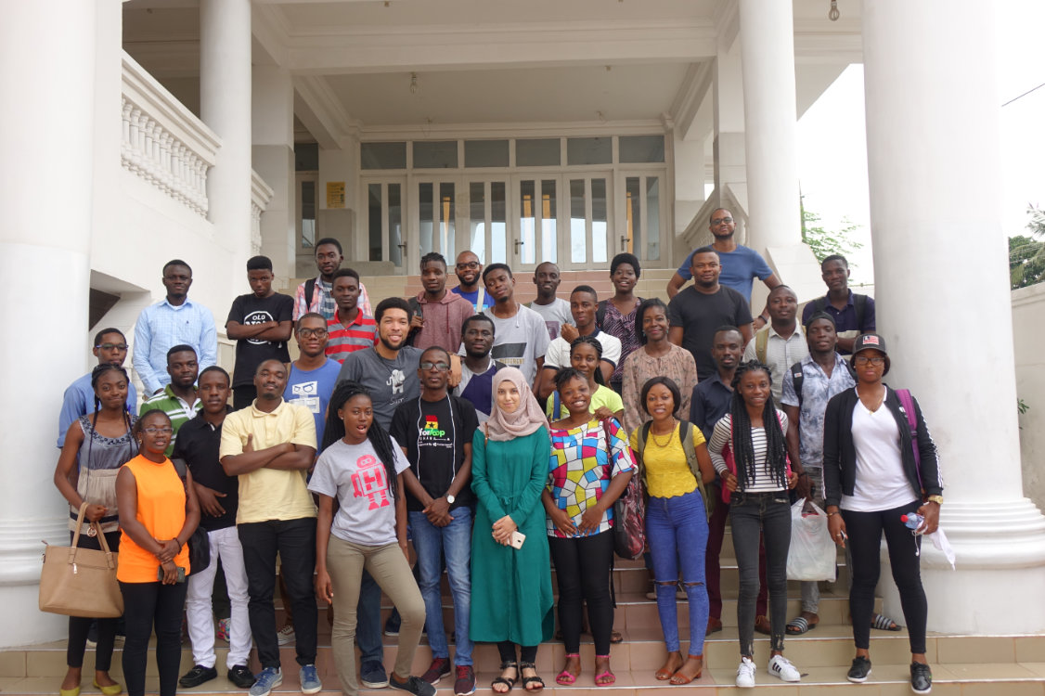

Building the Next Generation World Class Software Developers & Designers

Slide 2




Imagine your phone had no App Store or Play Store
What would be the State of Technology without Software Developers & Designers?

Slide 3
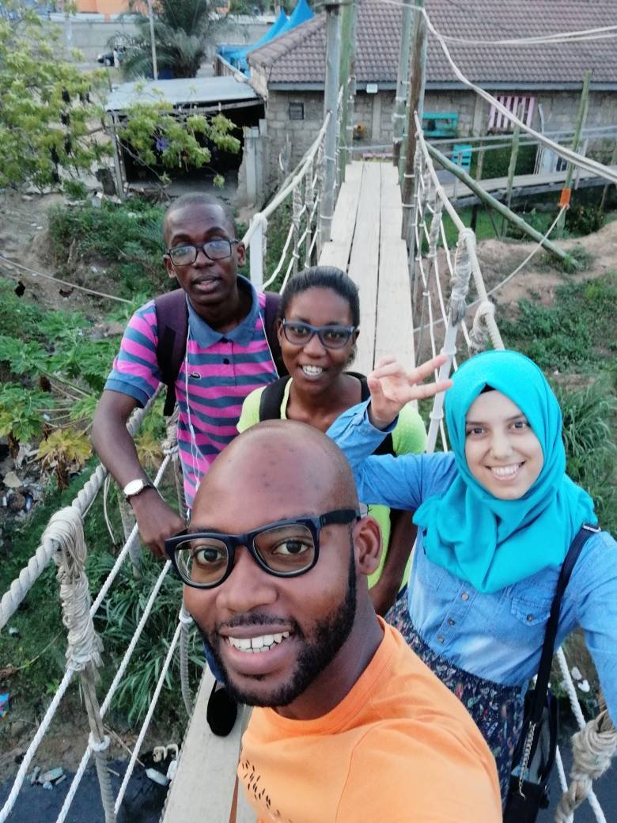


Our Story

Slide 4

The Problem
Out of 316,999 WASCE Candidates over 60% cannot advance to University.
According to World Bank 2016 report on jobs, 48% of the Ghanaian youth (15-24 years) labor force are Unemployed.
According to Ghana living Standard survey, it estimates 250,000 young men and women enter Ghana Labor Market with only 2% absorbed in formal sector and 98% either seek informal or are unemployed.
source: www.ghanaweb.com

Slide 5
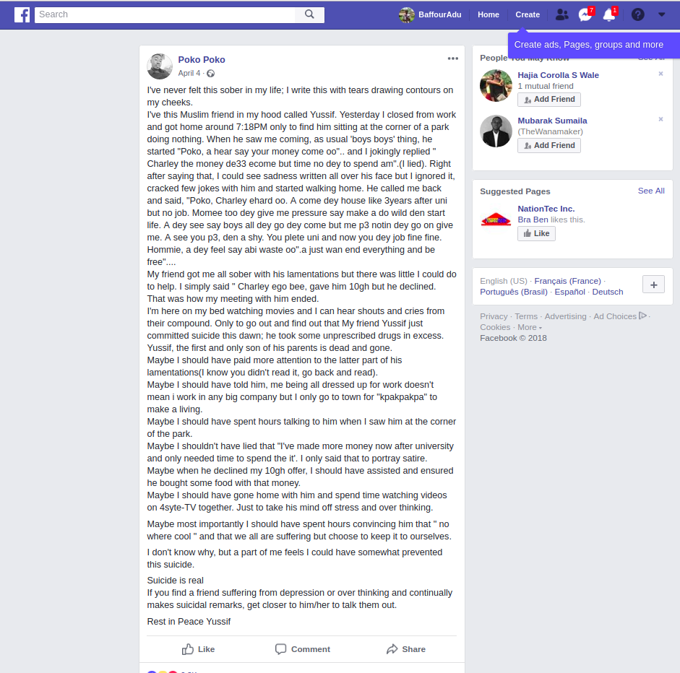


How big is the problem?

Slide 6

An intensive real world project-based learning program for the youth who aspire to become Software Developers & Designers
Our Solution?
“Brilliance is evenly distributed but opportunity is not”
- Jeremey Johnson

Slide 7


Application
Online Bootcamp
In-house project Simulation
Fellowship
Unleashed unto the Job Market
We choose the best talent based on our Core Values : Passion, Innovation, Excellence.
During this stage, the applicant is now a fellow (Employee) and will be given a Real world project, placed into a team where their Communication skills, Collaboration and Delivery is Tested.
During this stage, the fellow is now made to work on real-world client projects where he or she will be trained to become World Class.
At this stage, the fellow can choose to continue with us or be unleashed unto the market as a World Class developer.
Applicants at this stage will be paid a stipend after each successful challenge which will be reviewed by mentors .
Duration: 8 weeks
Duration: 4 weeks
Objectives:
Duration: 12 months
Fellow will be paid as a Software Developer.
Grow their Coding & Problem Solving skill
The stipend as to motivate them and also to solve the problem of internet and electricity.
Objectives:
Teach them soft skills, Collaboration & Discipline
Our Developer Apprenticeship Program
We looking to train 5,000 Developers & Designers annually

Slide 8

Practical and Fun way of learning
Bridges the Gap between Education and the Job Market
First-hand experience
Paid Internship
Empowering more Problem Solvers
Advantages
Trainees Come out more Passionate, Innovative and Confident in pioneering Tech in Africa

Slide 9

Software Development
Technical Leadership / Support
Product Design
API Design
Developer Outsourcing
Open Source
Our Services
We don't just train Developers and Design we put them on clients project to produce World Class results

Slide 10

It 'estimated that next 10 years 1.3m Software development Jobs will be created
Almost every startup being a Tech Startup, 159 African tech startups raised a total of over $195 million in 2017 according to Disrupt Africa.
The Market
In demand software developers are problem solvers and not just coders

Slide 11

We charge an upfront fee for each talent paired with a Client Company or per Project we work on for a Client.
Business Model
In demand software developers are problem solvers and not just coders
Our Target Market
SMEs (Main Target Market)
Cooperate organizations
Freelance Developers

Slide 12

Digital Advertisement
Social media
Search Engine Optimization
Search Engine Marketing
Referrals
Content Marketing
Sponsoring Tech related Events
Public Speaking
Marketing Strategies
We don't just train Developers and Design we put them on clients project to produce World Class results

Slide 13
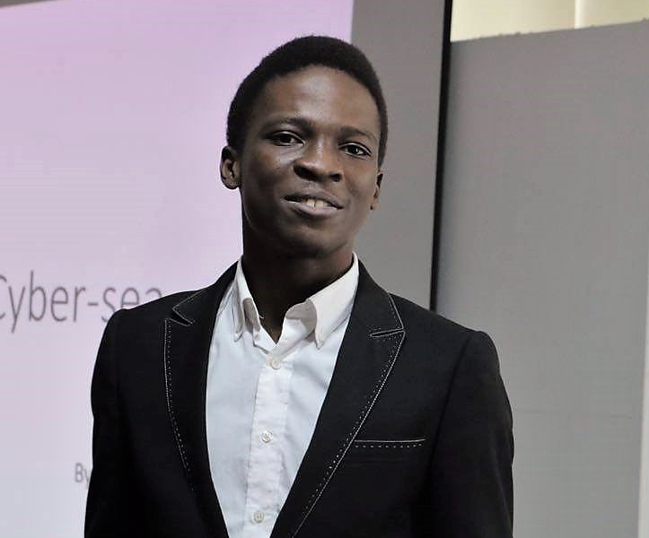


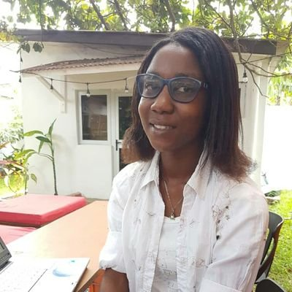

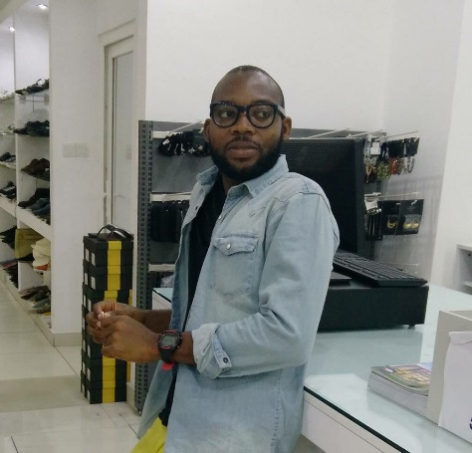
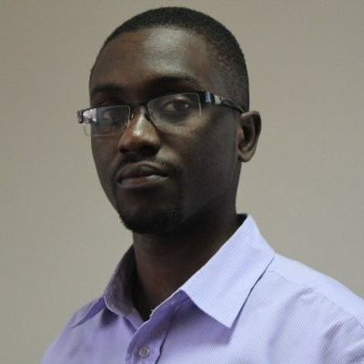

The Team
We are a Team of World Class Developers, Designers and Tech enthusiasts with experience in building World Class Software.
Baffour Adu Boampong
Founder, CEO
Projects Manager
Tano Onuvughe
Partnerships & Operations
Daniela Adjei
Sales & Marketing
Our Advisors
Michael Tettey Soli
Co-Founder and CEO at RedMarge Limited
Edem Kumodzi
Senior Technical Consultant, Andela
Roberta Akoto
Technical Success & Talent Development
Peter Perez
Product Designer
Micheal Sarpong
Lead Developer

Slide 14

Andela
Tunga
Freelance Developers
Software Development Companies
Our Competitors
In demand software developers are problem solvers and not just coders

Slide 15
Financial Forecast
Financials

Slide 16

We ask For $30,000
Item | Amount
Office Rent & Setup | $ 5,000 17%
Computers & Software | $ 20,000 67%
Business Development | $ 3,000 10%
Developer Apprenticeship Program | $ 2,000 6%
Our Ask
We don't just train Developers and Design we put them on clients project to produce World Class results

