Slide 1
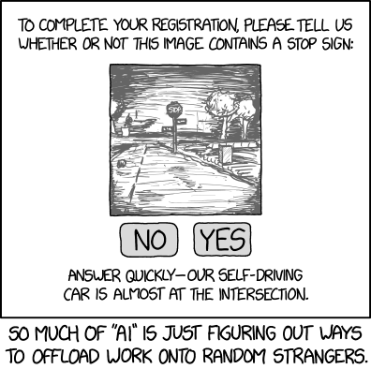

Sequence data
Xkdc
Machine Learning Methods for Biomedical Data (D012554)

Slide 2
Sequence modeling
Sequence modeling is a deep learning approach that deals with ordered data, where the position of elements matters (e.g., text, speech, time series, DNA).
Sequence models learn patterns and dependencies within sequences to make predictions or generate new sequences.
Unlike traditional models, sequence models must capture long-range dependencies and handle variable-length inputs while maintaining meaningful order information.
Machine Learning Methods for Biomedical Data (D012554)
Notes:
Also convex!

Slide 3
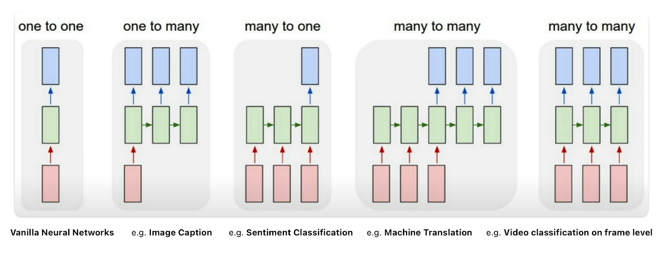
Sequence modeling
Machine Learning Methods for Biomedical Data (D012554)
Notes:
Also convex!

Slide 4








Recurrent neural network (RNN)
It is important to realize that the model parameters of the RNN are the same in each time-step, i.e. the green part in the diagram is always the same.
$${\hat{y}}_{0}^{i}$$
$${\hat{y}}_{1}^{i}$$
$${\hat{y}}_{1}^{i}$$
$$h_{0}^{i}$$
$$h_{1}^{i}$$
$$x_{0}^{i}$$
$$x_{1}^{i}$$
$$x_{2}^{i}$$
Machine Learning Methods for Biomedical Data (D012554)
Notes:
Also convex!

Slide 5

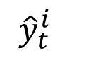

Recurrent neural network (RNN)
It is important to realize that the model parameters of the RNN are the same in each time-step, i.e. the green part in the diagram is always the same.
So, we can also represent the RNN as shown on the left.
$${\hat{y}}_{t}^{i}$$
$${\hat{y}}_{0}^{i}$$
$${\hat{y}}_{1}^{i}$$
$${\hat{y}}_{1}^{i}$$
$$h_{t}^{i}$$
$$h_{0}^{i}$$
$$h_{1}^{i}$$
$$x_{t}^{i}$$
$$x_{0}^{i}$$
$$x_{1}^{i}$$
$$x_{2}^{i}$$
Machine Learning Methods for Biomedical Data (D012554)
Notes:
Also convex!

Slide 6












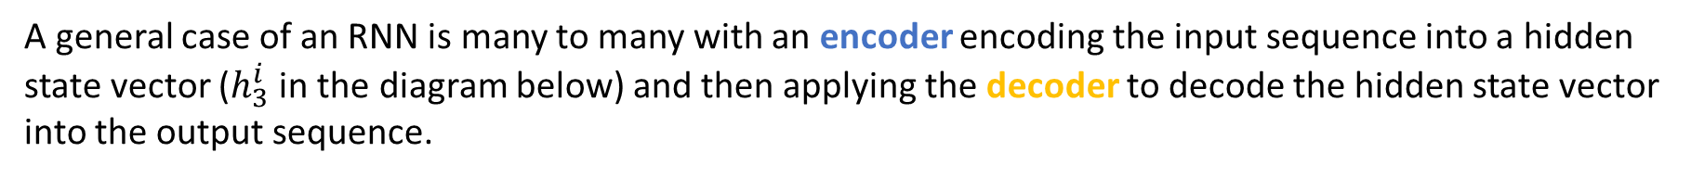

RNN encoding - decoding
A general case of an RNN is many to many with an encoder encoding the input sequence into a hidden state vector ($h_{3}^{i}$ in the diagram below) and then applying the decoder to decode the hidden state vector into the output sequence.
$${\hat{y}}_{3}^{i}$$
$${\hat{y}}_{4}^{i}$$
$${\hat{y}}_{5}^{i}$$
$$h_{0}^{i}$$
$$h_{1}^{i}$$
$$h_{3}^{i}$$
$$h_{3}^{i}$$
$$h_{3}^{i}$$
$$x_{0}^{i}$$
$$x_{1}^{i}$$
$$x_{2}^{i}$$
<stop>
$${\hat{y}}_{3}^{i}$$
$${\hat{y}}_{4}^{i}$$
Machine Learning Methods for Biomedical Data (D012554)
Notes:
Also convex!

Slide 7
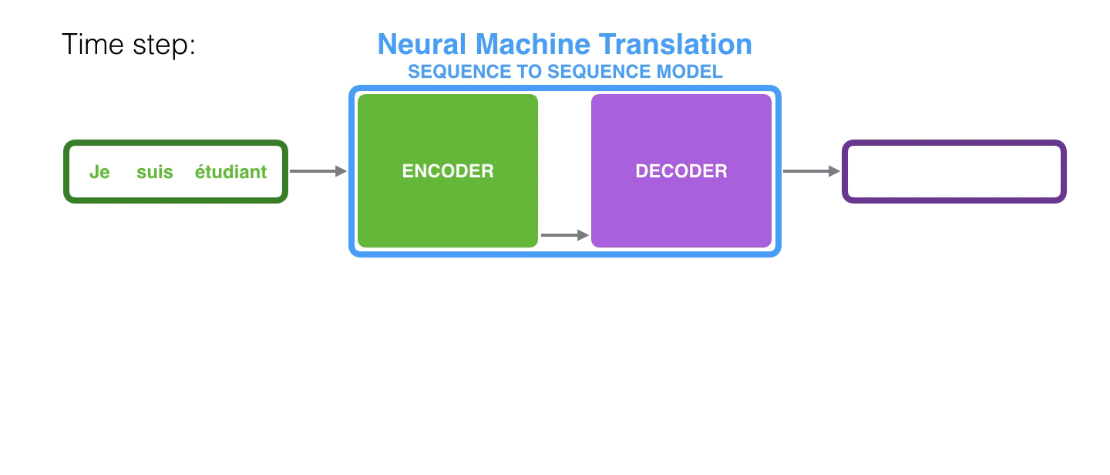
RNN encoding - decoding
Folded this looks like this:
https://jalammar.github.io/visualizing-neural-machine-translation-mechanics-of-seq2seq-models-with-attention/
Machine Learning Methods for Biomedical Data (D012554)

Slide 8
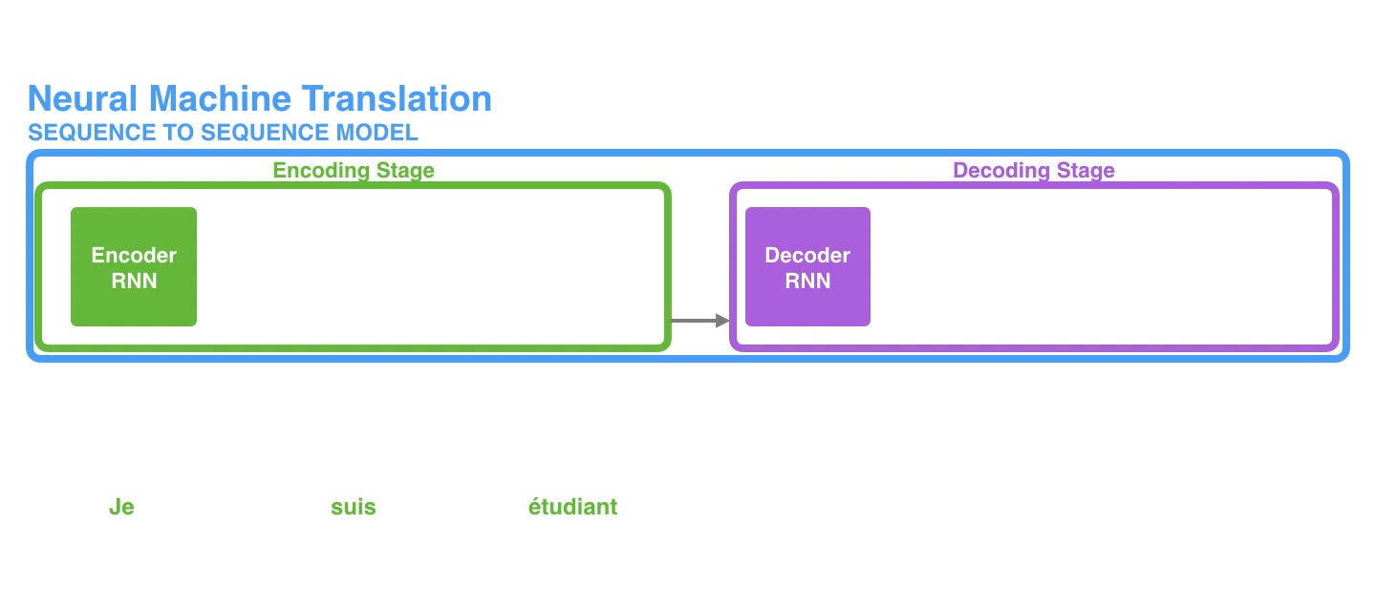
RNN encoding - decoding
Unfolded this looks like this.
This creates a bottleneck in which all information in the input sequence needs to be encoded into the final hidden state vector.
https://jalammar.github.io/visualizing-neural-machine-translation-mechanics-of-seq2seq-models-with-attention/
Machine Learning Methods for Biomedical Data (D012554)

Slide 9
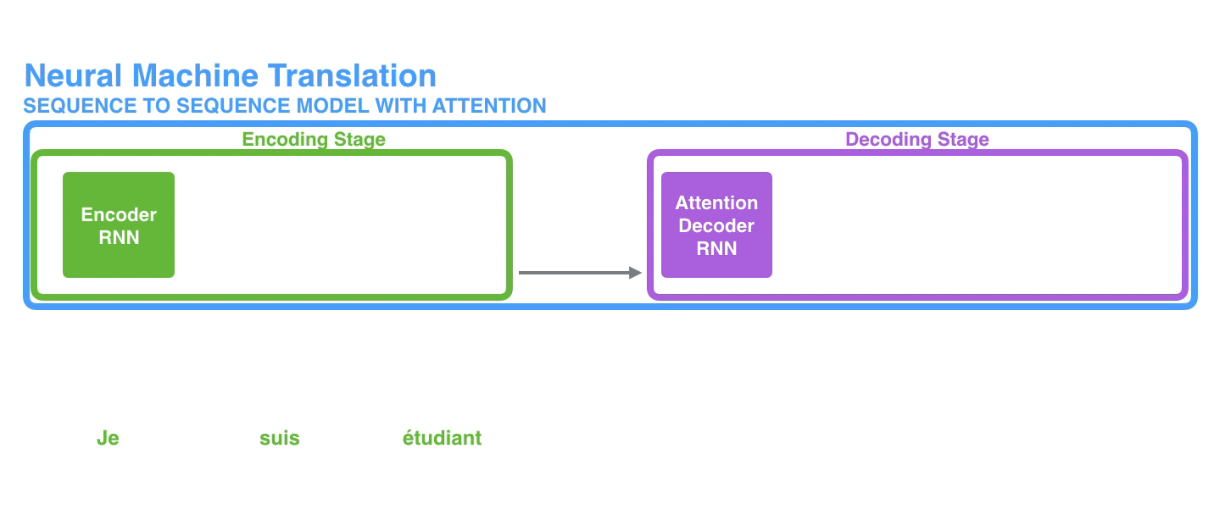
RNN encoding - decoding
One way to solve this issue is to use all hidden state vectors to decode.
But this can create an information overflow during decoding.
https://jalammar.github.io/visualizing-neural-machine-translation-mechanics-of-seq2seq-models-with-attention/
Notes:
The context vector turned out to be a bottleneck for these types of models. It made it challenging for the models to deal with long sentences
A solution was proposed in Bahdanau et al., 2014 and Luong et al., 2015. These papers introduced and refined a technique called “Attention”, which highly improved the quality of machine translation systems. Attention allows the model to focus on the relevant parts of the input sequence as needed.

Slide 10
Learning to pay attention
This issue can be solved by adding an attention layer. This is again a specialized architecture with model parameters that learns to pay more or less attention to the specific hidden state vectors during each time-step in the decoding.
Each input token is assigned a weight (attention score) indicating its importance for generating the current output token.
https://jalammar.github.io/visualizing-neural-machine-translation-mechanics-of-seq2seq-models-with-attention/
Machine Learning Methods for Biomedical Data (D012554)

Slide 11
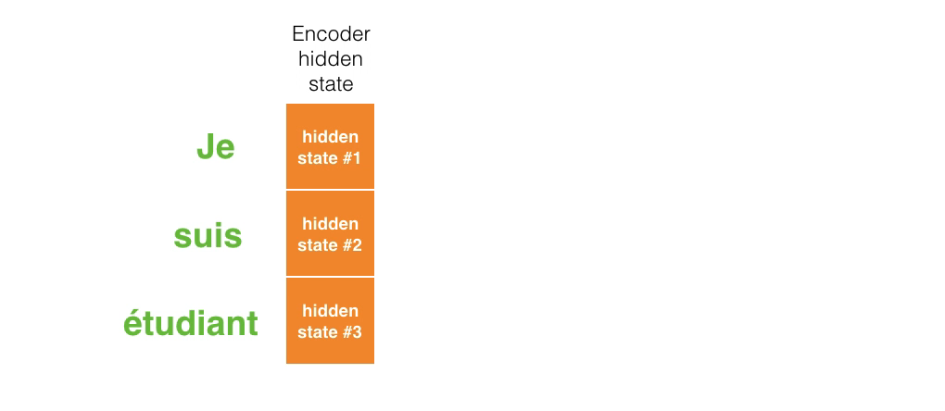
Learning to pay attention
This issue can be solved by adding an attention layer. This is again a specialized architecture with model parameters that learns to pay more or less attention to the specific hidden state vectors during each time-step in the decoding.
https://jalammar.github.io/visualizing-neural-machine-translation-mechanics-of-seq2seq-models-with-attention/
Machine Learning Methods for Biomedical Data (D012554)

Slide 12
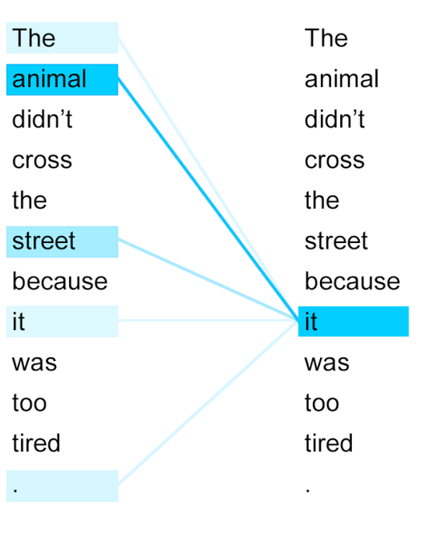
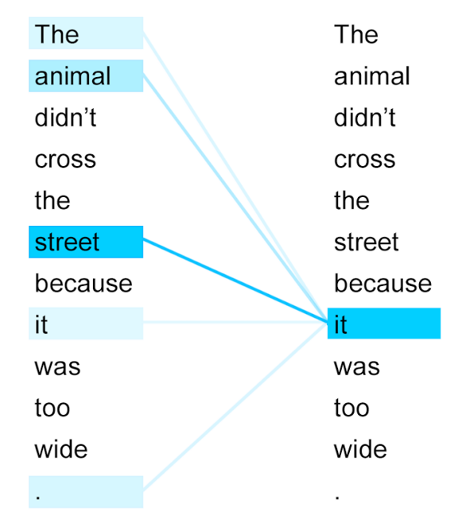
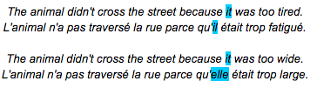
(Self-)attention
Machine Learning Methods for Biomedical Data (D012554)

Slide 13
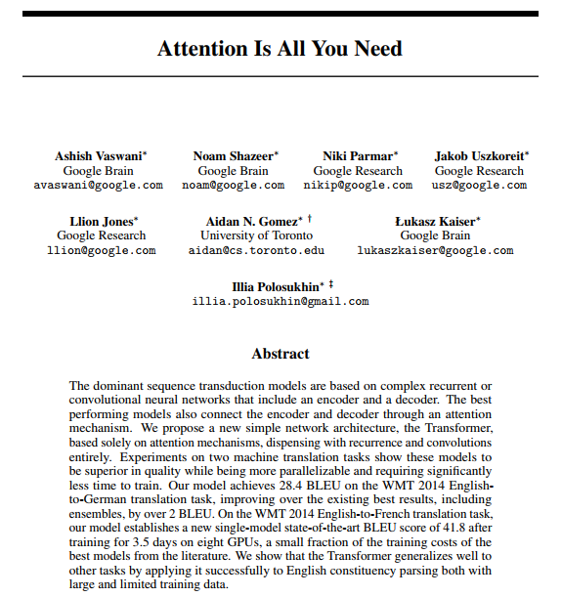
Transformer architecture
Self-attention mechanism: The Transformer model uses multi-head self-attention to capture long-range dependencies in text, allowing it to weigh the importance of different words regardless of their position.
Layered encoder-decoder structure: Originally designed for sequence-to-sequence tasks, the Transformer consists of stacked encoder and decoder layers, each containing self-attention and feedforward networks with normalization and residual connections.
Parallelization & efficiency: Unlike RNNs, Transformers process entire sequences simultaneously, making them highly parallelizable and enabling faster training on large datasets.
Ashish Vaswani et al., Attention is all you need. (NIPS'17)
Machine Learning Methods for Biomedical Data (D012554)

Slide 14
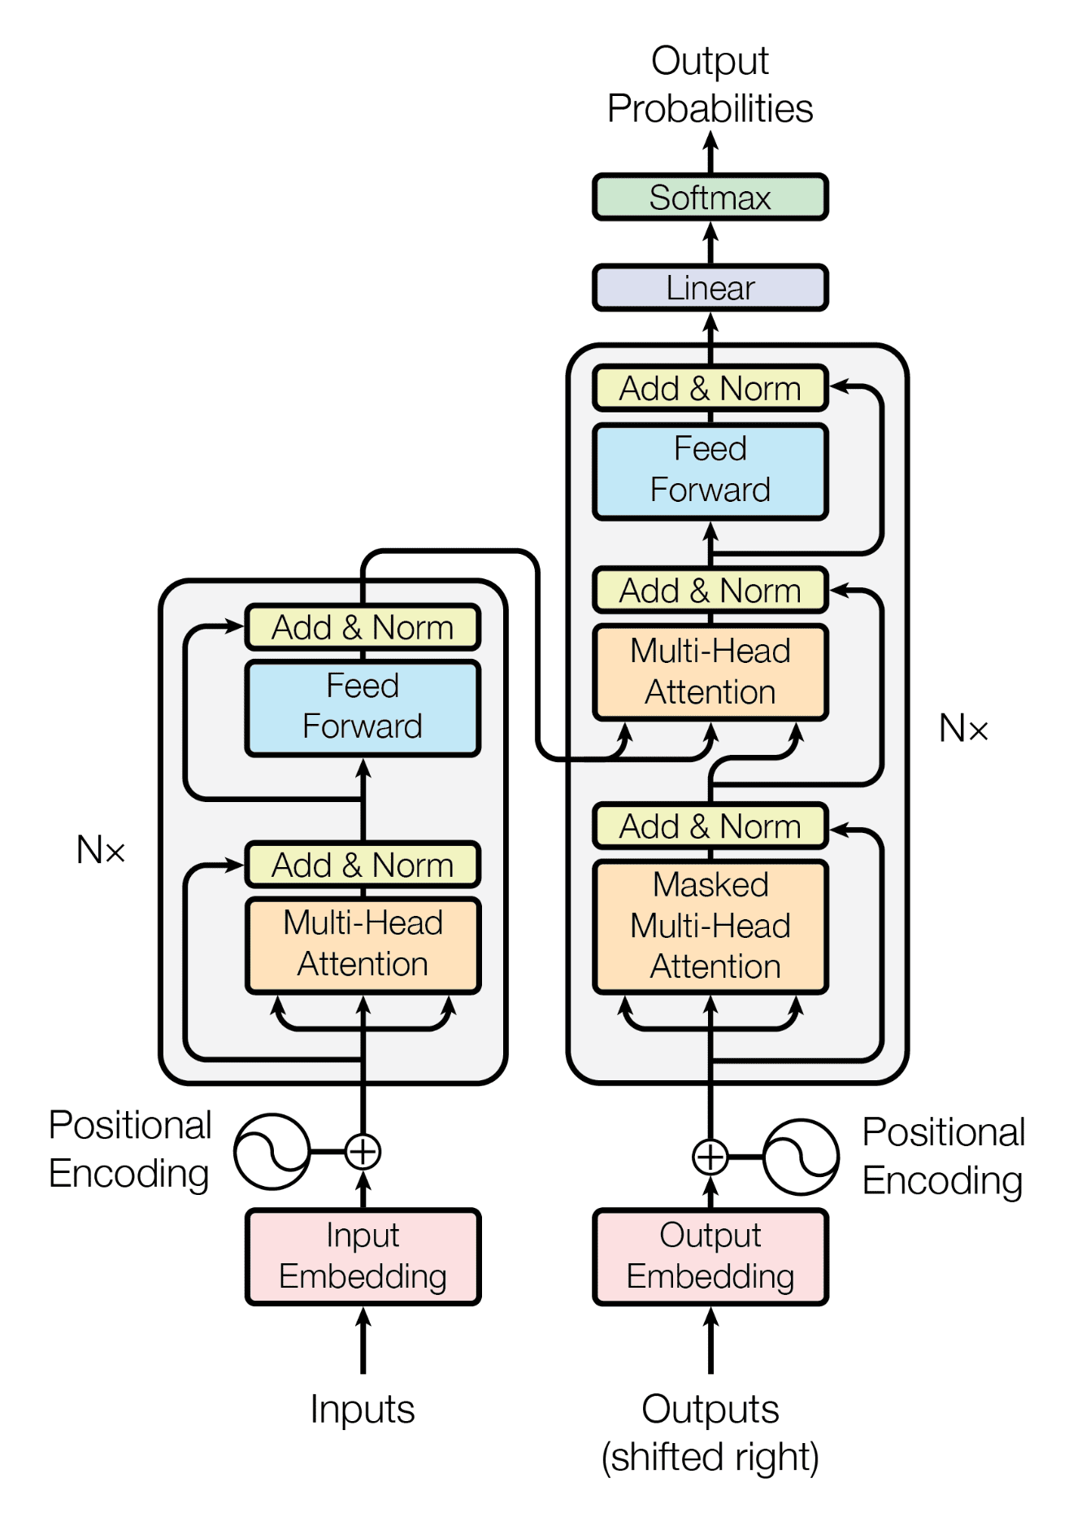
Transformer architecture
Self-attention mechanism: The Transformer model uses multi-head self-attention to capture long-range dependencies in text, allowing it to weigh the importance of different words regardless of their position.
Layered encoder-decoder structure: originally designed for sequence-to-sequence tasks, the Transformer consists of stacked encoder and decoder layers, each containing self-attention and feedforward networks with normalization and residual connections.
Parallelization & efficiency: Unlike RNNs, Transformers process entire sequences simultaneously, making them highly parallelizable and enabling faster training on large datasets.
Ashish Vaswani et al., Attention is all you need. (NIPS'17)
Machine Learning Methods for Biomedical Data (D012554)

Slide 15
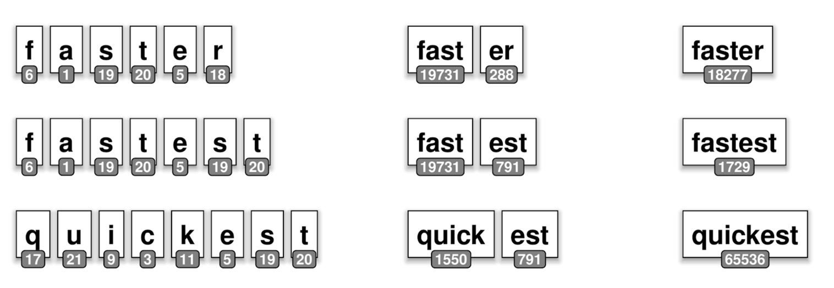
Sequence tokenization
Transformers require tokenized input for processing.
Padding [PAD] & truncation: Ensures fixed input length.
Special tokens: [CLS], [SEP] for sentence classification.
Character based WordPiece based Word based
Machine Learning Methods for Biomedical Data (D012554)

Slide 16
Sequence tokenization
##prefix (denotes subwords, e.g., ##ing in running → [run, ##ing])
Reduces out-of-vocabulary issues:
Rare or unseen words: "electromagnetism" → ["electro", "##magnet", "##ism"]
Misspelled words: "happyness" → ["happy", "##ness"]
Compound words: "smartwatch" → ["smart", "##watch"]
Foreign or loanwords: "sushimaster" → ["sushi", "##master"]
Machine Learning Methods for Biomedical Data (D012554)

Slide 17
BERT (Bidirectional Encoder Representations from Transformers)
Uses only the encoder part of the original Transformer architecture.
embedding
Ashish Vaswani et al., Attention is all you need. (NIPS'17)
Machine Learning Methods for Biomedical Data (D012554)

Slide 18
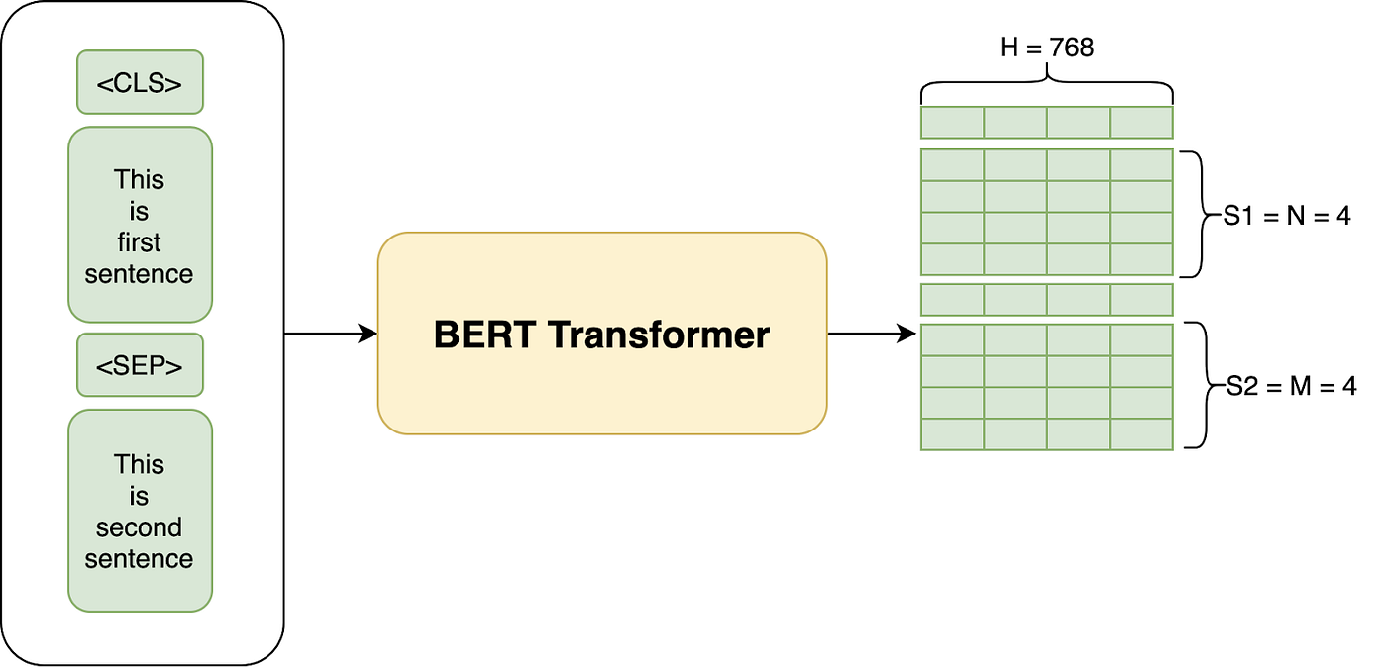
BERT (Bidirectional Encoder Representations from Transformers)
Uses only the encoder part of the original Transformer architecture.
Outputs a 768-dimensional embedding vector for each word in the input sequence.
Machine Learning Methods for Biomedical Data (D012554)

Slide 19
BERT (Bidirectional Encoder Representations from Transformers)
Uses only the encoder part of the original Transformer architecture
Outputs a 768-dimensional embedding vector for each word in the input sequence.
Reads text in both directions (uses all tokens in context window).
Pre-trained on a large corpus of text.
embedding
Ashish Vaswani et al., Attention is all you need. (NIPS'17)
Machine Learning Methods for Biomedical Data (D012554)

Slide 20
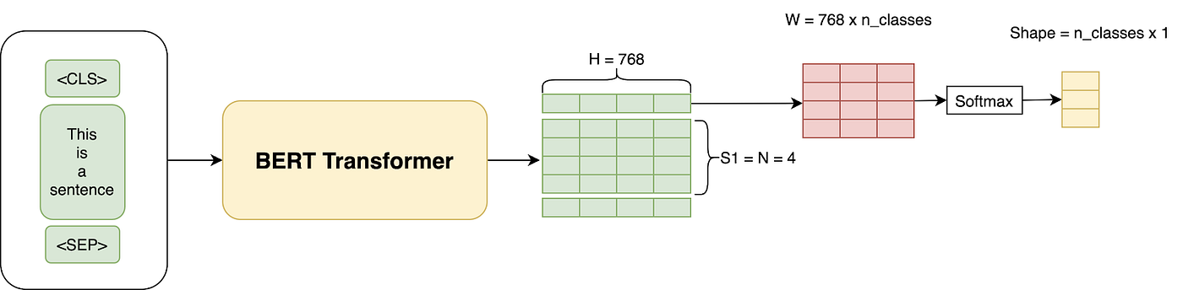
BERT (Bidirectional Encoder Representations from Transformers)
Uses only the encoder part of the original Transformer architecture
Outputs a 768-dimensional embedding vector for each word in the input sequence.
Reads text in both directions (uses all tokens in context window).
Pre-trained on a large corpus of text.
Fine-tuned for various NLP tasks such as:
Sentiment analysis
Named entity recognition
Text classification
…
Machine Learning Methods for Biomedical Data (D012554)

Slide 21
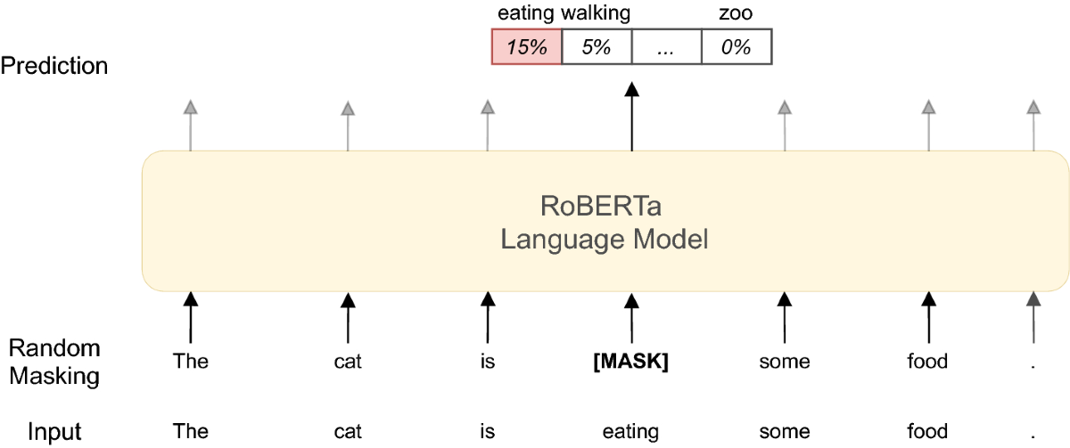
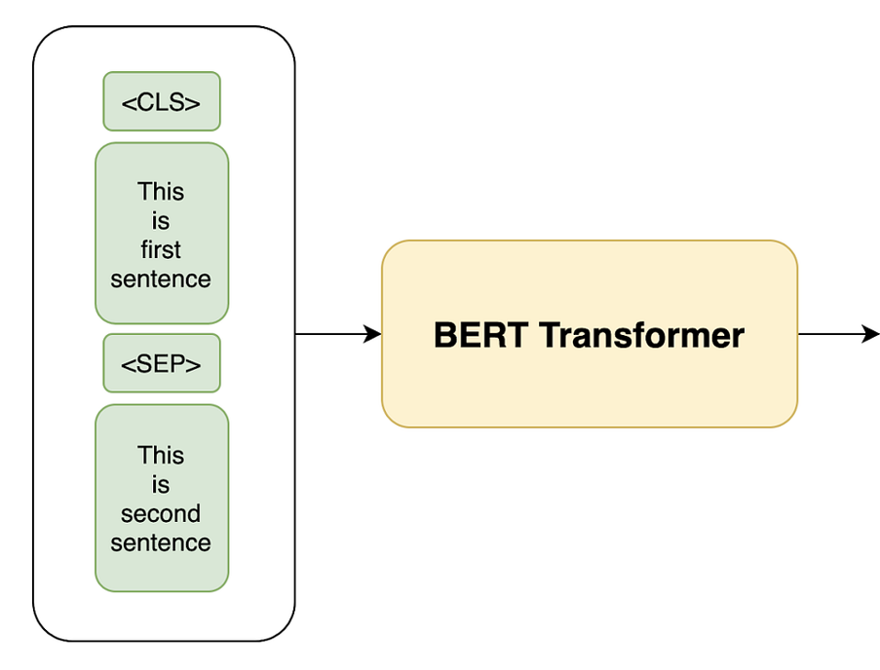
BERT pre-training
Pre-training. BERT is trained on unlabeled pair of sequences over two prediction tasks:
Masked language modeling (MLM)
Next sentence prediction (NSP)
{yes,no}
Machine Learning Methods for Biomedical Data (D012554)

Slide 22
BERT Flavours
BERT (Base & Large): The original BERT models introduced by Google in 2018. BERT-Base has 12 layers, 768 hidden units, and 12 attention heads, while BERT-Large has 24 layers, 1024 hidden units, and 16 attention heads.
DistilBERT: A lighter and faster version of BERT that retains 97% of its performance while being 60% smaller and running twice as fast. It uses knowledge distillation to learn from BERT while reducing size and computational cost.
BioBERT (Biomedical BERT): Pre-trained on PubMed abstracts and PMC full-text articles, making it highly effective for biomedical NLP tasks like named entity recognition (NER), question answering, and relation extraction.
ClinicalBERT: A variant of BERT trained on MIMIC-III clinical notes, making it more suitable for electronic health record (EHR) processing, medical note summarization, and patient outcome prediction.
PubMedBERT: Unlike BioBERT, which is initialized from standard BERT and then trained on biomedical data, PubMedBERT is trained from scratch using only PubMed abstracts and full-text papers, achieving better domain-specific performance.
…
Machine Learning Methods for Biomedical Data (D012554)

