Slide 1
COMP 1017
Day 07

Slide 2
<nav>

Slide 3
<nav> wraps elements that have navigation functionality.

Slide 4
It is how you would markup a navigation bar or menu*.
* This is usually an unordered list of links!

Slide 5
So, in which major sectioning element does our <nav> belong?

Slide 6
If the <nav> is in …
<header> | main navigation
<main> | sidebar links, ‘other articles like this’
<footer> | secondary or extended navigation

Slide 7
<section>

Slide 8
A <section> is a generic way of grouping similar content together.

Slide 9
Every <section> should begin with a heading, followed by some sort thematic content.

Slide 10
It’s generally used as a way of grouping parts of a page together that have similar functionality.

Slide 11
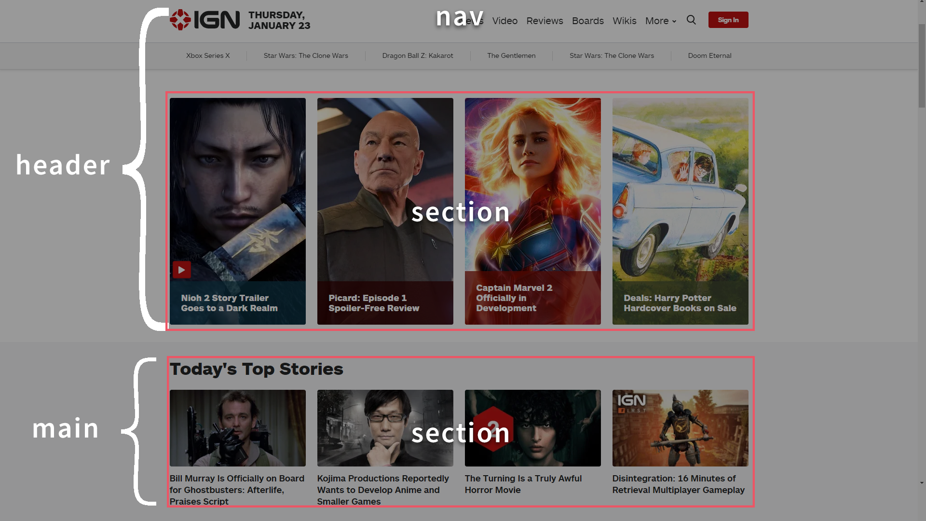

Slide 12
<aside>

Slide 13
An <aside> contains additional content that isn’t absolutely necessary for understanding or enjoying everything else.

Slide 14
It could be glossary entries,
the author’s biography, a list of related links, and so forth.

Slide 15
Note: an <aside> with a <nav> inside of it is how we usually markup a sidebar.

Slide 16
<article>

Slide 17
An <article> contains something that would make sense on its own (i.e. without the rest of the page).

Slide 18
A great example is a single
blog post, or a news story.

Slide 19
You can have other sectioning elements within an article —
or, depending upon the context, articles within other sectioning elements!

Slide 20
