Slide 1
COMP 1017
Day 08

Slide 2
So far, we’ve been creating
single page websites.

Slide 3
But single-page sites are
not really the norm.

Slide 4
So, how can we create multiple-page websites with functional navigation between pages?

Slide 5
Absolute vs.
Relative Pathing

Slide 6
So far, we’ve been using <a> to link to external websites.

Slide 7
The href has always been a URL
to somewhere else — that is,
on some other site, hosted on some other server.

Slide 8
These URLs are an example of what we’d call absolute paths.

Slide 9
Think of it like a street address. Absolute paths do not change.

Slide 10
ex. The HP Centre is located at
10504 Princess Elizabeth Ave NW.

Slide 11
However, we’ve also been using relative paths for other things.

Slide 12
Whenever we use an <img>, our src value is relative to where the index.html is located.

Slide 13
Our images are inside of our image folders, so we have to tell our browser to go there in order to get the image file it needs.

Slide 14
This is more like giving directions.

Slide 15
If we were in the CAT Building and you wanted to get to class, giving you an absolute address wouldn’t be very helpful.
( We would already be on campus, after all. )

Slide 16
Instead, I’d tell you how to get there starting from where we currently are.

Slide 17
This is exactly how linking within the same framework folder
(i.e. the same website) works.

Slide 18
Linking in the
Same Directory

Slide 19
Let’s say we’ve got a bunch of pages for our website, all in the root of our framework folder.
Note: When I say root, I mean immediately inside of the folder.

Slide 20
Instead of giving an absolute path or address, we will give a
relative path.

Slide 21
So, let’s say our framework folder looks like the following ...

Slide 22
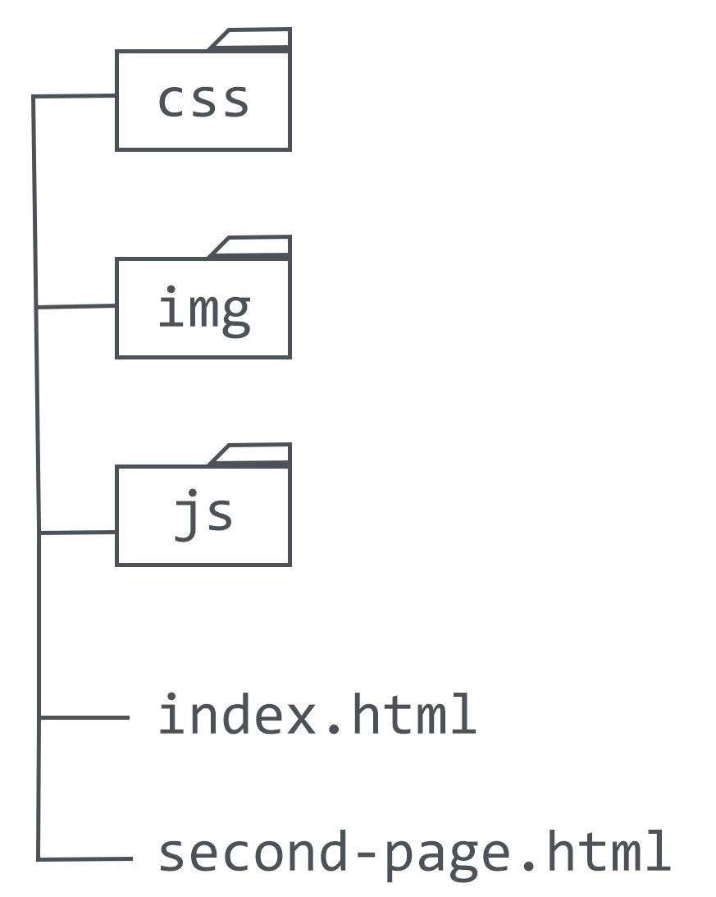
framework

Slide 23
How can we give ‘directions’ from index.html to second-page.html?

Slide 24
<a href="second-page.html">
Link to Second Page
</a>

Slide 25
… that’s literally it. If your other pages are in the same folder, you just have to point to them.

Slide 26
In this case, you do not have to tell your browser to go somewhere else in order to find the files.

