Slide 1
COMP 1017
Day 08

Slide 2
Link to Pages in
Subdirectories

Slide 3
So, what happens if we keep all of our pages inside of a sub-folder?

Slide 4
In that case, if we want to link to the page, we have to tell our browser to go into the sub-folder and find that HTML file.

Slide 5
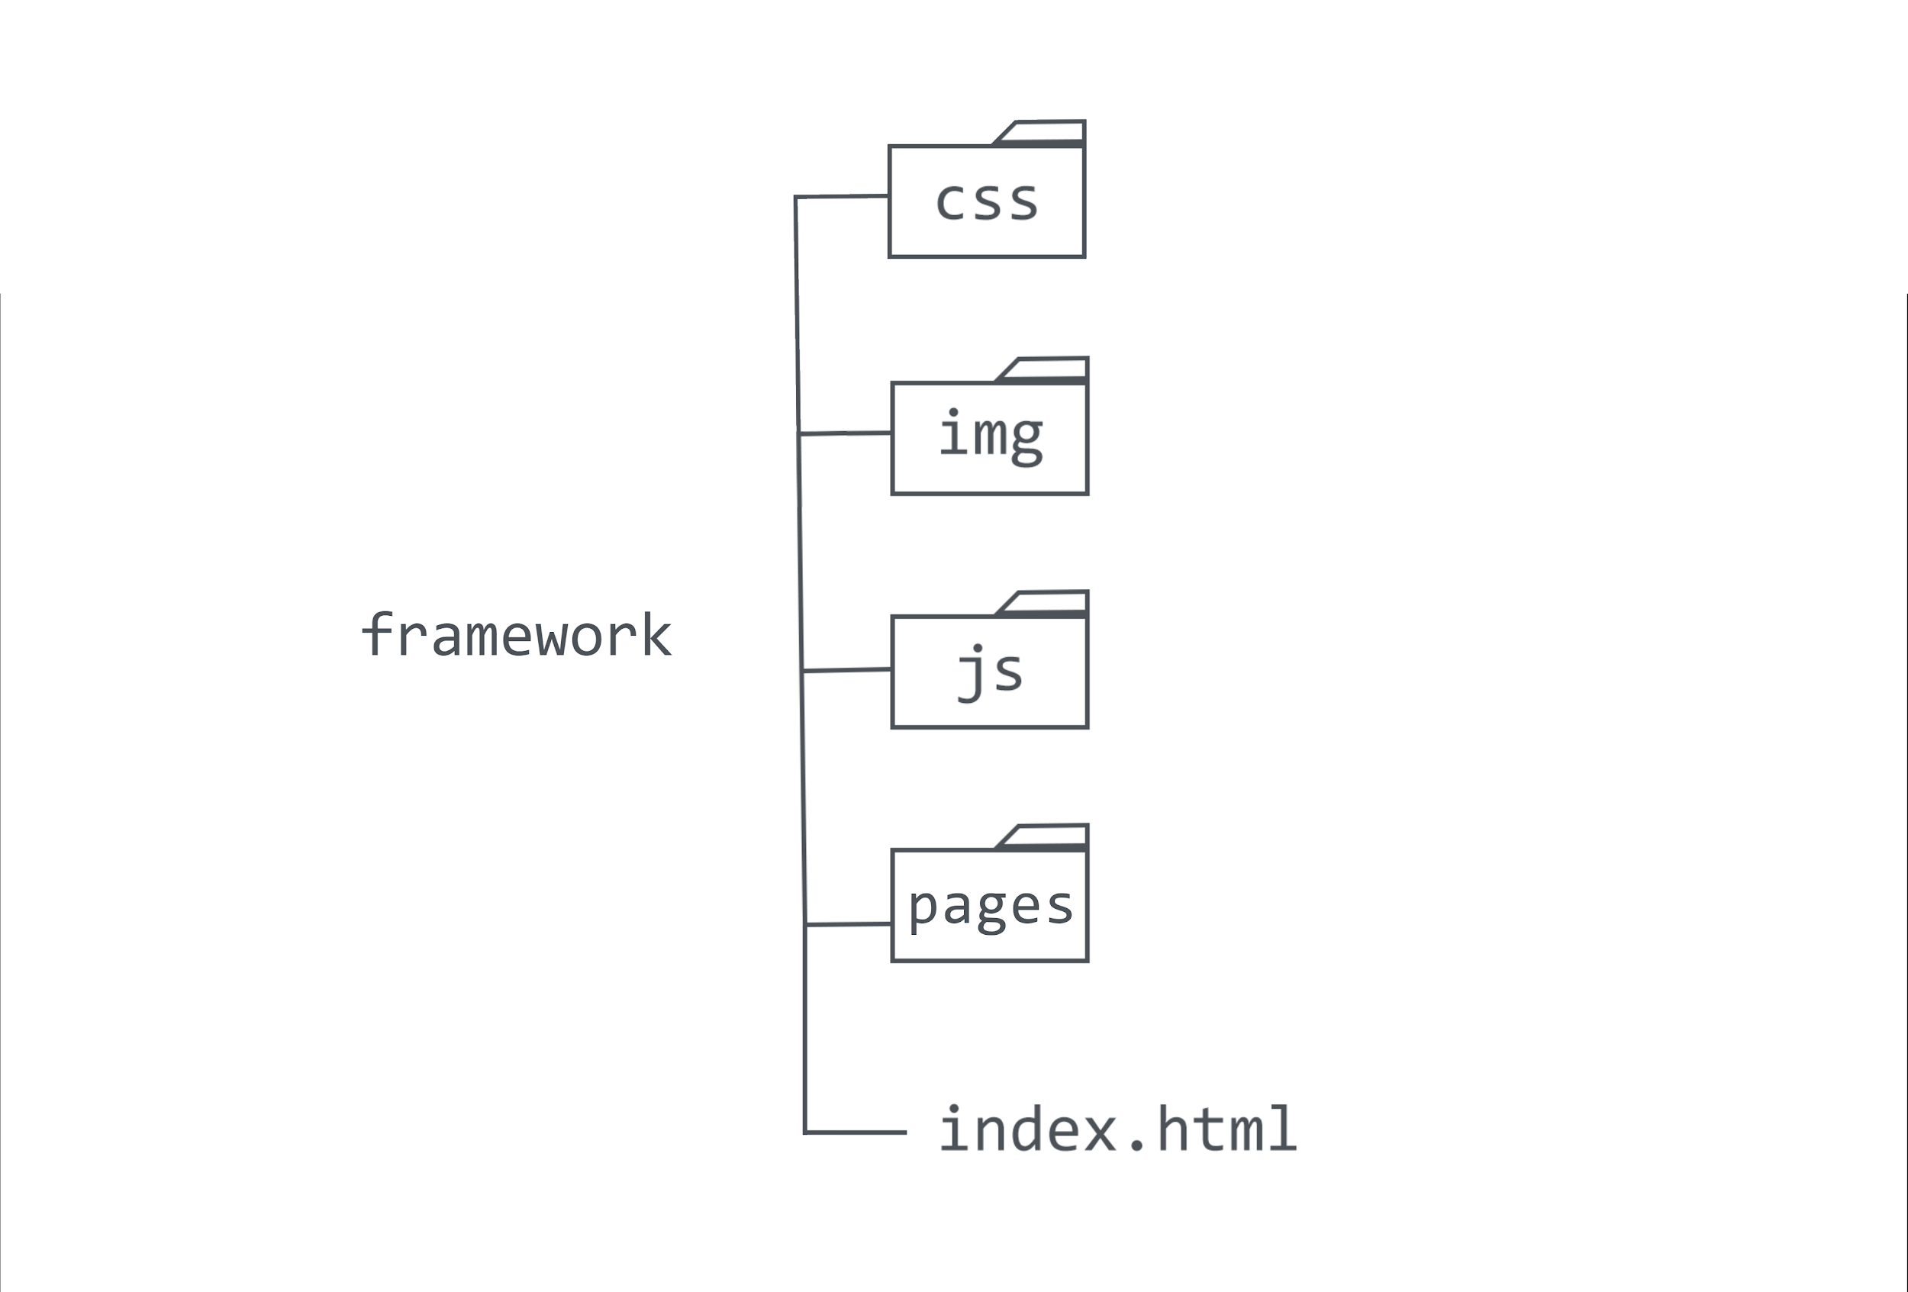

Slide 6
<a href="pages/second-page.html">
Link to Second Page
</a>

Slide 7
… but what if we’re linking from a page inside of the sub-folder and want to link back to the index?

Slide 8
We have to tell our browser to
go back (up one level, to the root) and find the index.

Slide 9
<a href="../index.html">
Return to Index
</a>

