Slide 1
Python: Linked Lists
Week 2
Adrian Gould / Sander Huijsen
ICT40518 Certificate IV in Programming ICT50718 Diploma of Software Development

Slide 2
Linked Lists
A Linked List can overcome some of the issues that are associated with arrays:
searching is slow (in unordered array)
insertion is slow (ordered array)
deletion is slow
fixed size

Slide 3
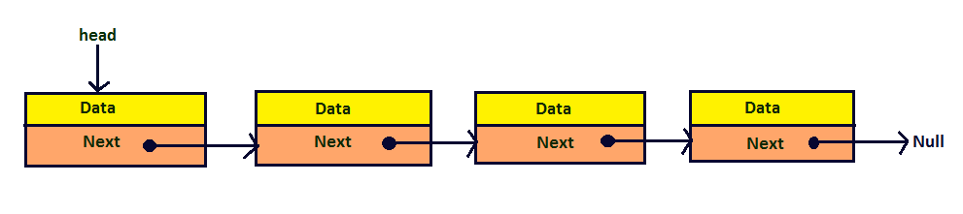
Linked Lists
Idea: create a list of link groups of memory “cells” together using references (or pointers).
Each record contains data and a reference to the next cell.

Slide 4
Linked Lists
The ‘Next’ field in the last item in the list contains Null, indicating it is the last item.
In Python, this is indicated with the value None.

Slide 5
Linked Lists: Nodes
A Node consists of data and a reference
class Node:
def __init__(self):
self.next = None
# data

Slide 6
Linked Lists: Nodes
Example:
class Node:
def __init__(self, int_val, float_val):
self.next = None
self.int_val = int_val
self.float_val = float_val
def __str__(self):
return str(self.int_val) + “ “ + \
str(self.float_val)

Slide 7
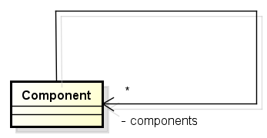
Linked Lists: Nodes
The next field would simply point to another Node
It is a self-reference:

Slide 8
Linked Lists
The Linked List will have the following methods:
is_empty()
find(key)
insert_first(key, val)
delete(key)
delete_first()

Slide 9
Linked Lists: class
class LinkedList:
def __init__(self):
self.__first = None
def is_empty(self):
return self.__first is None
# other methods follow…

Slide 10
Linked Lists: class
# continued…
def find(self, key):
current = self.__first
while current and current.int_value != key:
current = current.next
return current

Slide 11
Linked Lists: class
# continued…
def insert_first(self, id, dd):
new_node = Node(id, dd)
new_node.next = self.__first
self.__first = new_node

Slide 12
Linked Lists: class
# continued…
def delete(self, key):
current = self.__first
previous = self.__first
while current.int_value != key:
if current.next == None:
return None
else:
previous = current
current = current.next
if current == first:
first = first.next
else:
previous.next = current.next
return current

Slide 13
Linked Lists: class
# continued…
def delete_first(self):
temp_node = self.__first
self.__first = self.__first.next
return temp_node
def display(self):
print(“List first to last:”)
current = self.__first
while current != None:
print(current)
current = current.next

Slide 14
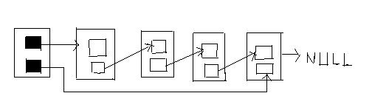
Double-ended Linked Lists
Not to be confused with doubly-linked list
Has a reference to the first and the last element
Makes it easier to add element at the end

Slide 15
Double-ended Linked Lists: class
def __init__(self):
# Add the the following line:
self.__last = None
# continued…
def insert_last(self, id, dd):
new_node = Node(id, dd)
if self.__first is None:
self.__first = new_node
else:
self.__last.next = new_node
self.__last = new_node

Slide 16
Double-ended Linked Lists: class
# update insert_first:
def insert_first(self, id, dd):
new_node = Node(id, dd)
if self.__first is None:
self.__last = new_node
new_node.next = self.__first
self.__first = new_node

