Slide 1
Genetic Algorithms vs.
8 Queens
Robby Bergers

Slide 2
What is a genetic algorithm?
Fitness function
Selection process
Crossing over
Mutation rate

Slide 3
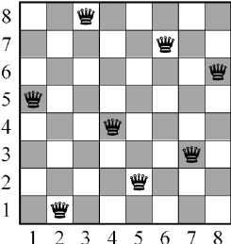
(8 Queens) Problem
8 Queens: Place 8 queens on a chess board such that no queen is capable of capturing another queen
How much faster can a genetic algorithm solve the 8 queens problem than a random agent?

Slide 4
Hypothesis
A genetic algorithm can perform 10 times faster on average than the random agent.

Slide 5
Genetic Algorithms
Both genetic algorithms have some similarities:
FItness function: x = c1 + c2 + … + c8
Selection process: Best selection
Crossover process: Single-point crossover
No mutation rate

Slide 6
Procedure
Random agent algorithm
First genetic algorithm
Second genetic algorithm
Each algorithm is run 10,000 times and the results of each execution are recorded

Slide 7
Results
Random agent mean average: 182,556
First genetic algorithm mean average: 75,848 (2.4x faster)
Second genetic algorithm mean average: 48,936 (3.7x faster)

Slide 8
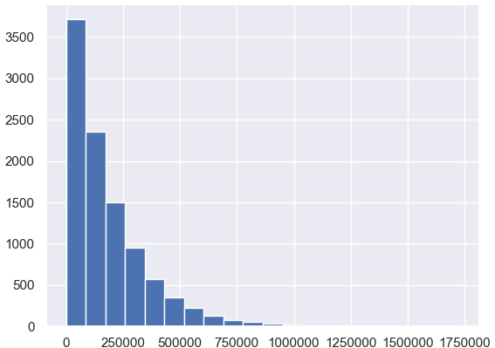
Random agent histogram

Slide 9
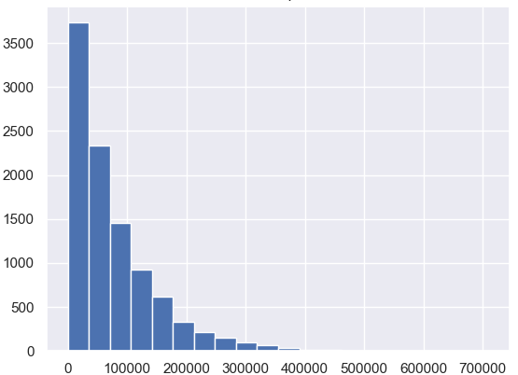
First genetic algorithm histogram

Slide 10
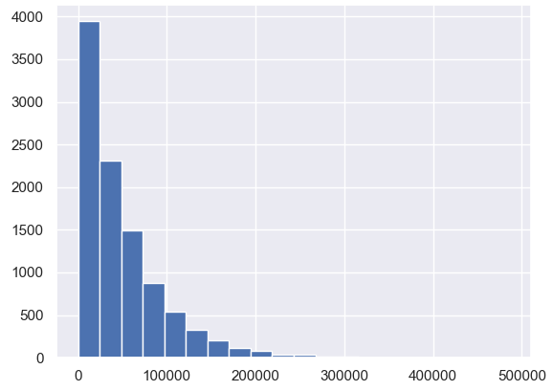
Second genetic algorithm histogram

Slide 11
Conclusion
Could not get GA to run 10 times faster
Diminishing returns
Inconclusive results
Could not be proven wrong, only fail to be proven right

