Slide 1
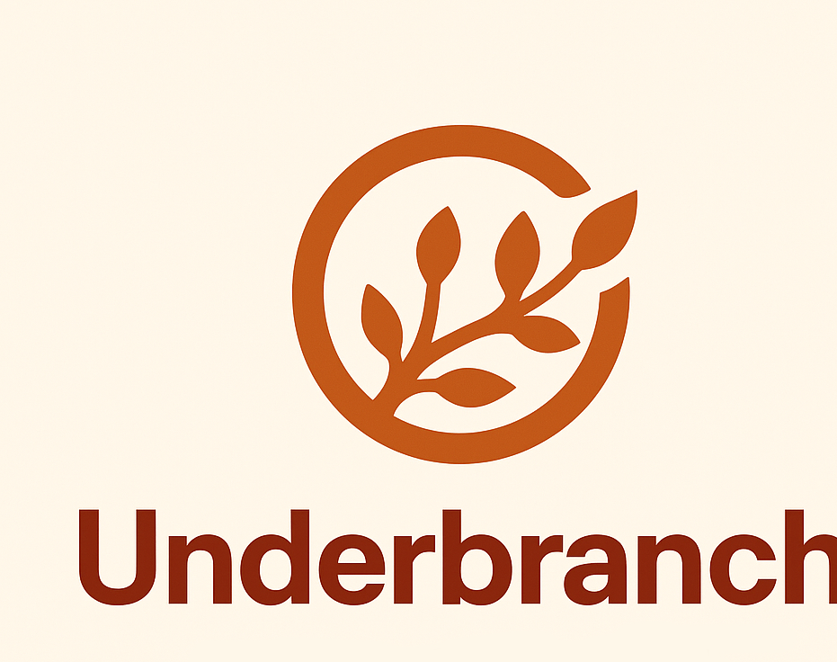
Underbranch
Aaron Brown, Brett Dowling, Paul Davis, Matthew Ferrari, Robby Lawrence

Slide 2
Motivation
We wanted to create an open-source collaborative LaTeX editor to help eliminate the paywall created by an Overleaf type product.
This project originated when Robby was maligned by the Overleaf team. Features like version history and collaborative editing shouldn't be locked behind a massive paywall.

Slide 3

What is LaTeX?
LaTeX (lah-teck) is a typesetting language created by Donald Knuth that compiles to PDFs.
It is commonly used in research and academic writing.
Several TeX compilers include pdflatex, XaTeX, and Knuth's Tex, to name a few.

Slide 4
Technologies
React UI with Monaco built editor, custom auto-complete implementation.
Robby bought the "underbranch.org" domain for $12 and had an old computer that we could use as the web server.
We installed Ubuntu Server on XPS, and set up nginx, cloudflared, pm2, and TeXLive, before switching away from Cloudflare Tunnels later on.
We chose to use Node servers to run our API endpoints, while the frontend remained a React app.

Slide 5

Features
Collaborative editing: currently, the users can join password-protected rooms that record changes between users.
Fast compilation: a compile button in the toolbar sends a compile request to the /compile/ endpoint on XPS, which returns either the compiled PDF or the error message as the HTTP response.
Downloads: the user can download both the compiled PDF and .tex file.
Auto-complete implemented in Monaco built text editor.

Slide 6
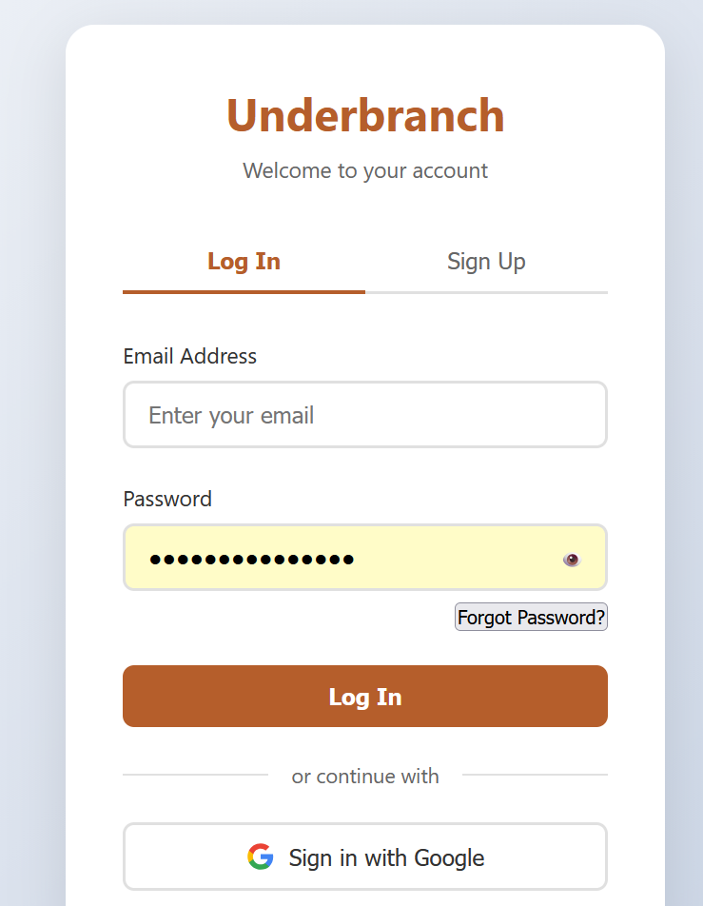
Login page
Log In and Sign Up functionality.
If someone forgets their password, they can reset with an email sent to their account.
Google sign in verification.

Slide 7
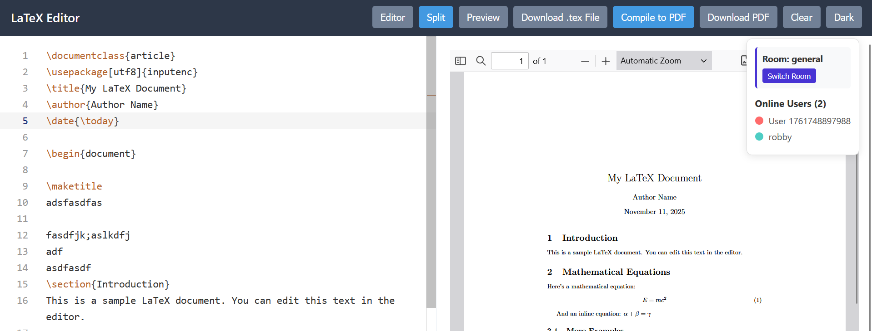
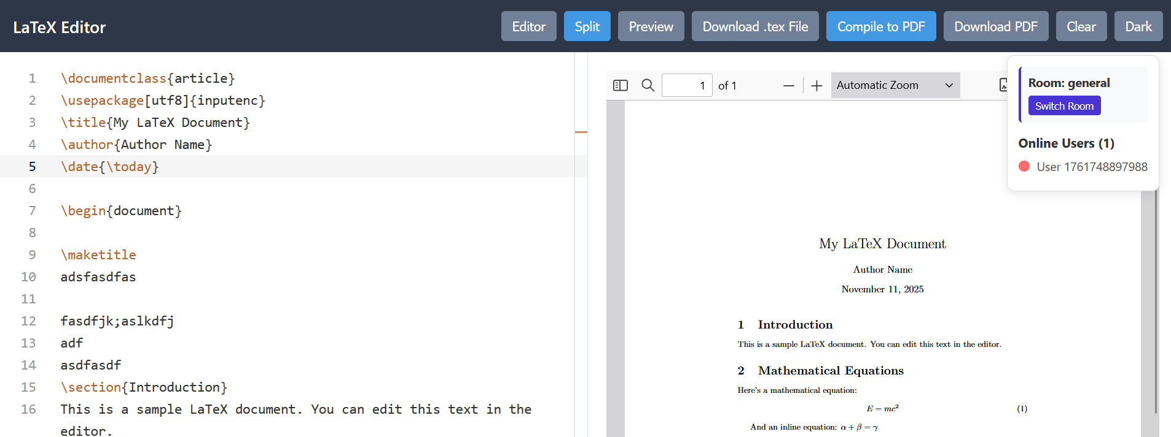
Editor Interface
From the editor you can split panes, preview pdf only, preview editor only, download .tex file, compile to pdf, download as pdf, clear, and change to light or dark mode.
Autocomplete implemented with basic latex library commands.

Slide 8

Collaborative Editing
Functionality
Web Sockets
Collaborative editing is the
ability for two or more people to
make changes to a file and view
others peoples' changes to that
file in real-time.
Web sockets enable
collaborative editing. They
detect any changes made from
one client and broadcast them
to all other clients in the socket.
Think of a cell phone tower.

Slide 9

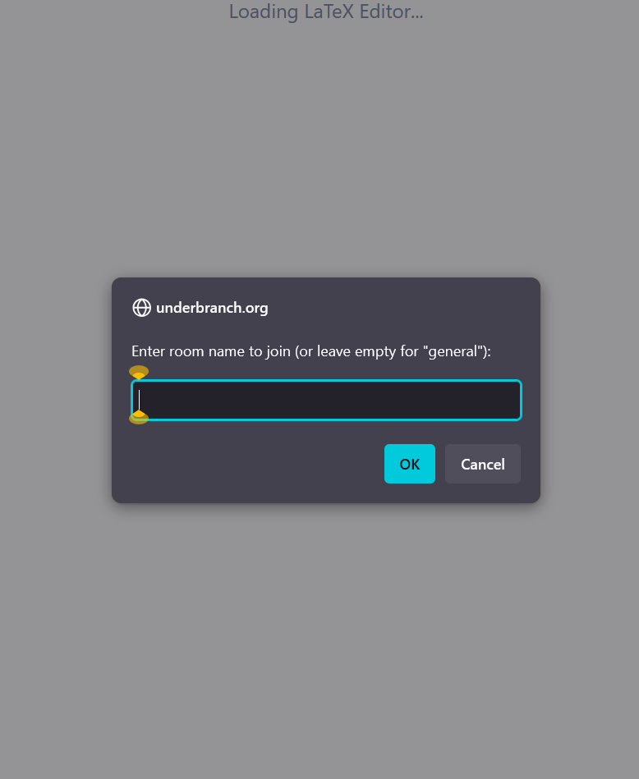
Rooms
When creating a room, you have the option to set a password.
Only people who know the password can access your room!

Slide 10
Demo Time!

Slide 11

Any questions?

