Slide 1
CSC422: Machine and Deep Learning
Module 2 – Deep Neural Networks
Robert Moseley (rmoseley@calbaptist.edu)
California Baptist University
Slides provided by

Slide 2
Deep neural networks
Networks with more than one hidden layer
Intuition becomes more difficult

Slide 3
Deep neural networks
Composing two networks
Combining the two networks into one
Hyperparameters
Notation change and general case
Shallow vs. deep networks

Slide 4
Composing two networks.
Network 1:
Network 2:

Slide 5
Composing two networks.
Network 1:
Network 2:

Slide 27
“Folding analogy”

Slide 28
Comparing to shallow with six hidden units
20 parameters
(at least) 9 regions
19 parameters
Max 7 regions

Slide 29
Composing networks in 2D

Slide 30
Deep neural networks
Composing two networks
Combining the two networks into one
Hyperparameters
Notation change and general case
Shallow vs. deep networks

Slide 31
Combine two networks into one
Network 1:
Network 2:
Hidden units of second network in terms of first:

Slide 32
Create new variables

Slide 33
Two-layer network

Slide 34
Two-layer network as one equation

Slide 35
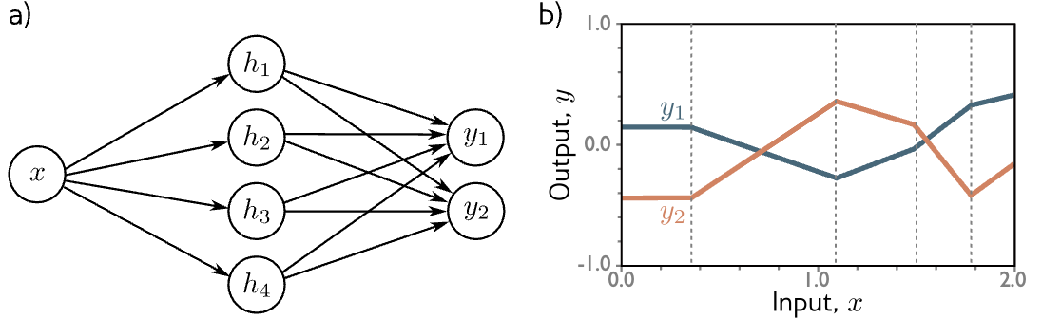
Remember shallow network with two outputs?
1 input, 4 hidden units, 2 outputs

Slide 36
Networks as composing functions
Consider the pre-activations at the second hidden units
At this point, it’s a one--layer network with three outputs

Slide 37
Networks as composing functions
Consider the pre-activations at the second hidden units
At this point, it’s a one--layer network with three outputs

Slide 38
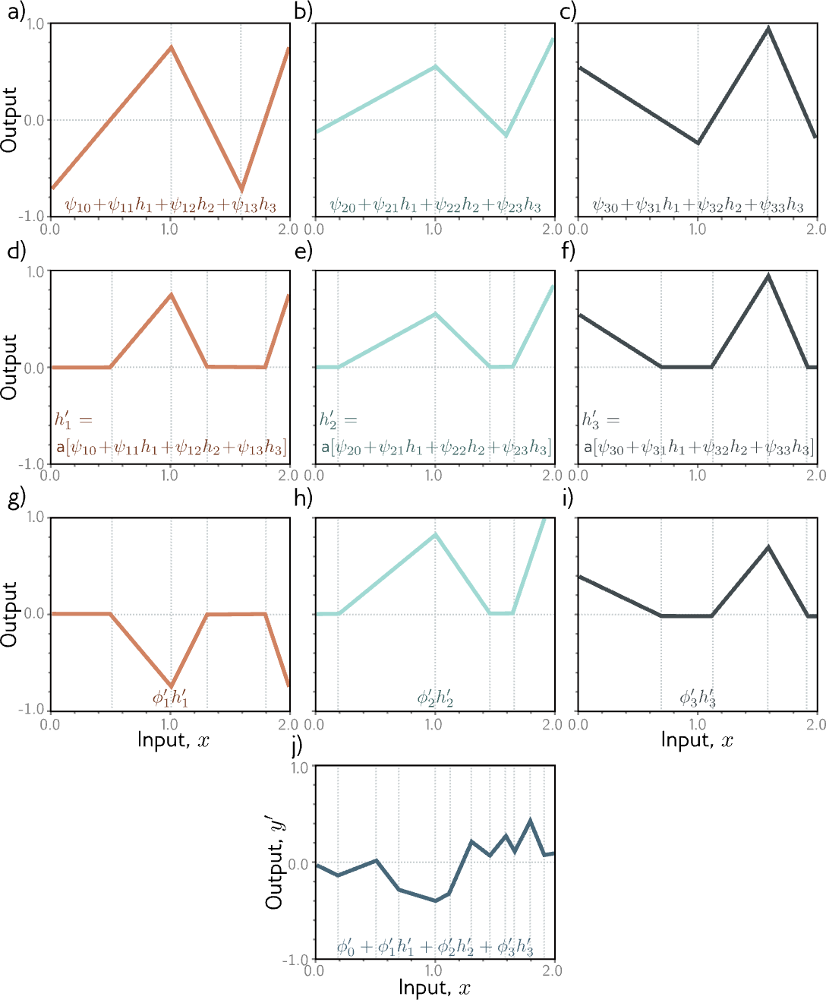

Slide 42
Deep neural networks
Composing two networks
Combining the two networks into one
Hyperparameters
Notation change and general case
Shallow vs. deep networks

Slide 43
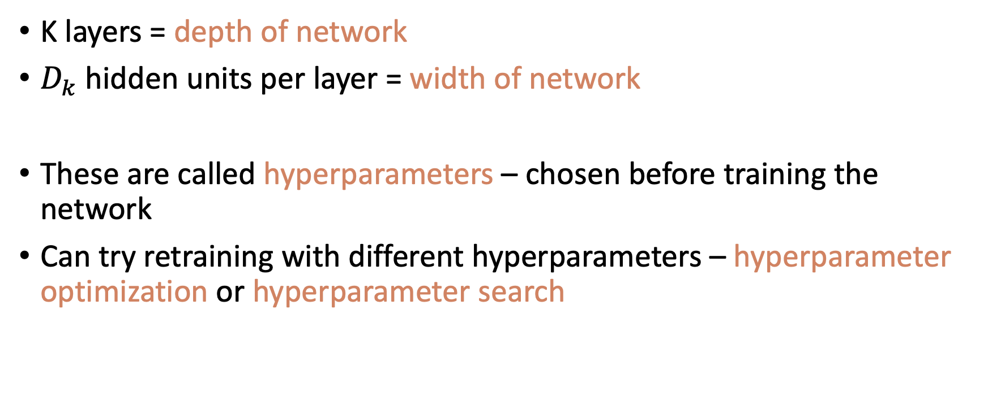
Hyperparameters
K layers = depth of network
$D_{k}$ hidden units per layer = width of network
These are called hyperparameters – chosen before training the network
Can try retraining with different hyperparameters – hyperparameter optimization or hyperparameter search

Slide 44
Deep neural networks
Composing two networks
Combining the two networks into one
Hyperparameters
Notation change and general case
Shallow vs. deep networks

Slide 45
Notation change #1

Slide 46
Notation change #1

Slide 47
Notation change #1

Slide 48
Notation change #1

Slide 49
Notation change #2

Slide 50
Notation change #3

Slide 51
Notation change #3
Bias vector
Weight matrix

Slide 52
General equations for deep network

Slide 53
Example

Slide 54
Deep neural networks
Composing two networks
Combining the two networks into one
Hyperparameters
Notation change and general case
Shallow vs. deep networks

Slide 55
Shallow vs. deep networks
The best results are created by deep networks with many layers.
  50-1000 layers for most applications
  Best results in
    Computer vision
    Natural language processing
    Graph neural networks
    Generative models
    Reinforcement learning
All use deep networks. But why?

Slide 56
Shallow vs. deep networks
Ability to approximate different functions?
Both obey the universal approximation theorem.
Argument: One layer is enough, and for deep networks could arrange for the other layers to compute the identity function.

Slide 57
Shallow vs. deep networks
2. Number of linear regions per parameter

Slide 58
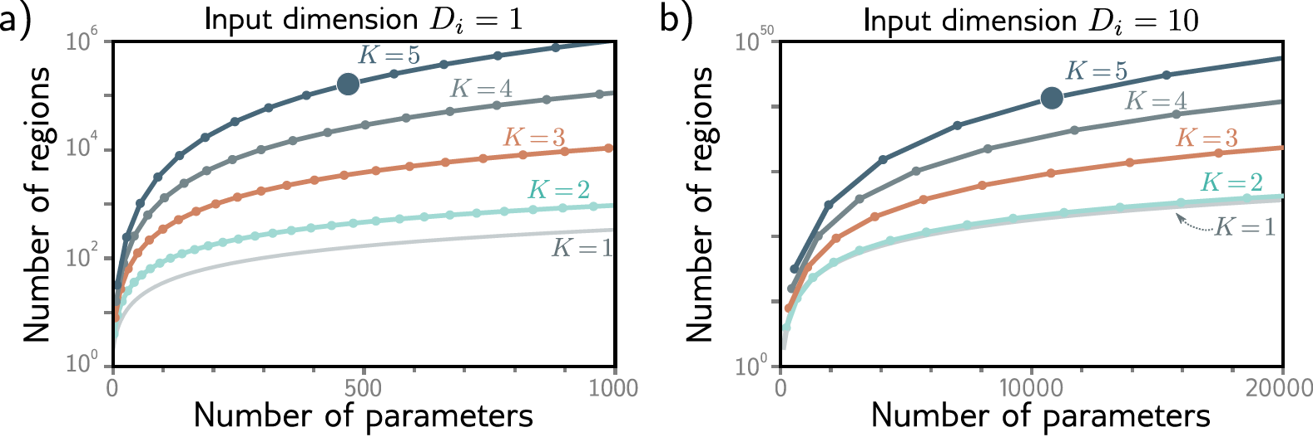
Number of linear regions per parameter
5 layers
10 hidden units per layer
471 parameters
161,501 linear regions

Slide 59
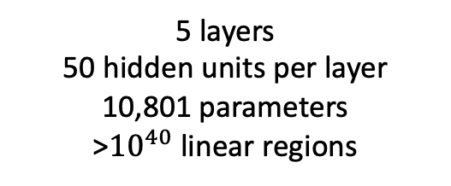
Number of linear regions per parameter
5 layers
10 hidden units per layer
471 parameters
161,501 linear regions
5 layers
50 hidden units per layer
10,801 parameters
>${10}^{40}$ linear regions

Slide 60
Shallow vs. deep networks
2. Number of linear regions per parameter
Deep networks create many more regions per parameters
But there are dependencies between them
  Think of folding example
  Perhaps similar symmetries in real-world functions? Unknown

Slide 61
Shallow vs. Deep Networks
3. Depth efficiency
There are some functions that require a shallow network with exponentially more hidden units than a deep network to achieve an equivalent approximation
This is known as the depth efficiency of deep networks
But do the real-world functions we want to approximate have this property? Unknown.

Slide 62
Shallow vs. Deep Networks
4. Large structured networks
Think about images as input – might be 1M pixels
Fully connected works not practical
Answer is to have weights that only operate locally, and share across image
This leads to convolutional networks
Gradually integrate information from across the image – needs multiple layers

Slide 63
Shallow vs. Deep Networks
5. Fitting and generalization
Fitting of deep models seems to be easier up to about 20 layers
Then needs various tricks to train deeper networks, so (in vanilla form), fitting becomes harder
Generalization is good in deep networks. Why?

Slide 64
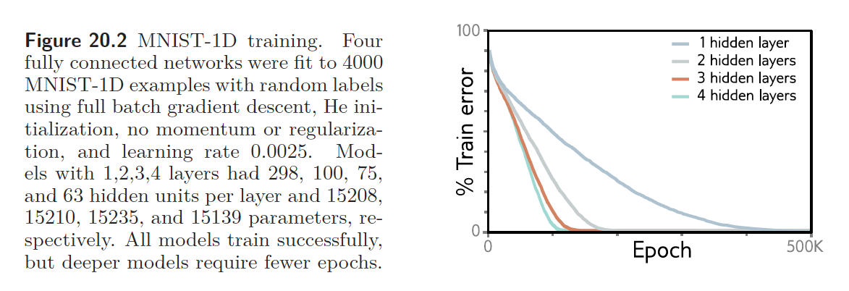
Shallow vs. Deep Networks
5. Fitting and generalization
Fitting of deep models is also faster

Slide 65
Where are we going?
We have defined families of very flexible networks that map multiple inputs to multiple outputs
Now we need to train them
  How to choose loss functions
  How to find minima of the loss function
  How to do this in particular for deep networks
Then we need to test them

Slide 66

Feedback

